Slide 1
Analisis :
Perencanaan keuangan
Peramalan keuangan
PERTEMUAN #3
FEB 302
MANAJEMEN KEUANGAN
FAKULTAS EKONOMI DAN BISNIS
UNIVERSITAS ESA UNGGUL

Slide 2
KEMAMPUAN AKHIR YANG DIHARAPKAN
Mahasiswa mampu membuat perencanaan keuangan/anggaran dan peramalan keuangan

Slide 3

Chapter
3
Introduction to Finance
Lawrence J. Gitman
Jeff Madura
Corporate Securities:
Bonds
and Stocks

Slide 4






Learning Goals
Describe the legal aspects of bond financing
and bond cost.
Discuss the general features, ratings, popular types,
and international issues of corporate bonds.
Differentiate between debt and equity capital.
Review the rights and features of common stock.
Discuss the rights and features of preferred stock.
Understand the role of the investment banker
in securities offerings.

Slide 5
Corporate Bonds
Corporate bonds are debt securities issued
by the corporation itself.
Investors lend money to the corporation
in exchange for a specified promised amount
of (coupon) interest income.
Most bonds are issued with face values of $1,000
and maturities of 10 to 30 years.
At the end of the bond term, investors receive
the face value of the bond.

Slide 6
Corporate Bonds
Legal Aspects
  The bond indenture specifies the conditions
  under which it has been issued.
  It outlines both the rights of bondholders and duties
  of the issuing corporation.
  It also specifies the timing of interest and principal payments, any restrictive covenants, and sinking
  fund requirements.

Slide 7
Corporate Bonds
Legal Aspects
  Common standard debt provisions
  in the indenture typically include:
    The maintenance of satisfactory accounting records
    Periodically furnishing audited financial statements
    The payment of taxes and other liabilities when due
    The maintenance of all facilities in good working order
    Identification of any collateral pledged against the bond

Slide 8
Corporate Bonds
Legal Aspects
  Common restrictive provisions (or covenants)
  in the indenture typically include:
    The maintenance of a minimum level of liquidity
    Prohibiting the sale of accounts receivable
    The imposition of certain fixed asset investments
    Constraints on subsequent borrowing
    Limits on annual cash dividend payments

Slide 9
Corporate Bonds
Legal Aspects
  An additional restrictive provision often included
  in the indenture is a sinking fund requirement,
  which specifies the manner in which a bond is systematically retired prior to maturity.
  Sinking funds typically dictate that the firm make semi-annual or annual payments to a trustee
  who then purchases the bonds in the market.

Slide 10
Corporate Bonds
Cost of Bonds
  In general, the longer the bond’s maturity,
  the higher the interest rate (or cost) to the firm.
  In addition, the larger the size of the offering,
  the lower will be the cost (in % terms) of the bond.
  Finally, the greater the risk of the issuing firm,
  the higher the cost of the issue.

Slide 11
Corporate Bonds
General Features
  The conversion feature of convertible bonds allows bondholders to exchange their bonds for a specified number of shares of common stock.
  Bondholders will exercise this option only when
  the market price of the stock is greater than the conversion price.
  A call feature, which is included in most corporate issues, gives the issuer the opportunity to repurchase the bond prior to maturity at the call price.

Slide 12
Corporate Bonds
General Features
  In general, the call premium is equal to one year
  of coupon interest and compensates the holder
  for having it called prior to maturity.
  Furthermore, issuers will exercise the call feature when interest rates fall and the issuer can refund
  the issue at a lower cost.
  Issuers typically must pay a higher rate to investors for the call feature compared to issues without
  the feature.

Slide 13
Corporate Bonds
General Features
  Bonds also are occasionally issued with stock purchase warrants attached to them to make them more attractive to investors.
  Warrants give the bondholder the right to purchase
  a certain number of shares of the same firm’s common stock at a specified price during a specified period of time.
  Including warrants typically allows the firm to raise
  debt capital at a lower cost than would be possible
  in their absence.

Slide 14
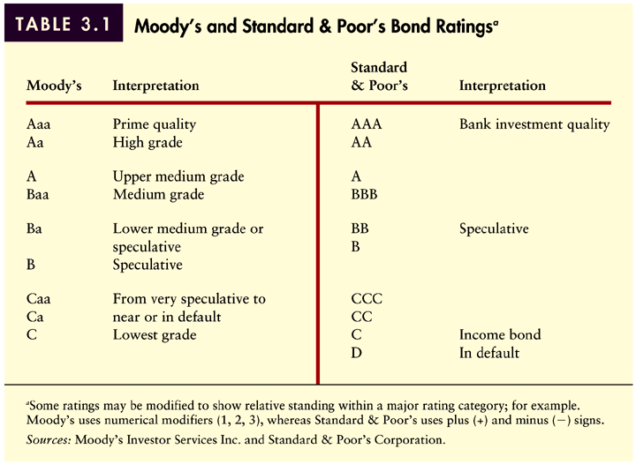
Bond Ratings
Table 3.1

Slide 15
Forms of Debt
Bearer Bonds
  Bearer bonds are often referred to as coupon
  bonds because they are not registered to any
  particular person.
  The coupons are submitted twice a year
  and the authorized bank pays the interest.
For instance, a twenty year $1,000 bond paying 8% interest would have 40 coupons for $40 each. Bearer bonds can be used like cash. They are highly negotiable. There are still many in circulation. However, the Tax Reform Act of 1982 ended the issuance of bearer bonds.

Slide 16
Forms of Debt
Registered Bonds
  Today, bonds are sold in a fully registered form.
  They come with your name already on them.
  Twice a year, you receive a check for the interest.
  At maturity, the registered owner receives a check
  for the principal.
  A partially registered bond is a cross between
  a registered bond and a coupon bond. The bond comes registered to you; however, it has coupons attached which you send in for payment.

Slide 17
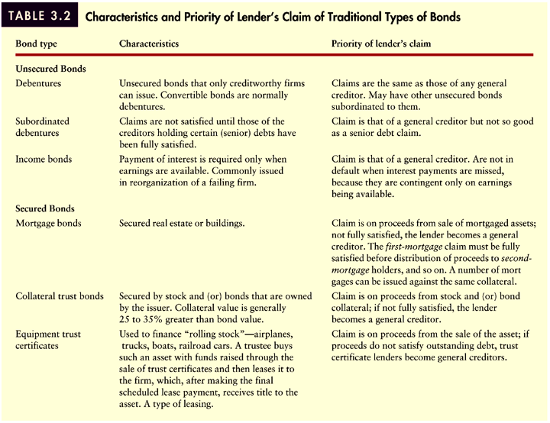
Popular Types of Bonds
Table 3.2

Slide 18
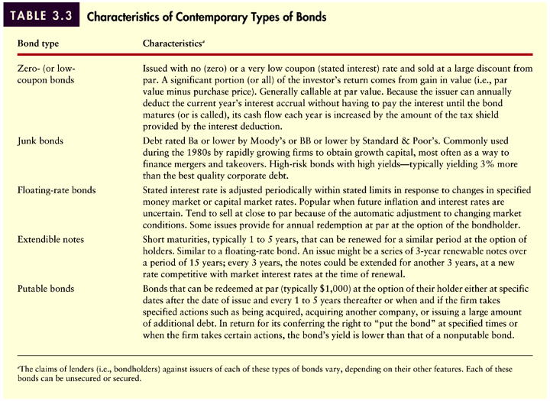
Popular Types of Bonds
Table 3.3

Slide 19
International Bond Issues
Companies and governments borrow internationally
by issuing bonds in either the Eurobond market
or the foreign bond market.
A Eurobond is issued by an international borrower
and sold to investors in countries with currencies other than the country in which the bond is denominated.
In contrast, a foreign bond is issued in a host country’s financial market, in the host country’s currency,
by a foreign borrower.

Slide 20
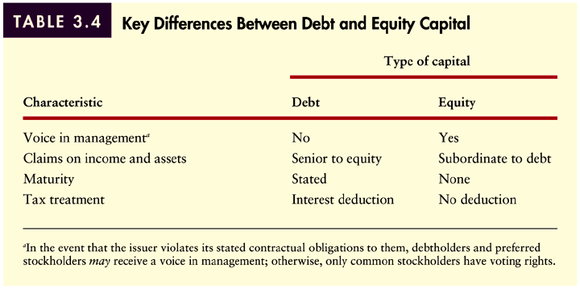
Contrasting Debt and Equity Capital
Table 3.4

Slide 21
Common Stock
Common stockholders are the true owners of the business and are sometimes referred to as residual claimants or owners.
Because they bear greater risk than other claimants, common stockholders expect to receive higher returns (from dividends and/or capital gains) than other claimants such as bondholders.

Slide 22
Common Stock
Ownership
  The common stock of a company can be privately owned, closely owned, or publicly owned.
  Many small corporations are privately or closely owned where shares are traded very infrequently without the aid of an exchange market.
  Large and/or publicly owned corporations
  have widely held shares which are actively
  traded on an exchange market.

Slide 23
Common Stock
Par Value
  Unlike the case for bonds and preferred stock,
  par value for common stock is a relatively
  useless value.
  Firms often issue stock with no par value, in which case they will record it on the books at the sale price.
  Low par values may have some advantages in states
  where some corporate taxes are based on par value.

Slide 24
Stockholder Rights
Voting Rights
  In general, voting rights are relatively meaningless since share ownership is very widely dispersed among a large number of individual shareholders.
  As a result, directors and top management are relatively well-insulated.
  This has begun to diminish to some extent
  in recent years due to the rapid expansion of large institutional investors such as mutual funds
  and insurance companies.

Slide 25
Stockholder Rights
Voting Rights
  Traditional voting
    Under traditional voting, each share owned gives the shareholder the right to vote for one individual for each set
    on the board of directors.
    Under this system, if the majority of shareholders vote
    as a block, the minority could never elect a director.

Slide 26
Stockholder Rights
Voting Rights
  Traditional voting
  Cumulative voting
    This system empowers minority stockholders by permitting
    each stockholder to cast all of his or her votes for one
    candidate for the firm’s board of directors.

Slide 27
Stockholder Rights
Voting Rights
  Traditional voting
  Cumulative voting
  Example
    Under traditional voting, a shareholder with 100 shares can vote
    100 shares for each of 5 members of the board of directors.
    Under cumulative voting, a shareholder with 100 shares can vote 500 shares for just one member running for the board of directors.

Slide 28
Stockholder Rights
Voting Rights
Preemptive Rights
  A preemptive right gives a shareholder the right
  to maintain his or her proportionate share of the company by requiring that all new shares issued
  must be done so through a “rights offering.”
  Under a rights offering, a shareholder who owns
  10% of the shares outstanding has the right
  to purchase 10% of any additional shares issued.

Slide 29
Stockholder Rights
Voting Rights
Preemptive Rights
Proxies
  Proxies are frequently used in the voting process since many smaller stockholders do not attend
  the annual meeting. Shareholders must sign
  a proxy statement giving their votes to another
  party who will then vote their shares.

Slide 30
Common Stock
Dividends
  Payment of dividends is at the discretion
  of the Board of Directors.
  Dividends may be made in cash, additional shares
  of stock, and even merchandise.
  Stockholders are residual claimants—
  they receive dividend payments only after all claims have been settled with the government, creditors,
  and preferred stockholders.

Slide 31
Common Stock
International Stock Issues
  The international market for common stock
  is not as large as that for international debt.
  However, cross-border trading and issuance of stock has increased dramatically during the past 20 years.
  Much of this increase has been driven by the desire of investors to diversify their portfolios internationally.

Slide 32
Common Stock
International Stock Issues
  Stocks issued in foreign markets
    A growing number of firms are beginning to list their stocks
    on foreign markets.
    Issuing stock internationally both broadens the company’s ownership base and helps it to integrate itself in the local business scene.

Slide 33
Common Stock
International Stock Issues
  Foreign stocks in United States markets
    Only the largest foreign firms choose to list their stocks
    in the United States because of the rigid reporting requirements of the U.S. markets.
    Most foreign firms instead choose to tap the U.S. markets using ADRs—claims issued by U.S. banks representing ownership shares of foreign stock trading in U.S. markets.

Slide 34
Preferred Stock
Preferred stock is an equity instrument that usually pays a fixed dividend and has a prior claim on the firm’s earnings and assets in case of liquidation.
The dividend is expressed as either a dollar amount
or as a percentage of its par value.
Therefore, unlike common stock a preferred stock’s
par value may have real significance.
If a firm fails to pay a preferred stock dividend,
the dividend is said to be in arrears.

Slide 35
Preferred Stock
In general, an arrearage must be paid before common stockholders receive a dividend.
Preferred stocks which possess this characteristic
are called cumulative preferred stocks.
Preferred stocks are also often referred to as hybrid securities because they possess the characteristics
of both common stocks and bonds.
Preferred stocks are like common stocks because
they are perpetual securities with no maturity date.

Slide 36
Preferred Stock
Preferred stocks are like bonds because they are fixed income securities. Dividends never change.
Because preferred stocks are perpetual, many have
call features which give the issuing firm the option
to retire them should the need or advantage arise.
In addition, some preferred stocks have mandatory sinking funds which allow the firm to retire the issue
over time.
Finally, participating preferred stock allows preferred stockholders to participate with common stockholders
in the receipt of dividends beyond a specified amount.

Slide 37
Preferred Stocks and Bonds Contrasted
Preferred stocks are riskier than bonds from the investor perspective because:
  Bond terms are legal obligations.
  The investor cannot expect the firm to redeem preferred
  stock for a preset face value. It must be sold in the market
  at an uncertain price.
Preferred stock prices are therefore more variable
and thus riskier than bond prices.

Slide 38
Disadvantages of Preferred Stock
Preferred stock offers no protection from inflation.
Preferred stock tends to be less marketable than
either bonds or common stock resulting in a large
bid-ask spread.
Inferior position to bondholders.
Yields are insufficient for most (non-corporate)
investors to justify risk.

Slide 39
Investment Banking
Corporations typically raise debt and equity
capital using the services of investment bankers
through public offerings.
When underwriting a security issue, an investment banker guarantees that the issuer will receive a specified amount of money from the issue.
The investment banker purchases the securities
from the firm at a lower price than the planned
resale price.

Slide 40
Investment Banking
When underwriting an issue, the investment banker bears the risk of price changes between the time
of purchase and the time of resale.
With a private placement, the investment banker arranges for the direct sale of the issue to one or more individuals or firms and receives a commission for acting as the intermediary in the transaction.
When a firm issues securities on a best-efforts basis, compensation is based on the number of securities sold.

Slide 41
Investment Banking
Advising
  Underwriters also act as advisors and consultants
  for corporations.
  They can assist firms in planning both the timing
  of an issue and the amount and features of an issue.
  They can also assist in evaluating mergers
  and acquisitions.

Slide 42
Investment Banking
Selecting an Investment Banker
  An investment banker may be selected through competitive bidding, where the banker or group
  of bankers that bids the highest price for an issue
  is chosen for the underwriting.
  With a negotiated offering, the investment banker
  is merely hired rather than awarded the issue
  through a competitive bid.

Slide 43
Investment Banking
Syndicating the Underwriting
  Underwriting syndicates are typically formed
  when companies bring large issues to the market.
  Each investment banker in the syndicate normally underwrites a portion of the issue in order to reduce the risk of loss for any single firm and insure wider distribution of shares.
  The syndicate does so by creating a selling group which distributes the shares to the investing public.

Slide 44
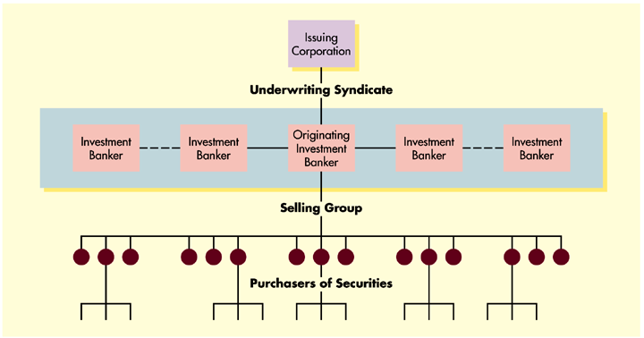
Investment Banking
Figure 3.1

Slide 45
Investment Banking
Fulfilling Legal Requirements
  Before a new security can be issued, the firm must file a registration statement with the SEC at least 20 days before approval is granted.
  One part of the registration statement called
  the prospectus details the firm’s operating
  and financial position.
  However, a prospectus may be distributed
  to potential investors during the approval period
  as long as a red herring is printed on the front cover.

Slide 46
Investment Banking
Fulfilling Legal Requirements
  As an alternative to filing cumbersome registration statements, firms with more than $150 million
  in outstanding stock can use a procedure
  called shelf registration.
  This allows the firm to file a single document
  that covers all issues during the subsequent
  2-year period.
  As a result, the approved securities are kept
  “on the shelf” until the need for or market conditions
  are appropriate for an issue.

Slide 47
Investment Banking
Pricing and Distributing an Issue
  In general, underwriters wait until the end
  of the registration period to price securities
  to ensure marketability.
  If the issue is fully sold, it is considered
  an oversubscribed issue; if not fully sold,
  it is considered undersubscribed.
  In order to stabilize the issue at the initial offering price as it is being offered for sale, investment bankers often place orders to purchase
  the security themselves.

Slide 48
Investment Banking
Cost of Investment Banking Services
  Investment bankers earn their income by profiting
  on the spread.
  The spread is difference between the price paid
  for the securities by the investment banker
  and the eventual selling price in the marketplace.
  In general, costs for underwriting equity are highest, followed by preferred stock, and then bonds.
  In percentage terms, costs can be as high as 17%
  for small stock offerings to as low as 1.6% for large bond issues.

Slide 49
Investment Banking
Private Placements
  Although diminishing in frequency, firms
  can also negotiate private placements rather
  than public offerings.
  Private placements can reduce administrative
  and issuance costs for firms since registration
  with and approval from the SEC is not required.
  However, they do pose problems for purchasers
  since the securities cannot not be resold
  via secondary markets.

Slide 50
Chapter
3
Introduction to Finance
Lawrence J. Gitman
Jeff Madura
End of Chapter

Slide 51
SEKIAN
DAN
TERIMA KASIH

