Slide 1
Risk and Return
PERTEMUAN #6
FEB 302
MANAJEMEN
KEUANGAN
FAKULTAS EKONOMI DAN BISNIS
UNIVERSITAS ESA UNGGUL

Slide 2
KEMAMPUAN AKHIR YANG DIHARAPKAN
Setelah mengikuti perkuliahan mahasiswa diharapkan mampu:
Memahami makna dari resiko
Memahami makna dari tingkat pengembalaian (return)

Slide 3
Chapter
9
Introduction to Finance
Lawrence J. Gitman
Jeff Madura
The Firm and Its Financial Environment

Slide 4
Learning Goals
Review the common forms of business organization.
Describe the financial management function, its relationship to economics and accounting, and the financial managers primary activities.
Explain the wealth maximization goal of the firm and the role of ethics in the firm.
Discuss the agency issue.

Slide 5
Learning Goals
Review the fundamentals of business taxation of ordinary income and capital gains.
Understand the effect of depreciation on the firm’s cash flows, the depreciable value of an asset, its depreciable life, and tax depreciation methods.
Discuss the firm’s cash flows, particularly the statement of cash flows.

Slide 6
Basic Forms of Business Organization
Sole Proprietorships
Partnerships
Corporations

Slide 7
Sole Proprietorships
Account for majority of small businesses.
Most businesses start out as sole proprietorships.
75 percent of all businesses in the United States are sole proprietorships.

Slide 8
Partnerships
Two or more owners.
Account for 10 percent of all businesses.
Finance, insurance, and real estate firms are the most common types of partnerships.

Slide 9
Corporations
Separate legal entity.
Although only 15 percent of all businesses are incorporated, corporations account for nearly 90 percent of receipts and 80 percent of net profits.
Most growing small businesses eventually become corporations.

Slide 10
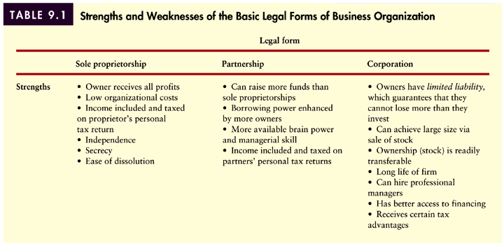
Strengths and Weaknesses of Organization Forms
Table 9.1 (Panel 1)

Slide 11
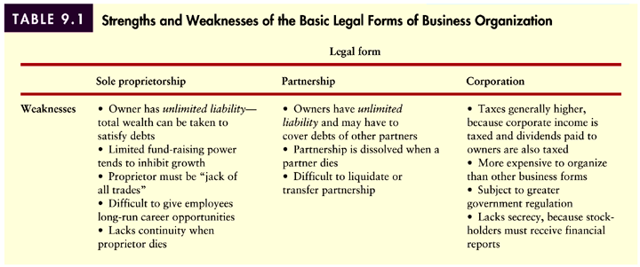
Strengths and Weaknesses of Organization Forms
Table 9.1 (Panel 2)

Slide 12
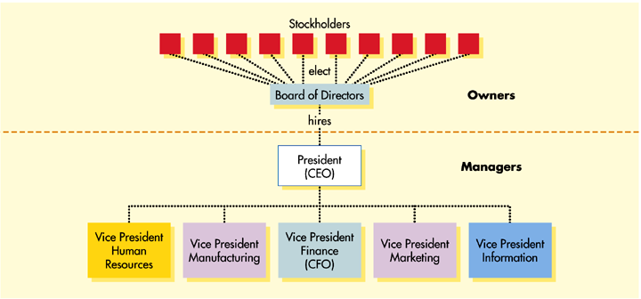
Corporate Organization
Figure 9.1

Slide 13
The Managerial Finance Function
The size and importance of the managerial finance function depends on the size of the firm.
In small companies, the finance function may be performed by the company president or accounting department.
As the business expands, finance typically evolves into a separate department linked to the president.

Slide 14
The Managerial Finance Function
Relationship to Economics
The field of finance is actually an outgrowth of economics.
In fact, finance is sometimes referred to as financial economics.
Financial managers must understand the economic framework within which they operate in order to react or anticipate to changes in conditions.

Slide 15
The Managerial Finance Function
Relationship to Economics
The primary economic principal used by financial managers is marginal analysis which says that financial decisions should be implemented only when benefits exceed costs.

Slide 16
The Managerial Finance Function
Relationship to Accounting
The firm’s finance (treasurer) and accounting (controller) functions are closely-related and overlapping.
In smaller firms, the financial manager generally performs both functions.

Slide 17
The Managerial Finance Function
Relationship to Accounting
One major difference in perspective and emphasis between finance and accounting is that accountants generally use the accrual method, while in finance the focus is on cash flows.
The significance of this difference can be illustrated using the following simple example.

Slide 18
The Managerial Finance Function
Relationship to Accounting
The Ferris Corporation experienced the following activity last year:
Sales: $100,000 (50% still uncollected)
Cost of Goods: $60,000 (all paid in full under supplier terms)
Expenses: $30,000 (all paid in full)
Now contrast the differences in performance under the accounting method versus the cash method.

Slide 19
The Managerial Finance Function
Relationship to Accounting
INCOME STATEMENT SUMMARY
ACCRUAL CASH
Sales $100,000 $50,000
– COGS ($60,000) ($60,000)
Gross Margin $40,000 ($10,000)
– Expenses ($30,000) ($30,000)
Net Profit/(Loss) $10,000 ($40,000)

Slide 20
The Managerial Finance Function
Relationship to Accounting
Finance and accounting also differ with respect to decision-making.
While accounting is primarily concerned with the presentation of financial data, the financial manager is primarily concerned with analyzing and interpreting this information for decision-making purposes.
The financial manager uses this data as a vital tool for making decisions about the financial aspects of the firm.

Slide 21
Key Activities of the Financial Manager
Figure 9.2

Slide 22
Goal of the Firm
Maximize Profit???
Profit maximization fails to account for differences in the level of cash flows (as opposed to profits), the timing of these cash flows, and the risk of these cash flows.

Slide 23
Goal of the Firm
Maximize Shareholder Wealth!!!
Why?
Because maximizing shareholder wealth properly considers cash flows, the timing of these cash flows, and the risk of these cash flows.
This can be illustrated using the following simple valuation equation:
level and timing of cash flows
Future dividends
Share price =
Required return
risk of cash flows

Slide 24
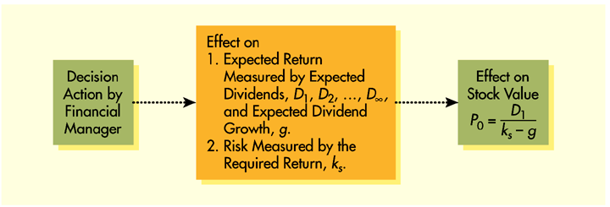
Goal of the Financial Manager
Maximize Shareholder Wealth!!!
It can also be described using the following flow chart:
Figure 7.3

Slide 25
Goal of the Financial Manager
Economic Value Added (EVA)
Economic value added (EVA) is a popular measure used by many firms to determine whether an investment—proposed or existing—positively contributes to the owners’ wealth.
EVA is calculated by subtracting the cost of funds used to finance an investment from its after-tax operating profits.
Investments with positive EVAs increase shareholder wealth and those with negative EVAs reduce shareholder value.

Slide 26
Goal of the Financial Manager
What about other stakeholders?
Stakeholders include all groups of individuals who have a direct economic link to the firm including:
Employees
Customers
Suppliers
Creditors
Owners
The ”stakeholder view" prescribes that the firm make a conscious effort to avoid actions that could be detrimental to the wealth position of its stakeholders.
Such a view is considered to be "socially responsible."

Slide 27
The Role of Ethics
Ethics Defined
Ethics: the standards of conduct or moral judgment— have become an overriding issue in both our society and the financial community.
Ethical violations attract widespread publicity.
Negative publicity often leads to negative impacts on a firm.

Slide 28
The Role of Ethics
Opinions
A wide majority (94%) of business school deans, business leaders, and members of Congress responding to a recent survey felt that the business community is troubled by ethical issues.
A majority (63%) of the respondents perceived that a firm strengthens its competitive position by maintaining high ethical standards.

Slide 29
The Role of Ethics
Considering Ethics
To assess the ethical viability of a proposed action, ask:
Does the action unfairly single out an individual or group?
Does the action affect the morals, or legal rights of any individual or group?
Does the action conform to accepted moral standards?
Are there alternative courses of action that are less likely to cause actual or potential harm?

Slide 30
The Role of Ethics
Ethics and Share Price
Ethics programs seek to:
Reduce litigation and judgment costs
Maintain a positive corporate image
Build shareholder confidence
Gain the loyalty and respect of all stakeholders
The expected result of such programs is to positively affect the firm's share price.

Slide 31
The Agency Issue
The Problem
Whenever a manager owns less than 100% of the firm’s equity, a potential agency problem exists.
In theory, managers would agree with shareholder wealth maximization.
However, managers are also concerned with their personal wealth, job security, fringe benefits, and lifestyle.
This would cause managers to act in ways that do not always benefit the firm shareholders.

Slide 32
The Agency Issue
Resolving the Problem
Market forces such as major shareholders and the threat of a hostile takeover act to keep managers in check.
Agency costs may be incurred to ensure management acts in shareholders’ interests.

Slide 33
The Agency Issue
Resolving the Problem
Examples would include bonding or monitoring management behavior, and structuring management compensation to make shareholders’ interests their own.
However, recent studies have failed to find a strong relationship between CEO compensation and share price.

Slide 34
Business Taxation
Both individuals and businesses must pay taxes on income.
The income of sole proprietorships and partnerships is taxed as the income of the individual owners, whereas corporate income is subject to corporate taxes.
Both individuals and businesses can earn two types of income: ordinary and capital gains.
Under current law, tax treatment of ordinary income and capital gains changes frequently due frequently changing tax laws.

Slide 35
Business Taxation
Ordinary Income
Ordinary income is earned through the sale of a firm’s goods or services and is taxed at the rates depicted in Table 9.2 on the following slide.
Calculate federal income taxes due if taxable income is $80,000.
Tax = [.15 ^{x} ($50,000)] + [.25 ^{x} ($25,000)] + [.34 ^{x} ($80,000 - $75,000)]
Tax = $15,450

Slide 36
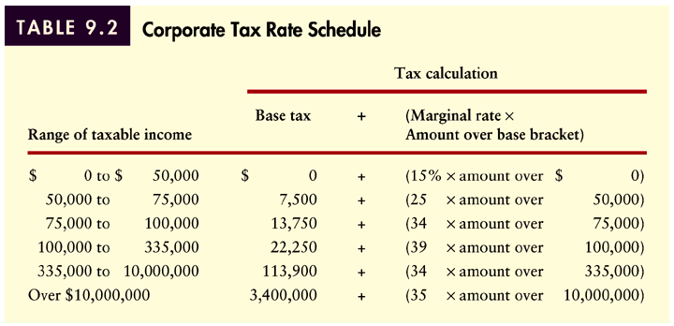
Business Taxation
Ordinary Income
Table 9.2

Slide 37
Business Taxation
Average and Marginal Tax Rates
A firm’s marginal tax rate represents the rate at which additional income is taxed.
The average tax rate is the firm’s taxes divided by taxable income.
This is illustrated using the simple example below.
What is the marginal and average tax rate for the previous example?
Marginal Tax Rate = 34%
Average Tax Rate = $15,450/$80,000 = 19.31%

Slide 38
Business Taxation
Tax on Interest and Dividend Income
For corporations only, 70 percent of all dividend income received from an investment in the stock of another corporation in which the firm has less than 20 percent ownership is excluded from taxation.
This exclusion is provided to avoid triple taxation for corporations.
Unlike dividend income, all interest income received is fully taxed.

Slide 39
Business Taxation
Debt versus Equity Financing
In calculating taxes, corporations may deduct operating expenses and interest expense but not dividends paid.
This creates a built-in tax advantage for using debt financing, as the following example will demonstrate.
A firm with 100,000 shares outstanding needs to raise an additional $500,000 in capital. They can do so by selling bonds that pay 6% interest or by issuing 10,000 additional shares at $50/share. The firm pays $3.00 in dividends for each share outstanding.

Slide 40
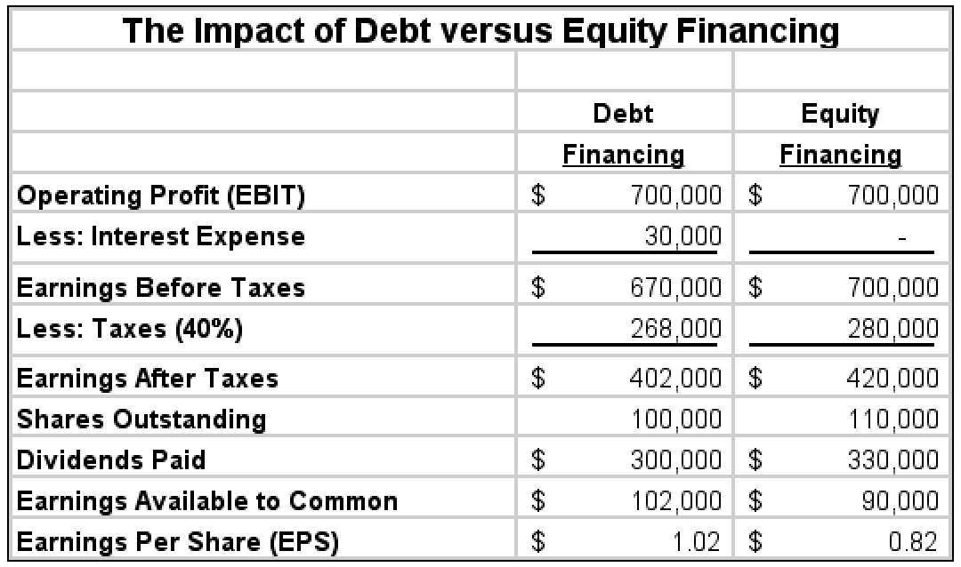
Business Taxation
Debt versus Equity Financing

Slide 41
Business Taxation
Debt versus Equity Financing
As the example shows, the use of debt financing can increase cash flow and EPS, and decrease taxes paid.
The tax deductibility of interest and other certain expenses reduces the actual (after-tax) cost to the profitable firm.
It is the non-deductibility of dividends paid that results in double taxation under the corporate form of organization.

Slide 42
Business Taxation
Capital Gains
A capital gain results when a firm sells an asset such as a stock held as an investment for more than its initial purchase price.
The difference between the sale price and the purchase price is called a capital gain.
For corporations, capital gains are added to ordinary income and taxed like ordinary income at the firm’s marginal tax rate.

Slide 43
Depreciation
Depreciation is the systematic charging of a portion of the costs of fixed assets against annual revenues over time.
Depreciation for tax purposes is determined by using the modified accelerated cost recovery system (MACRS).
On the other hand, a variety of other depreciation methods are often used for reporting purposes.

Slide 44
Depreciation
Depreciation and Cash Flows
Financial managers are much more concerned with cash flows rather than profits.
To adjust the income statement to show cash flows from operations, all non-cash charges should be added back to net profit after taxes.
By lowering taxable income, depreciation and other non-cash expenses create a tax shield and enhance cash flow as shown in Table 9.3.

Slide 45
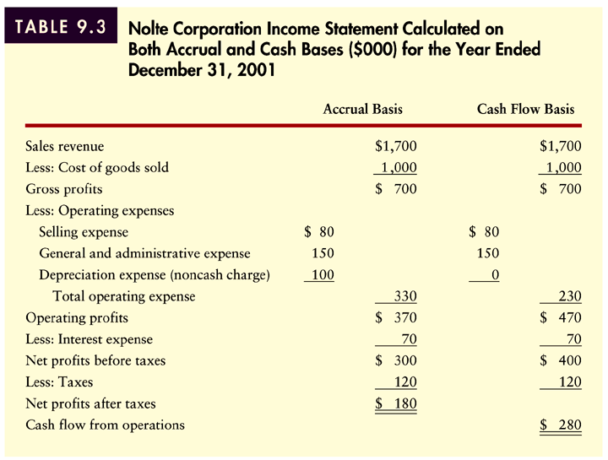
Depreciation
Depreciation and Cash Flows
Table 9.3

Slide 46
Depreciation
Depreciable Value and Depreciable Life
Under the basic MACRS procedures, the depreciable value of an asset is its full cost, including outlays for installation.
No adjustment is required for expected salvage value.
For tax purposes, the depreciable life of an asset is determined by its MACRS recovery predetermined period.
MACRS property classes and rates are shown in Tables 9.4 and Table 9.5 on the following slides.

Slide 47
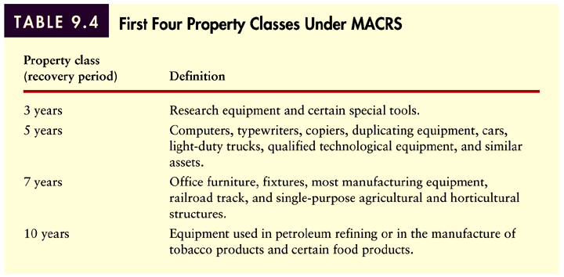
Depreciation
Table 9.4

Slide 48
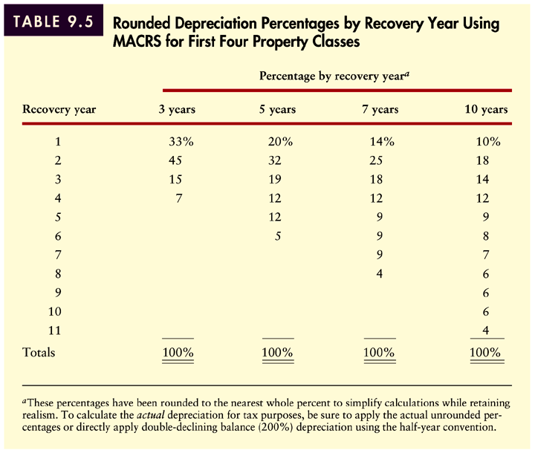
Depreciation
Table 9.5

Slide 49
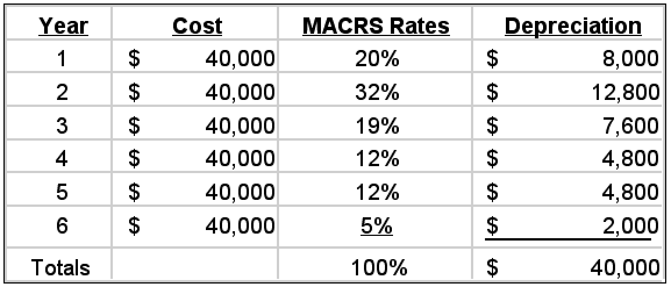
Depreciation
For an installed cost of $40,000, Nolte Corporation acquired a machine having a recovery period of 5 years. Using the applicable MACRS rates, the depreciation expense each year is as follows:

Slide 50
Cash Flow
The statement of cash flows summarizes the firm’s cash flow over a given period of time.
The statement of cash flows is divided into three sections:
Operating flows
Investment flows
Financing flows
The nature of these flows is shown in Figure 9.3 on the following slide.

Slide 51
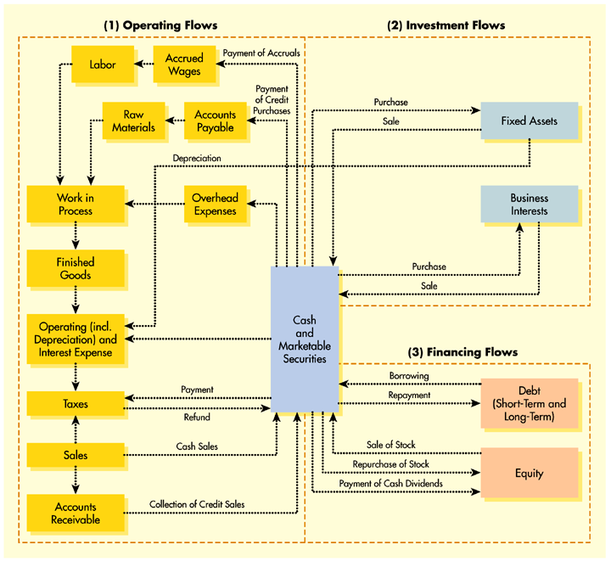
Cash Flow
Figure 9.3

Slide 52
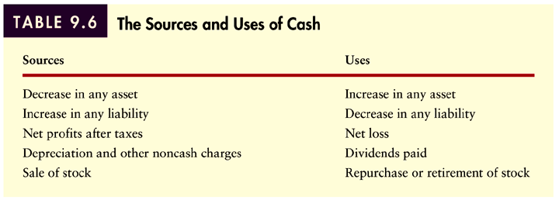
Classifying Sources and Uses of Cash
Table 9.6

Slide 53
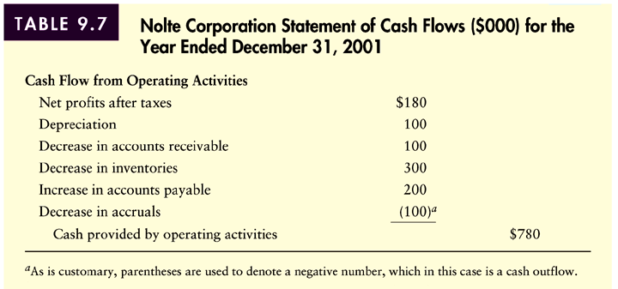
Cash Flow
Table 9.7 (Panel 1)

Slide 54
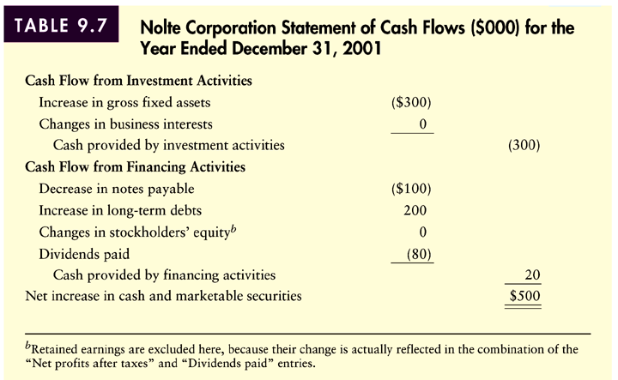
Cash Flow
Table 9.7 (Panel 2)

Slide 55
Cash Flow
Interpreting the Statement of Cash Flows
The statement of cash flows ties the balance sheet at the beginning of the period with the balance sheet at the end of the period after considering the performance of the firm during the period through the income statement.
“Net increase” (decrease) in cash and marketable securities should be equivalent to the difference between the cash and marketable securities on the balance sheet at the beginning of the year and the end of the year.

Slide 56
Using Microsoft® Excel
The Microsoft® Excel Spreadsheets used in the this presentation can be downloaded from the Introduction to Finance companion web site: http://www.awl.com/gitman_madura

Slide 57
Chapter
9
Introduction to Finance
Lawrence J. Gitman
Jeff Madura
End of Chapter

Slide 58
SEKIAN DAN TERIMA KASIH

