Slide 1
Physiotherapy and Office Ergonomics
Eko Wibowo, S. Ft, M. Fis

Slide 2
SEJARAH
Awal abad 18 para ahli menyatakan bahwa bekerja yang tidak ergonomis dan statis memicu masalah muskuloskeletal
Sampai dengan akhir abad 20 penelitian dengan sangat jelas menyatakan bahwa ada hubungan antara pekerjaan dan Repetitif Stress Injury (RSI) dan Musculoskeletal Disorders (MSD)

Slide 3
FAKTA
Rata-rata orang office mengetik 50.000 – 200.000 karakter.
Overuse, RSI dan MSD merupakan hal yang paling sering terjadi.
Rata – rata 125.000 kasus back pain terjadi setiap tahun akibat kesalahan mengangkat.
Otot yang overuse menjadikan otot mudah cidera dan mengakibatkan peradangan dan nyeri.

Slide 4
CSP (Chartered Society of Physiotherapy)
Survey di Eropa tahun 2007
46% Back pain.
44% Neck pain.
33% Headache and
25% Wrist pain

Slide 5
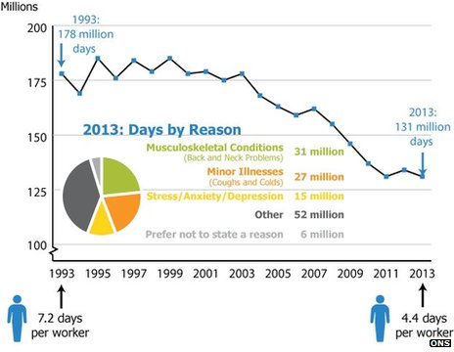
BBC News Business, 25 Feb 2014
Is back, neck and muscle pain hurting the UK economy?
The Work Foundation estimates that employees suffering from bone and joint pain cost the EU's economies 240 bn euros (£200bn) each year

Slide 6
FISIOTERAPI ERGONOMI
Pencegahan
Diagnosis dan
Terapi
Monitoring
Standar
PENYAKIT
KERJA
LINGKUNGAN
KERJA
Repetitive Stress Injury
Musculusceletal Disorders
(MSDs)
Rehabilitasi
Pengendalian
Evaluasi

Slide 7
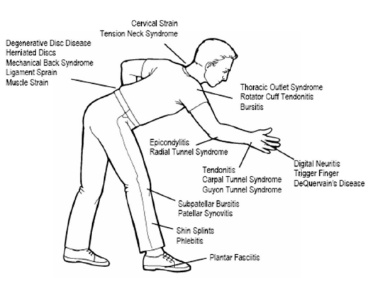
Work Related Musculoskeletal Disorder

Slide 8
NEW MIND SET
PARADIGMA SEHAT
P R E VEN T I F
RE H A B I L I T A T I F
P R O M O T I F
K U R A T I F

Slide 9
PENYEBAB
Poor posture
Faulty body mechanics
Stressful living and working habits
Stressful sleeping
Loss of flexibility
Decline of physical fitness

Slide 10
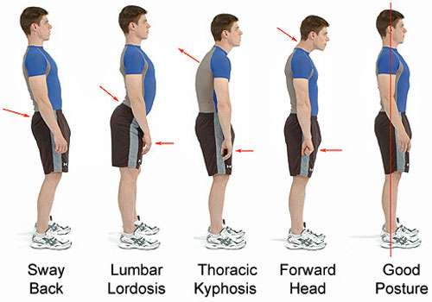
Poor Posture

Slide 11
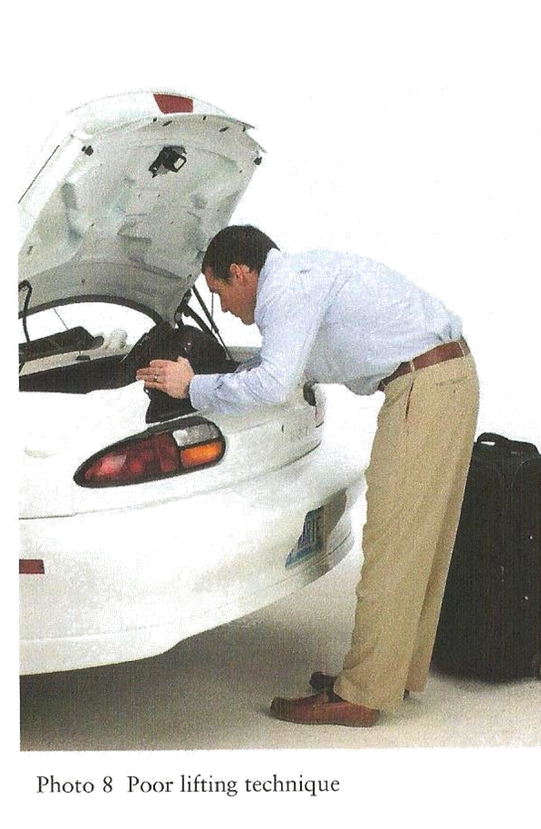
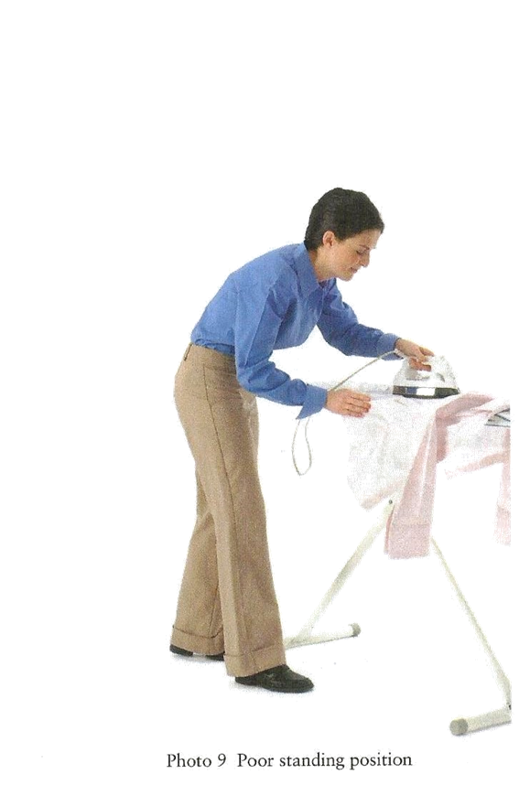
Poor Posture
46% Back pain.

Slide 12
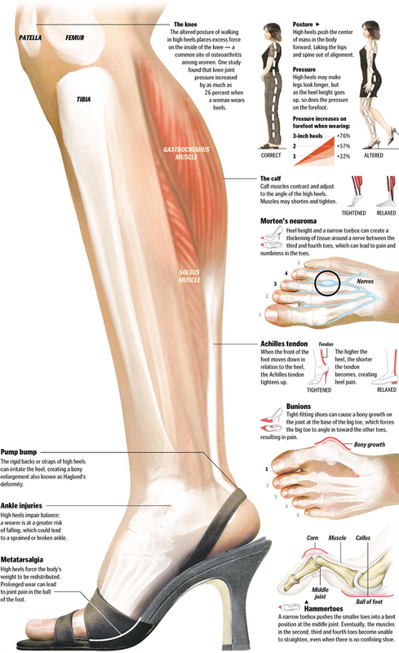
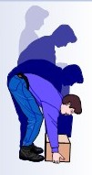
Faulty Body Mechanics

Slide 13
Stressful Living and Working Habits
44% Neck pain.

Slide 14
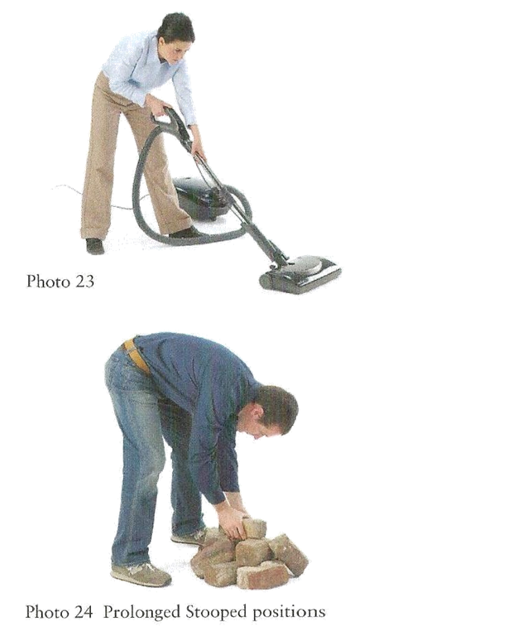
Stressful Living and Working Habits

Slide 15
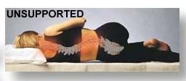
Stressful Sleeping
33% Headache and

Slide 16
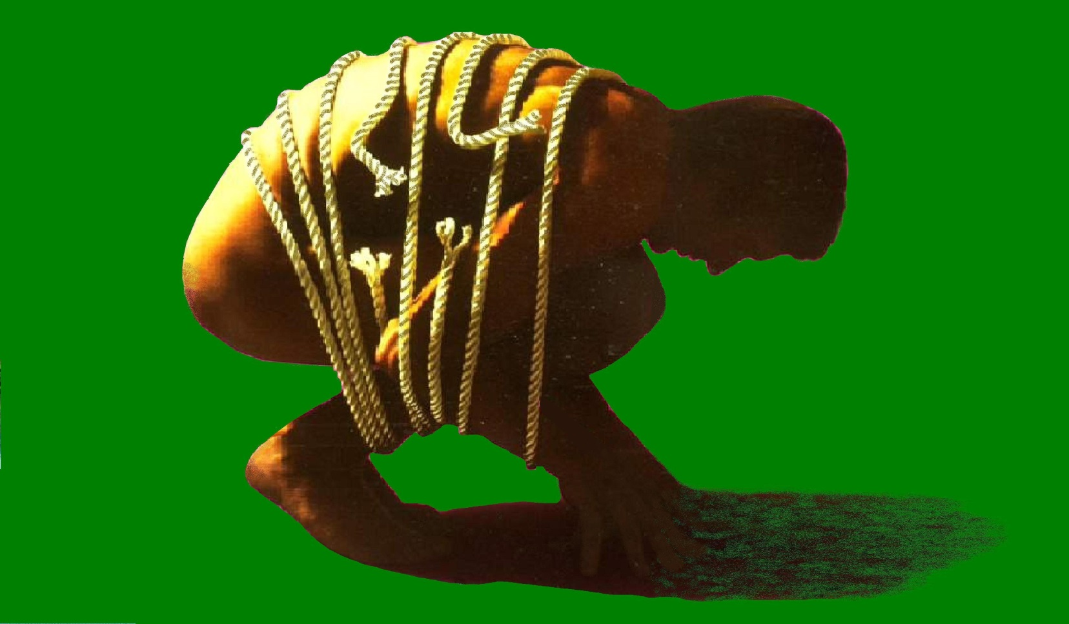
Loss of Flexibility

Slide 17
Decline of Physical Fitness

Slide 18
PAIN BETTER

Slide 19
Make A Balance
&
Change Your Posture Today…!

Slide 20
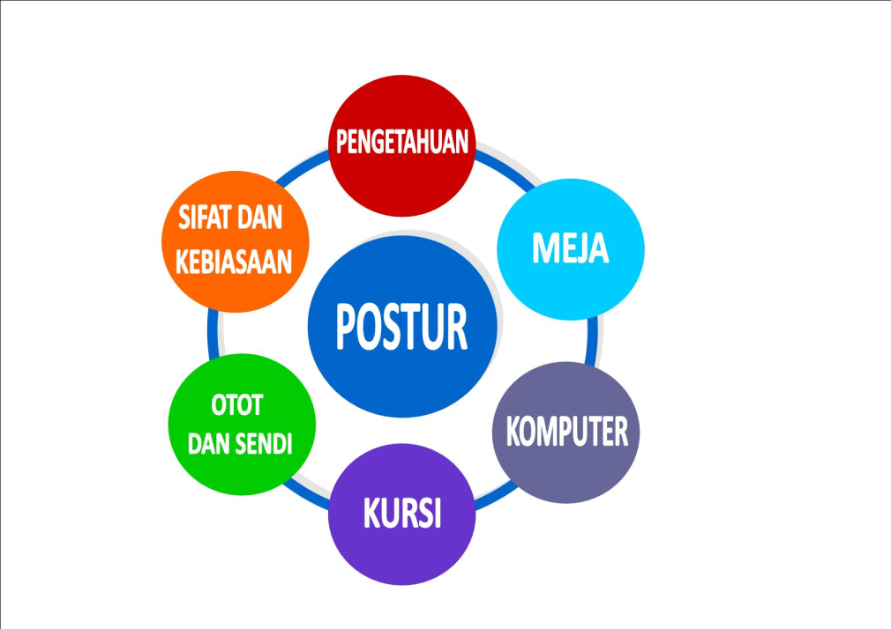
Postur adalah komponen yang paling penting dalam mengatur posisi bekerja

Slide 21
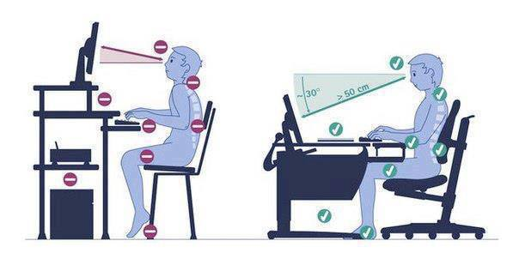
Change Your Posture Today

Slide 22
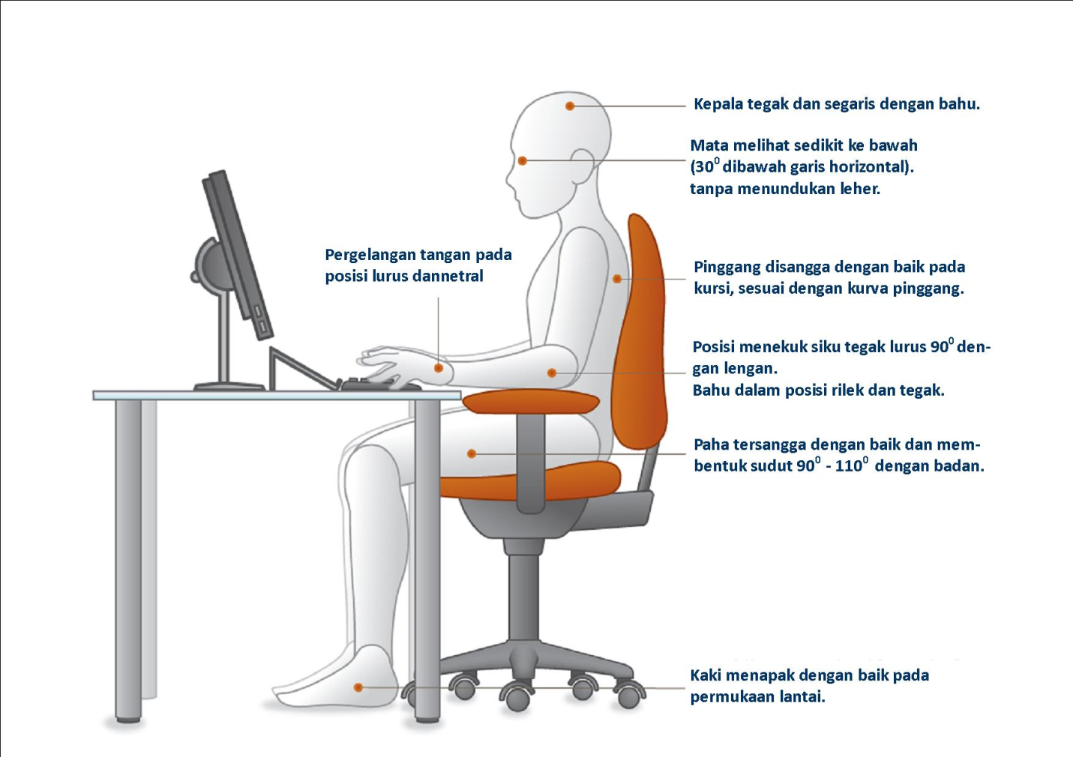
Change Your Posture Today

Slide 23
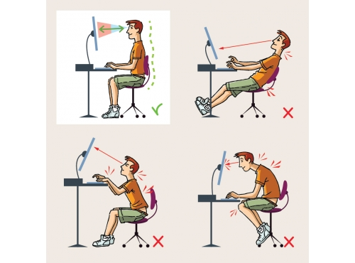
Change Your Posture Today

Slide 24
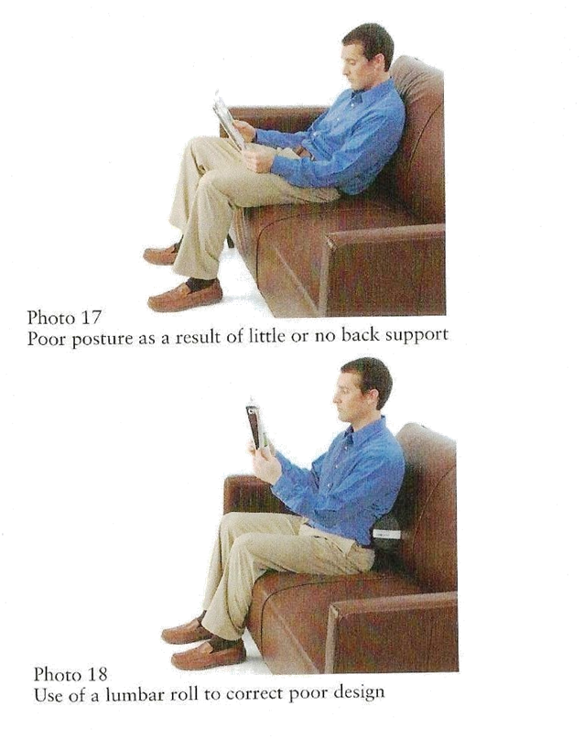
Change Your Posture Today

Slide 25
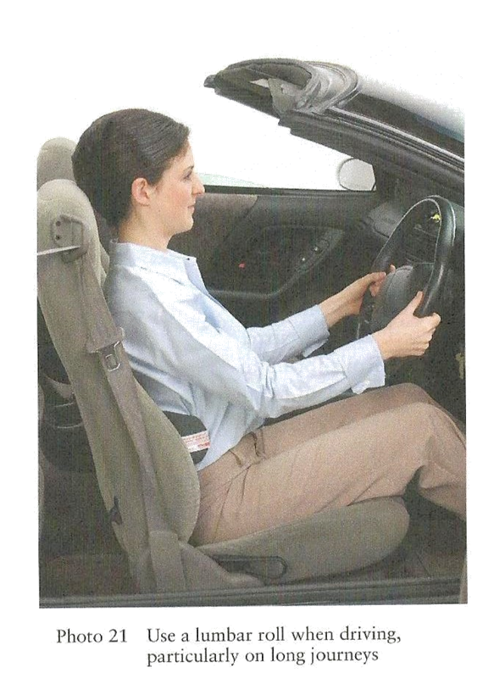
Change Your Posture Today
Break
Acceleration

Slide 26
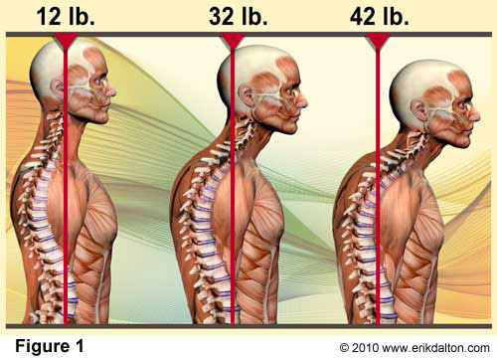
Change Your Posture Today

DUDUK

Slide 27
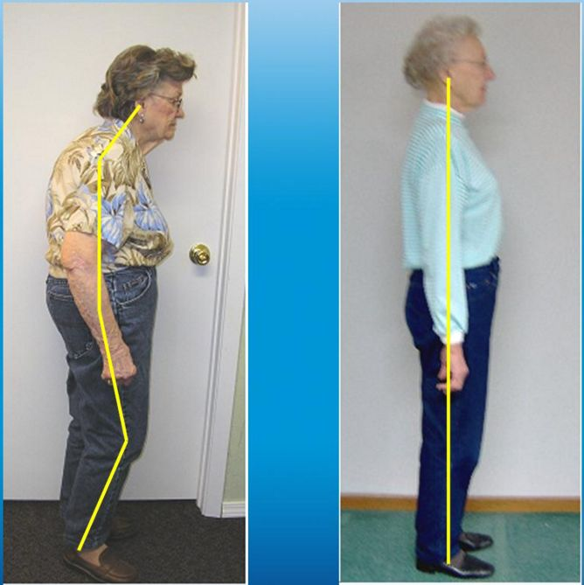
Change Your Posture Today
BERDIRI


Slide 28
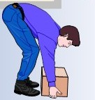
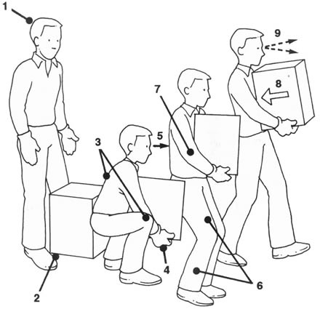
Change Your Posture Today

MENGANGKAT

Slide 29
Beban Sendi Lutut
Turun Tangga = 3,5 X Berat Badan
Naik Tangga = 3 X Berat Badan
Berjalan = 2,5 X Berat Badan
Berdiri 1 kaki = 3 X Berat Badan
Menekuk Lutut = 2,5 X Berat Badan
Berdiri 2 kaki = 1 X Berat Badan
Average peak resultant forces, in percent of body weight, were highest during stair descending (346% BW), followed by stair ascending (316% BW), level walking (261% BW), one legged stance (259% BW), knee bending (253% BW), standing up (246% BW), sitting down (225% BW) and two legged stance (107% BW).
Kutzner, 2010

Slide 30
Change Your Posture Today

TIDUR

Slide 31
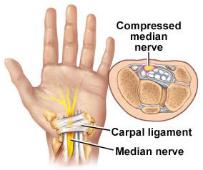
Carpal Tunnel Syndrome
25% Wrist pain

Slide 32
Change Your Posture Today


Slide 33
SOLUSI

Slide 34
TREATMENT CONCEPT
Symetry
Flexibel
Healthy lifestyle
Strengthen
Balance
Asymetry
Spasm
Unhealthy lifestyle
Weak
Imbalance

Slide 35
MAJOR ASPECT
RECURRENT / EPISODIC NATURE OF BACK PAIN
ROLE EVERYDAY MECHANICAL LOADING
IMPORTANCE OF PATIENT INVOLVEMENT IN THERAPY
PHYCHOSOCIAL ASPECTS OF BACK PAIN EXPERIENCE

Slide 36
MANAGEMENT
PASSIVE APPROACH
ACTIVE APPROACH

Slide 37
Muscle spasm cycle
PAIN
MUSCLE GUARDING
MUSCLE SPASM
CIRCULATORY
STASIS
RESTRICTED MOVEMENT
THIS CYCLE OFTEN NEEDS TO INTERRUPTED WITH EXERCISES

Slide 38
Cycle OF EXERCISE
EXERCISE
RECONDITIONING
IMPROVED FUNCTION
PAIN
REEDUCATION
STRONGER
MUSCLES

Slide 39
SOLUSI
S.M.A.R.T.
guidelines for computer use
Strecth
Move
Add Variety Exercise
Reduce Strain
Talk to a Physiotherapy

Slide 40
TIME TO EXERCISES

Slide 41
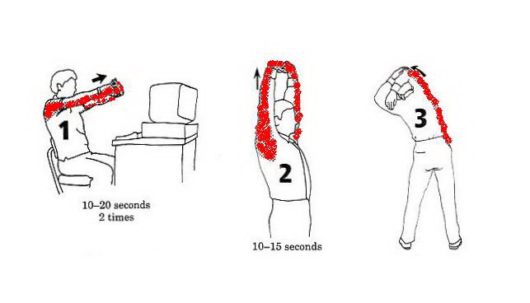
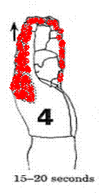
COMPUTER & DESK STRETCHES

Slide 42
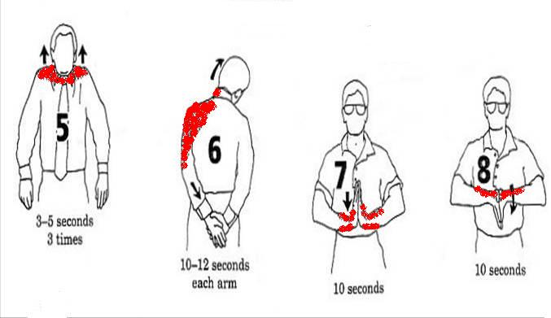
COMPUTER & DESK STRETCHES

Slide 43
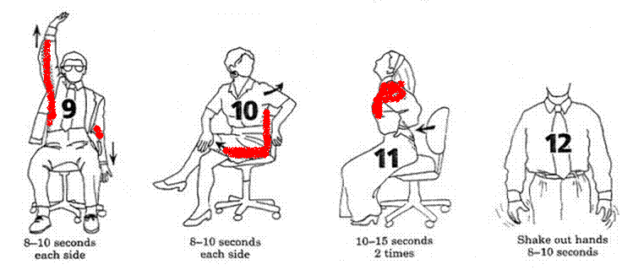
COMPUTER & DESK STRETCHES

Slide 44
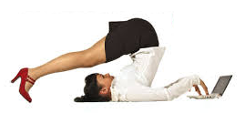
GOOD POSTURE
GOOD HEALTH
TERIMAKASIH

