Slide 1
Associated Reactions
Are a phenomen,
they are dynamic, can adapt
to treatment and functional activities
Therefore very interesting for therapists,
but not easy to understand.

Slide 2
Associated Reactions
are involuntary reactions to stimuli beyond the individuals level or threshold of inhibitory or modulatory control Stephenson et al 1998

Slide 3
Associated Reactions
They are compensatory answers
for the loss of postural control

Slide 4
Associated Reactions
„Associated Reactions are released postural reactions in muscles deprived of voluntary control.
Appearing in the muscles of the effected side on certain voluntary movements of the normal limb, head and trunk or on such semi-voluntary activities such as yawning.“
Walshe 1923

Slide 5
Associated Reactions
They are a deviation of the Hennemann - Principle and therefore are causing a deviation in reciprocal inhibition

Slide 6
Associated Reactions
They are muscle activities developed through new neural connections.
They can be seen as a re-innervation
and recovery.

Slide 7
Associated Reactions
Triggers and causes
Ideation
· Motivation and emotion
· Gravity and effort
· Sensation and hypersensibility
· Warm and cold
· Visual and Auditive input
· Pain

Slide 8
Characteristics of Associated Reactions
Amount/strength of the stimulus (trigger)
Typ of stimulus
Speed of appearance
Amount of reaction in the whole body
Single joint movement
Latency period
Time till fading or downgrading
Amount of voluntary control

Slide 9
If it is alive, it is plastic.
If it is not plastic, it is dead (KIDD,1986) .

Slide 10
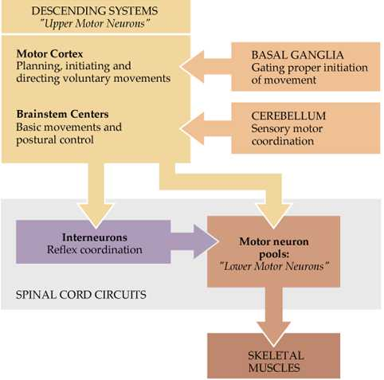
Overall organization of neural structures involved in the control of movement. Four distinct systems make essential and distinct contributions to motor control

Slide 11
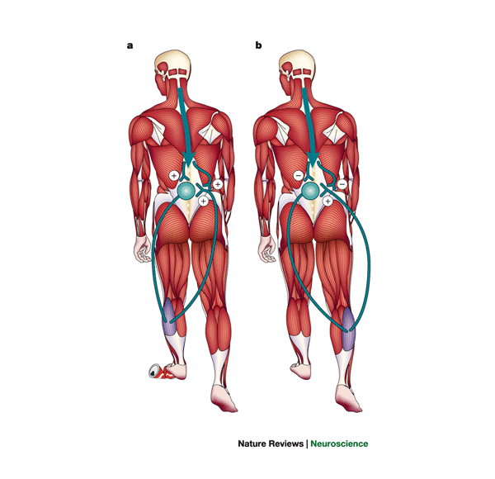
The stretch reflex of the calf muscles is differentially gated during locomotion. Presumed action of the short-latency stretch reflex during the stance (a) and swing phase (b) of locomotion. a | This reflex system is facilitated by supraspinal influences on the pre- and postsynaptic elements during the stance phase for the rapid compensation of ground irregularities. b | During the swing phase, the stretch-induced reflex activity in the triceps surae, evoked by active dorsiflexion of the foot, is inhibited pre- and postsynaptically to allow proper placing of the foot.

Slide 12
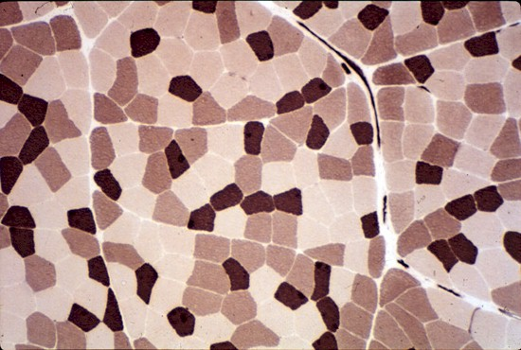
Muscle organs are mix of types
Type I (slow oxidative)
Type IIa (fast oxidative)
Type IIx (IIb) (fast glycolytic

Slide 13
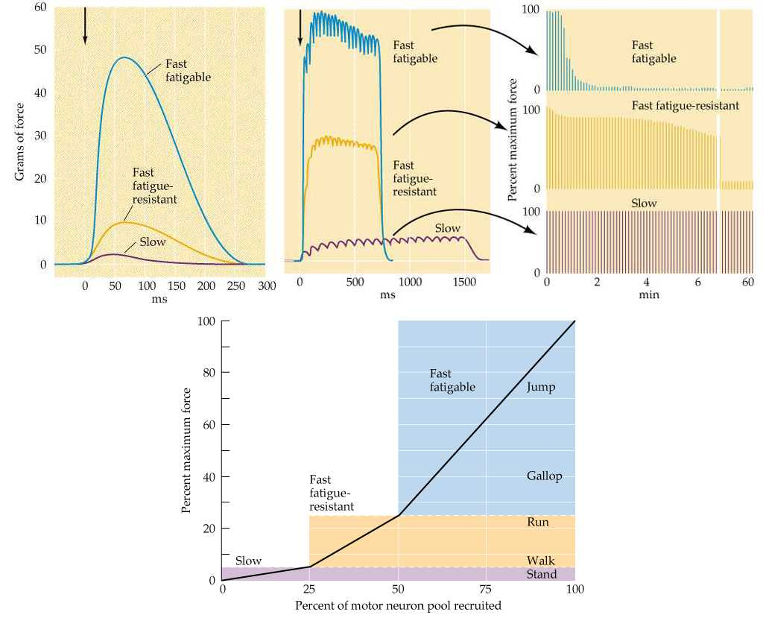
Comparison of the force and fatigability of the three different types of motor units. In each case, the response reflects stimulation of a single motor neuron. (A) Change in tension in response to single motor neuron action potentials. (B) Tension in response to repetitive stimulation of the motor neurons. (C) Response to repeated stimulation at a level that evokes maximum tension. The y axis represents the force generated by each stimulus.

Slide 14
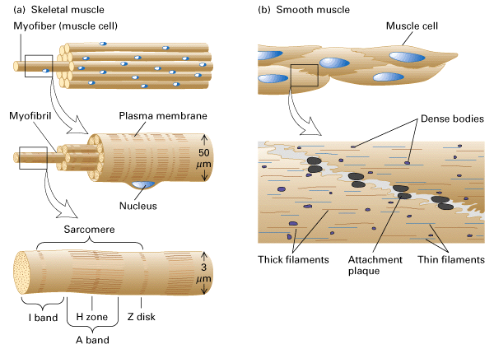

Slide 15
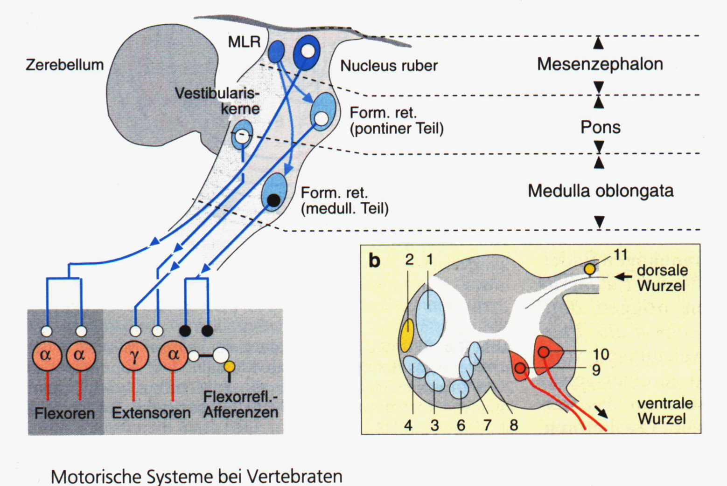

Slide 16
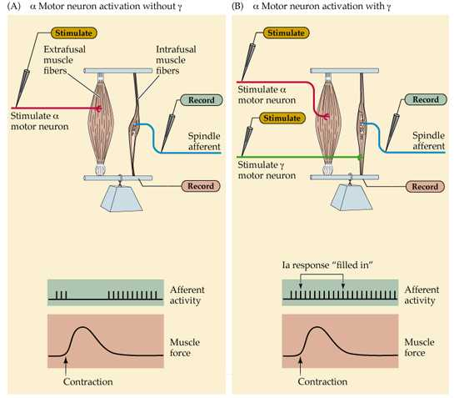
The role of gamma motor neuron activity in regulating the responses of muscle spindles. The gamma motor neurons can regulate the gain of muscle spindles so that they can operate efficiently at any length of the parent muscle.

Slide 17
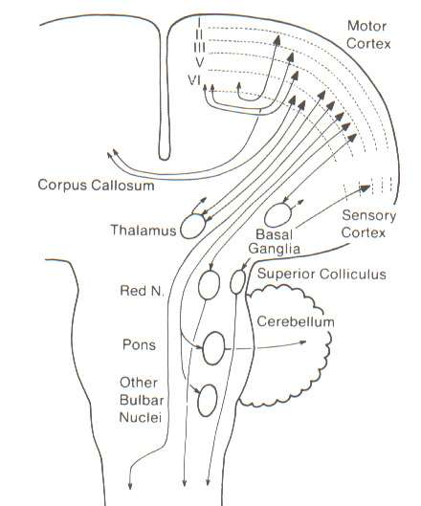
Summary view of descending pathways, showing multiple projections and different laminar locations of cortical output neurons. Note that superficial cortical laminae (II, III) project to other cortical areas, whereas deep cortical laminae (V, VI) give rise to descending projections, both pyramidal and extrapyramidal. Lamina IV (granule layer) is poorly developed in most parts of primary and secondary motor cortex.

Slide 18
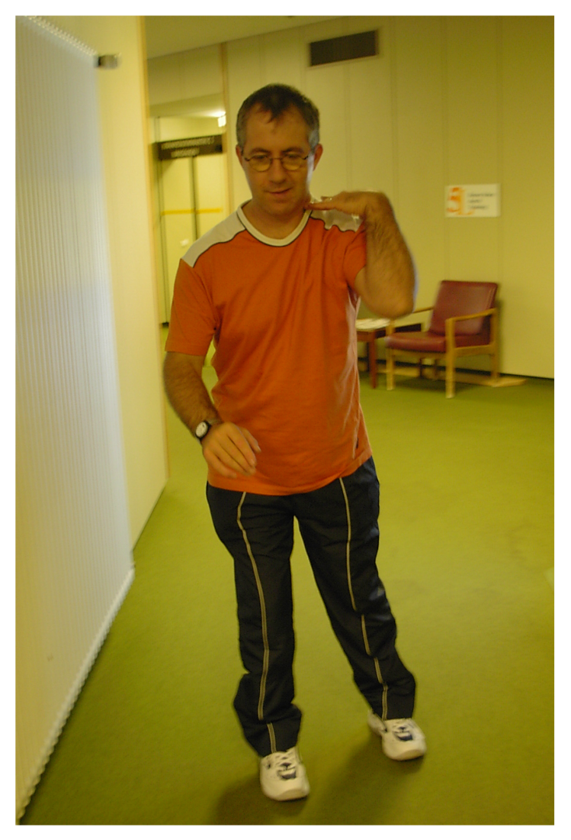

Slide 19
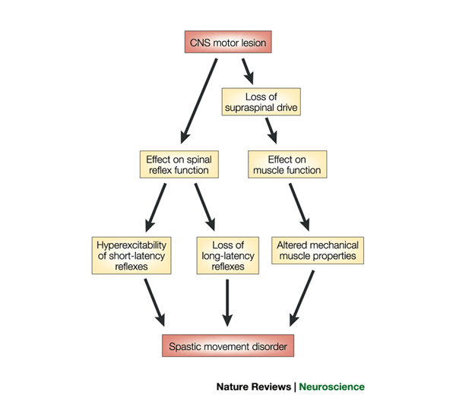
Schematic of the mechanisms that contribute to spastic paresis and spastic movement disorder. A central motor lesion leads to changes in the excitability of spinal reflexes and a loss of supraspinal drive. As a consequence, changes in muscle properties occur. The combination of all sequels of the primary lesion leads to the spastic movement disorder. CNS; central nervous system.

Slide 20
Activity
Inactivity
Unnatural activity
Impaired activity
All changes make NEUROPLASTICITY
Advantage
Disadvantage
KIDD, 1988

Slide 21
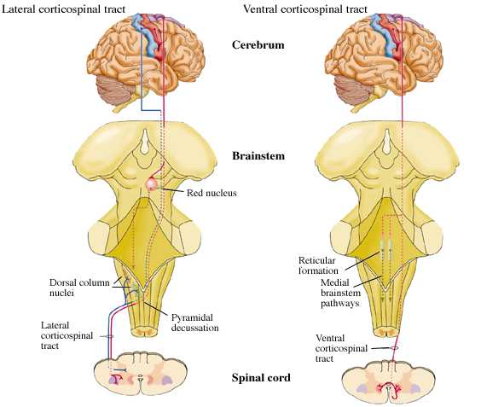
The lateral and ventral corticospinal tracts in the human nervous system, one crossed, one uncrossed

Slide 22
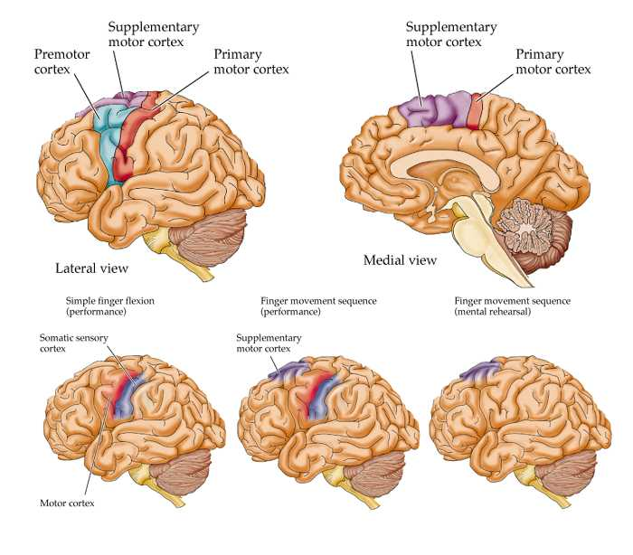
Regional blood flow to the motor cortices under different behavioral conditions. Simple finger flexion, finger movement sequence (performance) and finger movement sequence (mental rehearsal).

Slide 23
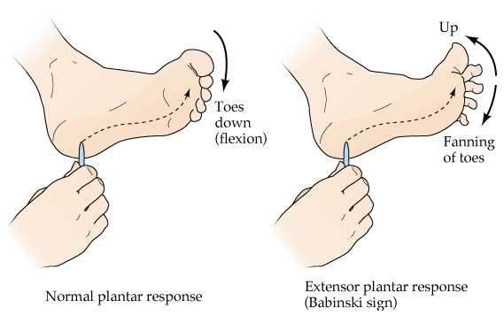
The Babinski sign. Following damage to descending motor pathways, stroking the sole of the foot causes an abnormal fanning of the toes and the extension of the big toe.

Slide 24
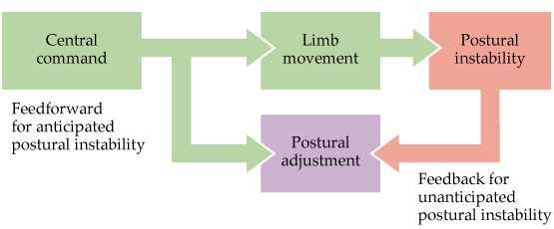
Feedforward and feedback mechanisms of postural control. Feedforward for anticipated postural instability and feedback for unanticipated postural instability.

Slide 25
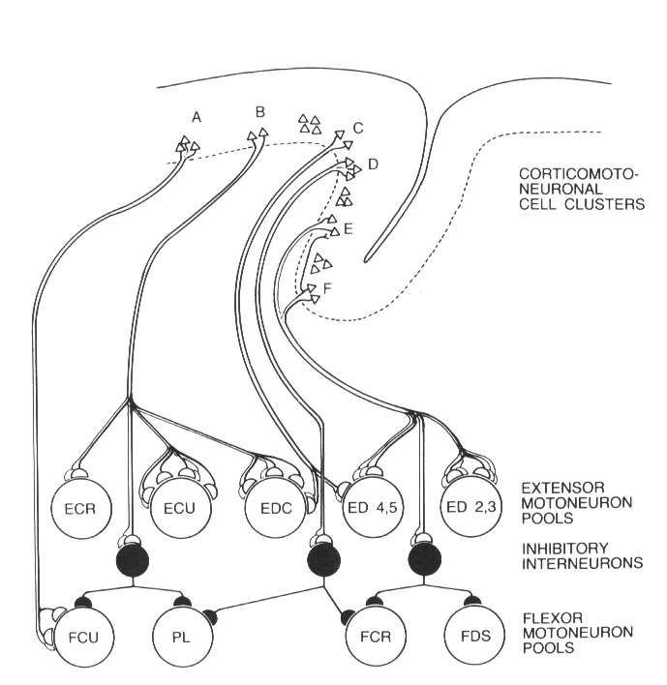
Summary of corticospinal circuit connections mediating fine control of the wrist and fingers, as indicated by experiments in awake, behaving monkeys. A F, clusters of pyramidal tract neurons in the motor cortex. Groups (pools) of motoneurons to different types of muscles: the six extensors were extensors carpi ulnaris (ECU), digitorum communis (EDG), digitorum 2 and 3 (ED2, 3), digitorum 4 and 5 (ED4, 5), carpi radialis longus (ECR-L), and carpi radialis brevis (ECR-B); the six flexors were flexors carpi radialis (FCR), digitorum profunds (FDP), carpi ulnaris (FCU), digitorum sublimis (FDS), plamaris longus (PL), and pronator teres (PT). Open profiles excitatory actions; filled profiles, inhibitory actions.

Slide 26
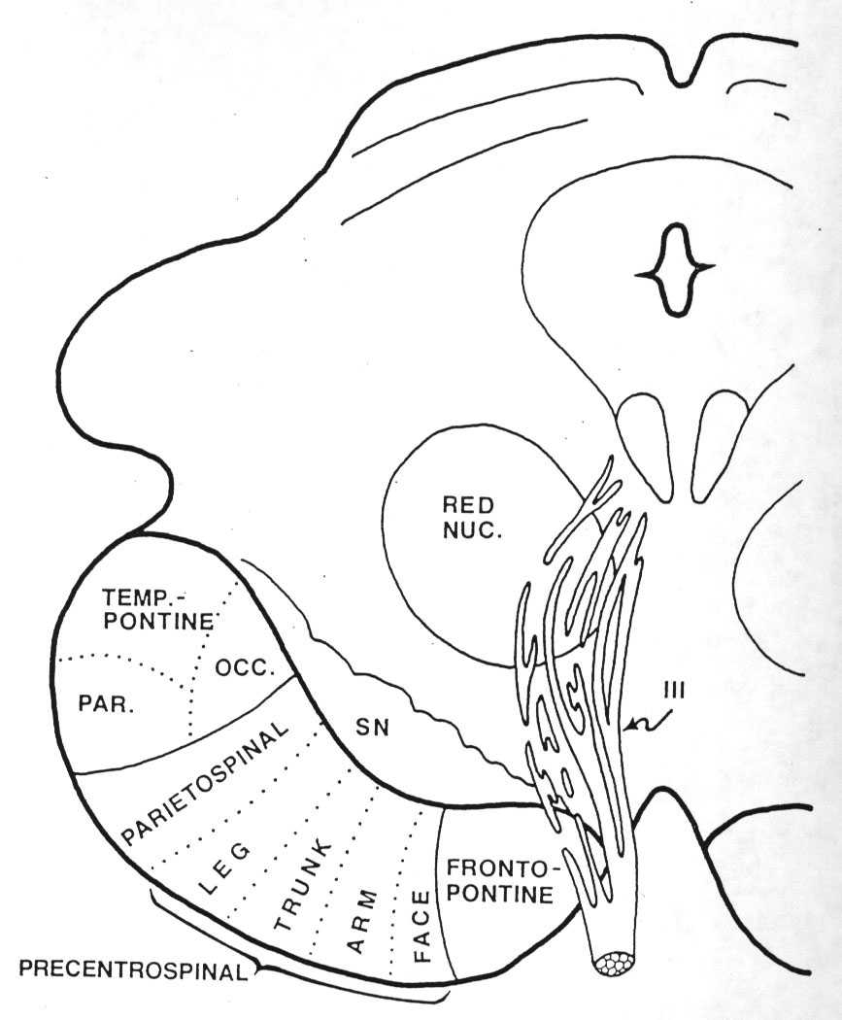
The topography of organization in the corticospinal tract is preserved in the axons as they descend into the brainstem.

Slide 27
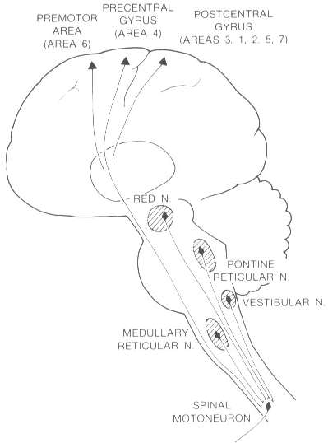
Principal regions of the human brain involved in immediate motor control through descending fibers to motoneurons.

Slide 28
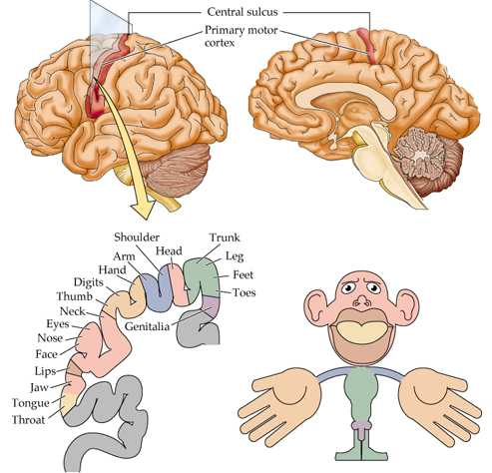
Topographic map of the body musculature in the primary motor cortex.

Slide 29
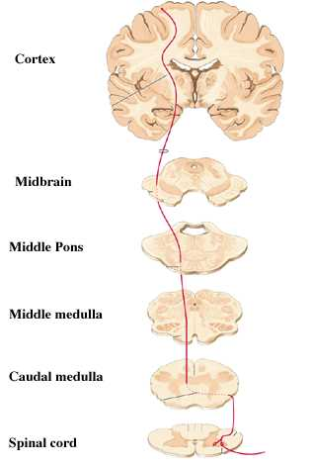
DESCENDING PATHWAY

Slide 30
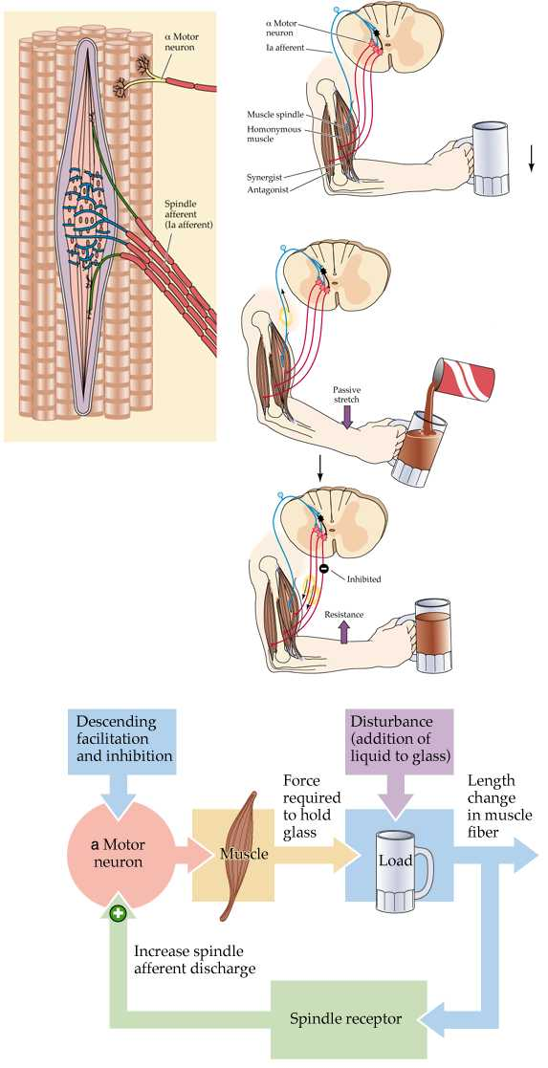
Stretch reflex circuitry, including a diagram of the muscle spindle (the sensory receptor that initiates the stretch reflex). The stretch reflex serves as a negative feedback loop to regulate muscle length.

Slide 31
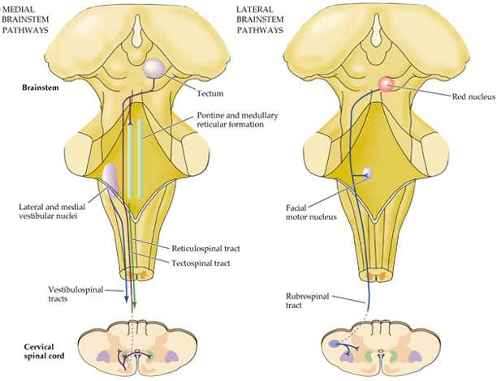
Diagram of the descending projections from the brainstem to the spinal cord. Pathways that influence motor neurons in the medial part of the ventral horn originate in the superior colliculus, reticular formation, and vestibular nucleus. Pathways that influence motor neurons in the lateral part originate in the red nucleus.

Slide 32
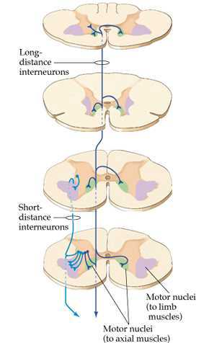
Interneurons that supply the medial region of the verbal horn are situated medially in the intermediate zone of the spinal cord gray matter and have axons that extend over a number of spinal cord segments and terminate bilaterally.

Slide 33
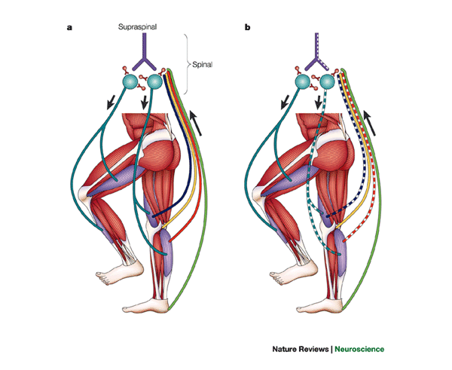
Schematic drawing of the neuronal mechanisms involved in human gait. a | Physiological condition. Leg muscles become activated by a programmed pattern that is generated in spinal neuronal circuits (turquoise pathway). This pattern is modulated by multisensory afferent input, which adapts the pattern to meet existing requirements. Both the programmed pattern and the reflex mechanisms are under supraspinal control. In addition, there is differential neuronal control of leg extensor and flexor muscles. Whereas extensors are mainly activated by proprioceptive feedback, the flexors are predominantly under central control. b | Proposed situation in Parkinson's disease. In this condition, a load-related impairment of proprioceptive feedback can be assumed (dotted lines). This leads to reduced leg extensor activation during the stance phase, which is poorly adapted to actual requirements (for example, ground conditions).

Slide 34
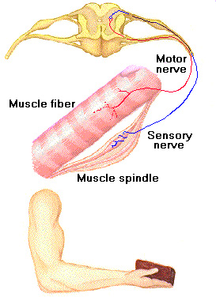
The phenomena of spasticity can be seen as the result of plastic re-organisation of responses in the spinal cord, released partially or wholly from cortical and subcortical controll. Lance, 1980

Slide 35
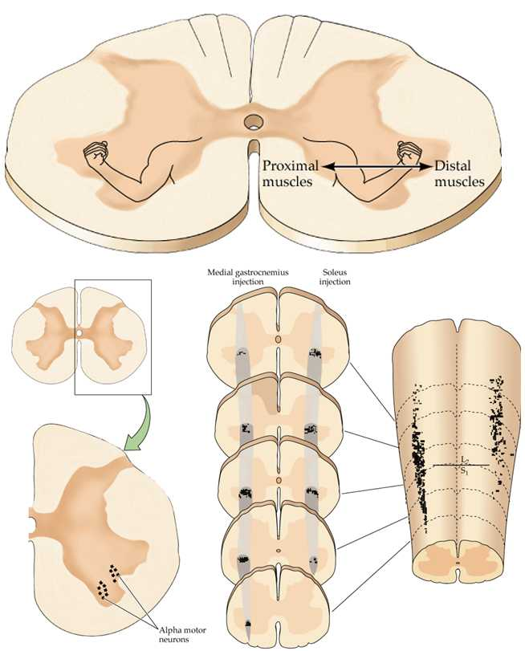
Organization of motor neurons in the ventral horn of the spinal cord demonstrated by retrograde labeling from individual muscles.

Slide 36
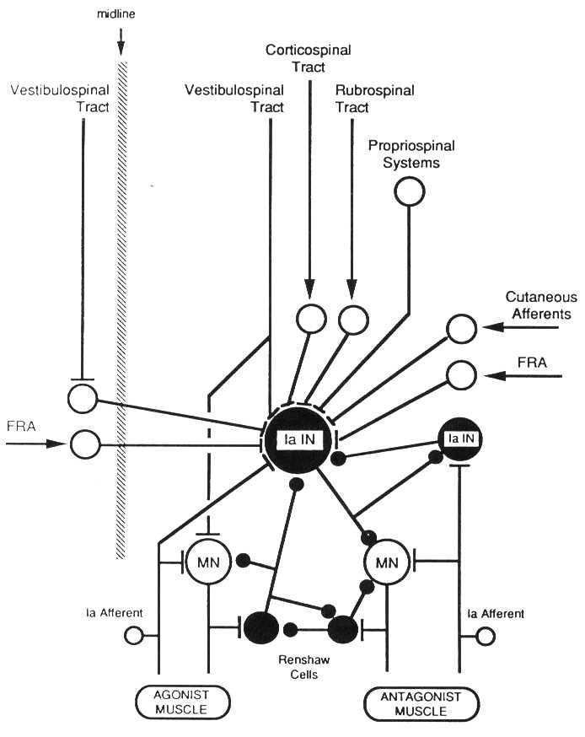
Diagram illustrating the position of the Ia inhibitory interneuron (Ia IN) as an integrating node in a number of spinal circuits. Excitatory neurons and synaptic terminals are indicated by open profiles, inhibitory by closed profiles. FRA, flexor reflex afferents; MN, motorneuron; Ia afferent, sensory nerve from muscle spindle.

Slide 37
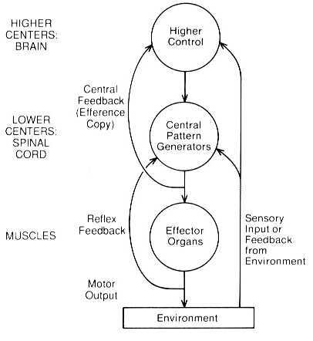
The main neural components common to most motor systems.

Slide 38
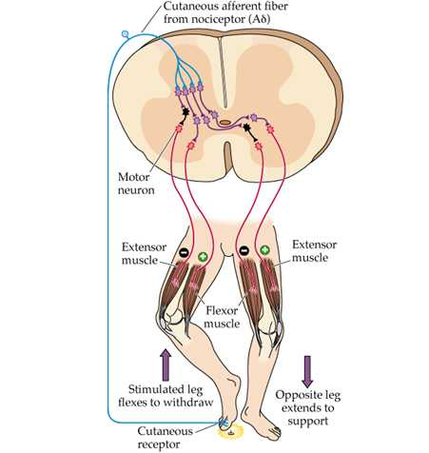
Spinal cord circuitry responsible for the flexion reflex.

Slide 39
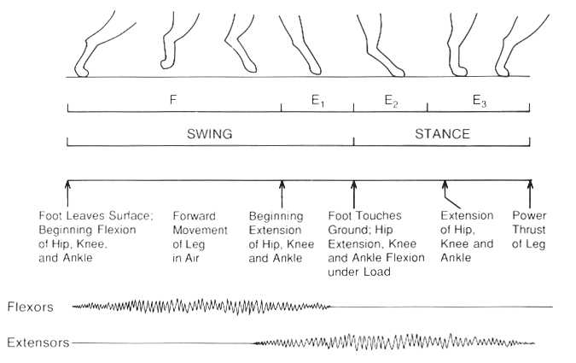
The step cycle, showing phases of leg flexion (F) and extension (E) and their relation to the swing and stance.

Slide 40
Levels of processing involved in regulation of a more "complex" movement, throwing a ball. Numerous inputs are monitored and adjust activity of motorneurons and interneurons throughout completion of the movement.

Slide 41
Spasticity
The term „Spasticity“ is used to discribe a number of clinical symptoms, but there is no distinction wether they are of cerebral or spinal natur or wether the intensity of hypertonus is presenting quickly and strongly like in brain injuries, or the development is more slowly and in different intensitivities as in more focal lesions like cerebral vascular accidents.

Slide 42
Upper motor neurone syndrome
Negative signs =
Minus-symptoms
Positive signs =
Plus-symptoms

Slide 43
Upper motor neurone syndrome
Negative signs
Weakness
Fatigue
Sensorischer loss
Acute hypotonia
Diaschisis
Hyperreflexia (Input of skin receptors is not filtered by CSS)

Slide 44
Upper motor neurone syndrome
Negative signs
Weakness
Fatigue
Sensorischer loss
Acute hypotonia
Diaschisis
Hyperreflexia (Input of skin receptors is not filtered by CSS)
Positive signs
Clonus
Associated Reactions
Non-neural changes in muscles
Spasticity
Dyssynergy in movement patterns
Fixation-strategies

Slide 45
The neurological deficit
Primary Impairments
Neurological weakness
Muscle activation deficit
Spasticity
Changes in tone
Secondary Impairments
Altered alignment
Changes in muscle length and position
edema
pain
Composite Impairments
Clinical hypertonicity (spastic movement disorder)
Altered postural control
Loss of selective movement

Slide 46
Primarye Denervation Flaccid / acute Hypotonia

Slide 47
Associated Reactions
Recovery / new

Slide 48
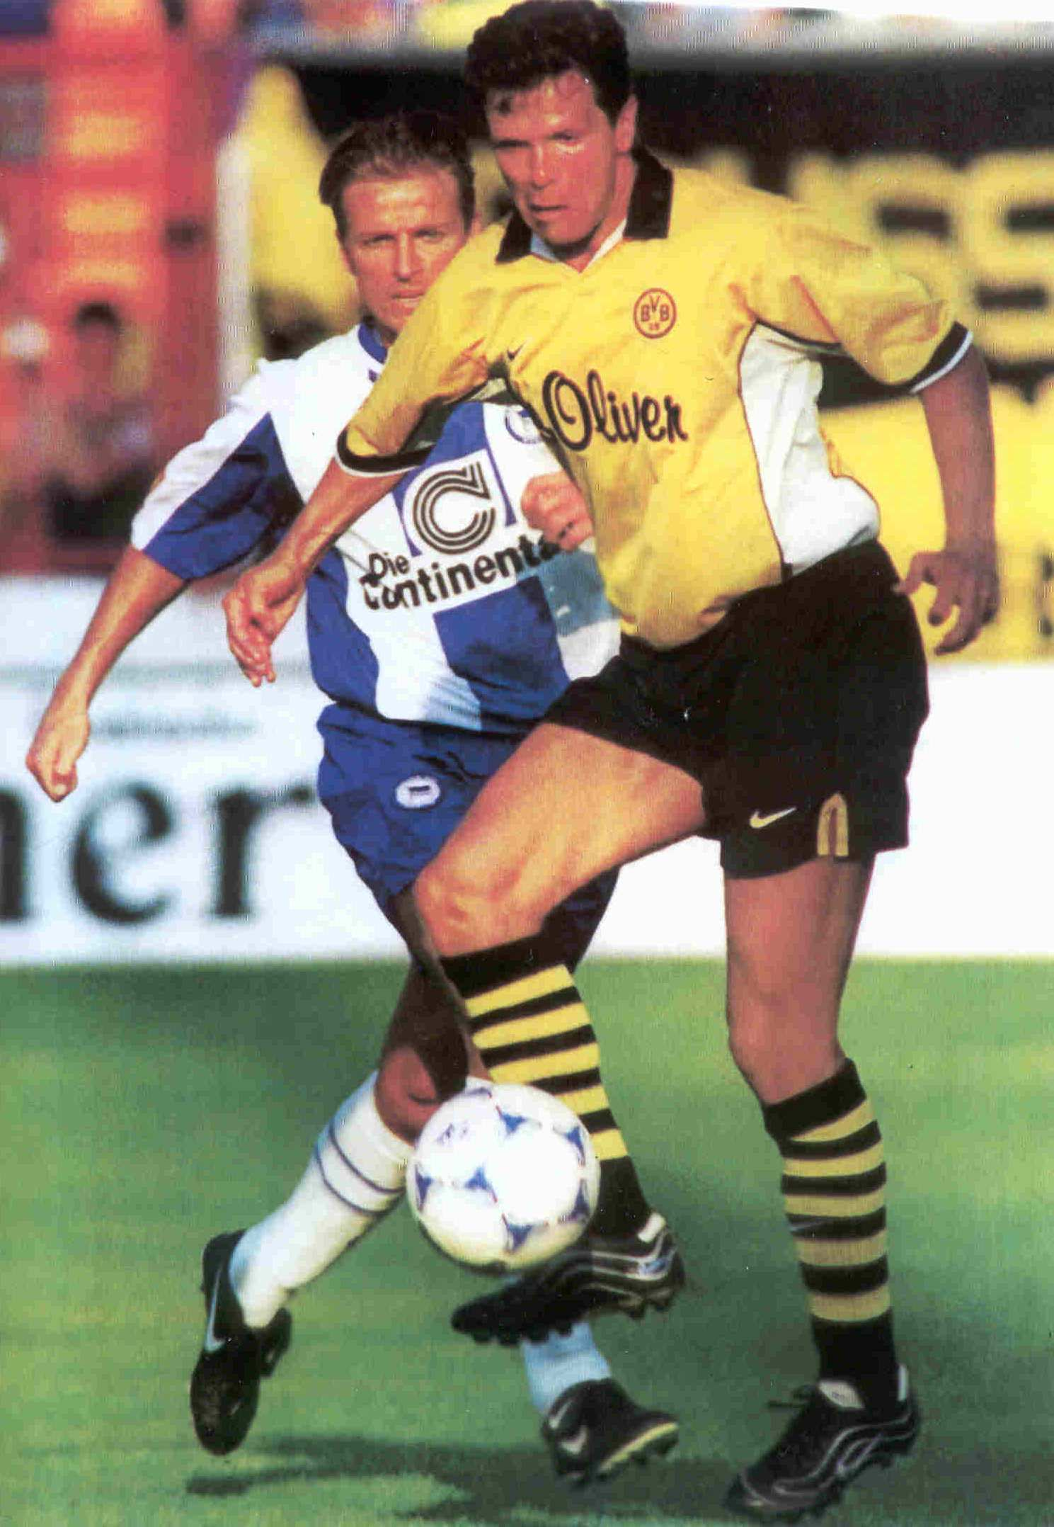

Slide 49
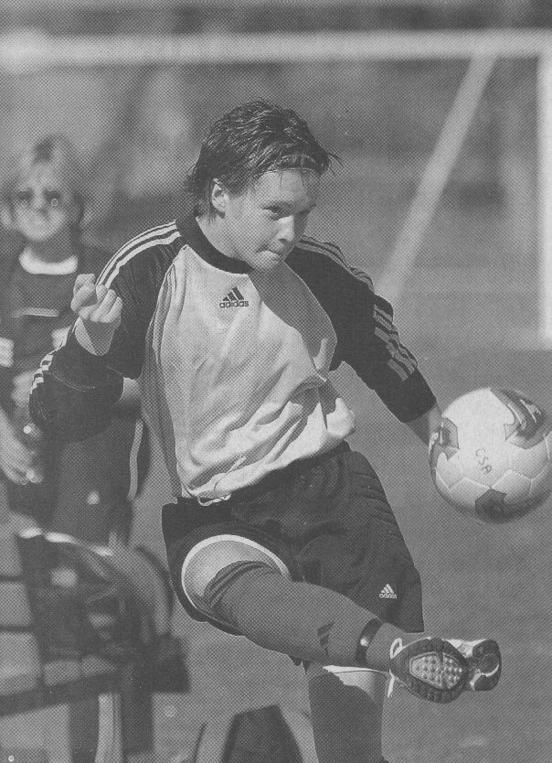

Slide 50
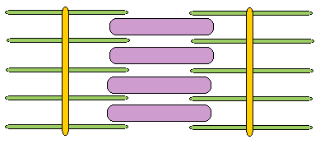
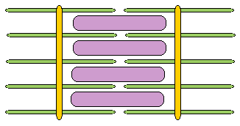
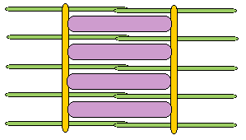
This figure corresponds to point C on the graph. The muscle is stretched to a point where there is very little overlap between actin and myosin. The isometric tension will be low.
At point B on the graph there is considerable overlap between actin and myosin. There are many active crossbridges, so the isometric tension will be high.
At point A there is a lot of overlap between actin and myosin, but the actin filaments are pushing on each other. This distorts the filaments, weakening the crossbridges.

Slide 51
Nerve
Name
Sensory
Motor
Autonomic Parasympathetic
I
Olfactory
Smell
II
Optic
Vision
III
Oculomotor
Proprioception
4 Extrinsic eye muscles
Pupil constriction Accomodation Focusing
IV
Trochlear
Proprioception
1 Extrinsic eye muscle (Sup.oblique)
V
Trigeminal
Somatic senses (Face, Tongue)
Chewing
VI
Abducens
Proprioception
1 Extrinsic eye muscle (Lat. rectus)
VII
Facial
Taste Proprioception
Muscles of facial expression
Salivary glands Tear glands
VIII
Auditory (Vestibulocochlear)
Hearing, Balance
IX
Glossopharyngeal
Taste Blood gases
Swallowing Gagging
Salivary glands
X
Vagus
Blood pressure Blood gases Taste
Speech Swallowing Gagging
Many visceral organs (heart, gut, lungs)
XI
Spinal acessory
Proprioception
Neck muscles: Sternocleidomastoid Trapezius
XII
Hypoglossal
Proprioception
Tongue muscles Speech

Slide 52
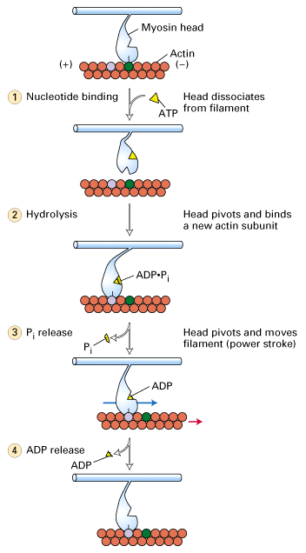
Coupling of ATP hydrolysis to movement of myosin along the actin filament. (From "Molecular Cell Biology"). A model of how myosin moves is diagrammed in the above figure. It is still not absolutely certain that the myosin head moves once per ATP hyrolyzed but this is the current model. Myosin is bound to actin in the absence of ATP and this is the "rigor" state i.e. gives rigidity to the muscle. ATP binds to the myosin causing the head domain to dissociate from actin. ATP is then hydrolyzed causing a conformational change in the mysoin head to move it to a new position and bind to actin. Pi is released causing the myosin head to change conformation again and it is this movement that moves the actin filament.

Slide 53
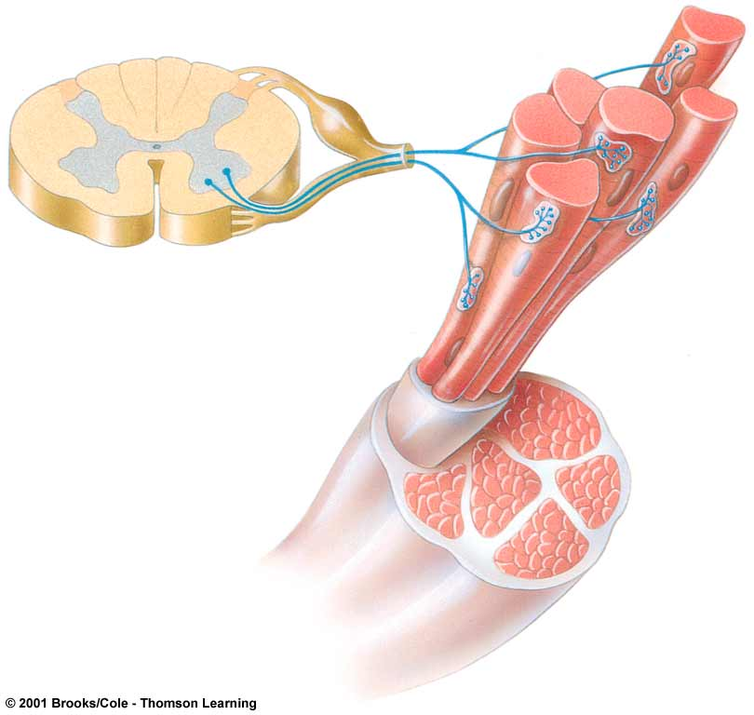
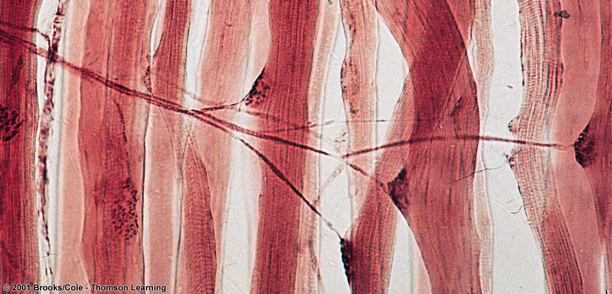
slice from spinal chord
neuromuscular junction
motor neuron axons in a nerve leading from spinal chord
muscle

Slide 54
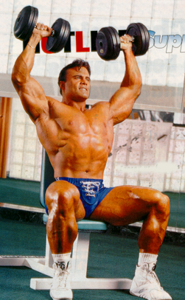
Muscle Hypertrophy
Enlargement of a muscle
More capillaries
More mitochondria
Caused by
Strenuous exercise
Steroid hormones
Notes:
Hypertrophy is the enlargement of a muscle. Hypertrophied muscles have more capillaries and more mitochondria to help them generate more energy. Strenuous exercise and steroid hormones can induce muscle hypertrophy. Since men produce more steroid hormones than women, they usually have more hypertrophied muscles.

Slide 55
Etablishment
Functional use
Secondary Problems
Bio-mechanical Changes
of muscles
Contractures
Deformity

