Slide 1
MIRROR NEURON SYSTEM
PERTEMUAN KE 13
ABDUL CHALIK MEIDIAN & JERRY MARATIS
FAKULTAS FISIOTERAPI

Slide 2
KEMAMPUAN AKHIR YANG DIHARAPKAN
Mahasiswa mampu memahami konsep dasar keilmuan bidang Neurosains dalam
Penerapannya → teori bidang fisioterapi
Implementasinya → praktik kasus penyakit bid. Fisioterapi
Aplikasi → pemecahan masalah penyakit pasien bidang Ft

Slide 3
MIRROR NEURONS SYSTEM
“The most important scientific discovery since DNA?”

Slide 4
NEURON SYNAPTIC

Slide 5
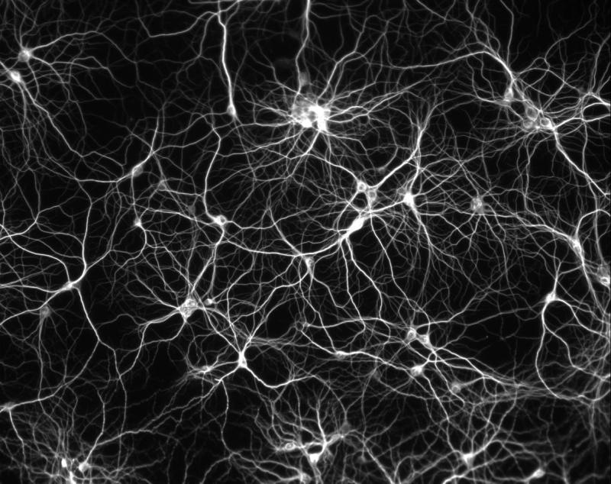

Slide 6
Area F5 of the premotor cortex, similar to Broca’s Area in the human brain

Slide 7
Let’s replicate the experiments
WORK IN PAIRS THROUGHOUT
1. Both grasp a small object, such as a pen
2. Now one of you grasp whilst the other watches only
3. Now just look at the object without grasping it

Slide 8
Around 20% of the neurons that fired when you grasped the object also fired when you watched your partner grasp that object. These are mirror neurons.
Some “logically related” mirror neurons, the same ones, will also have fired when you saw the object which may have been about to be grasped.

Slide 9
Continuing the experiment:
Still working in your pairs, one of you grasp the object again and then let it go.
Now place the card in front of the object so that the observer cannot see it. Reach to grasp the same, now invisible object.
Now remove the card and object. Place the card in front of nothing and reach again.

Slide 10
Around 50% of the mirror neurons will have fired when you reached behind the card the first time. None fired when you did so the second time.

Slide 11
And the conclusion to all this?
ACTION
PERCEPTION
INTENTION
are all the same thing as far as the brain is concerned.
It is holistic. This is how we empathise, by simulating others’ actions and their possible intentions.

Slide 12
IMITATION
Piaget suggested that babies learn to imitate
Mirror neurons tell us that babies imitate to learn – from the first hour of their lives

Slide 13
Broca’s Area shows that gestures and language are simultaneous. When we hear a word our action neurons fire. This is called embodied semantics.

Slide 14
LANGUAGE – Broca’s Area
Create 4 word sentences from the following:
1. HIM WAS WORRIED SHE ALWAYS
2. FENCE FRAIL THE IS PICTURE
3. BALL THE THROW TOSS SILENTLY
4. SHOES GIVE REPLACE OLD THE
5. SKY THE SEAMLESS GREY IS
6. SUNLIGHT MAKES TEMPERATURE WRINKLE RAISINS

Slide 15
Why is it easier to have a conversation than to speak a monologue?
Because in a conversation the same neurons fire when we hear a word as when we say it.
In other words, our brain actually has both sides of the conversation.
We are the other person!

Slide 16
Mirror neurons are the source of empathy.
When we see a facial gesture, our brains automatically mirror the face and send a message to the limbic system. Once this emotional reaction has kicked in, we understand the other because we have become the other.

Slide 17
So, does this have any application to our work?
As teachers, our job is to change brains so we need to understand as much as we can
It can help us to see the importance of relationships to learning
It emphasises the need to model behaviours – imitation is what we do
It shows the power of drama, role play and freeze frames

Slide 18
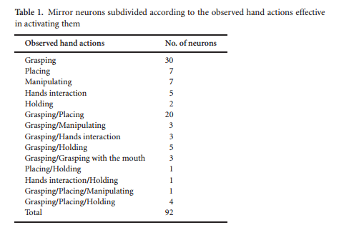

Slide 19
MNS
The mirror system, appears to support the action understanding ability.
It most likely constitutes the neural basis for this fundamental social cognitive function required by the complex social environment typical of primates.
We think that the mirror system offers also a new heuristic tool for the empirical investigation of cognitive capacities, such as mindreading, considered to be uniquely human, and still poorly understood.

Slide 20
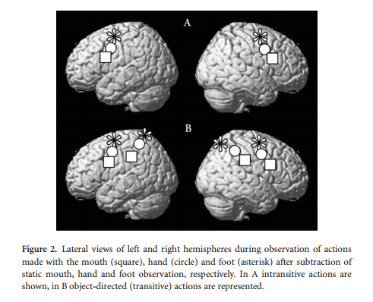

Slide 21
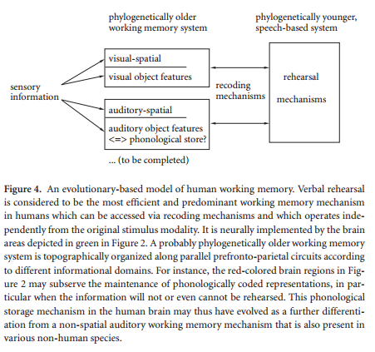

Slide 22
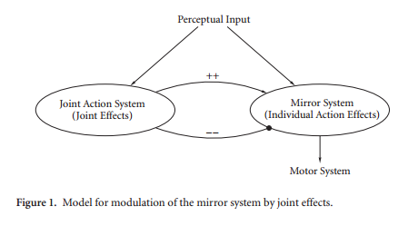

Slide 23
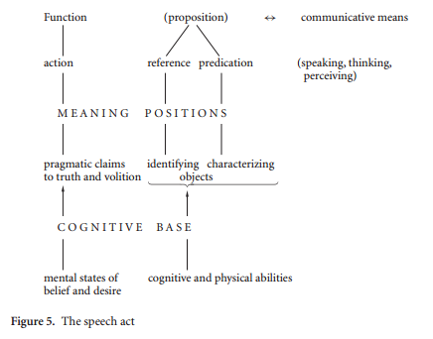

Slide 24
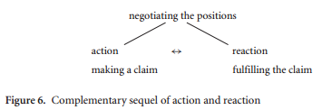

Slide 25
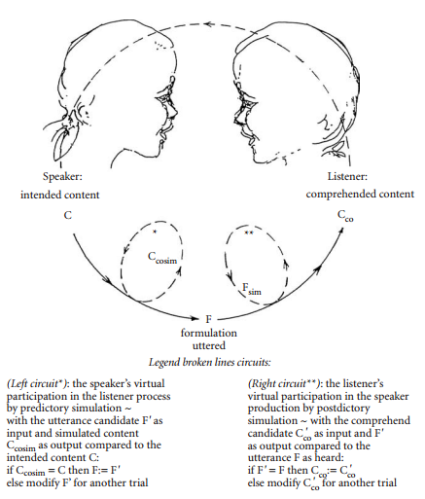

Slide 26
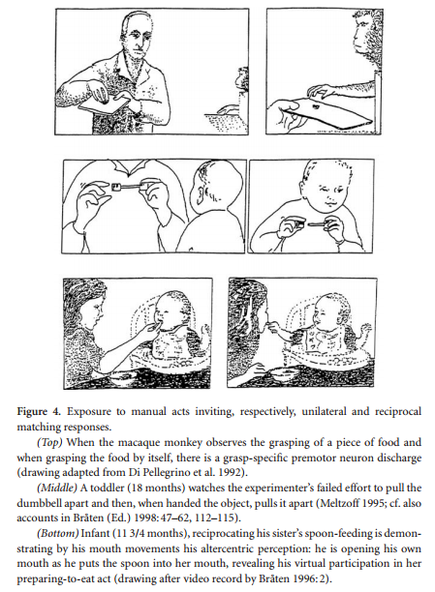

Slide 27
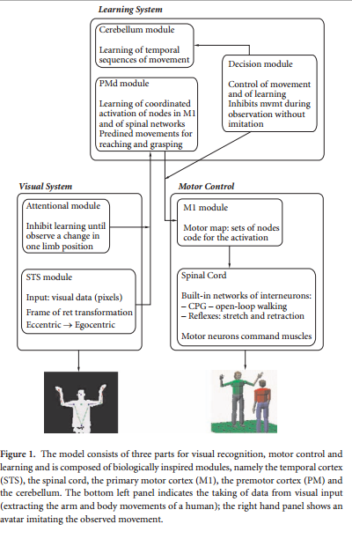

Slide 28
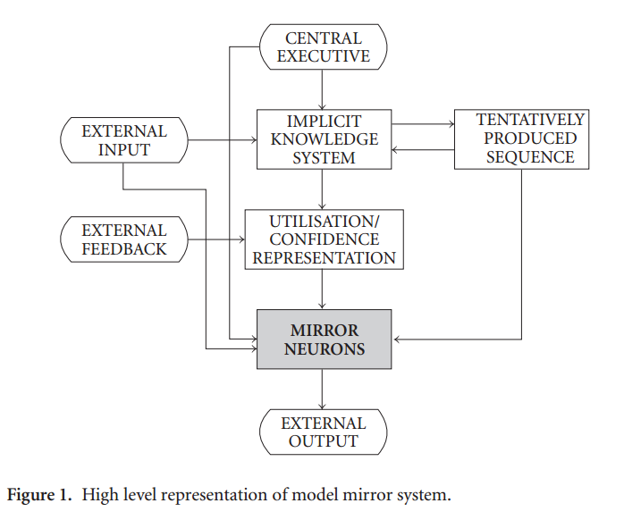

Slide 29
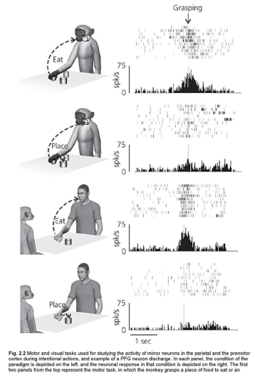

Slide 30
Referensi
Stamenov, M., I., Gallese, V., tt. Mirror Neurons and the Evolution of Brain and Language. Amsterdam/Philadelphia : John Benjamins Publishing Company

Slide 31
TERIMA KASIH &
SELAMAT BELAJAR

