Slide 1
SENSORI-MOTOR SYSTEM
PERTEMUAN ke 7
ABDUL CHALIK MEIDIAN & JERRY MARATIS
FAKULTAS FISIOTERAPI

Slide 2
KEMAMPUAN AKHIR YANG DIHARAPKAN
Mahasiswa mampu memahami konsep dasar keilmuan bidang Neurosains dalam
Penerapannya → teori bidang fisioterapi
Implementasinya → praktik kasus penyakit bid. Fisioterapi
Aplikasi → pemecahan masalah penyakit pasien bidang Ft.

Slide 3
Sensorimotor System

Slide 4
Principles
Sensory
Input to primary somatosensory area via dorsal root
Two main pathways:
1. Dorsal spinothalamic tract for proprioception (body awareness and position in space) and hapsis (sensation of fine touch and pressure) – crosses in medulla
2. Ventral spinothalamic tract for nocioceptive information – crosses over in spinal cord
Motor
Output to Muscles via ventral root
Two main pathways:
1. Ventromedial system for balance, posture and controlling head & eye movements. Important for muscles of legs & trunk needed for walking.
2. Dorsolateral system for controlling movements of upper limbs & extremities such as fingers and toes as well as movement of facial muscles.

Slide 5
Principles
Sensorimotor System is organized in an hierarchy
Association Cortex
Secondary Motor Cortex
Primary Motor Cortex
Brainstem Motor Nuclei
Muscles
Behavior
Recognize that there is “cross-talk” or feedback between hemispheres and within regions. There is also a converging of descending motor circuits to muscles, which leads to behavior. See page 145 for diagram in Elias & Saucier, 2006.

Slide 6
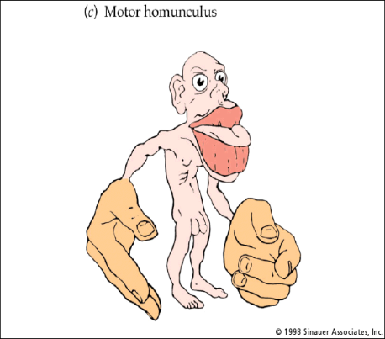
Principles
Primary Motor Cortex:
Damage reduces speed, accuracy and force of the movement, not paralysis.
Interconnections exist directly between this area and somatosensory area, causing astereognosis (i.e. failure to identify objects by touch)
Overlapping representation of fingers for both motor cortex and somatosensory cortex. The latter can affect tactile discrimination when visual input is removed.

Slide 7
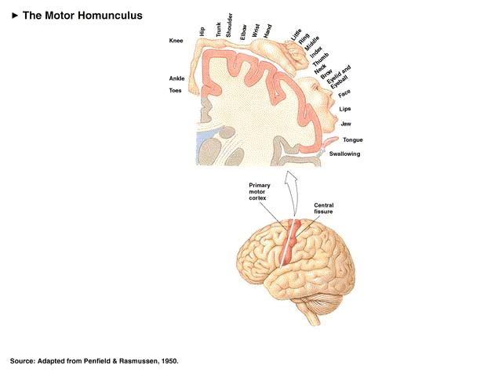

Slide 8
The Somatosensory Cortex
Note the proximity of the face with the hand. Phantom sensation occurs in an amputated hand if the face is touch. Why does that occur?

Slide 9
How does sensory information get to the Association Cortex?
All sensory input ascends via the dorsal spinothalamic track regardless of where it originates (i.e., dermatomes or cranial nerves).
Specific thalamic areas send the ascending sensory information to the respective primary sensory area.
Somatosensory information is often accompanied by auditory or visual sensory information.
From the primary sensory areas, the information converges in the association cortices (note: both secondary & tertiary areas are considered association cortex)

Slide 10
4 Lobus dari Korteks Cerebral , Korteks Sensori Motor dan Korteks Asosiasi

Slide 11
Korteks Auditori Primer dan Sekunder

Slide 12
Korteks Cerebral Manusia pada Area Penglihatan

Slide 13
Jalur Korteks Masuk dan Keluar

Slide 14
Jalur Dorsolateral Prefrontal Korteks Asosiasi

Slide 15
4 Area dari Korteks Motor Sekunder

Slide 16
Jalur Motorik Dorsolateral (Cortico Spinal & Cortico Rubrospinal)

Slide 17
Traktus Cerebro Spinal
Another view of the cerebrospinal track

Slide 18
Sensorimotor Disorder: Apraxia* or Dyspraxia** (a deficit* or impairment** in performing skilled voluntary movements; when this occurs in children is falls under the category of “developmental dyspraxia”)
Ideomotor Apraxia or Dyspraxia : a problem in the execution or imitation of simple gestures (e.g., wave goodbye, salute, using hammer). The problem occurs in converting a command to a behavior. Etiology is left hemisphere and often involves language areas as well (note: limited gesturing is present in children in the Autism Spectrum).

Slide 19
Dyspraxia
Constructional Dyspraxia: A reduced ability to construct a complex object (e.g., Block Design). Sensory (visuospatial) and movements are intact but the linkage between the sensory and the motor response is disrupted. In other words the “sensorimotor” linkage is impaired.
Oral or Verbal Dyspraxia: A reduced ability to voluntarily control single or sequenced silent movements of the lips, tongue or soft palate. Speech is limited and may be difficult for people to understand. A dyspraxic child may have difficulty saying single speech sounds, imitating strings of different sounds and sequencing sounds together to form words. Poor intelligibility is often due to a child’s limited range of speech sounds and omission or substitution of sounds. These difficulties may also mean that the child may not be able to use the correct grammatical endings for words.

Slide 20
Dyspraxia
Limb Dyspraxia: Also known as a developmental coordination disorder. It is also referred to as "motor planning" deficits, global apraxia/dyspraxia, postural praxis or kinesthetic praxis. The child is unable to imitate postural body/limb positions. Problems with handwriting fall into this category.
Other apraxias are not often found in children (i.e. gaze apraxia, asterognosia, dressing apraxia (note: this would be more related to “developmental coordination disorder” in children)

Slide 21
Disorders of the Motor System
Cerebral Palsy: caused by an injury to the brain before, during, or shortly after birth. Basal ganglia and cerebellum are affected.
Muscular Dystrophy: Progressive muscle wasting, weakness, and loss of function. In Duchenne's MD, delayed development of basic muscle skills and coordination in children. Common signs include poor balance with frequent falls, walking difficulty with waddling gait and calf pain, and limited range of movement
Tourette’s Disorder: a motor dysregulation involving executive functions of the frontal lobe, striatum and primary motor cortex.

Slide 22
Sensorimotor System

Slide 23
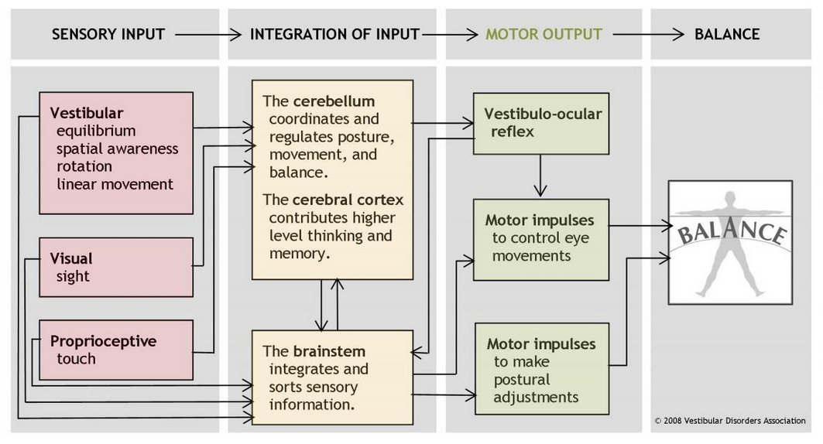

Slide 24
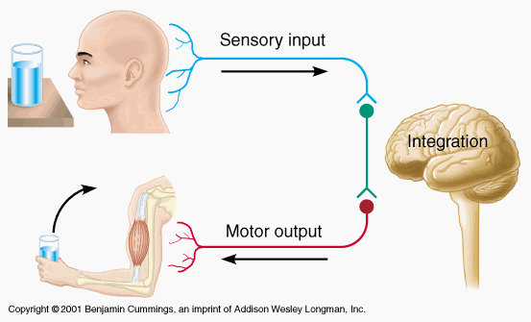

Slide 26
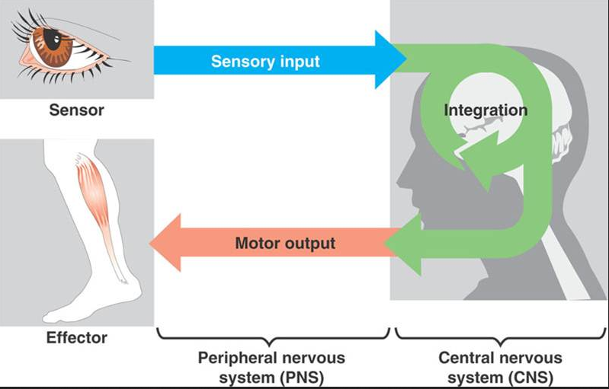

Slide 27
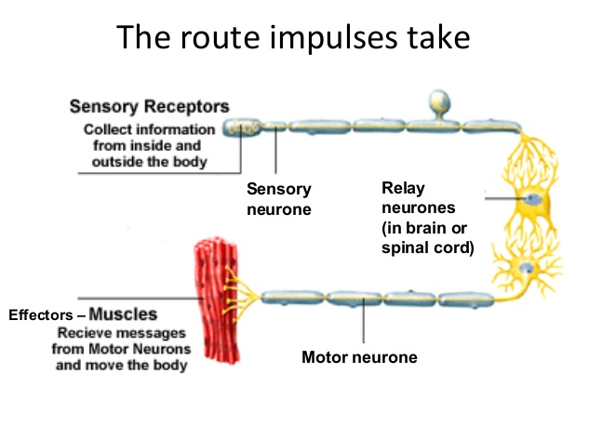

Slide 28
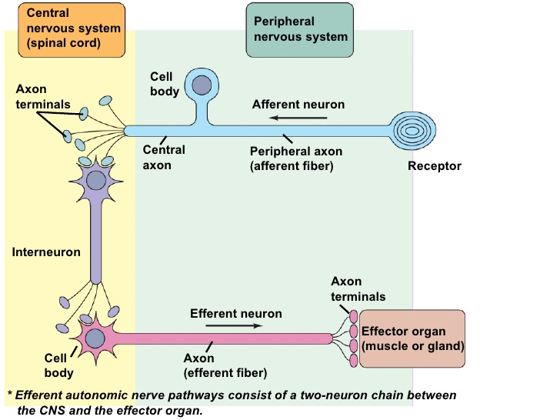

Slide 29
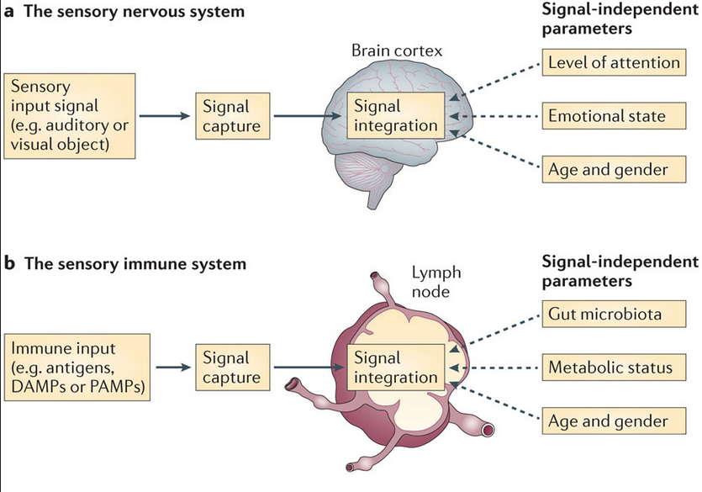

Slide 30
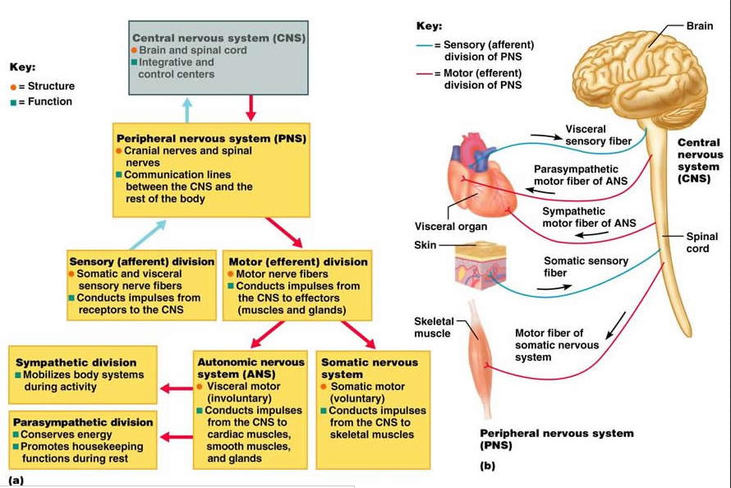

Slide 31
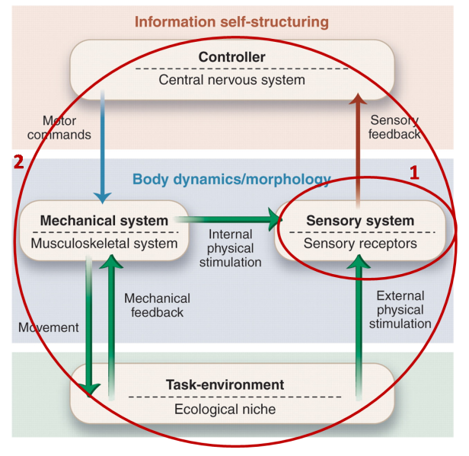

Slide 32
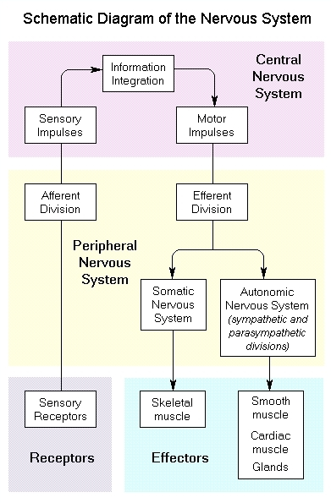

Slide 33
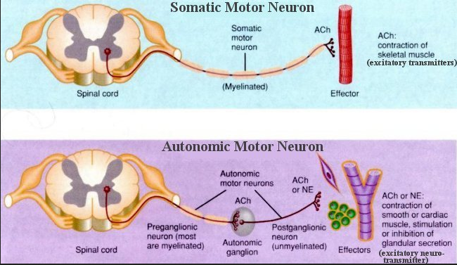

Slide 34
&
TERIMA KASIH
SELAMAT BELAJAR

