Slide 1
NEUROPLASTICITY
PERTEMUAN KE 8
ABDUL CHALIK MEIDIAN & JERRY MARATIS
FAKULTAS FISIOTERAPI

Slide 2
KEMAMPUAN AKHIR YANG DIHARAPKAN
Mahasiswa mampu memahami konsep dasar keilmuan bidang Neurosains dalam
Penerapannya → teori bidang fisioterapi
Implementasinya → praktik kasus penyakit bid. Fisioterapi
Aplikasi → pemecahan masalah penyakit pasien bidang Ft.

Slide 3
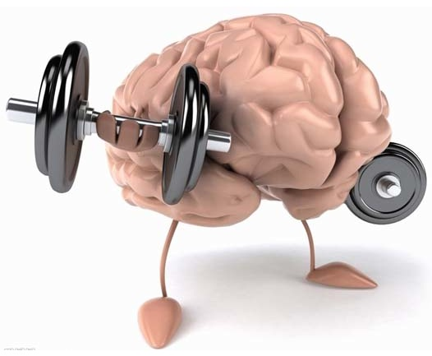
Neuroplasticity

Slide 4
Plastisitas
PLASTISITAS adalah kemampuan untuk merubah atau memodifikasi struktur.
Kemampuan cell untuk merubah beberapa aspek phenotype dalam beberapa tahap sebagai respon dari kerusakan struktur dan pengaruh lingkungan.
(Brown and hardman, 1987).
Untuk proses motor learning perubahan /modifikasi yang diperlukan adalah neural plasticity dan muscular plasticity.
Otak manusia mepunyai kemampuan yang luar biasa untuk belajar,dan proses belajar akan merubah struktur dan fungsi baik pada orang normal atau pada ganguan CNS
stein et al (1995)

Slide 5
Neuroplastisitas
Secara klinis,terapis menemukan pasien berkembang dan belajar kembali untuk bergerak seperti sebelum terjadi stroke atau dengan strategi lain
bobath (1990)
Neuroplastisitas : Kemampuan neuron untuk merubah fungsinya, profil zat kimia(jumlah & tipe neurotransmitter yang diproduksi) atau strukturnya

Slide 6
Neuroplastisitas ini merupakan istilah umum yang digunakan dalam cakupannya dalam mekanisme:
Habituation
Experience-Dependent Plasticity: Learning & Memory
Cellular recovery after Injury
Neuroplastisitas
GENOTYPE→kemampuan merubah diri yang dibawa oleh GENOME(GENETIC POTENTIAL)
PHENOTYPE→sejumlah karakter yang ditampilkan oleh organisme (GENETIC EXPRESSION).
(GENOTYPE+ENVIRONMENT)

Slide 7
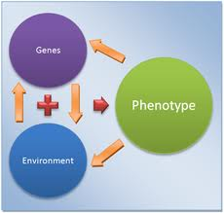
Neuroplastisitas

Slide 8
Form function
Konsep tentang kemampuan CNS beradaptasi,rebuild,dan reorganise sendiri dengan perubahan FORM (bentuk) dan FUNCTION(fungsi).
Membuat manusia mempunyai kesempatan untuk recovery dan melakukan fungsi kembali.
(Kidd et al. 1992)

Slide 9
Neuro thropic
Merupakan level paling dasar terjadinya respon plastisitas yaitu dari cell yang memproses signal dari lingkunganya.
Phenotypic plasticity melewati beragam fenomena yang terjadi pada seluruh level organisation/sistem dari tubuh.
(schlichting &smith 2005)

Slide 10
Synaptic plasticity
Synaps dapat merubah struktur dan fungsinya dengan cara”ACTIVITY-DEPENDENT”
(Kandel 2000,Brodal 2004,Nudo 2003)
Perubahan efisiensi synaps terjadi melalui
Presinaptic terminal menambah/mengurangi neurotransmiter disesuaikan dgn aksi potensial.
Postsynaptic neuron menaikan atau menurunkan responnya terhadap neurotransmiter.
(Brodal 2004)

Slide 11
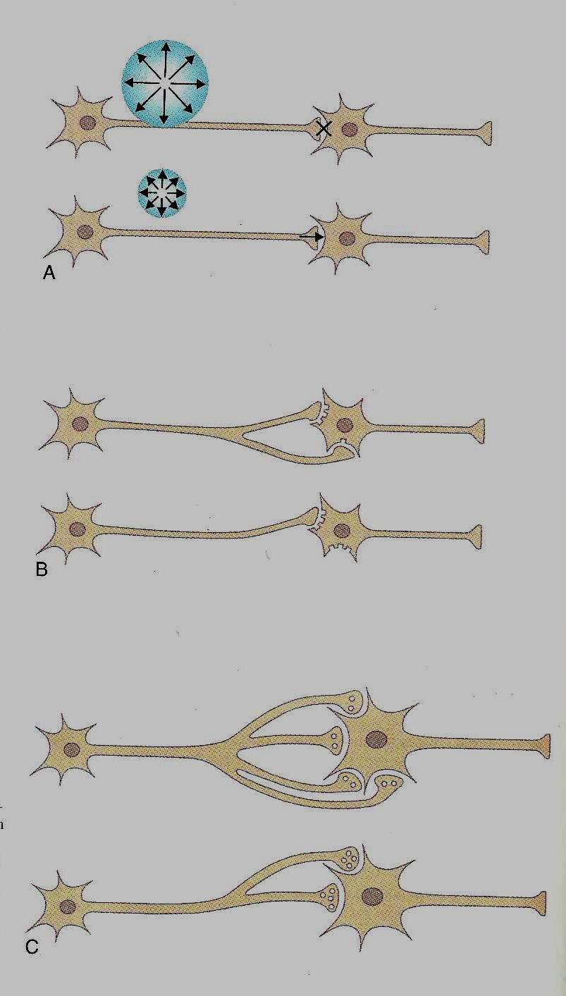
Axonal Sprouting

Slide 12
Cortical plasticity
Perubahan bentuk pada masing-masing area cortical secara terus menerus dibentuk karena kebiasaan melalui pengulangan /repetisi dgn gerakan yang sama. (Nudo 2007)
Pengulangan bukan sekedar pengulangan tetapi pengulangan yang bervariasi.
(breinstein 1967)
“Repetition without repetition”

Slide 13
Cortical Plasticity
The motor system
“use it or lose it”
The somatosensory system
“Stimulate or lose it”
(Bayona et al 2005)

Slide 14
Neuroplasticity – Brain Remodeling
Steps to remodel the brain based upon experiences:
1. Repetition
2. Correct fundamentals
3. Authentic environment

Slide 15
Positive Outcomes of Neuroplasticity
New skills
Better cognition
More efficient communication between sensory and motor pathways
Improved function of the aging brain
Slowing down pathological processes
Promoting recovery of sensory losses
Improved motor control
Improved memory
(Mahncke, Bronstone & Merzenich, 2006; Mahucke & Merzenich, 2006; Nudo 2007; Stein & Hoffman, 2003).

Slide 16
Negative Outcomes of Neuroplasticity
Decline in brain function
Altered motor control
Impaired performance of activities of daily living
Amplified perception of pain

Slide 17
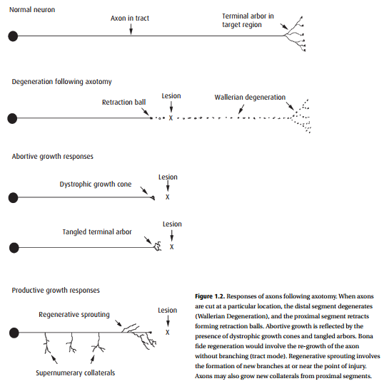
Regenerative sprouting

Slide 18
Neuroplasticity
The term “neuroplasticity” is used to describe the ability of neurons and neuron aggregates to adjust their activity and even their morphology to alterations in their environment or patterns of use.

Slide 19
Neuroplasticity
The term encompasses diverse processes, as from learning and memory in the execution of normal activities of life, to dendritic pruning and axonal sprouting in response to injury.

Slide 20
Neuroplasticity
Once considered overused and trite, the term “neuroplasticity” has regained currency in the neurorehabilitation community as a concise way to refer to hypothetical mechanisms that may underlie spontaneous or coaxed functional recovery after neural injury and can now be studied in humans through such techniques as :
functional imaging (including positronemission tomography (PET) and
functional magnetic resonance imaging (fMRI)),
electrical and magnetic event-related potentials (including electroencephalogram (EEG),
evoked potentials (Eps),
and magneto-encephalography (MEG)) and
noninvasive brain stimulation in the form of transcranial magnetic or electrical stimulation (TMS and trancranial direct current stimulation, tDCS).

Slide 21
Neural repair
The term “neural repair” has been introduced in the past several years to describe the range of interventions by which neuronal circuits lost to injury or disease can be restored.

Slide 22
Neural repair
Included in this term are means to :
enhance axonal regeneration,
the transplantation of a variety of tissues and cells to replace lost neurons, and
the use of prosthetic neuronal circuits to bridge parts of the nervous system that have become functionally separated by injury or disease.

Slide 23
Neural repair
Although there is overlap with aspects of “neuroplasticity,” the term “neural repair” generally refers to processes that do not occur spontaneously in humans to a degree sufficient to result in functional recovery.

Slide 24
Neural repair
Thus therapeutic intervention is necessary to promote repair.
The term is useful as part of the basic science of neurorehabilitation because it encompasses more than “regeneration” or “transplantation” alone.
In recent years, concepts of neural plasticity have been accepted as important elements in the scientific understanding of functional recovery.

Slide 25
Neural repair
The rehabilitation community has been slower to embrace repair as a relevant therapeutic goal.
“Neural repair” has been used in the title of this textbook in order to convey the breadth of subject matter that it covers and is now considered relevant to neurorehabilitation.

Slide 26
Referensi
Selzer, M. E., Clarke, S., Cohen, L. G., Duncan, P. W., Gage, F. H., 2006. Textbook of Neural Repair and Rehabilitation. Vol 1. UK: Cambridge University Press

Slide 27
TERIMA KASIH &
SELAMAT BELAJAR

