Slide 1
THE PAIN SYSTEM AND SOMATOSENSATION
PERTEMUAN KE - 9
ABDUL CHALIK MEIDIAN & JERRY MARATIS
FAKULTAS FISIOTERAPI

Slide 2
KEMAMPUAN AKHIR YANG DIHARAPKAN
Mahasiswa mampu memahami konsep dasar keilmuan bidang Neurosains dalam
Penerapannya → teori bidang fisioterapi
Implementasinya → praktik kasus penyakit bid. Fisioterapi
Aplikasi → pemecahan masalah penyakit pasien bidang Ft.

Slide 3
Pain
Definitions:
An unpleasant sensory and emotional experience associated with actual or potential tissue damage.
Pain is whatever the experiencing person says it is.
May not be directly proportional to amount of tissue injury.
Highly subjective, leading to undertreatment

Slide 4
Nyeri
DEFINISI :
SUATU PENGALAMAN SENSORIK DAN EMOSIONAL YANG TIDAK MENYENANGKAN YANG BERHUBUNGAN DENGAN KERUSAKAN SUATU JARINGAN

Slide 5
Jenis-jenis Nyeri
Nyeri berdasarkan jenisnya ada 4 :
Nyeri Nociceptik
Nyeri Neuropatik
Nyeri Psikogenik
Nyeri Idiopatik

Slide 6
Nyeri (lanjutan)
Nyeri Nociceptik dibagi menjadi 3 :
Nyeri Somatik
Nyeri Visceral
Referred Pain
Nyeri Neuropatik dibagi menjadi 2 :
Nyeri Perifer
Nyeri Sentral

Slide 7
Nyeri (lanjutan)
Berdasarkan timbulnya nyeri dibagi 2 :
Nyeri Akut
Nyeri Kronik
Berdasarkan derajat nyeri dibgi 3 :
Nyeri Ringan
Nyeri Sedang
Nyeri Berat

Slide 8
Types of Pain
1. Acute
2. Cancer
3. Chronic non-malignant

Slide 9
Major Categories of Pain
Classified by inferred pathophysiology:
Nociceptive pain (stimuli from somatic and visceral structures)
Neuropathic pain (stimuli abnormally processed by the nervous system)

Slide 10
MEKANISME TIMBULNYA NYERI
Terdiri dari 4 proses, antara lain :
Transduksi
Merupakan perubahan rangsang nyeri (noxious stimuli) menjadi aktifitas listrik pada ujung-ujung saraf sensoris. Zat-zat algesik seperti prostaglandin, serotonin, bradikinin, leukotrien, substans P, potassium, histamin, asam laktat, dan lain-lain akan mengaktifkan atau mensensitisasi reseptor-reseptor nyeri

Slide 11
Mekanisme timbulnya nyeri (lanjutan)
Transmisi
Merupakan proses perambatan impuls nyeri melalui serabut A-delta dan C yang menyusul proses tranduksi.
Modulasi
Merupakan interaksi antara sistem analgesik endogen (endorfin) dengan input nyeri yang masuk ke kornu posterior. Impuls nyeri yang diteruskan oleh serat-serat A-delta dan C ke sel-sel neuron nosisepsi di kornua dorsalis medula spinalis tidak semuanya diteruskan ke sentral lewat traktus spinotalamikus.

Slide 12
Mekanisme timbulnya nyeri (lanjutan)
Persepsi
Impuls yang diteruskan ke kortex sensorik akan mengalami proses yang sangat kompleks, termasuk proses interpretasi dan persepsi yang akhirnya menghasilkan sensibel nyeri.

Slide 13
TANDA – TANDA INFLAMASI
KEMERAHAN (RUBOR)
PANAS (KALOR)
PEMBENGKAKAN (TUMOR)
NYERI (DOLOR)
PENURUNAN FUNGSI

Slide 14
HARMFUL EFFECTS
Cardiovascular and respiratory systems are significantly affected by the pathophysiology of pain
adrenergic stimulation
hypercoagulation,
↑ heart rate
↑ cardiac output
↑ myocardial oxygen consumption

Slide 15
PATHOPHYSIOLOGY OF PAIN
↓ pulmonary vital capacity
↓ alveolar ventilation
↓functional residual capacity
arterial hypoxemia
suppression of immune functions, predisposing trauma patients to wound infections and sepsis

Slide 16
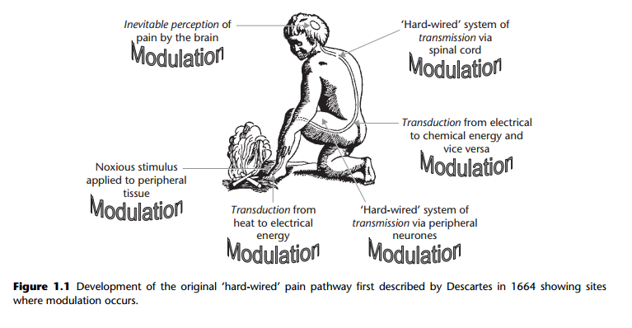

Slide 17
Nociception
Nociception is the neural mechanism by which an individual detects the presence of a potentially tissueharming stimulus.
There is no implication of (or requirement for) awareness of this stimulus.

Slide 18
Pain
Pain is ‘an unpleasant sensory and emotional experience associated with actual or potential tissue damage, or described in terms of such damage’.
Thus, perception of sensory events is a requirement, but actual tissue damage is not.

Slide 19
The nociceptive mechanism (prior to the perceptive event) consists of a multitude of events as follows:
Transduction
Transmission
Modulation

Slide 20
Transduction
This is the conversion of one form of energy to another.
It occurs at a variety of stages along the nociceptive pathway from:
Stimulus events to chemical tissue events.
Chemical tissue and synaptic cleft events to electrical events in neurones.
Electrical events in neurones to chemical events at synapses.

Slide 21
Transmission
Electrical events are transmitted along neuronal pathways, while molecules in the synaptic cleft transmit information from one cell surface to another

Slide 22
Modulation
The adjustment of events, by up- or downregulation.
This can occur at all levels of the nociceptive pathway, from tissue, through primary (1°) afferent neurone and dorsal horn, to higher brain centres.

Slide 23
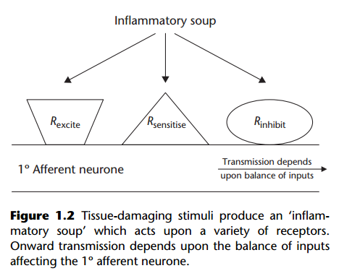

Slide 24
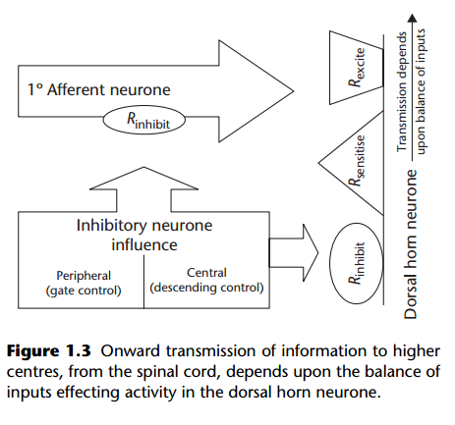

Slide 25
PERIPHERAL MECHANISMS
Nociception forms an integral part of the somatosensory nervous system, whose main purpose can be described by :
exteroceptive,
proprioceptive and
interoceptive functions.

Slide 26
PERIPHERAL MECHANISMS
Exteroceptive functions include :
mechanoreception,
thermoception and
nociception.

Slide 27
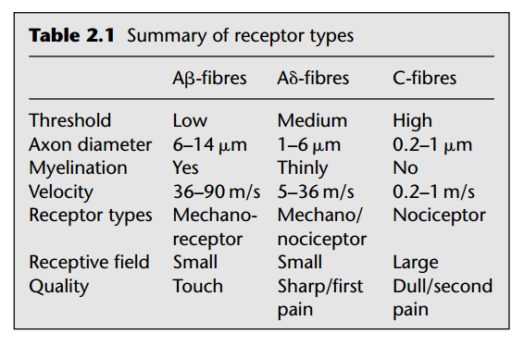

Slide 28
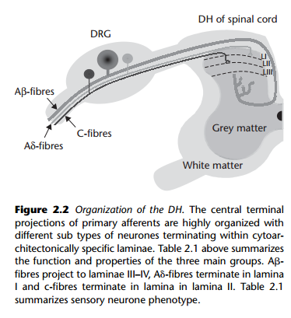

Slide 29
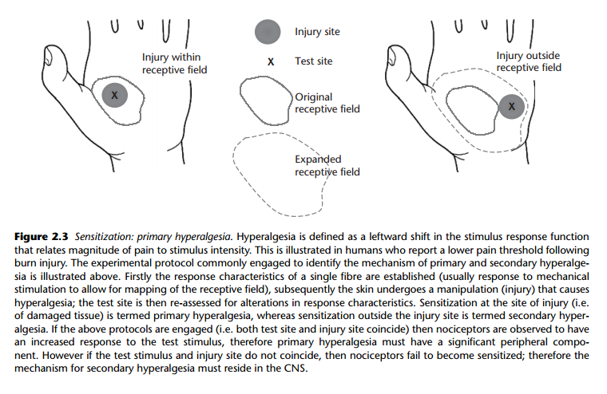

Slide 30
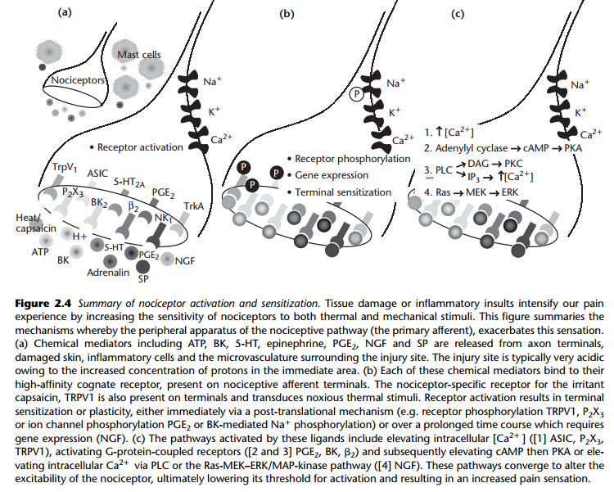

Slide 31
CENTRAL MECHANISMS
There is no simple relationship between a given noxious stimulus and the perception of pain.
Psychological factors, such as arousal, attention and expectation can influence central nervous system (CNS) circuits involved in pain modulation.

Slide 32
CENTRAL MECHANISMS
Pain transmission depends on the balance of inhibitory and facilitatory influences acting on the neural circuits of the somatosensory system.
Integration of these influences occurs at multiple levels of the CNS including the spinal cord, brain stem and multiple cortical regions.

Slide 33
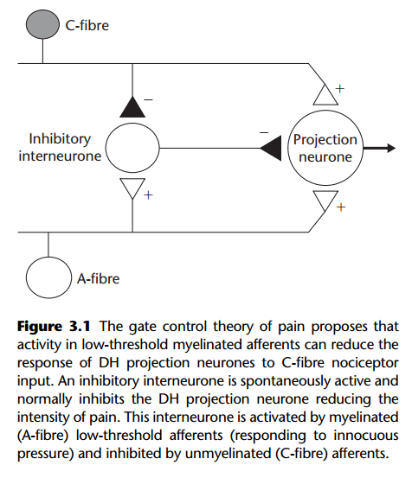
Modulation of pain processing at the level of the spinal cord

Slide 34
The influences of attention and emotion on pain
Many of the pain modulating mechanisms so far discussed can be accessed not only by pharmacological means, but also by contextual and/or cognitive manipulation.
Pain perception can be altered by variables, such as: • Attentional state. • Emotional context. • Attitude. • Experience

Slide 35
Key points
There is evidence for ‘top-down’ control, with the brain controlling its own input from lower centres.
The endogenous opioid peptides form part of an intrinsic descending pathway inhibiting the transmission of nociceptive information.
There are multiple cortical regions involved in the central processing of pain. The anterior cingulate and insular cortices encode its affective component. The 1° and 2° somatosensory cortices are responsible for sensory discrimination.
Both attentional state and emotional context canhave an important influence on pain perception.
The complex central processing of sensory information means that there is no simple relationship between a given noxious stimulus and the perception of pain.

Slide 36
The pain matrix
The pain matrix consists of brain structures that process and regulate information and are capable of creating pain perception in the absence of nociceptive input.
It includes part of the brain stem, amygdala, hypothalamus, thalamus and areas of the cerebral cortex.
It is further divided into a lateral and medial pain system.
Lateral pain system. Perceives location and intensity of tissue damage
Medial pain system. Affective and cognitive responses to these signals.

Slide 37
Acute and chronic pain
Acute pain
Pain experienced on a daily basis due to tissue injury.
Nociception – excessive noxious stimulus giving rise to and intense and unpleasant sensation
Chronic pain
Abnormal functioning of the normal physiological pathway
Hyperalgesia – An increased amount of pain associated with a mild noxious stimulus
Allodynia – Pain evoked by a non-noxious stimulus, or spontaneous pain without any
precipitating stimulus.

Slide 38
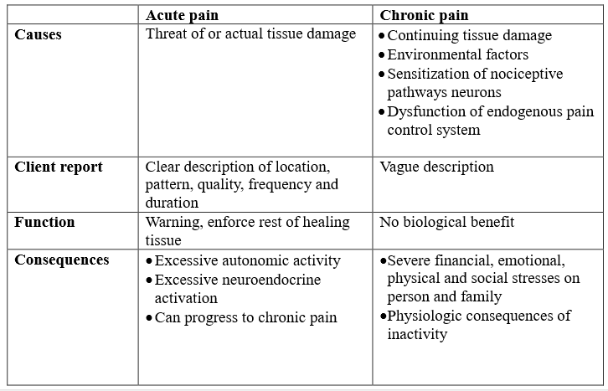
Acute and chronic pain

Slide 39
Symptoms of chronic pain pathology
Parasthesia: Abnormal sensation
Dysaesthesia: Unpleasant abnormal sensation
Allodynia: Pain evoked by a non-noxious stimulus or spontaneous pain without any precipitating stimulus
Hyperalgesia: An increased amount of pain associated with a mild noxious stimulus.

Slide 40
Referensi
Holdcroft, A., Jaggar, S., 2005. CORE TOPICS IN PAIN. UK: Cambridge University Press

Slide 41
TERIMA KASIH &
SELAMAT BELAJAR

