Slide 1
Alkaloid

Slide 2
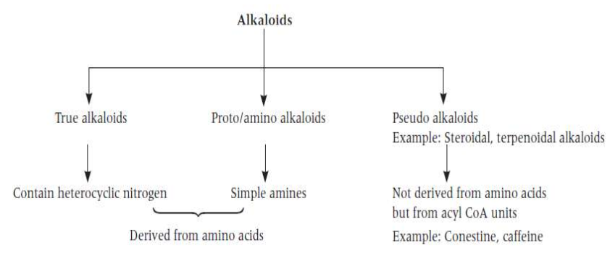
The term “alkaloid” (alkali-like) is commonly used to designate basic heterocyclic nitrogenous compounds of plant origin that are physiologically active. Derived from amino acids.

Slide 3
DEVIATION FROM DEFINITION
Basicity: Some alkaloids are not basic e.g. Colchicine, Piperine, Quaternary alkaloids.
Nitrogen: The nitrogen in some alkaloids is not in a heterocyclic ring e.g. Ephedrine, Colchicine, Mescaline.
Plant Origin: Some alkaloids are derived from Bacteria, Fungi, Insects, Frogs, Animals.
Biosynthesis: Some alkaloids are not derived from amino acids e.g purine, steroidal alkaloid .

Slide 4
QUALITATIVE CHEMICAL TESTS FOR ALKALOIDS
General tests answered by all alkaloids are as follows:
Dragendorff’s test: To 2–3 mL of the alkaloid solution add few drops of Dragendorff’s reagent (potassium bismuth iodide solution). An orange brown precipitate is formed.
Mayer’s test: To 2–3 mL of the alkaloid solution add few drops of Mayer’s reagent (potassium mercuric iodide solution). White brown precipitate is formed.
Hager’s test: To 2–3 mL of the alkaloid solution add few drops of Hager’s reagent (saturated solution of picric acid). Yellow precipitate is formed.
Wagner’s test: To 2–3 mL of the alkaloid solution add few drops of Wagner’s reagent (iodine– potassium iodide solution). Reddish brown precipitate is formed.

Slide 5
Physical Properties
State:
Most alkaloids are crystalline solids.
Few alkaloids are amorphous solids e.g. emetine.
Some are liquids that are either: Volatile e.g. nicotine and coniine, or Non-volatile e.g. pilocarpine and hyoscine.
Color: The majority of alkaloids are colorless but some are colored e.g.:
Colchicine and berberine are yellow.
Betanidine is orange.
The salts of sanguinarine are copper-red.

Slide 6
Solubility:
Basa alkaloid dan garamnya larut dalam alcohol
Secara umum, basa larut dalam pelarut organic dan tidak larut dalam air. Exceptions: – Basa larut air: caffeine, ephedrine, codeine, colchicine, pilocarpine and quaternary ammonium bases. – Basa yang tidak larut atau sedikit larut dalam pelarut organic tertentu: morphine in ether, theobromine and theophylline in benzene.
Garam biasanya larut dalam air dan, tidak larut atau sedikit larut dalam pelarut organic. Exceptions: – Salts insoluble in water: quinine monosulphate. – Salts soluble in organic solvents: lobeline and apoatropine hydrochlorides are soluble in chloroform

Slide 7
Isomerization:
Optically active isomers may show different physiological activities. l-ephedrine is 3.5 times more active than d-ephedrine. l-ergotamine is 3-4 times more active than d-ergotamine. d- Tubocurarine is more active than the corresponding l- form.
Quinine (l-form) is antimalarial and its d- isomer quinidine is antiarrythmic.
The racemic (optically inactive) dl-atropine is physiologically active.

Slide 8
Chemical Properties
Most of the alkaloids are basic in nature, due to the availability of lone pair of electrons on nitrogen.
The basic character of the alkaloid compound is enhanced if the adjacent functional groups are electron releasing.
The alkaloid turns to be neutral or acidic when the adjacent functional groups are electron withdrawing like amide group which reduces the availability of the lone pair of electron.
In the natural form, the alkaloids exist either in Free State, as amine or as salt with acid or alkaloid N-oxides.
The alkaloid may contain one or more nitrogen and exist in the form of • Primary amines R-NH2 e.g. Norephedrine • Secondary amines R2-NH e.g. Ephedrine • Tertiary amines R3-N e.g. Atropine • Quaternary ammonium salts R4-N e.g d-Tubocurarine

Slide 9
Distribution in Plant
All Parts e.g. Datura.
Barks e.g. Cinchona
Seeds e.g. Nux vomica
Roots e.g. Aconite
Fruits e.g. Black pepper
Leaves e.g. Tobacco
Latex e.g. Opium

Slide 10
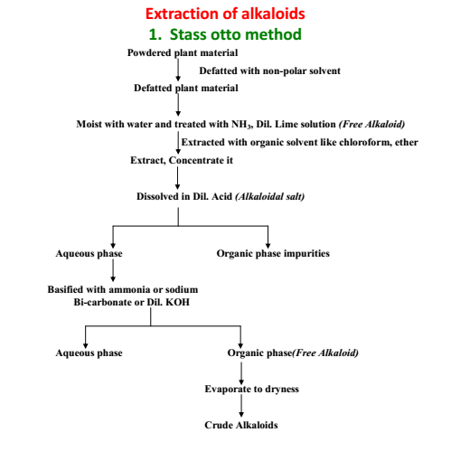

Slide 11
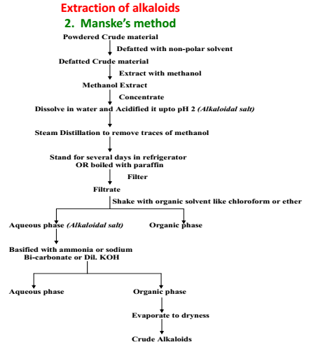

Slide 12
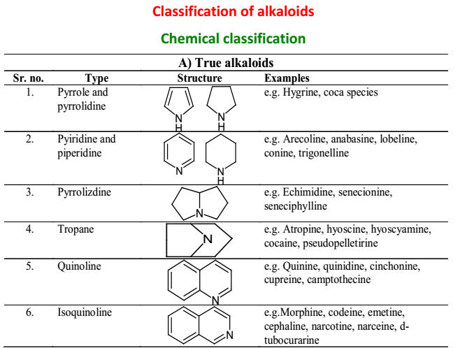

Slide 13
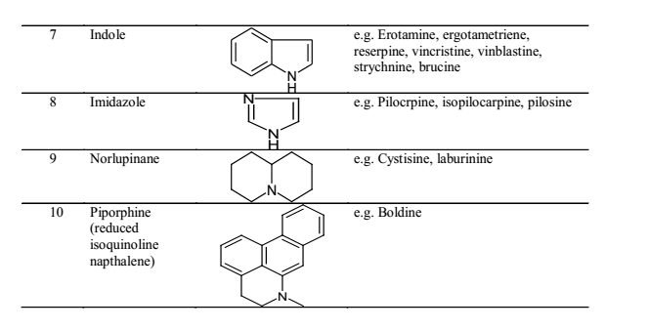

Slide 14
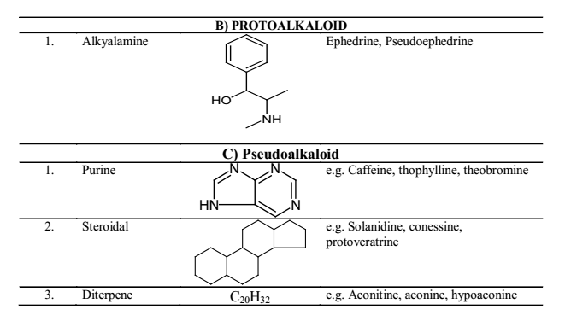

Slide 15
Pharmacological classification
Narcotic analgesic e.g.Morphine
Antimalerial e.g. Quinine
Reflux excitability e.g.Strychnine
Respiratory stimulant e.g.Lobeline
Neuralgia e.g. Aconitine
Oxytocic e.g. Erogotometrine
Bronchodilator e.g. Ephedrine, vasicine
Anticholinergic e.g. Atropine
CNS stimulant e.g. Caffeine
Antitussive e.g. Codeine
Antiarrythmic e.g.Quinidine
Antihypertensive e.g. Reserpine
Anticancer e.g. Vincristine
Antiglucoma e.g. Pilocarpine

