Slide 1
SPECTROSCOPY Tools for Structure Determination

Slide 2
Introduction
Spectroscopy: the study of the interaction of energy with matter
Energy applied to matter can be absorbed, emitted, cause a chemical change, or be transmitted
Spectroscopy can be used to elucidate the structure of a molecule
Examples of Spectroscopy
Infrared (IR) Spectroscopy
Infrared energy causes bonds to stretch and bend
IR is useful for identifying functional groups in a molecule
Nuclear Magnetic Resonance (NMR)
Energy applied in the presence of a strong magnetic field causes absorption by the nuclei of some elements (most importantly, hydrogen and carbon nuclei)
NMR is used to identify connectivity of atoms in a molecule
Mass Spectrometry (MS)
Molecules are converted to ions by one of several methods (including bombardment by a beam of electrons)
The ions formed may remain intact (as molecular ions, M+), or they may fragment
The resulting mixture of ions is sorted by mass/charge (m/z) ratio, and detected
Molecular weight and chemical formula may be derived from the M+ and M+1 ions
Molecular structure may be deduced from the distribution of fragment ions

Slide 3
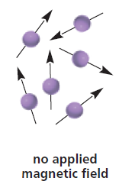
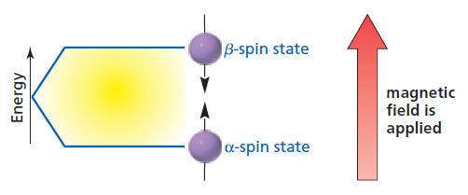
Nuclear Magnetic Resonance (NMR) Spectroscopy
NMR spectroscopy membantu mengidentifikasi kerangka (framework) carbon-hydrogen dari suatu senyawa organik
Didasarkan pada penyerapan gelombang radio oleh inti-inti tertentu dalam molekul organik, apabila molekul ini berada dalam medan magnet yang sangat kuat.
Inti tertentu menunjukkan perilaku seolah-olah mereka berputar (spin), karena inti bermuatan → menciptakan medan magnet

Slide 4
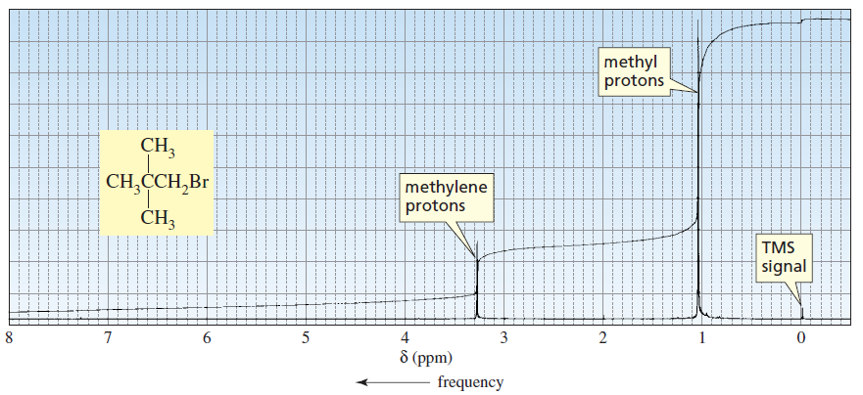
Contoh Spektra H-NMR → sinyal NMR

Slide 5
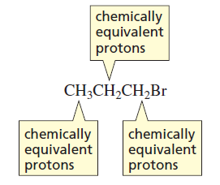
The number of signals
Protons in the same environment are called chemically equivalent protons
Each set of chemically equivalent protons in a compound gives rise to a signal in the ¹H-NMR spectrum of that compound

Slide 6
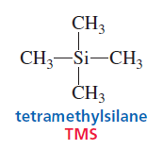
Chemical Shift / Pergeseran Kimia : Peak Position in an NMR Spectrum
Tidak semua inti H membalikkan spinnya tepat sama dengan frekuensi radio → adanya perbedaan lingkungan kimianya dalam molekul
Posisi dimana muncul sinyal pada spektrum NMR dianamakan chemical shift (pergeseran kimia). Pergeseran kimia merupakan ukuran seberapa jauh sinyal dari sinyal standar TMS
The most common scale for chemical shifts is the δ (delta) scale. The TMS signal is used to define the zero position on this scale

Slide 7
Chemical Shift Equivalent and Nonequivalent Protons
To predict the number of signals to expect in an NMR spectrum it is necessary to determine how many sets of protons are in unique environments
Chemically equivalent protons are in the same environment and will produce only one signal

Slide 8
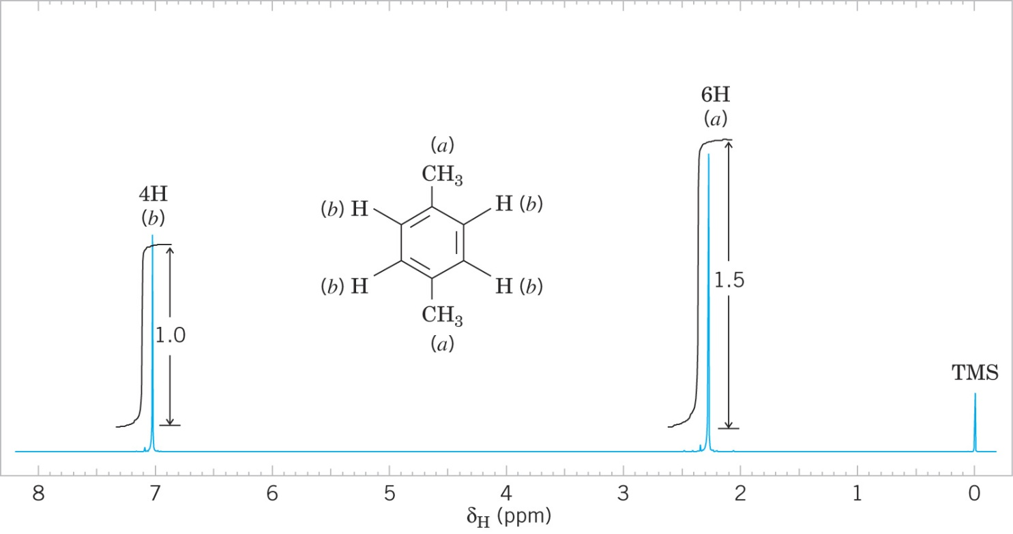
Example: 1,4-dimethylbenzene
The spectrum is measured on a delta (δ) scale in units of parts per million (ppm)
Frekuensi terbesar → sebelah kiri spektrum, absorbsinya disebut “medan bawah” (downfield)
Frekuensi terkecil → sebelah kanan spektrum, absorbsinya disebut “medan atas” (upfield)
The small signal at δ 0 (nol) corresponds to an internal standard (reference) called tetramethylsilane (TMS) used to calibrate the chemical shift scale
The number of signals in the spectrum corresponds to the number of unique sets of protons
1,4-dimethylbenzene has protons in two unique environments and so shows two signals

Slide 9
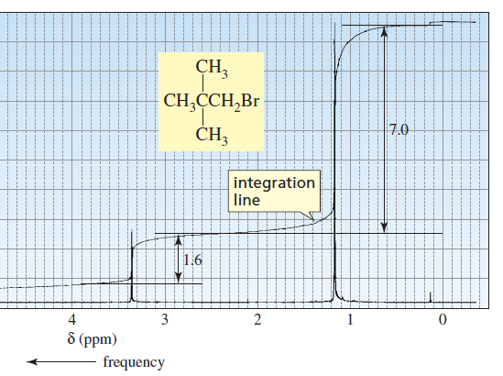
Integration of Peak Areas. The Integral Curve
Area di bawah puncak (luas puncak) berbanding lurus dengan jumlah inti H pada masing-masing lingkungan kimia dalam molekul itu (tinggi puncak proporsional dengan luas puncak)

Slide 10
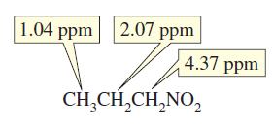
Faktor yang mempengaruhi pergeseran kimia :
Gugus penarik elektron (elektronegatif) biasanya menyebabkan pergeseran kimia medan bawah
Keberadaan elektron phi. H yang melekat pada C ik. Majemuk/cincin aromatik muncul di medan bawah dari H pada C jenuh

Slide 11
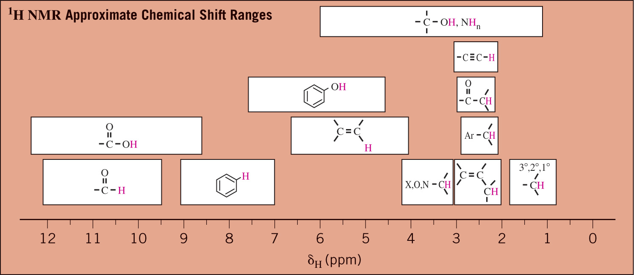
Pergeseran kimia H-NMR

Slide 12
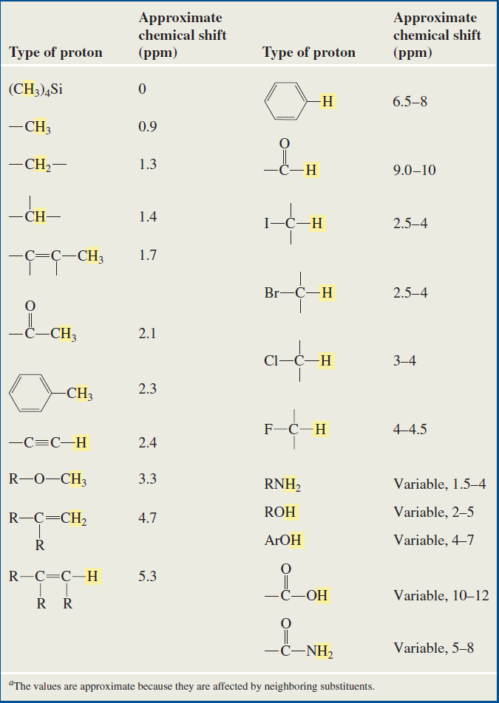

Slide 13
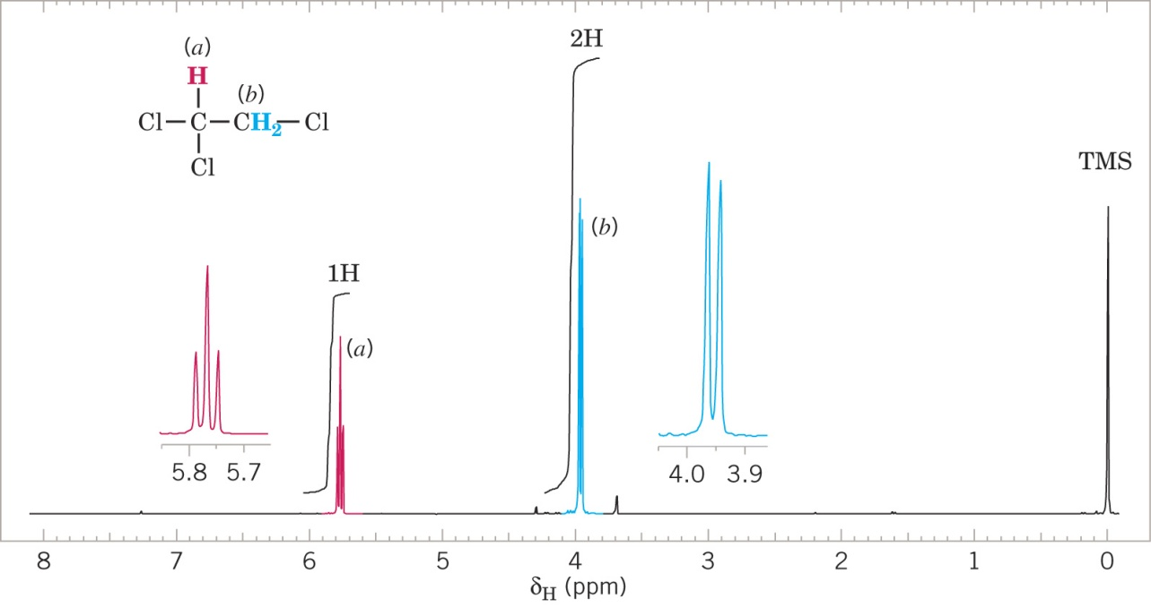
Signal Splitting
Sinyal NMR bisa terjadi pembelahan akibat efek dari medan magnet yang berhubungan dengan proton dari karbon yang berdekatan (bertetangga)
Characteristic peak patterns result from signal splitting that are related to the number of protons on adjacent carbons
Signal splitting occurs only when two sets of protons have different chemical shifts (i.e., are not chemical shift equivalent)
Example: 1,1,2-trichloroethane

