Slide 1
Transcutaneous Electrical Nerve Stimulation (TENS)

Slide 2
Definition
Generally TENS is applied at high frequency (>50 Hz) with an intensity below motor contraction (sensory intensity) or low frequency (<10 Hz) with an intensity that produces motor contraction.

Slide 3
Mechanism of Pain:
Pain is felt as a result of the brain's response to electrical (neural) and chemical (hormonal) changes in the body as a result of damage.
Signals from damage or injury are picked up by sensory receptors in nerve endings. The nerves then transmit the signal via the nerves to spinal cord and brain.

Slide 4
Mechanism of Pain:

Slide 5
Pain Relief:
Pain can be managed in the short term using analgesics, but long-term use can be detrimental to the patient's health.
Side effects of the long use of analgesics may affect on liver, kidney or stomach.
In many cases where pain is constant, a medical practitioner or physiotherapist may recommend the use of a TENS unit.
Why TENS?
Because it is safe, effective and virtually with no side effects.

Slide 6
Functions and Features of TENS:
A TENS unit provides electrical stimulation to the painful area using electrodes attached to the skin.
Some scientists say:
electrical signal
v
nerve sensation stops
v
natural pain relieving substances (endorphins)
v
no pain massages to brain
v
no pain.

Slide 7
Features:
1- Two different modes:
a- Continuous (continuous stream)
b- Intermittent (short bursts)
Usually the continuous mode is used but for long term treatment intermittent mode is used
2- Adjustable.
We can control three variables:
a- Output voltage.
b- Width of the pulses.
c- Pulse rate.

Slide 12
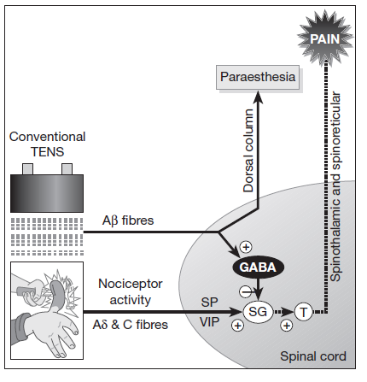
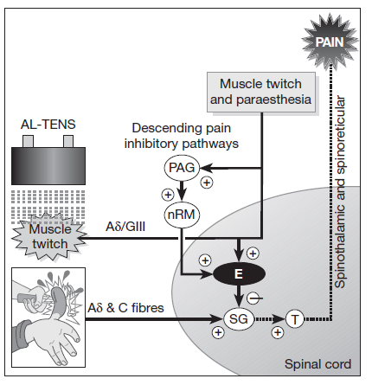

Slide 15
Therapeutic Uses of Electrical Stimulation of Sensory Nerves – Asymmetric Biphasic Currents (TENS)
Gate Control Theory
Descending Pain Control
Opiate Pain Control

Slide 16
TENS & Gate Control Theory
Provide high frequency sensory level stimulation to stimulate peripheral sensory Aβ fibers and “close gate”
Referred to as conventional, high frequency or sensory-level TENS
Intensity is set at a level to cause tingling sensation without muscle contraction
Pain relief lasts only while stimulation is provided

Slide 17
TENS & Descending Pain Control
Intense electrical stimulation of smaller peripheral Aδ and C fibers through input to the CNS causes a release of enkephalins blocking pain at the spinal cord level
Cognitive input from the cortex relative to past pain perception also contributes to this mechanism
Low-frequency or motor-level TENS is used → elicits tingling and muscle contraction
Provides pain relief >1 hour

Slide 18
TENS & Endogenous Opiate Pain Control
Noxious stimulus causes release of β–endorphins and dynorphin resulting in analgesia
A point stimulation set-up must be used
β–endorphin stimulation may offer better relief for deep aching or chronic pain
Intensity of impulse is a function of pulse duration and amplitude
Greater pulse width is more painful

Slide 19
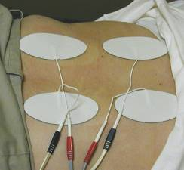
Electrode Placement
Electrodes may be placed:
On or around the painful area
Over specific dermatomes, myotomes, or sclerotomes that correspond to the painful area
Over trigger point locations

Slide 20
Mechanisms of Pain Control
Gate control theory
Descending mechanisms(Central Biasing)
Release of endogenous opioids (ß-endorphin)
Pain relief may result from combination of these 3 mechanisms

Slide 21
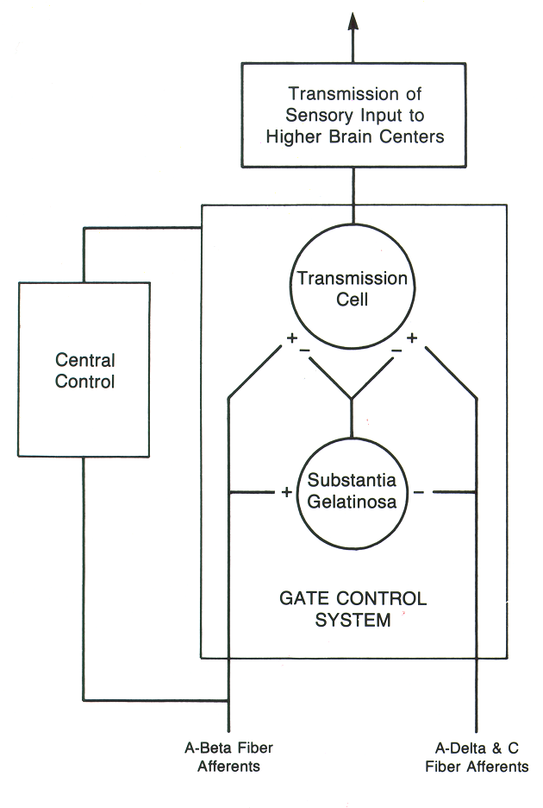
Gate Control Theory
Information from ascending Aβ afferents and (pain messages) carried along Aδ and C afferent fibers enter the dorsal horn

Slide 22
Gate Control Theory
Impulses stimulate the substantia gelatinosa at dorsal horn of the spinal cord inhibiting synaptic transmission in Aδ & C fiber afferent pathways

Slide 23
Gate Control Theory
Sensory information coming from Aβ fibers is transmitted to higher centers in brain
“Pain message" carried along Aδ & C fibers is not transmitted to second-order neurons and never reaches sensory centers

Slide 24
Descending Pain Control Mechanisms
Stimulation of descending pathways in the dorsolateral tract of the spinal cord by Aδ and C fiber afferent input results in a “closing of the gate” to impulses carried along the Aδ and C afferent fibers

Slide 25
Descending Pain Control Mechanisms (Central Biasing)
It is theorized that previous experiences, emotional influences, sensory perception, and other factors could influence transmission of pain message and perception of pain

Slide 26
Descending Pain Control Mechanisms
Ascending neural input from Aδ and C fiber afferents and possibly central biasing stimulates periaquductal grey region in midbrain which stimulates raphe nucleus in pons and medulla thus activating descending mechanism in dorsolateral tract

Slide 27
Descending Pain Control Mechanisms
Efferent fibers in dorso- lateral tract synapse with enkephalin interneurons
Serotonin is a neuro-transmitter
Interneurons release enkephalin into the dorsal horn, inhibiting the synaptic transmission of impulses to second-order afferent neurons

Slide 28
Descending Pain Control Mechanisms
A second descending, pathway projecting from the pons to the dorsal horn has been identified
Thought to inhibit transmission due to release of norepinephrine

Slide 29
β-Endorphin and Dynorphin
Stimulation of Aδ and C afferents can stimulate release of endogenous opioid ß-endorphin from hypothalamus
Dynorphin released from periaqueductal grey
Dynorphin
released

Slide 30
Mechanisms of Pain Control
The theories presented are only models
Pain control is the result of overlapping mechanisms
Useful in conceptualizing the perception of pain and pain relief

Slide 31
Pain Management
Therapeutic modalities can be used to
Stimulate large-diameter afferent fibers( TENS, massage, analgesic balms)
Decrease pain fiber transmission velocity (cold, ultrasound)
Stimulate small-diameter afferent fibers and descending pain control mechanisms (accupressure, deep massage, TENS)

Slide 32
Pain Management
Therapeutic modalities can be used to
Stimulate release of endogenous opioids through prolonged small diameter fiber stimulation with TENS

