Slide 1
Basic Electricity
Muthiah M

Slide 2
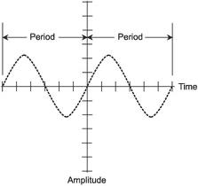
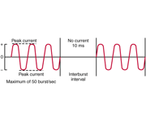
Atom merupakan molekul terkecil yang mengandung ion (+,-)
Atom move ( High to Low Concentration)
Proses perpindahan concentration dinamakan Electrical Potensial
3 Type Of Current:
a. Alternating Current (AC)
b.Direct Current ( DC )
c.Polyphasic
a
c
b

Slide 3
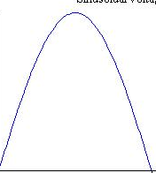
3 Type Waveform:
a.Rectangular
b.Sine
c.Triangular
b
c

Slide 4
Respon Perubahan Fisiologi
I Celluler : - Peningkatan aktifasi cell nerve
- Perubahan Permeabilitas Membran
- Sintesa Protein
- Stimulati Fibroblast, Osteoblast
- Sirkulasi of cell
II Tissue : - Contraction Muscle Skeletal
- Contraction Smooth Muscle
- Tissue Regeneration
III Segmental: - Muscle Pump Tp change Circulation & Lymph
- Meningkatkan aliran Protein ke salurran Lymph
IV System: - Analgesic

Slide 5
Penempatan PAD Electrode
- Positive Elektrode = Anode (Red) Proximal
- Negative Elektrode = Catode (Black) Distal

