Slide 1
Skin Graff

Slide 3
A skin graft is a patch of skin that is removed by surgery from one area of the body and transplanted, or attached, to another area.
Skin grafts may be recommended for:
infection that caused a large amount of skin loss
Burns
Skin cancer surgery
Venous ulcers, pressure ulcers, or diabetic ulcers that do not heal

Slide 4
Risks for this surgery are:
Bleeding
Chronic pain (rarely)
Infection
Loss of grafted skin (the graft not healing, or the graft healing slowly)
Reduced or lost skin sensation, or increased sensitivity
Scarring
Skin discoloration
Uneven skin surface

Slide 5
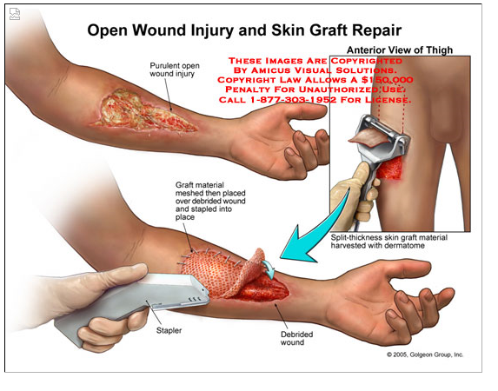

Slide 6
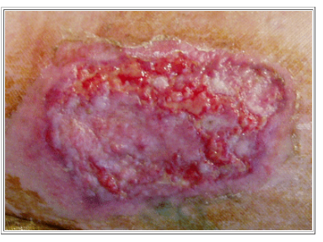
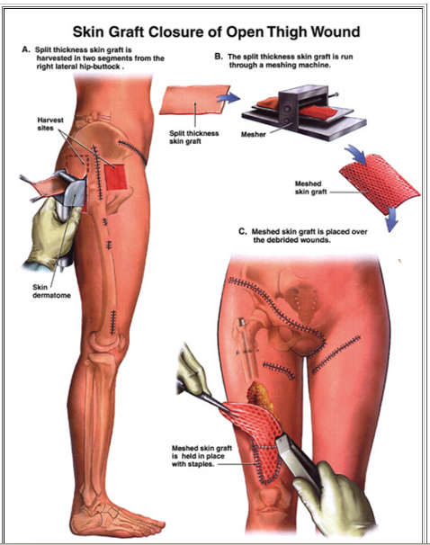

Slide 7
autograft - A tissue or organ grafted into a new position in or on the body of the same individual; the most desirable source for skin grafting in burns, if possible, because no rejection will occur.
isograft - A graft of tissue that is obtained from a donor genetically identical to the recipient for which no rejection will occur.
allograft = homograft - A tissue or organ transplanted from a donor of the same species but different genetic makeup; the recipient's immune system must be suppressed to prevent rejection of the graft.
xenograft = heterograft - A type of tissue graft in which the donor and recipient are of different species; most often restricted to temporary grafting (as in cases of severe burns) because the recipient's immune system must be suppressed to prevent rejection of the graft.

Slide 8
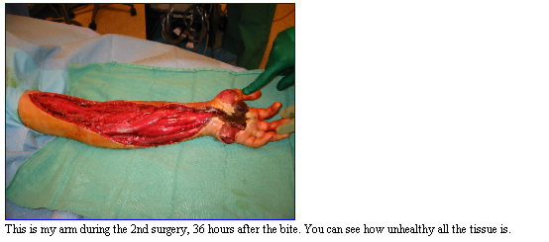
History skin graf

Slide 9
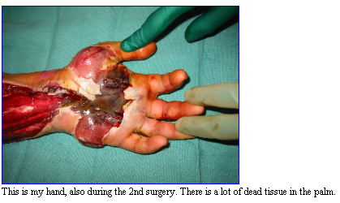

Slide 22
Next case

Slide 26
