Slide 1
SURVEY KONSUMSI PANGAN
PERTEMUAN 11
DUDUNG ANGKASA
PROGRAM STUDI ILMU GIZI-FIKES

Slide 2
VISI DAN MISI UNIVERSITAS ESA UNGGUL

Slide 3
KEMAMPUAN AKHIR YANG DIHARAPKAN
Mahasiswa dapat menjelaskan prinsip, kelebihan dan kekurangan dan pelaksanaan household food account

Slide 4
Households
Food Account
Record detail of food quantities: purchasing, home produced, gift, and from other sources
No account of food stock is taken
Inventory Method
Similary to food account but consider the stored food
Household record
The foods presented for consumption to HH members are weighed or estimated in household measures (URT)
Appropriate for home produce population e.g farmer

Slide 6
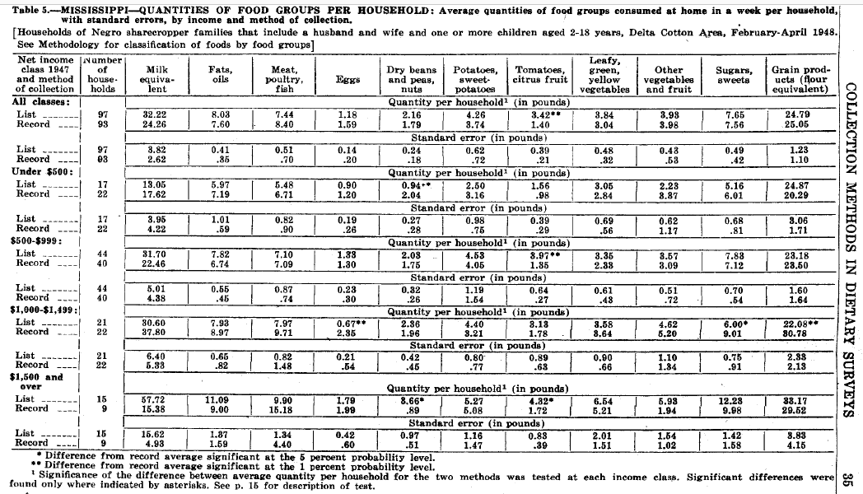

Slide 7
Thank You

