Slide 1
SURVEY KONSUMSI PANGAN
PERTEMUAN 5
DUDUNG ANGKASA
PROGRAM STUDI ILMU GIZI-FIKES

Slide 2
VISI DAN MISI UNIVERSITAS ESA UNGGUL

Slide 3
KEMAMPUAN AKHIR YANG DIHARAPKAN
Mahasiswa dapat menjelaskan prinsip food record

Slide 4
Methods for measuring food consumption

Slide 5
Food Records: principles and uses
Two types:
Estimated Food Records
Weighed Food Records (Weighed Diet Record, WDR)
Principle and Uses:
Based on recording portion sizes of actual foods consumed by an individual, estimated using household measures or weighed using dietary scales.
Weighed Food Records → ideal for scientific and controlled studies in particular when diet counseling or correlations of intake with biological parameters are involved.
Uses: research, multi-center epidemiological studies, for controlled metabolic studies.
Weighed food record → respondents must be motivated, numerate and illiterate.

Slide 6
Food records: procedures
1. Respondent records (or measurer weighs), at the same time of consumption, all foods and beverages (including snacks) eaten in household measures, for a specified time period.
2. Recorded:
detailed description of the food/drinks/ supplements/ condiments
amounts consumed (portion served minus left over) or estimate using household measures and calibrated household utensils
If occasional meals are eaten away from home, respondents are generally requested to record descriptions of the amounts of food eaten. The nutritionist can then buy and weigh a duplicate portion of each recorded food items, where possible, to assess the probable weight consumed.

Slide 7
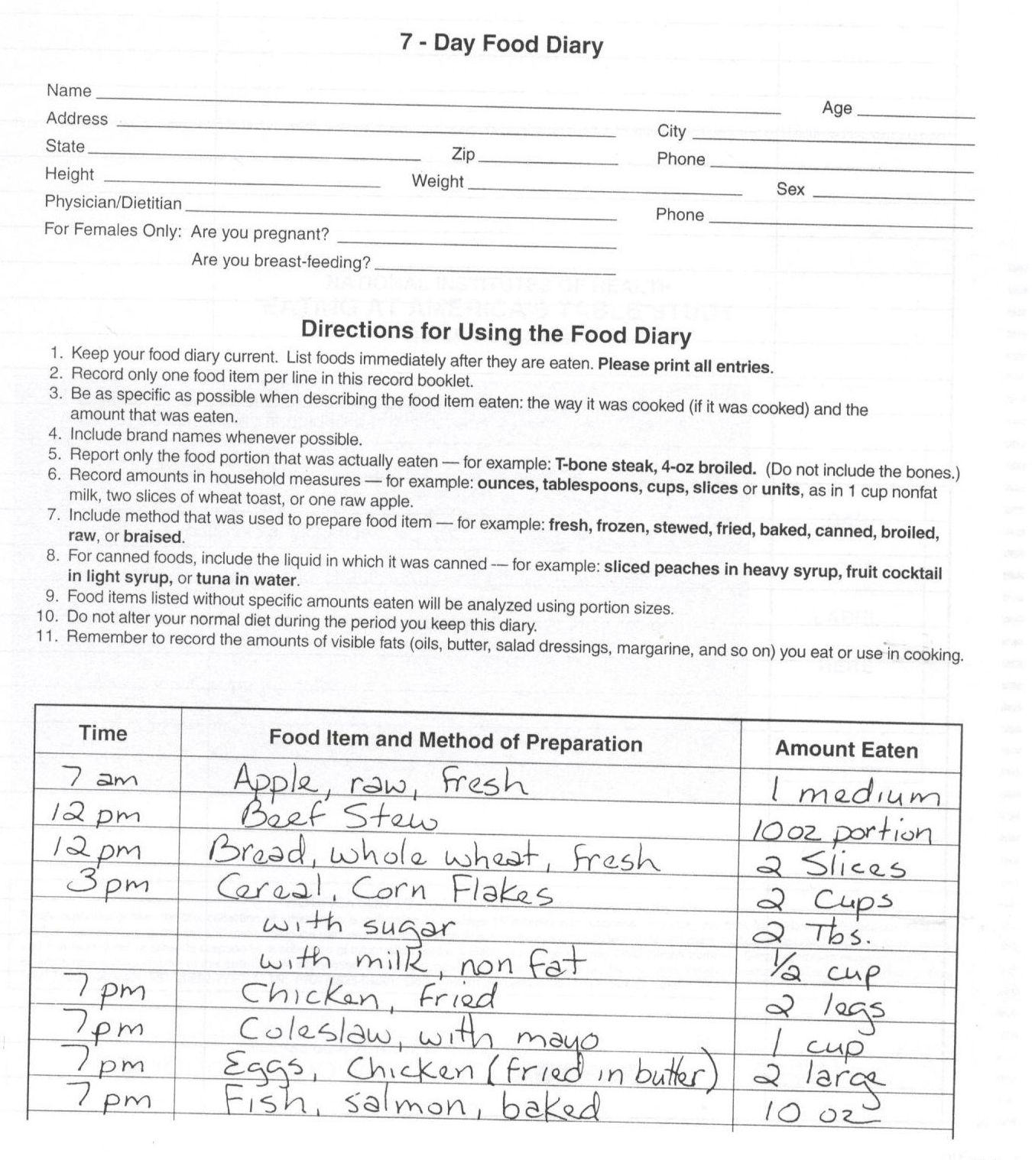

Slide 8
Tugas
Tugas bersifat individu
Tiap individu melakukan food record (FR) selama dua hari
Tiap item makanan diambil foto
Hasil FR diketik dalam format word sesuai format FR yang diberikan
Semua hasil FR dan foto-nya dikumpulkan dalam satu flash disk
Semua hasil FR (formulir) sudah dikumpulkan di meja sebelum dosen masuk.

