Slide 1
KONDISI FISIK DAN PROGRAM LATIHAN
PERTEMUAN IV
Mury Kuswari & Nazhif Gifari
Ilmu Gizi & FIKES

Slide 2
Endurance ???
Endurance
is the ability of one's organism to fight fatigue that arises
when running activities for a long time.
(Suharno, 1985)

Slide 3
Formulation of the problem
What is endurance and health?
What is relation of endurace training with heath?
What kind of endurance training?
What is benefit of endurance?

Slide 4
Purpose
Describe understanding endurance and strength.
Explain forms exercise endurance power.
Know the relationship between endurance and health

Slide 5
Capability of endurance power due to some of among others
Central nervous systems
Fighting power
Capacity aerobic
Capacity anerobik
Reserve speed
Intramuscular coordination
Reaction muscle to a stimulation of the nerves
Angles joints
the measurement of endurance power

Slide 6
Endurance and health
move a certain group of muscles continuously
blood circulation
good breathing
heart

Slide 7
“You can do a variety of exercises to keep the body fit and healthy and to keep your physical activity routine exciting”

Slide 8
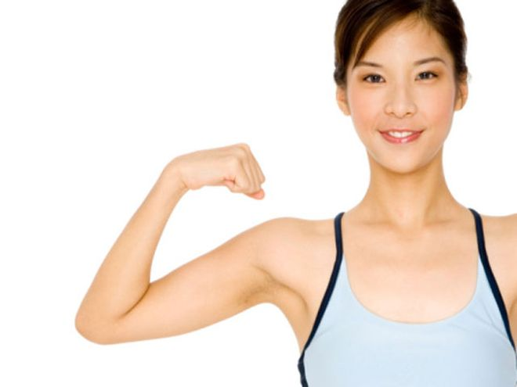
Benefit endurance
Inprove brainpowe
Increase endurance

Slide 9
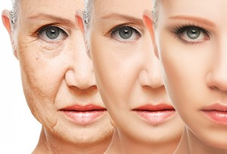
Slow the aging process
Eliminating the risk of stress
Forming the ideal body

Slide 10
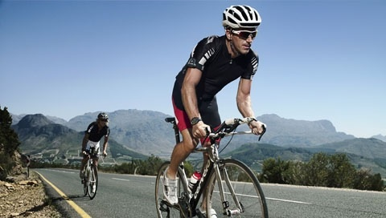
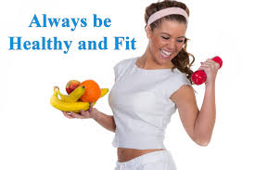
“The higher the person's endurance level the higher the physical fitness”

Slide 11
References
Irawadi, Hendri.Kondisi Fisik dan Pengukurannya. Padang: UNP Press Tahun 2013.
Sajoto. (1988). Pembinaan Kondisi fisik dalam olahraga. Jakarta: Depdikbud
Suharno. (1985). Ilmu Kepelatihan Olahraga. Yogyakarta : FPOK IKIP. Yogyakarta
Haskell, W.L., Lee, I.M., Pate, R.R., Powell, K.E., Blair, S.N. And Franklin, B.A. (2007) Physical activity and public health: updated recommendation for adults from the American College of Sports Medicine and the American Heart Association. Medicine & Science in Sports & Exercise 39, 1423-1434.
Kuno Hottenrott 1,2􀀍, Sebastian Ludyga 2 and Stephan Schulze 1,2 1 Department of Sport Science and 2 Institute of Performance Diagnostics and Health Promotion, Martin-Luther- University Halle-Wittenberg, Germany

Slide 12
Thank you ☺

