Slide 1
KONDISI FISIK DAN PROGRAM LATIHAN
PERTEMUAN V
Mury Kuswari & Nazhif Gifari
Ilmu Gizi & FIKES

Slide 2
Kinds of Endurance
general endurance
local endurance

Slide 3
General endurance
Namely the ability a person in have system the heart , the lungs and distribution his blood effectively and efficiently to run work continuously involving contraction a number of the muscles with high intensity long enough

Slide 5
simple example of general endurance

Slide 6
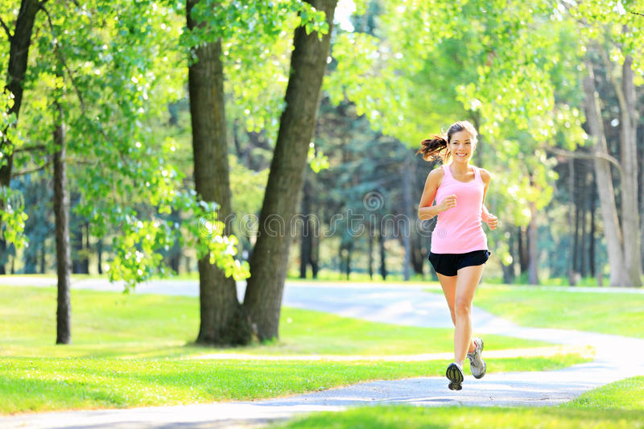
The types of exercise can increase endurance kerdiovaskuler
1) Jogging
2) Walk

Slide 7
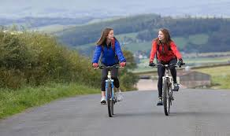
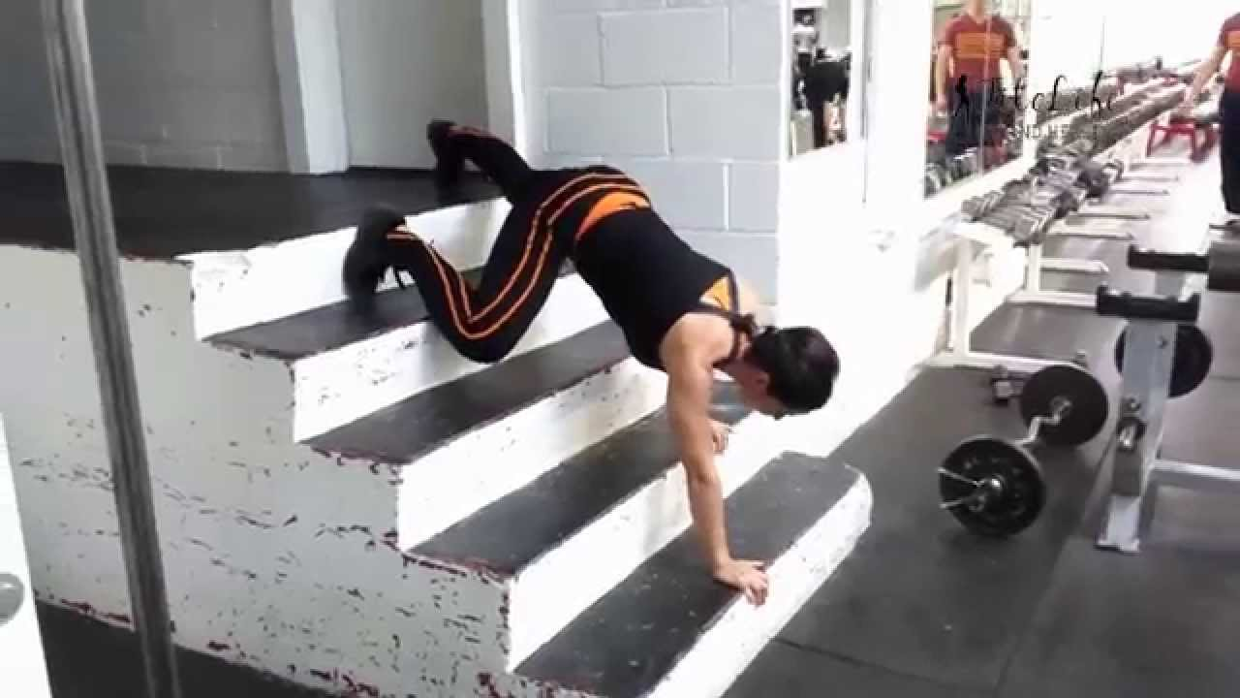
Advanced........
3) Cycling
4) Movement up and
down stairs

Slide 8
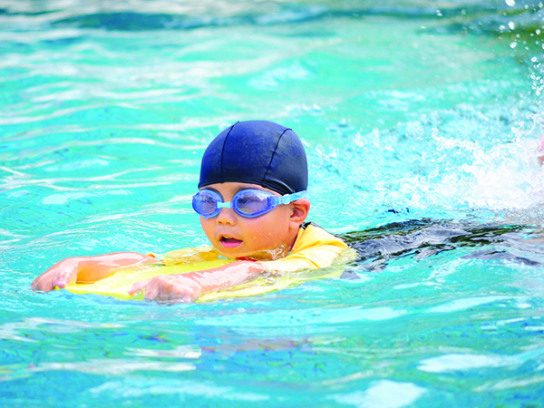
Anvenced......
5) Swimming

Slide 9
Local endurance
Namely the ability a person in have brawn to contract continuously in relatively a long time with a load certain

Slide 10
Divided into
Fartlek
The combination of run slow and a quick run that varies without any real break .Can be carried out in the field , rice fields / the field , and the regions being hilly
2) Cross country
Run long-distance across a natural hollow with speed is not too slowly and not really too fast

Slide 11
FACTORS INFLUENCE of ENDURANCE
Genetic
Age
Gender
Physical Activity
Smoking Habit

Slide 12
Endurance Exercise
The traits or exercises that can be applied to train general endurance are as follows:
Giving stimulus in one turn 60 seconds to 90 2.
Seconds low or medium intensity training
Load volume of training load, the pols beat of trainee after doing one unit of exercise increase and reach 120-140 times per minutes
The form of workload run in place or run by taking the distance with the interval method

Slide 13
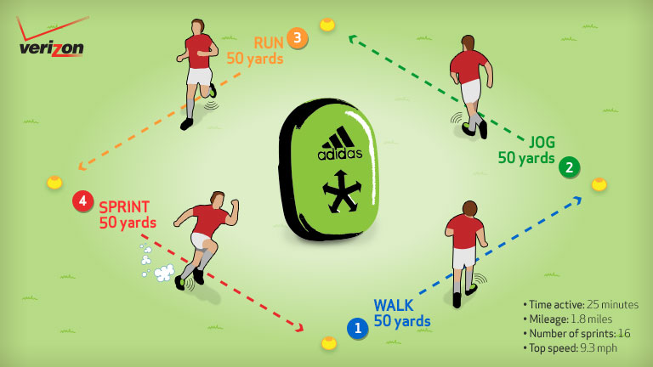
Shape of endurance training 1. Fartlek (speed play)

Slide 14
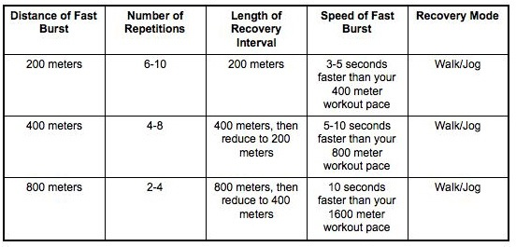

Slide 15
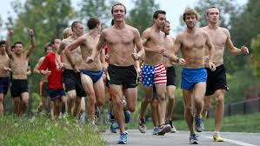
2. Cross country cross-country running is one of the long-distance running numbers conducted in the open field such as highways, mountains, settlements or forests

Slide 16
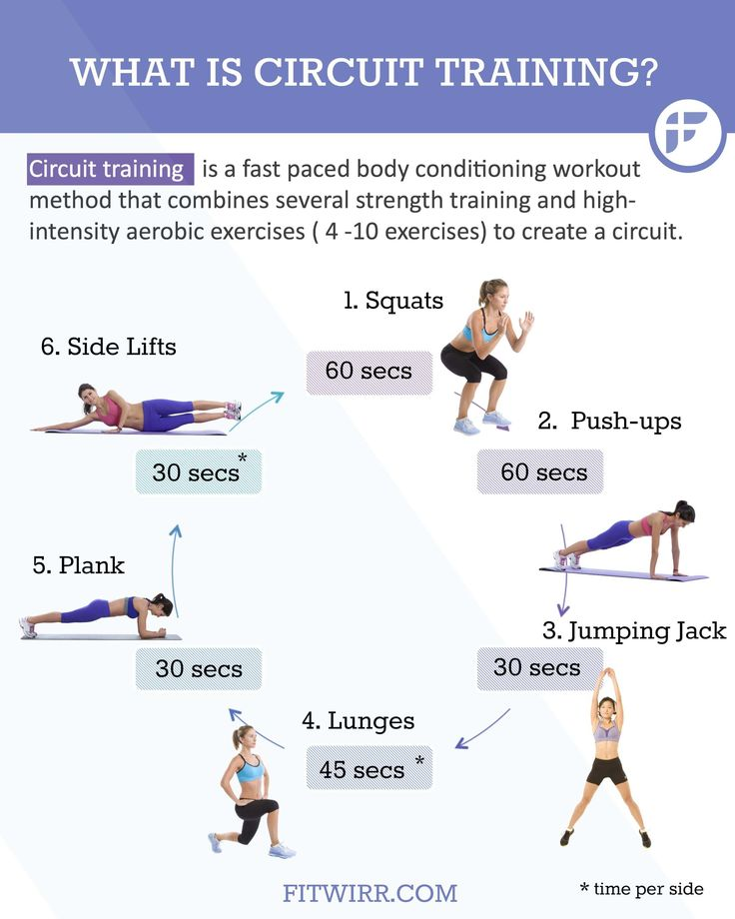
3. Circuit training

Slide 17
References
Irawadi, Hendri.Kondisi Fisik dan Pengukurannya. Padang: UNP Press Tahun 2013.
Sajoto. (1988). Pembinaan Kondisi fisik dalam olahraga. Jakarta: Depdikbud
Suharno. (1985). Ilmu Kepelatihan Olahraga. Yogyakarta : FPOK IKIP. Yogyakarta
Haskell, W.L., Lee, I.M., Pate, R.R., Powell, K.E., Blair, S.N. And Franklin, B.A. (2007) Physical activity and public health: updated recommendation for adults from the American College of Sports Medicine and the American Heart Association. Medicine & Science in Sports & Exercise 39, 1423-1434.
Kuno Hottenrott 1,2􀀍, Sebastian Ludyga 2 and Stephan Schulze 1,2 1 Department of Sport Science and 2 Institute of Performance Diagnostics and Health Promotion, Martin-Luther- University Halle-Wittenberg, Germany

Slide 18
Thank you ☺

