Slide 1
KONDISI FISIK DAN PROGRAM LATIHAN
PERTEMUAN VI
Mury Kuswari & Nazhif Gifari
Ilmu Gizi & FIKES

Slide 2
STRENGTH
Strength is ability of the human physical condition required in improving learning achievement of motion. Strength is a person's ability to awaken tension to a resistance. Strength is the result of muscle work of ability to lift, carry, withhold, push or pull loads

Slide 3
For sport in speed dominant very need parctice of strength. But not necessarily the trained of strength without taking the parameters and the flow of appropriate periodization.
Period of the strength practice consists of: 1. Anatomy Adaptation Phase 2. Maximum strength Phase 3. Conversion Phase 4. Maintenance Phase 5. Transition Phase

Slide 4
Factors Affecting Strength:
The Factor
Age
Gender
Food
Sleep & Rest

Slide 5
Each level of age has a different level of physical, then can be improved in almost all ages. Strength on physical body of the children increases until it reaches maximum at the age of 25-30 year.
Age
The level strength of men is usually better than woman strength levels. This is because physical activity performed by men more than women.
Gender

Slide 6
A balanced nutritional intake (12% protein, 50% carbohydrate, and 38% fat) will greatly affect the strength of a person. With a balanced nutrition, it is expected to be fulfilled nutritional needs of the body.
Food
Rest and sleep very important for the body to rebuild muscles after exercise for inner workouts stimulation growth of muscle. Rest and sleep are important for relaxing the mind and body.
Sleep and Rest

Slide 7
STRENGTH
8 Types of strength according to Bompa:
General strength
Specific strength
Maximum strength
Muscular endurance
Power
Absolut strength
Relative strength
Strength reserve

Slide 8
Strength Training
Strength Training is a physical exercise designed to improve muscle fitness, muscle strength, and power by training of muscles. Strength training can be done in various ways, there are:
Body Weight
Free Weight
Weight Machine

Slide 9
1. Body Weight
Body Weight is a strength training by using or against the burden of the body itself. Examples: push ups, crunches, squats, deadlifts and so on. The exercise is simple without the need for special tools or machines. Exercise of muscles and joints in this exercise more (multiple joint).

Slide 10
2) Free Weight
It is a strength training by using free weights with simple load tools such as dumbbell, barbell, or rubber band.
3) Weight Machine
It is a strength training by using tools or machines designed specifically for certain muscle groups. Example: Chest Press Machine, Leg curl machine, Pectoral Machine and so on. This exercise trains muscles more specifically.

Slide 11
Training of Strength
We recognize three kinds of strengths:
Maximal Strength
Speed Strength
Strength Endurance

Slide 12
Maximum Strength can be improved by 2 (two) ways:
The first: increase the muscle diameter, people believe if the diameter muscle increases, the muscle strength will be increased too. This method makes the muscle diameter becomes larger called the Hypertropie method.
The second: improving cooperation among muscle groups is also called improve Intramuscular Coordination , methods of improving intramuscular coordination is called the Neural Activation method.

Slide 13
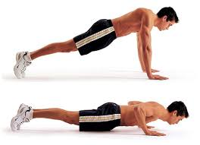
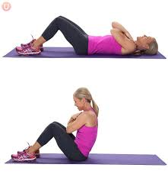
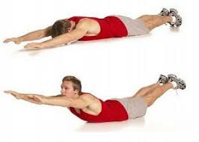
Excercise to improve the strength
Strength is the ability of the muscles to perform contractions in order arousing tension against a prisoner.
Strength training can be done with a variety of movements there are :

Slide 14
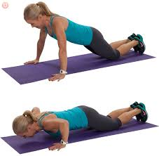
1. Push Up
Purpose of push ups to increase arm muscle strength.
How to do push ups:
Perform sleeping movements face down, both feet straight together backward with the foot resting on the floor.
Place both palms beside the chest, position both elbows bent and fingers headed forwards.
Body lifted up to both hands straight. In this movement, body position and legs straight.
Lower the body back by bending both elbows. In this movement, the body and both legs remain straight and not touching the floor.
This movement is performed repeatedly for 10-15 minutes.

Slide 15
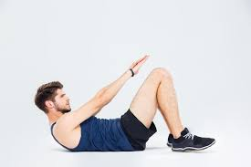
2. Sit Up
The purpose of sit ups to strengthen the abdominal muscles.
How to do sit ups:
Students in pairs, one of the students doing sit ups and his partner was holding his friend's legs.
At first one of the students sleeps on his back, both legs are bent, and both hands are placed at front of the chest.
The next movement of the body is lifted up, up into position sit.
This movement is repeated for 15-20 seconds.

Slide 16
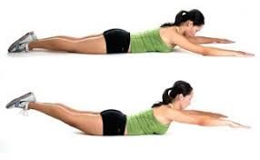
3. Back Up
The purpose of backing up to strengthen the back muscles. How to back up as follows:
First lie face down, position both legs tightly, and both hands clinging to the back of the head.
Lift the body up with the chest position not touching to the floor.
Movements are done repeatedly for 10-20 seconds.

Slide 17
HEALTH OF SPORT
Sports health is required for optimal physical health and strength by exercising physically well, correctly, measurably, regularly and continuously in improving the quality and productivity of human resources work. Sports for health is a form of sport for health purposes, with sports activities that work on body. Health Efforts that take advantage of exercise or physical exercise to improve health status

Slide 18
The scope health of sport
Promotive approach to improving physical fitness
The approach preventive to prevent the onset of disease and slow the aging process.
Approach curative properties for an alternative to the healing of disease
The approach with rehabilitative to restore impaired bodily functions due to defect.

Slide 19
The target health of sport
goals that want to be treated through sports health efforts include:
increased management capabilities of the organization and development of sports health efforts
increased coverage and quality of public health services
increasing the culture of society to do physical exercise / sport well, rightly, measurably, and regularly

Slide 20
General characteristics of sports for health:
1. Mass
sports health should be able to accommodate a large number of participants together.
2. Easy
easy to follow the movement followed by all participants.
3. Benefits
the benefit can be feel by all people and safety to all participants

Slide 21
The type sport for health
1. Aerobic
Which is a continuous exercise where the needs of oxygen can still be met by the body
2. Anaerobic
is sports where oxygen demand can not be fulfilled entirely by the body

Slide 22
Sport Activity of Health
Life is active by doing the activity light for 10 minutes several times each day
To be healthy by doing the activity during 30 minutes every day
The physical exercise to fit by doing the activity was for 20 minutes, three time a week
The physical exercise for the sport depends on the level of physical health

Slide 23
Health benefits of exercise
Increasing metabolism to prevent obesity and maintain ideal body weight
Increasing the power of muscle and bone density
Increasing work and functions of the heart, lung and blood vessels
Reduce the risk of diseases such as high blood pressure, coronary hearth disease, cholesterol, diabtes, etc
Increasing the activity of immune response to disease

Slide 24
Exercise is good for health
Sports that start from an early age to old age
Exercise should be varied and favored
Performed gradually starting from heating with 10-15 minutes stretch. This exercise followed 20-60 minutes and ended cooling

Slide 25
Tittle : Strength And Health
Outcomes :
students are able to understand what is meant by strength and health
students are able to understand the factors affecting the power
students are able to understand what are the exercises to increase strength
students are able to understand the scope of health in sports
students are able to understand the advantage of exercise for health

Slide 26
Reference :
www.perpustakaan.depkes.go.id : http://perpustakaan.depkes.go.id:8180/bitstream/123456789/758/13/Bab%20II%20Halaman%207%20-%2013.pdf
http://staff.uny.ac.id/sites/default/files/pendidikan/dr-muhammad-ikhwan-zein-spko/bahan-ajar-ilmu-kesehatan-or.pdf
https://online-journal.unja.ac.id/index.php/csp/article/view/.../631
http://www.kesjaor.kemkes.go.id/documents/Kebijakan-Penyelenggaraan-Kesjaor-Rakontek-Kesmas-2017-1.pdf
http://staffnew.uny.ac.id/upload/131808341/pendidikan/kesehatan+olahraga.pdf
http://file.upi.edu/Direktori/FPOK/JUR._PEND._OLAHRAGA/197103282000121LUCKY_ANGKAWIDJAJA_RORING/OLAHRAGA_DAN_OLAHRAGA_KESEHATAN.pdf
http://staff.uny.ac.id/sites/default/files/Teori_latihan_9.pdf

Slide 27
THANK YOU

