Slide 1
KONDISI FISIK DAN PROGRAM LATIHAN
PERTEMUAN IX
Mury Kuswari & Nazhif Gifari
Ilmu Gizi & FIKES

Slide 2
Training Programs
In general we know the term training and exercise. Although it has the same meaning, but the meaning is different.
Exercise is a physical activity performed with the aim of obtaining the desired outcome directly
Training is a program or pattern of training that designed systematically and performed reapetedly to improve skills or improve physical conditions with a specific purpose

Slide 3
Factors That Affect the
Quality of Training

Slide 4
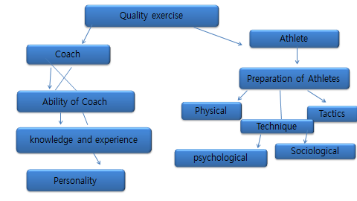

Slide 5
The Purpose of Training Programs
The Purpose of training program is to help the athlete improve his or her skills and accomplishments to the maximum as possible. This is some important aspect for achieve that purpose.
Physical Training
Tactic Training
Technical Training
Mental Training

Slide 6
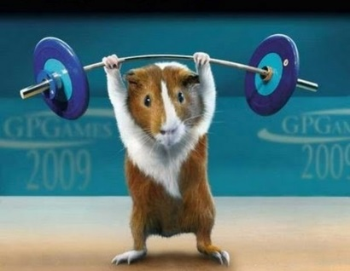
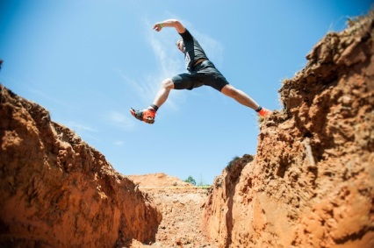
Physical Training
The component to be trained and developep are :
Strength
Speed
Durability
Agility

Slide 7
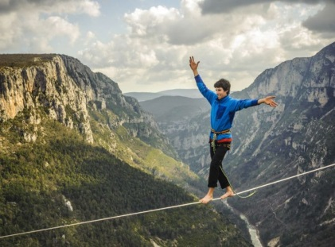
Flexibility
Balance
Power
Technical Training
The function of technical training is to advanced the technique of athletes

Slide 8
Tactic Training
The function of tactic training is to develop interpretative of athletes
Mental Training
The function of mental training is to improve development of athlete's maturity and
emotional

Slide 9
Benefits of Training Programs
Preparation the training program is a guideline for the leadership of organized activities to achieve the peak performance of a sport
2. To avoid the fit factor in achieving excellence in sports
3. Effective and efficient in the use of time, funds, energy to achieve goals

Slide 10
4. Training program will clarify the direction and goals to be achieved.
5. As control tool a predetermined target has been reached or not

Slide 11
Principle of Training Programs
Duration of training
The amount of time spent training. For example, the exercise at
14.00-17.00 o’clock means the duration of exercise is 3 hours
Volume of training
The amount of time spent active during the exercise. For example
exercise at 14:00 -17:00 o’clock and rest 1 hour then the volume of
exercise is 2 hours
Intensity of training
The weight or lightness of the training load provided by the trainer.

Slide 12
Overload
The exercises given should be heavier than the ability of the athlete
Comprehensive development
Although one ultimately has a specialization of skills, it is preferable at
the beginning of the exercise to be involved in various aspects of the
activity so that during the specialization period it has solid foundations
Specialization
Specialization means devoting all abilities, both physical and psychic in a particular branch
Individualization
Individualization should be applied to every athlete even though it has
the same level of achievement, the whole concept of the exercise should be
tailored to the specificity of each individual so that the goal of the
exercise can be achieved

Slide 13
Various of Sport Training Programs
There are 3 kinds of sports training programs that can be used for a
championship or match event. The choice of training program is
determined by the time held before the championship takes effect.
The type of exercise program is a long-term, cheap and short-term
training program.
The three kinds of training programs we can choose as a coach adjusted to the timing of the preparation of the championship event to be
followed.

Slide 14
Long-term program (5 - 12 years).
The purpose of the long-term plan is the ultimate goal to achieve
high achievement.
2. Medium term program (2 - 4 years).
As mentioned in the above paragraph, that medium-term plan is a
long-term direct implementation

Slide 15
3. Short-term program (≤1 year)
Short-term program is the operational implementation of the
medium-term plan. The training objectives are the objectives of the medium-term program.
Short-term plans consist of:
* Annual training program (macro cycle)
* The monthly training program (messo cycle)
* Weekly training program (micro cycle)
* Daily exercise program (myo cycle)

Slide 16
Title : Training Programs I
Outcome :
Definition of training Programs
Factors That Affect the Quality of Training
The Purpose of Training Programs
Benefits of Training Programs
Principle of Training Programs
Various of Sport Training Programs

Slide 17
Source :
https://www.apki.or.id/panduan-mudah-menyusun-program-latihan/
https://www.hiithighintensityintervaltraining.ga/2015/07/Cara-Menyusun-Program-Latihan-Untuk-Para-Pelatih-Olahraga.html
https://sehatafiat.com/bentuk-latihan-kebugaran-jasmani/
Bompa.O, Tudor. 2015. Periodization : Theory and Methodology of Training. Canada
Sukadiyanto, 2010. Pengantar Teori dan Metodologi Melatih Fisik, CV. Lubuk Agung. Bandung.

Slide 18
THANK YOU

