Slide 1
Pertemuan 4
INTERAKSI OBAT, SUPLEMEN DAN MAKANAN
PADA LANSIA
Anugrah Novianti, SGz, M.Gizi
PROGRAM STUDI ILMU GIZI
FAKULTAS ILMU-ILMU KESEHATAN

Slide 2
Effects Of Drugs On Food And Nutrition
Nutrient Absorpstion
Medication can decrease or prevent nutrient absorption. Chelation reactions between medications and minerals (metal ions) reduce the amount of mineral available for absorption.
An example is tetracycline and ciprofloxacin, which chelate calcium found in supplements or in dairy products such as milk or yogurt.
Drugs that affect intestinal transport mechanisms include : (1)colchicine , (2) sulfasalazine (Azulfidine), (3) trimethoprim and (4) antiprotozoal agent pyrimethamine (Daraprim).

Slide 3
Nutrient Metabolism
Drugs may increase the metabolism of a nutrient, potentiating excretion and resulting in higher nutrient requirements. Drugs may cause vitamin antagonism by blocking conversion of a vitamin to the active form.
Anticonvulsants phenobarbital and phenytoin induce hepatic enzymes and increase the metabolism of vitamins D, K, and folic acid. Supplementation of these vitamins often is prescribed with phenobarbital and phenytoin.
Carbamazepine (Tegretol) has been reported to affect the metabolism of biotin, vitamin D, and folic acid, leading to possible depletion. Regular measurement of vitamin D levels and supplementation are recommended with carbamazepine.

Slide 4
Nutrient Excretion
Drugs can increase the excretion of a nutrient by interfering with nutrient reabsorption by the kidneys. For instance, loop diuretics including furosemide (Lasix) and bumetanide (Bumex) can increase the excretion of potassium while also increasing the excretion of magnesium, sodium, chloride, and calcium
Prolonged use of high-dose diuretics, particularly by older patients on low-sodium diets, can cause sodium depletion.
Hyponatremia may be overlooked in older patients because the mental confusion that is symptomatic of sodium depletion may be misdiagnosed as organic brain syndrome or dementia. Thiazide diuretics such as hydrochlorothiazide (HCTZ) increase the excretion of potassium and magnesium, but reduce the excretion of calcium by enhancing renal reabsorption of calcium, although this is much less significant than with the loop diuretics.

Slide 5
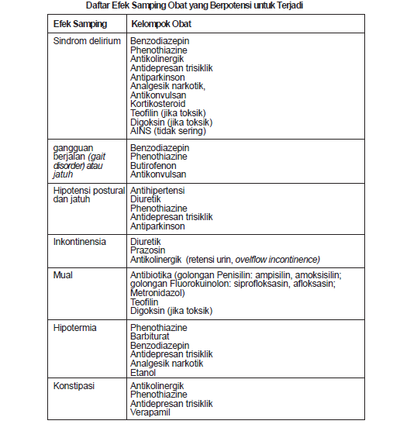

Slide 6
Role of Polyphenol in Cancer
Dietary increase of antioxidant defense capacity has been considered a reasonable way to prevent ROS-mediated carcinogenicity. Epidemiological and human studies indicate that a low risk of cancer is related to antioxidant-rich diets. Plant polyphenols have shown potential as natural anticarcinogenic compounds that, according to their mechanism of action, may have potential as cancer-blocking or cancer-suppressing agents.

Slide 7
Polyphenol
Inflamation (ROS, NOS)
Neuronal Energy homeostatis
Microglial cell activation
Oxidative stress
Apoptotic death in neurons
Neurotoxic factors
Neuronal damage (protein adducts, lipidperoxidetion, DNA adducts)
Inflammatory Signal
Figure 15.4

Slide 8
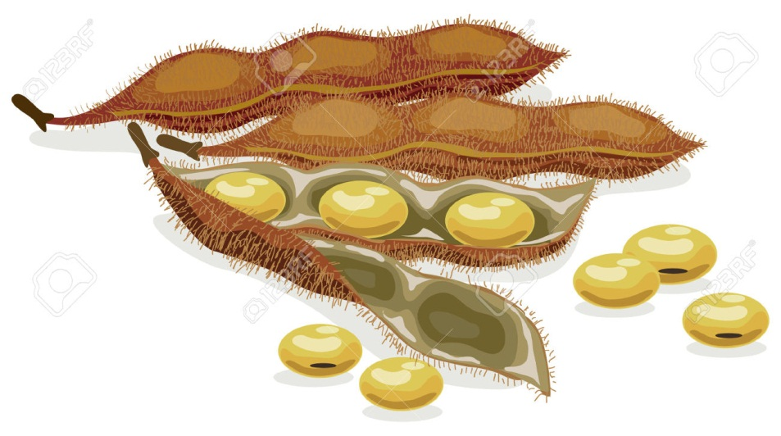
Soy
Soybeans and their products are consumed in many Asian countries, and many epidemiological reports describe the health benefits of soy consumption related to the prevention of cancer. Such as Daidzein and Genistein “they exhibit similar chemical structure to the mammalian steroid hormone 17ß - Oestradiol and so have been linked to the low incidence of hormone related cancers”
Although epidemiological studies have related the low breast cancer incidence in Asian nations and the high consumption of foods rich in phytoesrogen, some human intervention trials failed to show the precise effect of dietary phytoesrogen on the proliferation of mammary tissue.
An alternative protection exerted by phytoesrogen may be throught inhibition of enzymes involed in estrogen synthesis such sulfotransferases and aromatases. In summary, soy as many health benefits, however, older people should consume soy product with caution,especially if soy has not been a reguler part of their diet.

Slide 9
BRASSICA
Epidemiological data suggest that high consumption of brassica vegetables is a associated with a decreased risk of cancer this has been coupled to the relatively high content of glucosinolates and related compounds.
This association appears to be most consistent for lung, stomach, colon and retal cancer, and least consitent for prostatic, endomettrial, andovarian cancer. The mechanism for this protection have been found to be related to the ability to modify xenobiotic metabolizing enzymes and induce cell cycle arrest and apoptosis.

Slide 10
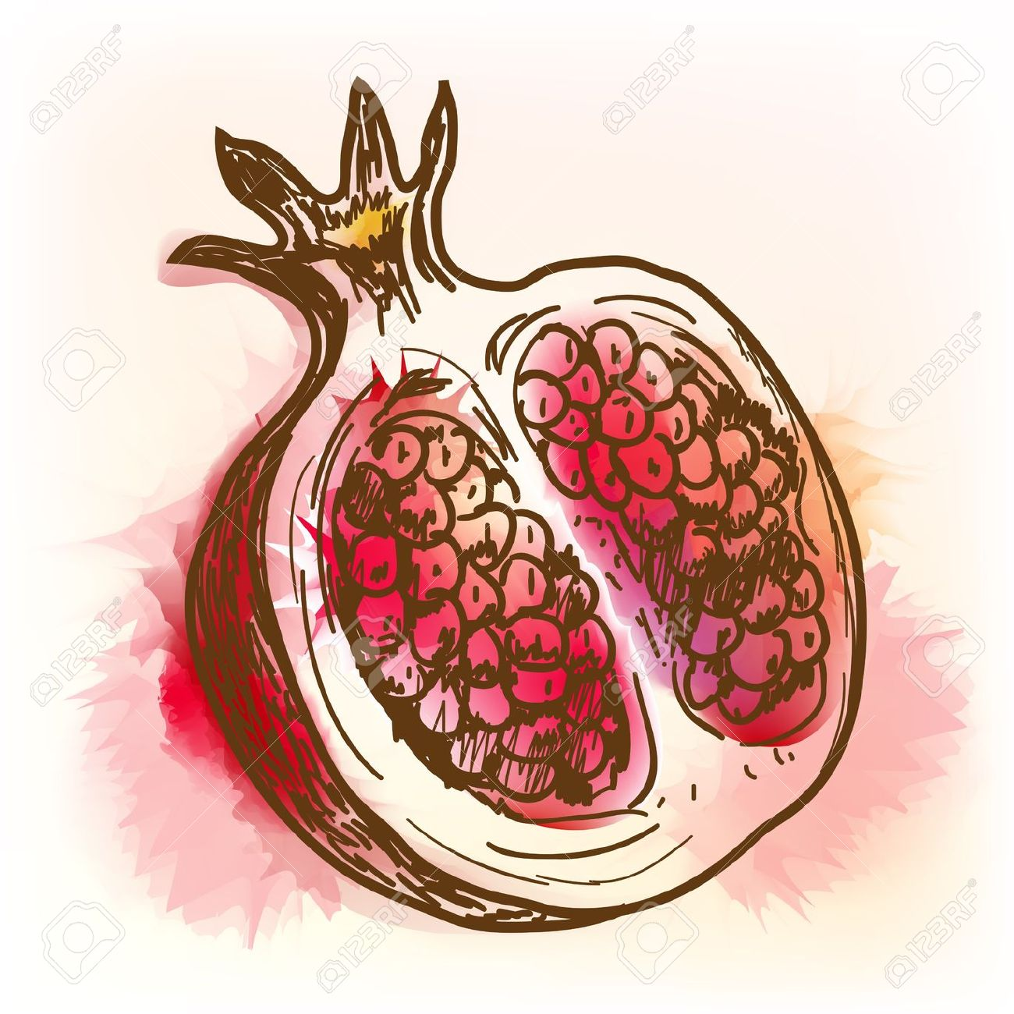
POMEGRANATE
Pomegranate juice has been reported to exert potent antioxidant capacity against lipid peroxidation, tto inhibit serum angiotensin converting enzyme (ACE) acivity (pottent vasoconstrictor glycoprotein), and to reduce systolic blood pressure. The possible mechanisms by which the ACE inhibitors may effect atherosclerosis are associated to lowering of blood preassuree, antiproliferation of vascular cells, inhibition of platelet aggregation, and inibition of lipidperoxidation effects.
Alternatively, it has been shown how different pomegranate fractions inhibit cancer cell proliferation and invasion and promote apoptosis of breast and prostate cancer cells. The active components of pomegranate fruit extract, antocyanin and hydrolyzable tannin rich fraction, may possess chemopreventive acttivity in a wide range of tumor models trought the modulation of MAPK and NF-kB pathways.

