Slide 1
ALERGI DAN INTOLERANSI MAKANAN PADA LANSIA
Anugrah Novianti, SGz, M.Gizi
PROGRAM STUDI ILMU GIZI
FAKULTAS ILMU-ILMU KESEHATAN

Slide 2
INTRODUCTION
World Allergy Organization (WAO) 2011 showed a high prevalence of food allergy and increase during the past 20 years in severity and scope until 30-40 % among of world’s population
in each year
INDONESIA
30%
(pdpersi.co.id, 2012)

Slide 3
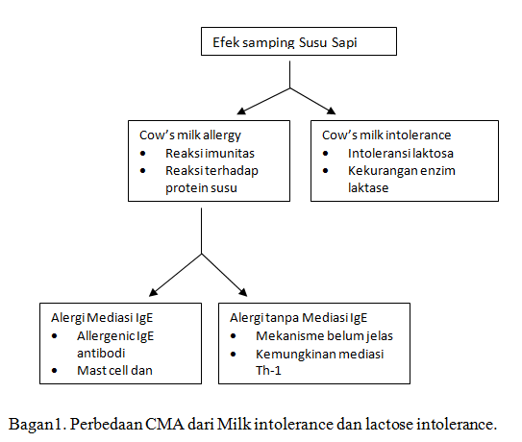
Differentiation between Food Allergy and Intolerance
Th-2

Slide 4
FOOD ALLERGIES
Alergi atau hipersensitivitas ialah suatu reaksi imunologik yang melibatkan Ig-E sebagai perantara terhadap protein makanan yang biasanya menimbulkan berbagai macam reaksi yang berlangsung secara cepat.
Seseorang yang memiliki riwayat atopi atau predisposisi genetik, mempunyai kecendrungan lebih besar mengalami alergi makanan.
Gejala yang ditimbulkan umumnya terjadi segera atau dalam 2 jam setelah terpapar alergen, dengan tingkat keparahan ringan sampai berat.

Slide 5
Food allergies Involve 2 features of the human immune response
1) Production of immunoglobulin E (IgE)
A type of protein called an antibody that circuclates through the blood
2) Mast cell, a specific cell that occurs in all body tissues but is especially common in areas of body that are typical sites of allergic reactions (including nose & throat, lungs, skin & gastrointestinal tract)

Slide 6
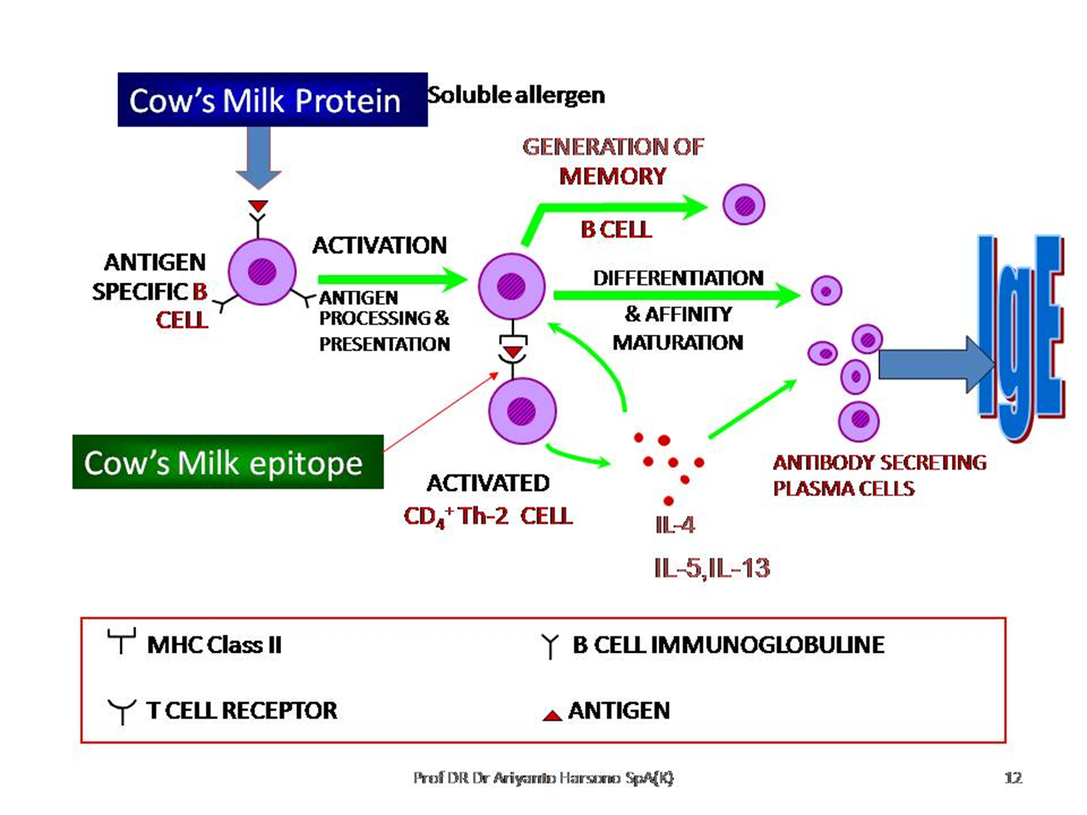
Mechanism

Slide 7
Forming IgE
First has to be exposed to the food
As food is digested, it triggers certain cells to produce IgE in large amounts
IgE released and hooks to Mast Cells
IgE
Rhinitis
Asthma
Mast Cell
Histamin, Serotonin, Lekotrien, Prostaglandin, TNF , etc
Urticaria
Diarrhea

Slide 8
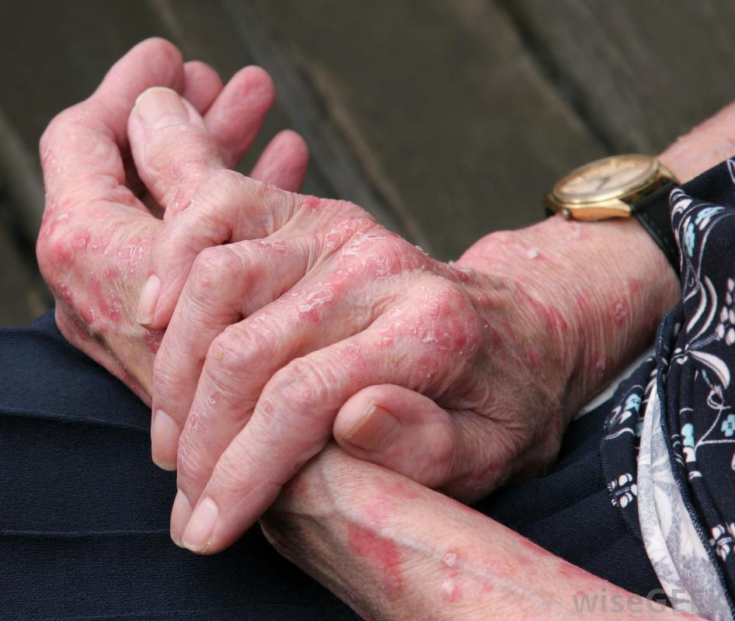
Food Allergy Disorders
Within minutes or 1 hour
Anaphylactic shock
Urticaria
Angio-edema
Abdominal pain, diarrhea, nausea, vomiting
Acute Rhinojunctivitis, bronchospasm
Delayed onset > 2 hour
Heavy Atopic Dermatitis
Gastroenteritis
Asthma

Slide 9
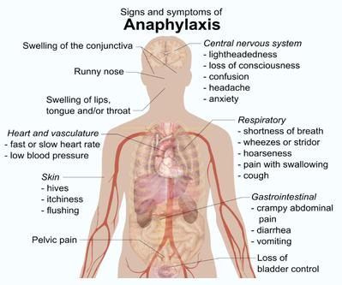
SEVERE REACTION OF
FOOD ALLERGY
Skin reactions, including hives along with itching, flushed or pale skin (almost always present with anaphylaxis)
A feeling of warmth
Constriction and tightening of airways
A swollen throat or the sensation of a lump in the throat that makes it difficult to breathe
Weak and rapid pulse
Dizziness, lightheadedness or loss of consciousness

Slide 10
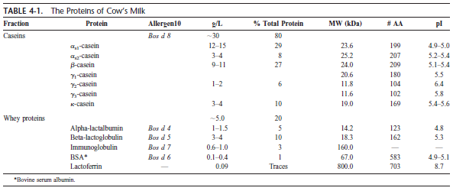
The Proteins of Cow’S Milk

Slide 11
Common Food Treats in Elderly

Slide 12
FOOD INTOLERANCES
Lacks the chemicals called enzymes, necessary to properly digest certain proteins found in food
Intolerances to some chemical ingredients added to food to provide color, taste, or protect against growth or bacteria

Slide 13
Non-IgE Mediated (Delay Onset Hypersensitivity)
The Sypmtoms of Non IgE Mediated > 2 hr :
Nausea
Bloating
Abdominal pain
Diarrhea
Enterocolitis
Celiac Disease

Slide 14
Non-IgE Mediated (Delay Onset Hypersensitivity)
Pada Non IgE- mediasi reaksi menunjukan hasil yang negative pada hasil dari skin prick test dan RAST (Radio Allegosorbant Test), dikarenakan tidak adanya IgE yang bersirkulasi.
Reaksi tipe-1 T helper cell (Th1) ;
Aktivasi komplemen dan cell mast →
menginduksi perubahan pada otot polos
dan pergerakan intestinal.

Slide 15
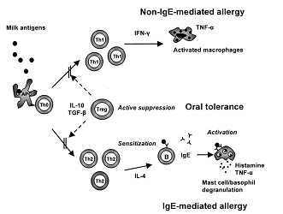
Patofisiologi Non-IgE Mediated

Slide 16
DIAGNOSIS
Food Allergy History
RAST: radioallergosorbent test (e.g. ImmunoCap-RAST; Phadebas-RAST)
FAST; Fluorescence allergosorbent test
ELISA: enzyme-linked immunosorbent assay
Skin prick test
Patch test
Gold Standar : Food Challenge (double blind placebo controlled food challenge)

Slide 17
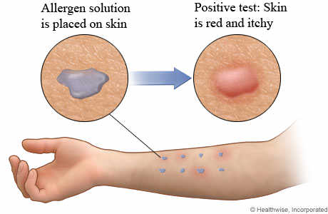
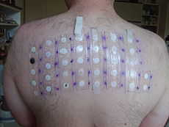
Skin Prick Test & Patch Test

Slide 18
DIETARY MANAGEMENT
Balance Nutrition
Elimination and Provocation Test
Subtitutes with soy milk
Medical and Supplementation
Avoid the Offending Food
Hydrolized of Cow’s Milk

Slide 19
3 Type of Food Challenge
Double Blind Placebo Controlled Food Challenge (DBPCFC) : orang tua dan petugas kesehatan tidak tau jenis alergen yang diujicobakan.
Single Blind : Pasien dan orangtua tidak mengetahui makanan/alergen yang akan dicobakan, hanya petugas kesehatan yang tau.
Open Challenge : Pasien, orangtua dan petugas tau jenis makanan yang dicobakan.

Slide 20
How to do DBPCFC
Eliminasi Diet :
Melakukan eliminasi bahan makanan terduga yang mngandung alergen minimal 14 hari sebelum dilakukan tes
Anti histamin tidak boleh diberikan sejak 3 hari sebelumnya, serta tidak boleh mengkonsumsi steroid dan bronkodilator sejak 1 hari sebelumnya.
Selama proses ini, diobservasi adakah gejala alergi berkurang/hilang atau tidak.

Slide 21
How to do DBPCFC
Provokasi Diet :
Kelanjutan dari eliminasi, bila dari hasil eliminasi selama 2 minggu gejala alergi berkurang atau hilang.
Dengan mencobakan kembali makanan yang telah dieliminasi sebelumnya, dan muncul kembali gejala alergi.
Besarnya dosis minimal 400 mg makanan yang telah dikeringkan dan maksimal 8-10 gram untuk penentuan hasil negatif.
Periode observasi minimal 2 jam setelah provokasi selesai.
Dilakukan dibawah pengawasan dokter dengan peralatan dan obat-obatan lengkap guna menangani reaksi anafilaktik.
Bila tidak muncul gejala, orangtua diberi catatan untuk mengamati dan mencatat kemungkinan timbulnya alergi dikemudian hari.

Slide 22
Tips
Proper food tip recommendations to ensure patients' safety include the following:
Read all food labels and recheck periodically, as ingredients will change. It's important to avoid if uncertain.
Modify recipes. Many websites provide appropriate substitutions and/or modified recipes.
Ask questions. Knowledge is essential for management.
Avoid cross-contact by cleaning food preparation areas, utensils, dishes, pans, and kitchen appliances. Consider safe equipment when needed.
Check out a restaurant's menu before arrival. If several menu items contain the food allergen, cross-contact is highly probable.
Bring safe food to a function, outing, cookout, or holiday dinner. If shared, discard any leftovers, as cross-contact is likely. Eat a snack or meal before attending.

