Slide 1
IMPLEMENTASI PROGRAM GIZI
PERTEMUAN III
Nazhif Gifari
Ilmu Gizi & FIKES

Slide 2
Background
Kurang Vitamin A (KVA) merupakan salah satu masalah gizi kurang yang masih dihadapi oleh negara-negara berkembang termasuk Indonesia
KVA : Suatu keadaan, ditandai rendahnya kadar Vitamin A dalam jaringan penyimpanan (hati) & melemahnya kemampuan adaptasi terhadap gelap & sangat rendahnya konsumsi/masukkan karotin dari Vitamin A

Slide 3
Prevalence of Vitamin A
AROUND THE WORLD
250 million children vitamin A deficient (serum retinol <0.70 μmol/l)
3 million children have xerophthalmia (“dry eyes”)
Areas with high rates of night blindness in children also have high rates of night blindness in mothers

Slide 4
DATA WHO
Setiap tahun􏰂3-10 juta anak menderita xeroftalmia dan 250.000 – 500.000 anak menjadi buta-> menyebabkan dediferensiasi; keratinisasi sel epitel, perubahan nafsu makan; xerofthalmia

Slide 5
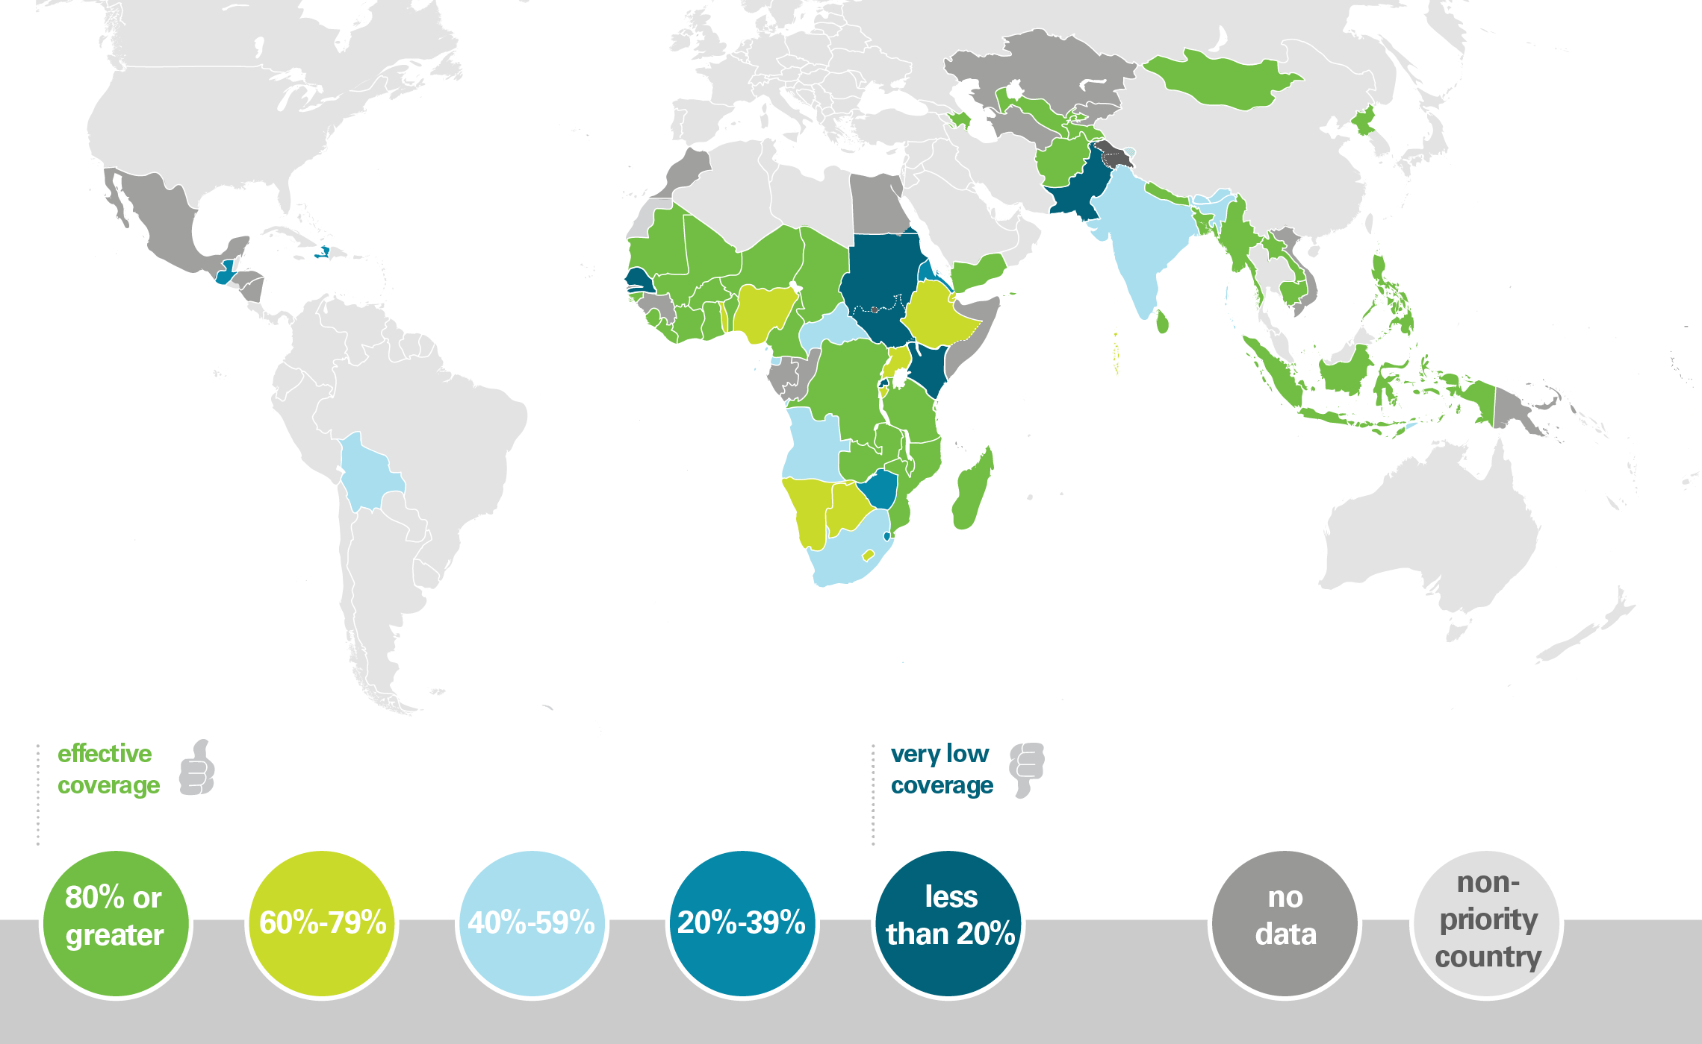
Vitamin A Deficiency

Slide 6
Vitamin A deficiency: consequences
Night blindness - ancient Egypt, Greek and Assyrian medical literature
Early deaths
High rates of respiratory and diarrheal diseases
Affects immunocompetence
Cured with animal and fish liver or plants with green and yellow pigments

Slide 7
Risk factors for VAD
Age
Diet
Disease
Seasonality
Culture
Clustering

Slide 8
KLASIFIKASI KVA (Xeroftalmia)
XN : Buta Senja X1A : Xerosis konjungtiva
X1B : Bercak bitot
X2 : Xerosis kornea
X3A : Ulkus kornea dengan xerosis
X3B : Keratomalasia
XS : Xeroftalmia scars
XF : Xeroftalmia fundus

Slide 9
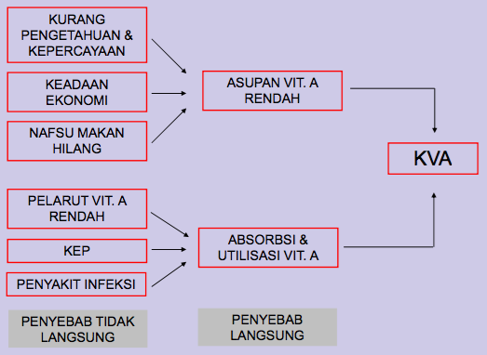
PENYEBAB KVA

Slide 10
KVA Status
Death
Hepatotoxicity
Bone fracture
Hemorrhage
Eczema
Vit A
level
Night blindness
Xerophthalmic keratinization
Death
Vit A intake µg/kg body weight

Slide 11
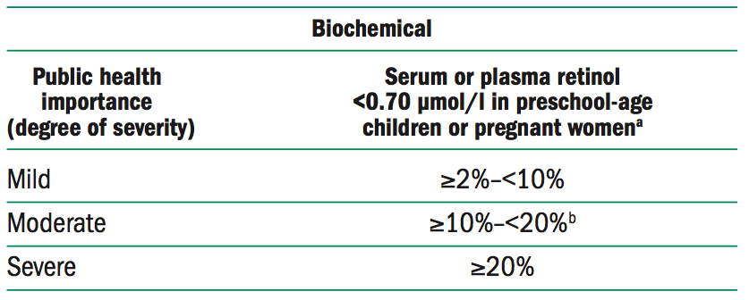
Prevalence cut-offs to define vitamin A deficiency in a population and its level of public health significance
source: reference (28); Children 6–71 months of age. As there is no WHO recom- mended cut-off for serum retinol in pregnant women, the cut-off for children was used (<0.70 μmol/l).
the moderate range includes, as its mid-point, the minimum prevalence of 15% currently recommended by the micronutrient forum/international Vitamin A Consulta- tive Group (iVACG) as the cut-off at or above which vitamin A deficiency should be considered a problem of public health significance among preschool children (21). the distribution of prevalence cut-offs for pregnant women is provisional.

Slide 12
Pencegahan dan Penanggulangan KVA
Prinsip dasar untuk mencegah dan menanggulangi masalah KVA adalah menyediakan vitamin A yang cukup untuk tubuh. Dalam upaya menyediakan vitamin A yang cukup untuk tubuh, sebagai berikut:
Meningkatkan konsumsi sumber vitamin A alami melalui penyuluhan
Menambahkan vitamin A pada bahan makanan yang dimakan oleh golongan sasaran secara luas (fortifikasi)
Distribusi kapsul vitamin A dosis tinggi secara berkala.

Slide 13
Nutrition intervention programs
Critical elements for successful programs are:
Political commitments
Community mobilization & participation
Human resources development
Targeting
Monitoring, evaluation & management information systems
Replicability and sustainability

Slide 14
CONCLUSION
Vitamin A deficiency is highly prevalent
It has severe consequences especially in the young
Supplementation, fortification and dietary changes have all been used successfully to reduce it’s prevalence
The cost of the programs is not high if integrated into existing child care services

