Slide 1

PATOFISIOLOGI DISLIPIDEMIA
PERTEMUAN 5
MERTIEN SA’PANG
ILMU GIZI / FAKULTAS ILMU KESEHATAN

Slide 2

KEMAMPUAN AKHIR YANG DIHARAPKAN
Mampu menjelaskan definisi dislipidemia
Mampu menjelaskan metabolisme lipid dalam tubuh
Mampu menjelaskan patofisiologi dislipidemia
Sumber utama:
1. Guyton & Hall, 1997, Buku ajar Fisiologi Kedoteran, EGC
2. Gerald TG & RS Wright, 2006, Pathophysiolog, Diagnosis and Management of Dyslipidemia
3. Harvey & Ferrier, 2011, Lippincot’s Ilustrated Reviews Biochemistry 5th Ed, Wolters Kluwer
4. American Association Of Clinical Endocrinologists And American College Of Endocrinology Guidelines For Management Of Dyslipidemia And Preventio Of Cardiovascular Disease

Slide 3

review metabolisme lipid

Slide 5
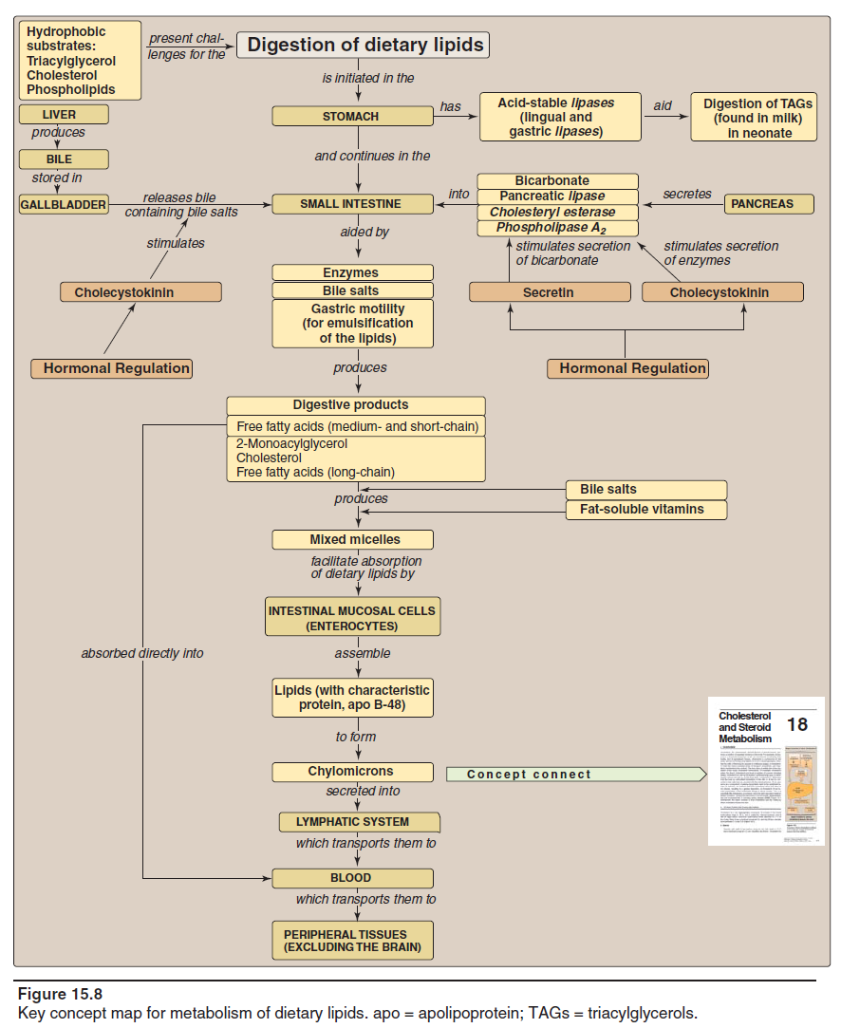

Slide 6
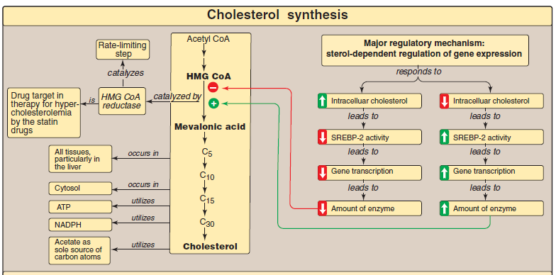

Slide 7
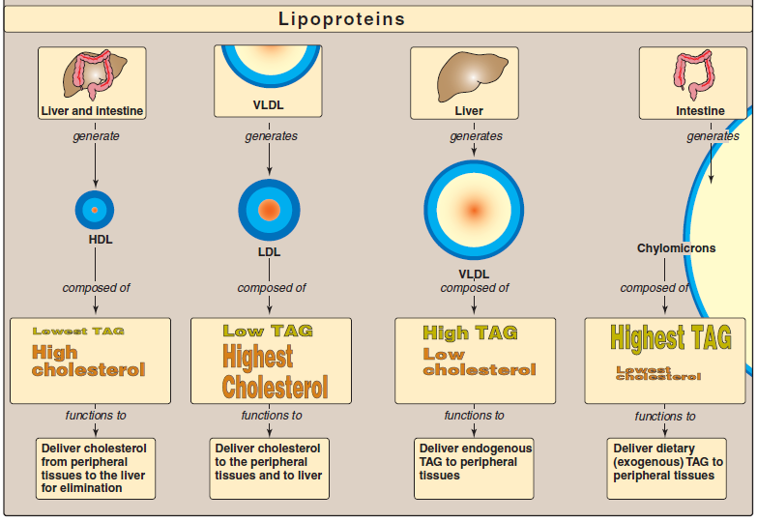

Slide 8

https://www.youtube.com/watch?v=PkKH8lTxvzA&t=25s

Slide 9
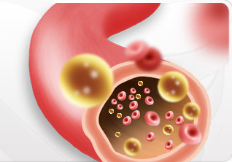
Dislipidemia
Dislipidemia adalah kelainan metabolisme lipid yang ditandai dengan peningkatan atau penurunan fraksi lipid dalam plasma

Slide 10
Klasifikasi Dislipidemia
Primer
Peningkatan kadar LDL atau penurunan kadar HDL yg disebabkan oleh kelainan genetik
Sekunder
Peningkatan kadar LDL atau penurunan kadar HDL yg disebabkan oleh adanya penyakit lain atau obesitas

Slide 11
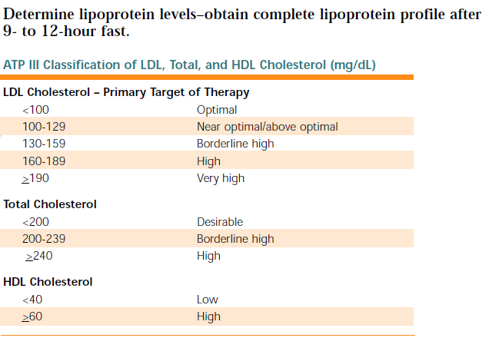
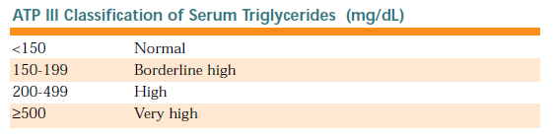
Identifikasi Dyslipidemia

Slide 12
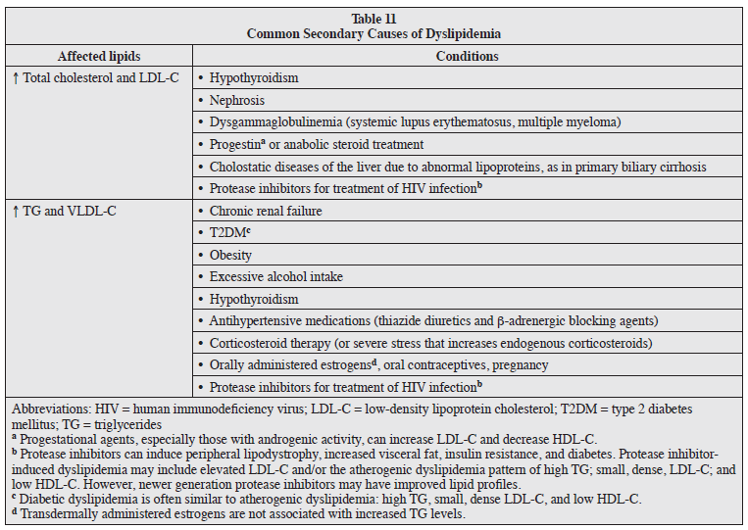

Slide 13
Terapi Pengobatan
Terapi Diet; rendah energi rendah lemak, min 5 porsi sayur dan buah/hari, serat 10-25 g/hr
Aktifitas fisik (moderate intensity training 4-6 kali/mgg); jalan cepat, bersepeda statis, aerobik dll
Terapi Farmakologi

Slide 14
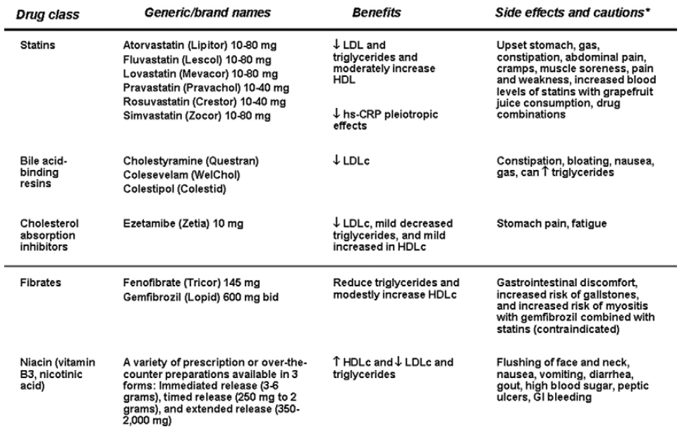
Lipid-lowering Agent

Slide 15
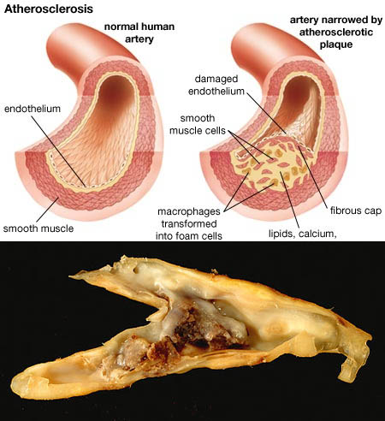
Aterosklerosis

Slide 16
Lanjutan....
The first stage of atherogenesis is the fatty streak, which consists largely of cholesterol-filled macrophages; most of the cholesterol in fatty streaks is derived from LDL cholesterol.
The second stage consists of fibrous plaques in which a layer of scar tissue overlies a lipid-rich core. Other risk factors contribute to plaque growth at this phase.
The third stage is represented by the development of unstable plaques that are prone to rupture and formation of luminal thrombosis. Plaque rupture (or erosion) is responsible for most acute coronary syndromes (myocardial infarction, unstable angina, and coronary death).

Slide 17
Lanjutan....
Elevated LDL cholesterol plays a role in the development of the mature coronary plaque, which is the substrate for the unstable plaque. Recent evidence also indicates that elevated LDL cholesterol contributes to plaque instability as well; conversely, LDL cholesterol lowering stabilizes plaques and reduces the likelihood of acute coronary syndromes.

Slide 18
Etiologi
Genetik
Kebiasaan merokok
Peningkatan kadar LDL
Hipertensi
Penuaan

Slide 19

Terima kasih

