Slide 1
PATOFISIOLOGI
GANGG. SISTEM KARDIOVASKULAR
MERTIEN SA’PANG
ILMU GIZI / FAKULTAS ILMU KESEHATAN

Slide 2
KEMAMPUAN AKHIR YANG DIHARAPKAN
Mampu menjelaskan patofisiologi Aterosklerotik Koroner
Mampu menjelaskan penyakit gagal jantung (Congestive Heart Failure)

Slide 3
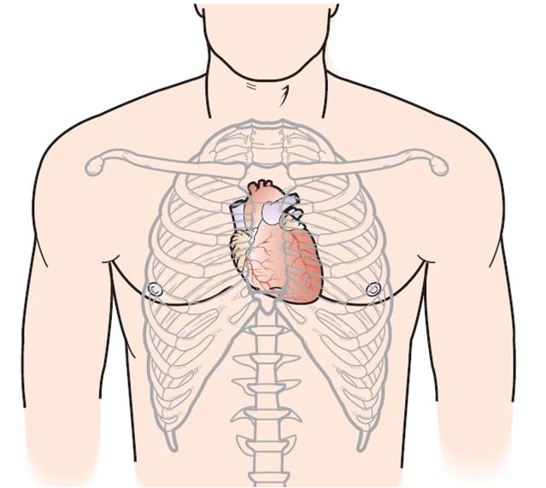

Slide 5
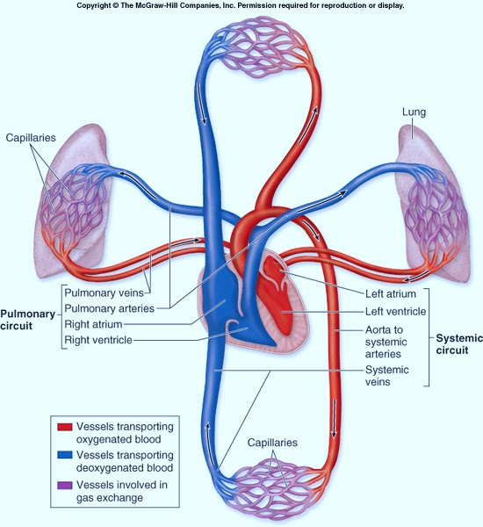

Slide 6
Fungsi sirkulasi darah
Penghantar oksiges ke jaringan
Penghantar zat gizi
Pembuangan karbon dioksida dari jaringan
Pembuangan ion hidrogen dari jaringan
Mempertahankan konsentrasi ion-ion lain di jaringan
Pengangkutan berbagai hormon dan bahan spesifik lainnya
Pengaturan suhu

Slide 7
Prosedur diagnostik Penyakit Kardiovaskular
Prosedur diagnostik invasif
Studi elektrofisiologi
Keteterisasi Jantung
Prosedur diagnostik non invasif
Elektrokardiogram (EKG) permukaan
Ekaokardiografi
Pemindaian CT
Pencitraan Radionulida
Pemeriksaan MRI
Uji berlatih
Radiografi Dada

Slide 8
Lanjutan.....
Penilaian klinis
Anamnesis
Pemeriksaan Fisik

Slide 9
Tanda dan Gejala
Angina : nyeri dada, seolah berasal dari mandibula, lengan atas atau pertengahan punggung
Dispnea : berkesulitan bernafas, ortopnea (kesulitan bernafas saat berbaring); dispnea nokturnal paroksismal (kesulitan bernafas saat tidur);.
Palpitasi: perubahan kecepatan, keteraturan, atau kekuatan kontraksi jantung
Edema perifer: pembengkakan akibat penumpukan cairan di ruang interstisial
Sinkop, kehilangan kesadaran sesaat akibat aliran darah ke otak yg tdk adekuat
Kelelahan dan kelemahan, akibat curah jantun dan perfusi aliran darah perifer yg berkurang

Slide 10
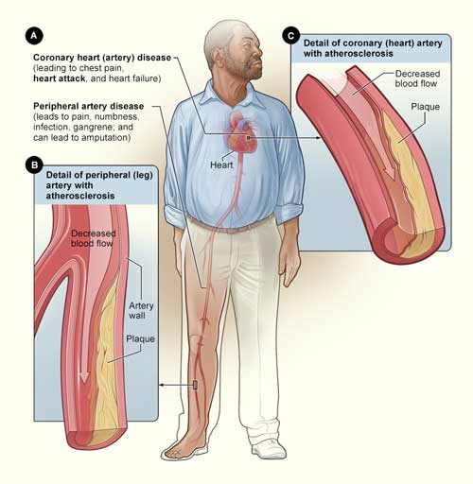
Penyakit Aterosklerotik Koroner

Slide 11
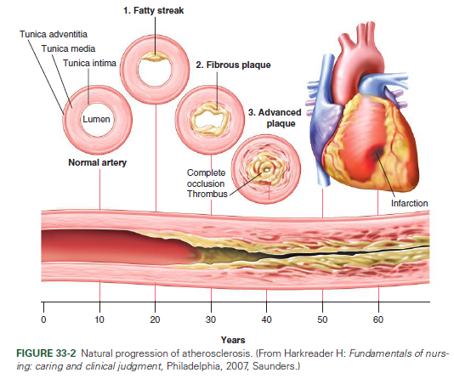
Atherosclerosis is a disease in which plaque builds up inside your arteries. Arteries are blood vessels that carry oxygen-rich blood to your heart and other parts of your body.
Plaque is made up of fat, cholesterol, calcium, and other substances found in the blood. Over time, plaque hardens and narrows your arteries. This limits the flow of oxygen-rich blood to your organs and other parts of your body.
Sumber: https://www.nhlbi.nih.gov/health/health-topics/topics/atherosclerosis

Slide 12
What is atherosclerosis?
https://youtu.be/ecuCECYhw_M

Slide 13
Penyakit terkait
Coronary heart disease (CHD), also called coronary artery disease, occurs when plaque builds up in the coronary arteries. These arteries supply oxygen-rich blood to your heart. Plaque narrows the coronary arteries and reduces blood flow to your heart muscle. Plaque buildup also makes it more likely that blood clots will form in your arteries. Blood clots can partially or completely block blood flow.
If blood flow to your heart muscle is reduced or blocked, you may have angina (chest pain or discomfort) or a heart attack.
Plaque also can form in the heart's smallest arteries. This disease is called coronary microvascular disease (MVD). In coronary MVD, plaque doesn't cause blockages in the arteries as it does in CHD.
Sumber: https://www.nhlbi.nih.gov/health/health-topics/topics/atherosclerosis

Slide 14
Lanjutan....
Carotid artery disease occurs if plaque builds up in the arteries on each side of your neck (the carotid arteries). These arteries supply oxygen-rich blood to your brain. If blood flow to your brain is reduced or blocked, you may have a stroke.
Peripheral artery disease (P.A.D.) occurs if plaque builds up in the major arteries that supply oxygen-rich blood to your legs, arms, and pelvis.
If blood flow to these parts of your body is reduced or blocked, you may have numbness, pain, and, sometimes, dangerous infections.
Chronic kidney disease can occur if plaque builds up in the renal arteries. These arteries supply oxygen-rich blood to your kidneys.
Over time, chronic kidney disease causes a slow loss of kidney function. The main function of the kidneys is to remove waste and extra water from the body.
Sumber: https://www.nhlbi.nih.gov/health/health-topics/topics/atherosclerosis

Slide 15
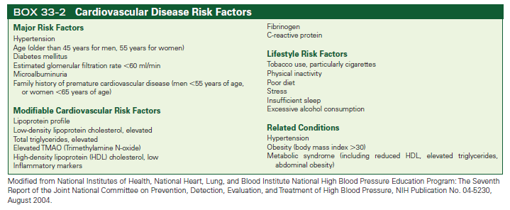

Slide 16
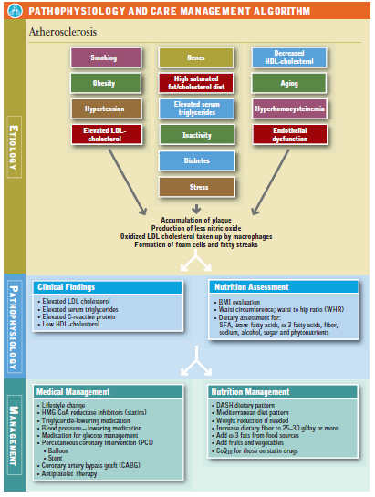
Sumber:Krause’s Food and Nutrition Care Process, 14Ed, 2017

Slide 17
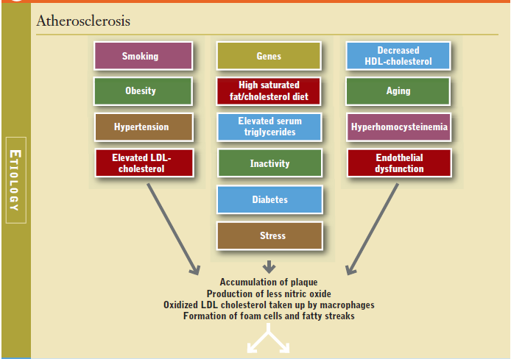
Sumber:Krause’s Food and Nutrition Care Process, 14Ed, 2017

Slide 18
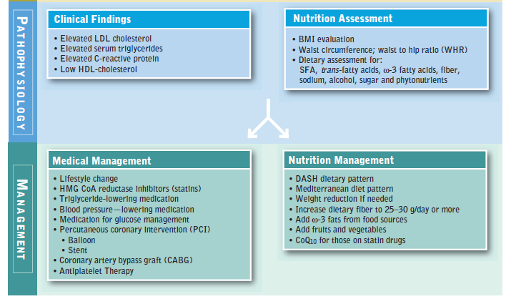
Sumber:Krause’s Food and Nutrition Care Process, 14Ed, 2017

Slide 20
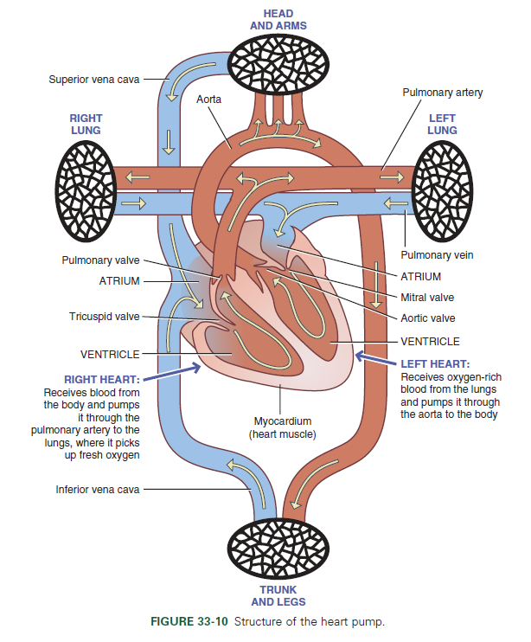

Slide 21
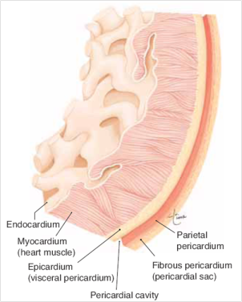
Epikardium,yaitu bagian luar otot jantung atau pericardium visceral
Miokardium, yaitu jaringan utama otot jantung yang bertanggung jawab atas kemampuan kontraksi jantung.
Endokardium, yaitu lapisan tipis bagian dalam otot jantung atau lapisan tipis endotel sel yang berhubungan langsung dengan darah dan bersifat sangat licin untuk aliran darah, seperti halnya pada sel-sel endotel pada pembuluh darah lainnya.

Slide 22
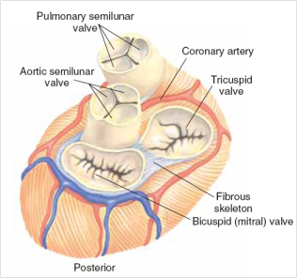
Katup jatung terbagi menjadi 2 bagian, yaitu katup yang menghubungkan antara atrium dengan ventrikel dinamakan katup atrioventrikuler, sedangkan katup yang menghubungkan sirkulasi sistemik dan sirkulasi pulmonal dinamakan katup semilunar.

Slide 23
Congestive Heart Failure (CHF)
Merupakan kongesti sirkulasi akibat disfungsi miokardium
Disfungsi ventrikel kiri mengakibatkan kongesti pada vena pulmonalis sedangkan disfungsi ventrikel kanan mengakibatkan kongesti vena sistemik.

Slide 24
Lanjutan....
Iskemia : keb. Oksigen yang melebihi kapasitas suplai oksigen krna pembuluh darah yg mengalami gangguan
Infark: Iskemia ang berlangsung lebih dari 30-45 menit yang akan menyebabkan kerusakan sel irreversible
Infark miokardium akan menurunkan fungsi ventrikel krn otot yangnekrosis kehilangan kontraksi, menimbulkan abnormalitas gerakan dinding dan mengubah daa kembang ruang jantung

Slide 25
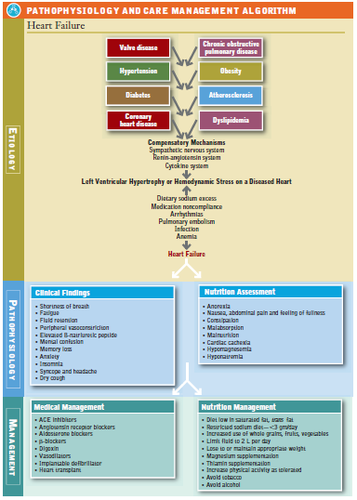
Sumber:Krause’s Food and Nutrition Care Process, 14Ed, 2017

Slide 26
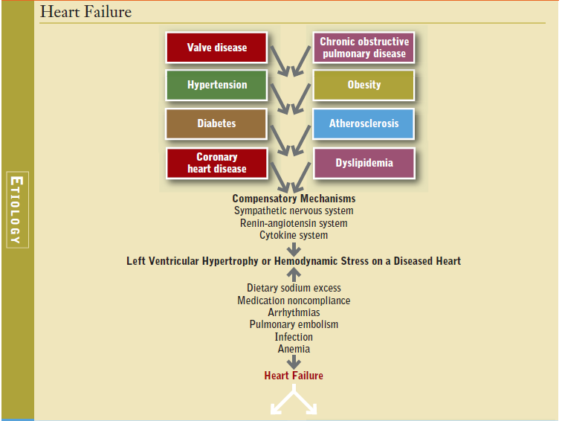
Sumber:Krause’s Food and Nutrition Care Process, 14Ed, 2017

Slide 27
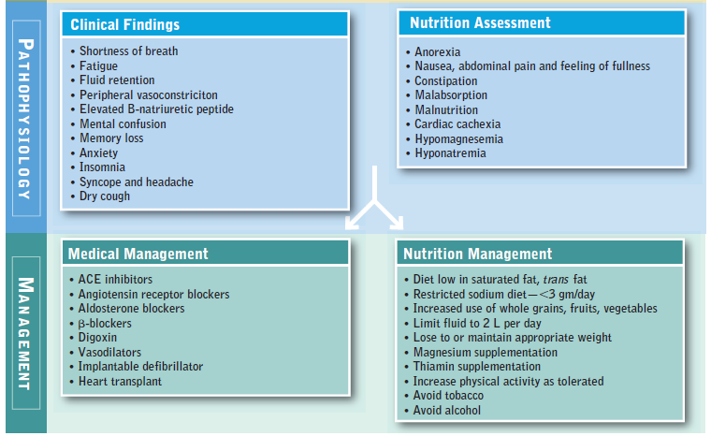
Sumber:Krause’s Food and Nutrition Care Process, 14Ed, 2017

Slide 28
Congestive Heart failure
https://youtu.be/ypYI_lmLD7g

Slide 29
Classes of Heart Failure
Class | Patient Symptoms
I | No limitation of physical activity. Ordinary physical activity does not cause undue fatigue, palpitation, dyspnea (shortness of breath).
II | Slight limitation of physical activity. Comfortable at rest. Ordinary physical activity results in fatigue, palpitation, dyspnea (shortness of breath).
III | Marked limitation of physical activity. Comfortable at rest. Less than ordinary activity causes fatigue, palpitation, or dyspnea.
IV | Unable to carry on any physical activity without discomfort. Symptoms of heart failure at rest. If any physical activity is undertaken, discomfort increases.
Sumber: Criteria Committee, New York Heart Association , Inc. Diseases of the Heart and Blood Vessels. Nomenclature and Criteria for diagnosis, 6th edition Boston, Little, Brown and Co. 1964, p 114

Slide 30
Lanjutan....
Class | Objective Assessment
A | No objective evidence of cardiovascular disease. No symptoms and no limitation in ordinary physical activity.
B | Objective evidence of minimal cardiovascular disease. Mild symptoms and slight limitation during ordinary activity. Comfortable at rest.
C | Objective evidence of moderately severe cardiovascular disease. Marked limitation in activity due to symptoms, even during less-than-ordinary activity. Comfortable only at rest.
D | Objective evidence of severe cardiovascular disease. Severe limitations. Experiences symptoms even while at rest.
Sumber: Criteria Committee, New York Heart Association , Inc. Diseases of the Heart and Blood Vessels. Nomenclature and Criteria for diagnosis, 6th edition Boston, Little, Brown and Co. 1964, p 114

Slide 31
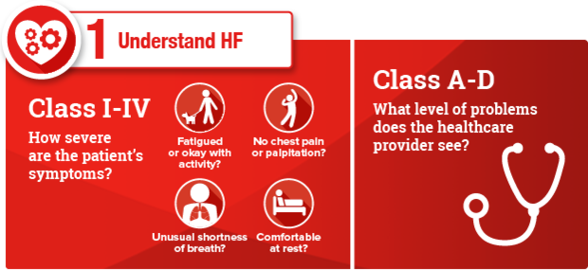
Terima Kasih….

