Slide 1
GIZI KEBUGARAN
PERTEMUAN XII
Nazhif Gifari
Ilmu Gizi & FIKES

Slide 2
EFFECTS OF EXERCISE ON IMMUNE FUNCTION
The amount of physical activity that a person does influences his/ her risk of infection, most likely by affecting immune function.
It is known that regular moderate exercise reduces the risk of infection compared with a sedentary lifestyle

Slide 3
Exercise, Immunity And Illness In Athletes

Slide 4
Causes of Illness in Athletes
These symptoms are generally trivial, but no matter whether the cause is infectious or allergic inflammation, they can cause an athlete to interrupt training, under perform or even miss an important competition.
A recent survey of hundreds of elite Great Britain athletes in 30 different Olympic sports reported that among the reasons for missing training, in 33% of cases it was because of infection

Slide 5
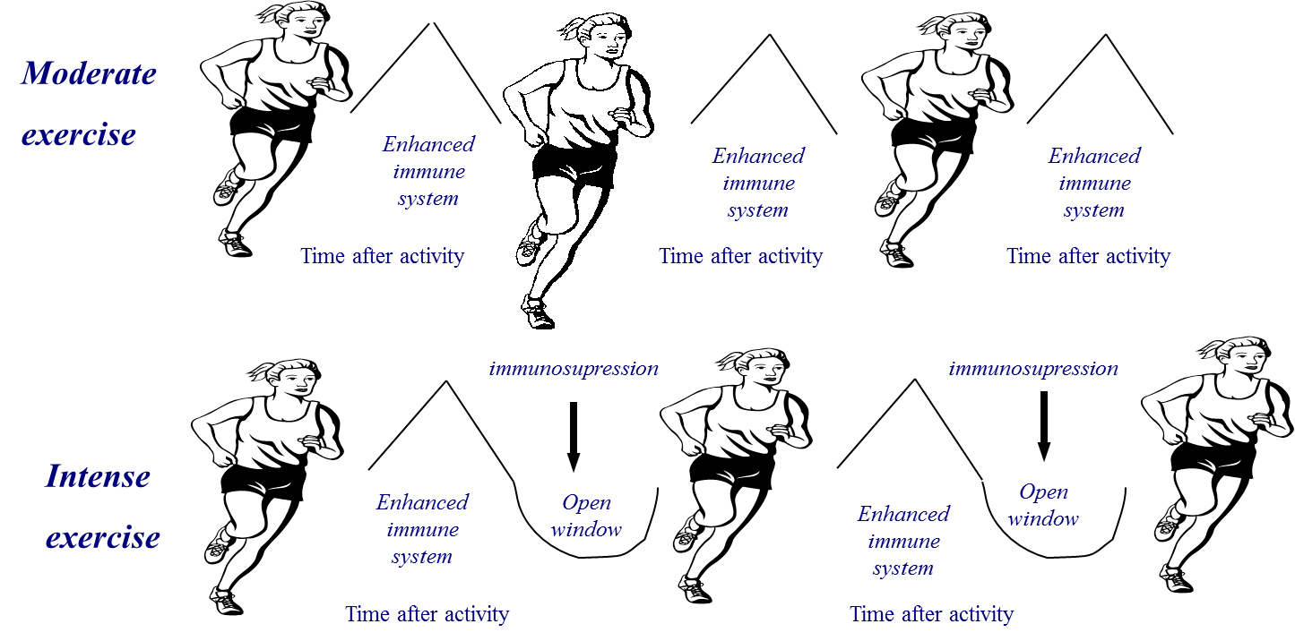
Prolonged bouts of strenuous exercise have been shown to result in transient depression of white blood cell (leukocyte) functions and it is suggested that such changes create an “open window” of decreased host protection, during which viruses and bacteria can gain a foothold, increasing the risk of developing an infection.
Other factors such as psychological stress, lack of sleep and inadequate nutrition (particularly deficiencies of protein and essential micronutrients) can also depress immunity and lead to increased risk of infection.

Slide 6
Acute Prolonged Exercise Effects on Immune Function
Prolonged bouts of strenuous exercise have a temporary negative impact on immune function.
Post-exercise immune function depression is most pronounced when the exercise is continuous, prolonged (>1.5 h), of moderate to high intensity (55-75% of aerobic capacity) and performed without food intake

Slide 7
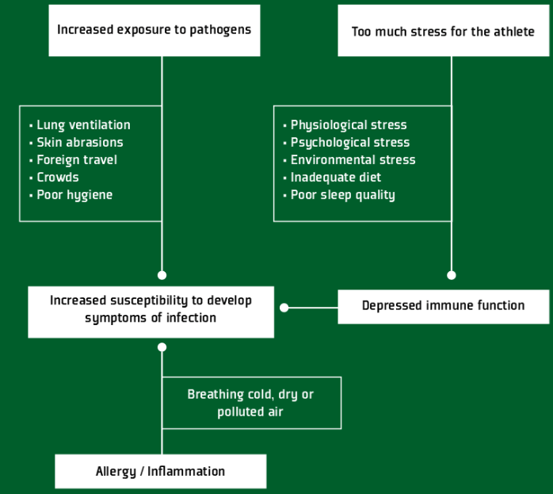
Potential causes of infection symptoms in athletes

Slide 8
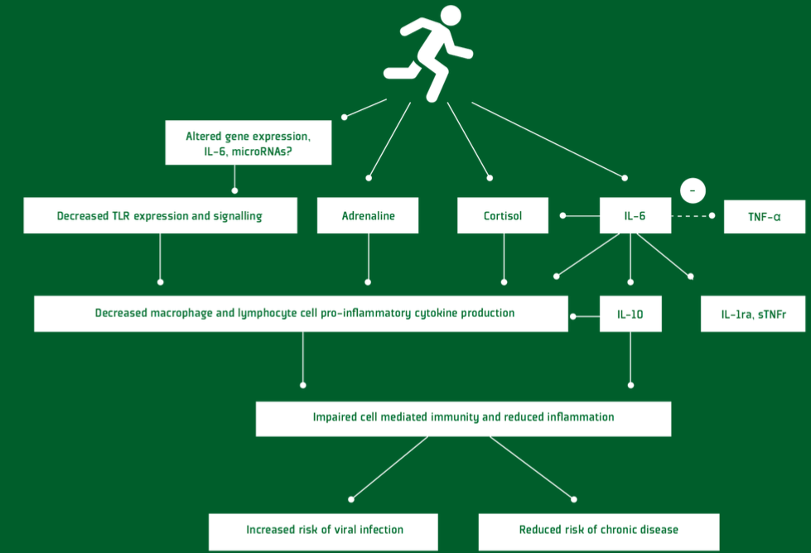
Events contributing to exercise-induced immunodepression

Slide 9
Chronic Exercise Training Effects on Immune Function
Immune function indices in athletes in the true resting state (i.e., at least 24 h after the last exercise)

Slide 10
PRACTICAL APPLICATIONS Guidelines for Maintenance of Immune Health and Limiting the Risk of Infection

Slide 11
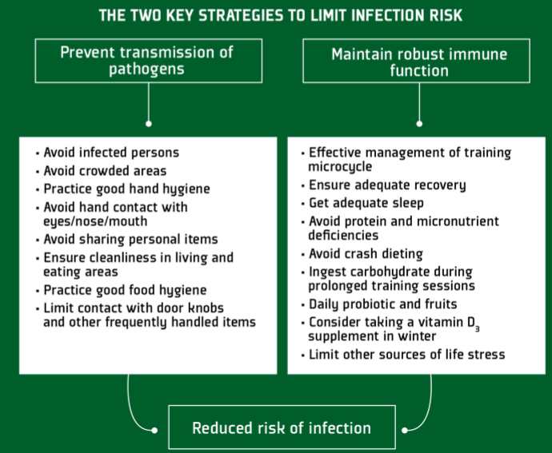
Strategies to limit infection risk for athlete

Slide 12
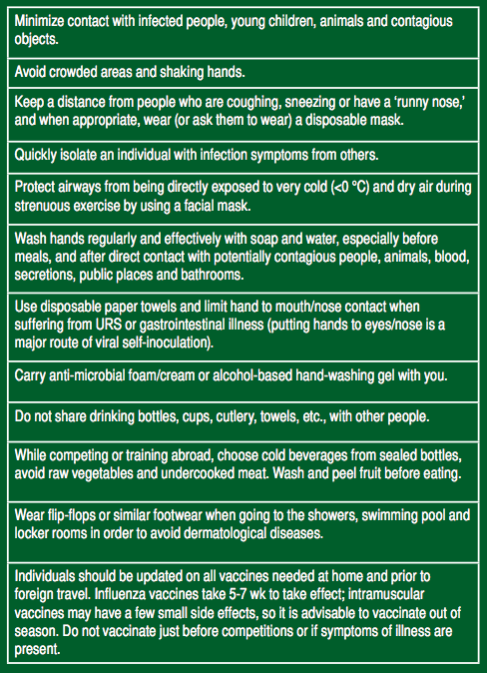
Behavioural and lifestyle strategies to limit transmission of infections among athletes

Slide 13
Summary
There is now substantial evidence to support the notion that prolonged strenuous exercise is associated with a transient suppression of immune functions which usually recover within 24 H. However, in situations of intensive training a lack of sufficient recovery between exercise sessions can lead to chronic depression of immune responses.
There are various training, behavioral and nutritional strategies that can help to minimise risk and these should become part of the athlete’s normal routine.

Slide 14
TERIMA KASIH

