Slide 1
GIZI KEBUGARAN
PERTEMUAN III
Nazhif Gifari
Ilmu Gizi & FIKES

Slide 2
Structure and Function of Exercising Muscle

Slide 3
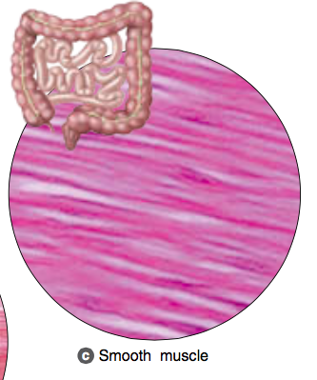
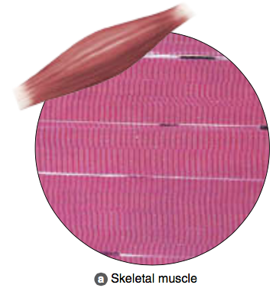
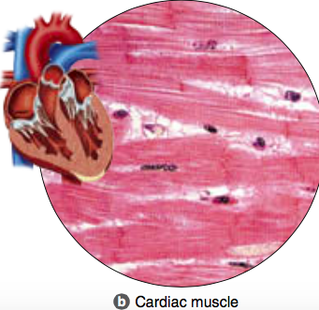
Three Types of Muscle Tissue
Smooth muscle: involuntary, hollow organs
Skeletal muscle: voluntary, skeleton
Cardiac muscle: involuntary, heart

Slide 4
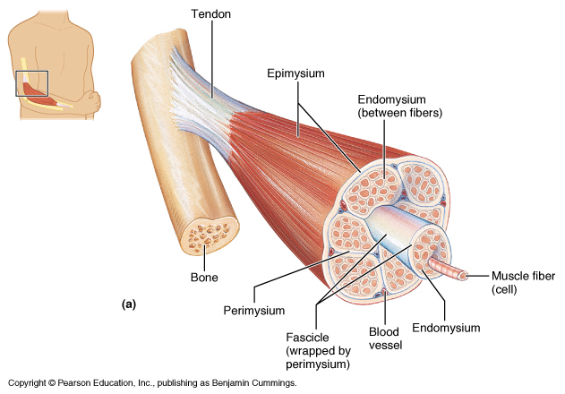

Slide 6
Myofibrils and Sarcomeres
Myofibrils
Muscle → fasciculi → muscle fiber → myofibril
Hundreds to thousands per muscle fiber
Sarcomeres
Basic contractile element of skeletal muscle
End to end for full myofibril length

Slide 7
Sarcomere: Protein Filaments
Used for muscle contraction
Actin (thin filaments)
Show up lighter under microscope
I-band contains only actin filaments
Myosin (thick filaments)
Show up darker under microscope
A-band contains both actin and myosin filaments
H-zone contains only myosin filaments

Slide 8
Myosin (Thick Filaments)
Two intertwined filaments with globular heads
Globular heads
Protrude 360° from thick filament axis
Will interact with actin filaments for contraction
Stabilized by titin

Slide 9
Actin (Thin Filaments)
Actually composed of three proteins
Actin: contains myosin-binding site
Tropomyosin: covers active site at rest
Troponin: anchored to actin, moves tropomyosin
Anchored at Z-disk
Equally spaced out by titin

Slide 10
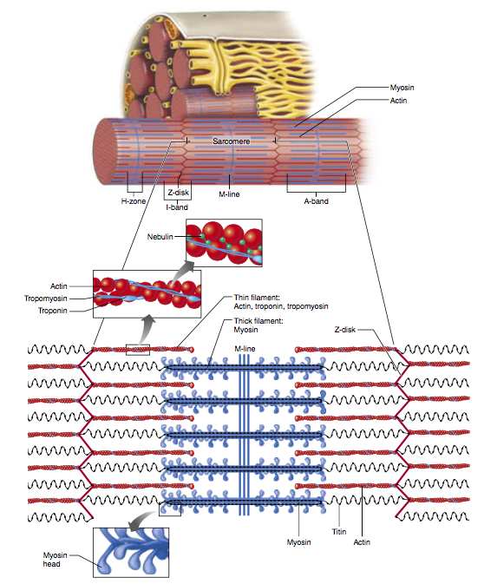
The sarcomere contains a specialized arrangement of actin (thin) and myosin (thick) filaments. The role of titin is to position the myosin filament to maintain equal spacing between the actin filaments. Nebulin is often referred to as an “anchoring protein” because it provides a framework that helps stabilize the position of actin

Slide 11
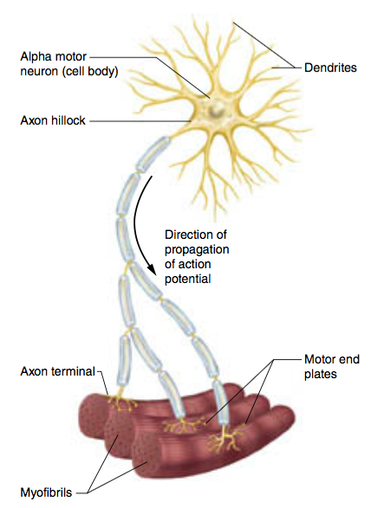
Motor Units
α-Motor neurons innervate muscle fibers
Motor unit
Single α-motor neuron + all fibers it innervates
More operating motor units = more contractile force
Neuromuscular junction
Site of communication between neuron and muscle
Consists of synapse between α-motor neuron and muscle fiber
When an 􏰂-motor neuron is activated, all of the muscle fibers in its motor unit are stimulated to contract.

Slide 12
Skeletal Muscle Contraction (Excitation-Contraction Coupling)
Action potential (AP) starts in brain
AP arrives at axon terminal, releases acetylcholine (ACh)
ACh crosses synapse, binds to ACh receptors on plasmalemma
AP travels down plasmalemma, T-tubules
Triggers Ca²⁺ release from sarcoplasmic reticulum (SR)
Ca²⁺ enables actin-myosin contraction

Slide 13
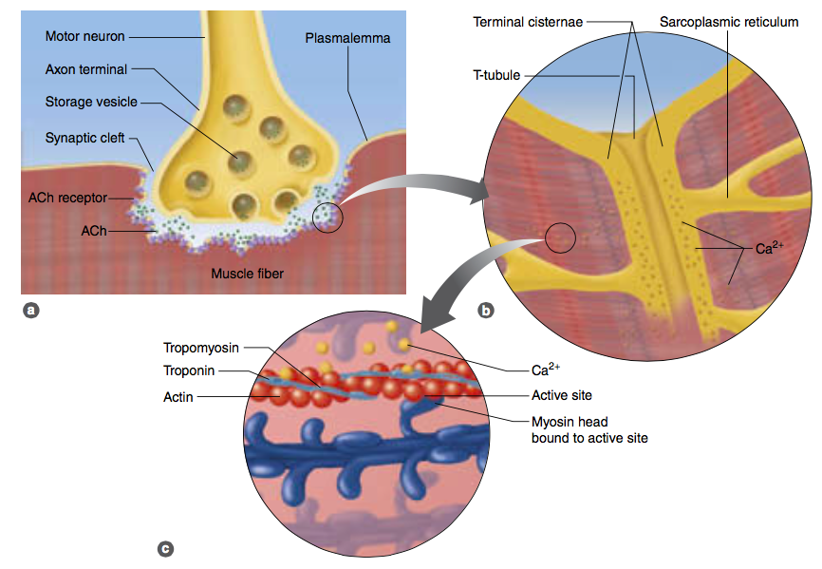
The sequence of events leading to muscle action, known as excitation–contraction coupling.

Slide 14
Watch this video

Slide 15
Muscle Relaxation
AP ends, electrical stimulation of SR stops
Ca²⁺ pumped back into SR
Stored until next AP arrives
Requires ATP
Without Ca²⁺, troponin and tropomyosin return to resting conformation
Covers myosin-binding site
Prevents actin-myosin cross-bridging

Slide 16
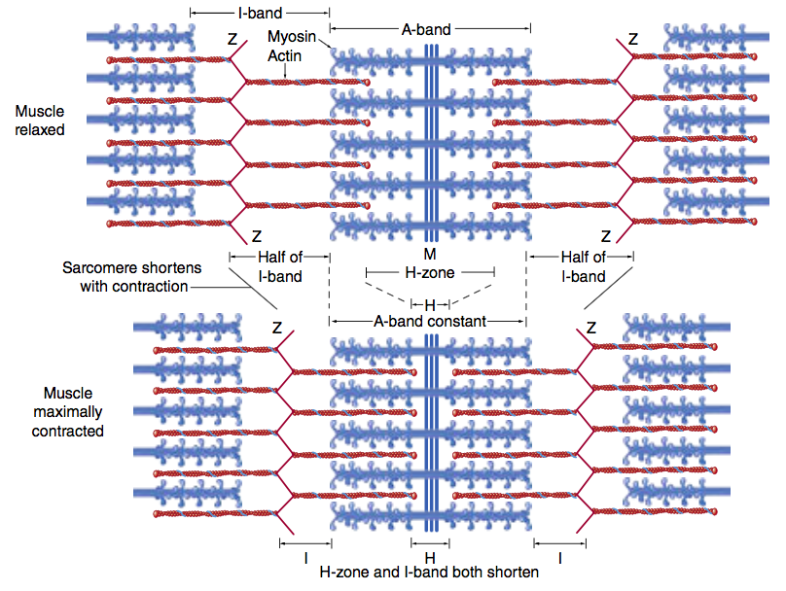
A sarcomere in its relaxed (top) and contracted (bottom) state, illustrating the sliding of the actin and myosin filaments with contraction.

Slide 17
Energy for Muscle Contraction
Adenosine triphosphate (ATP)
Binds to myosin head
ATPase on myosin head
ATP → ADP + P_{i} + energy
Necessary for muscle contraction

Slide 18
Muscle Fiber Types
Type I
~50% of fibers in an average muscle
Peak tension in 110 ms (slow twitch)
Type II
Peak tension in 50 ms (fast twitch)
Type IIa (~25% of fibers in an average muscle)
Type IIx (~25% of fibers in an average muscle)

Slide 19
Type I Fibers During Exercise
High aerobic endurance
Can maintain exercise for prolonged periods
Require oxygen for ATP production
Low-intensity aerobic exercise, daily activities
Efficiently produce ATP from fat, carbohydrate

Slide 20
Type II Fibers During Exercise
Type II fibers in general
Poor aerobic endurance, fatigue quickly
Produce ATP anaerobically
Type IIa
More force, faster fatigue than type I
Short, high-intensity endurance events (1,600 m run)
Type IIx
Seldom used for everyday activities
Short, explosive sprints (100 m)

Slide 21
Fiber Type Determinants
Genetic factors
Determine which α-motor neurons innervate fibers
Fibers differentiate based on α-motor neuron
Training factors
Endurance versus strength training, detraining
Can induce small (10%) change in fiber type
Aging

Slide 22
Muscle Fiber Recruitment
Also called motor unit recruitment
Method for altering force production
Less force production: fewer or smaller motor units
More force production: more or larger motor units
Type I motor units smaller than type II
Recruitment order: type I, type IIa, type IIx

Slide 23
Fiber Type and Athletic Success
Endurance athletes—type I predominates
Sprinters—type II predominates
Fiber type not sole predictor of success
Cardiovascular function
Motivation
Training habits
Muscle size

Slide 24
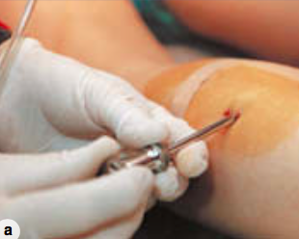
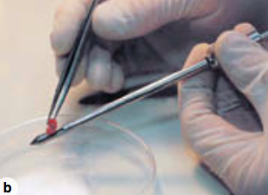
(a) The use of a biopsy needle to obtain a sample from the leg muscle of an elite female runner. (b) A close-up view of a muscle biopsy needle and a small piece of muscle tissue.

Slide 25
TERIMA KASIH

