Slide 1
GIZI KEBUGARAN
PERTEMUAN IV
Nazhif Gifari
Ilmu Gizi & FIKES

Slide 2
Fuel for Exercise: Bioenergetics an Muscle Metabolism

Slide 3
Energy Substrates
L
P
KH

Slide 4
Carbohydrate
The amount of carbohydrate utilized during exercise is related to both the carbohydrate availability and the muscles’ well-developed system for carbohydrate metabolism.

Slide 5
FAT
Fats provide a large portion of the energy utilized during prolonged, less intense exercise. Body stores of potential energy in the form of fat are substantially larger than the reserves of carbohydrate.

Slide 6
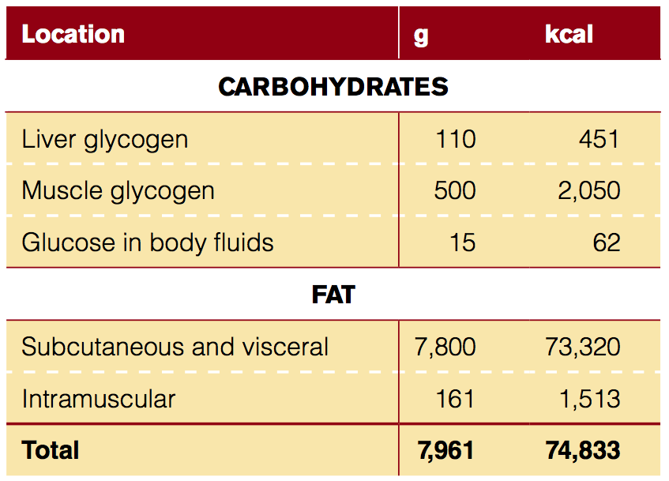
Body Stores of Fuels and Associated Energy Availability
These estimates are based on a body weight of 65 kg with 12% body fat.

Slide 7
Protein
Protein also can be used as a minor energy source under some circumstances, but it must first be converted into glucose.

Slide 8
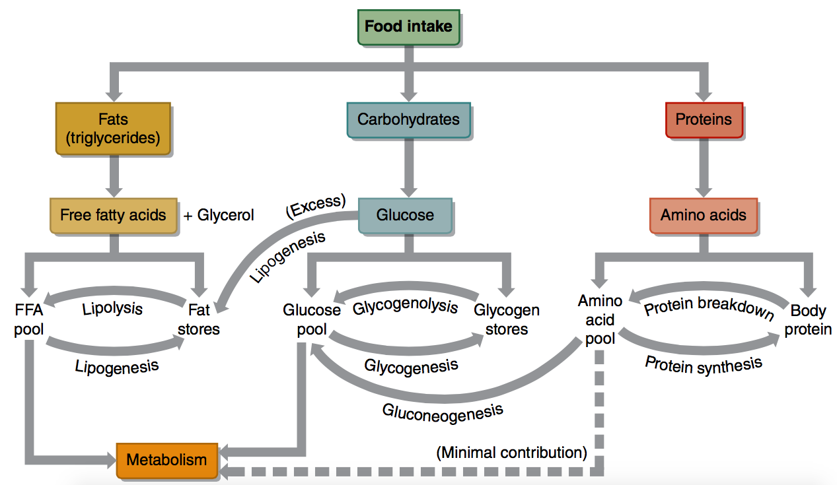
Cellular metabolism results from the breakdown of three fuel substrates provided by the diet

Slide 9
In Review
Energy for cell metabolism is derived from three substrates in foods: carbohydrate, fat, and protein.
Carbohydrate, stored as glycogen in muscle and the liver, is more quickly accessible as an energy source than either protein or fat. Glucose, directly from food or broken down from stored glycogen, is the usable form of carbohydrate.
Fat, stored as triglycerides in adipose tissue, is an ideal storage form of energy.

Slide 10
The Basic Energy Systems
The ATP-PCr system
The glycolytic system (glycolysis)
The oxidative system (oxidative phosphoryla- tion)

Slide 11
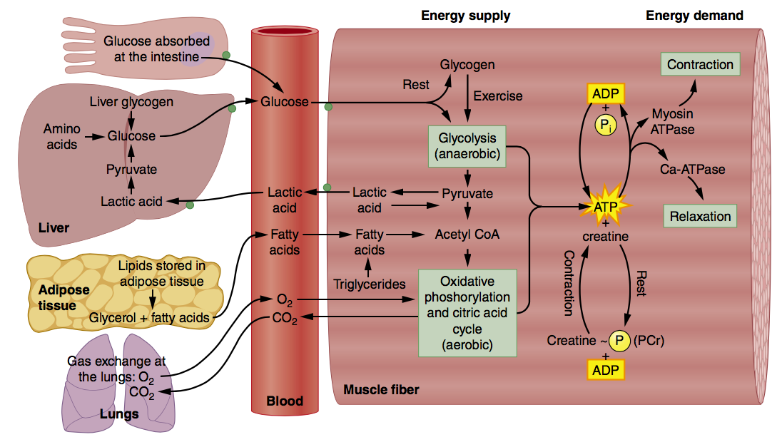
Summary of Substrate Metabolism
The metabolism of carbohydrate, fat, and to a lesser extent protein share some common pathways within the muscle fiber

Slide 12
Interaction Among the Energy Systems
The three energy systems do not work independently of one another, and no activity is 100% supported by a single energy system.

Slide 13
Characteristics of the Various Energy Supply Systems

Slide 14
In this course, we focused on energy metabolism and the synthesis of the storage form of energy in the body, ATP. We described in some detail the three basic energy systems used to generate ATP and their regulation and interaction.
Finally, we highlighted the important role that oxygen plays in the sustained generation of ATP for continued muscle contraction and the three fiber types found in human skeletal muscle. We next look at the neural control of exercising muscle.

Slide 15
Coffee Break !
What is ATP and how is it of importance in metabolism?
What is the primary substrate used to provide energy at rest? During high-intensity exercise?
What is the role of PCr in energy production? Describe the relationship between muscle ATP and PCr during sprint exercise?
Describe the essential characteristics of the three energy systems?
Why are the ATP-PCr and glycolytic energy systems considered anaerobic?
What role does oxygen play in the process of aerobic metabolism?
Describe the by-products of energy production from ATP-PCr, glycolysis, and oxidation?

Slide 16
TERIMA KASIH

