Slide 1
GIZI KEBUGARAN
PERTEMUAN V
Nazhif Gifari
Ilmu Gizi & FIKES

Slide 2
THERMOREGULATION

Slide 3
Objective
Identify environmental factors that affect thermoregulation
Describe thermal balance and discuss factors that contribute to heat gain & heat loss
Describe the body’s regulatory system for temperature control in terms of the sensory input, neural integration, and effector responses to increase or decrease heat loss
Identify the factors that influence heat exchange between an individual and the environment
Describe the goals for fluid ingestion before, during, and after exercise.

Slide 4
Thermoregulation
Many athletic competitions and recreational activities occur in settings in which hot or cold environmental conditions affect or may threaten physical performance, health, and even life
Thermoregulation is the process whereby body temperature is maintained or controlled under a wide range of such environmental conditions

Slide 5
Exercise in Environmental Extremes ?
Cold
Hot

Slide 6
Basic Concepts
Measurement of Environmental Conditions
Human thermoregulation is affected by several environmental conditions
Measurement of Body Temperature
Exercise physiologists differentiate among temperatures in different body sites; most commonly used are core temperature (Tco) and skin temperature (Tsk).

Slide 7
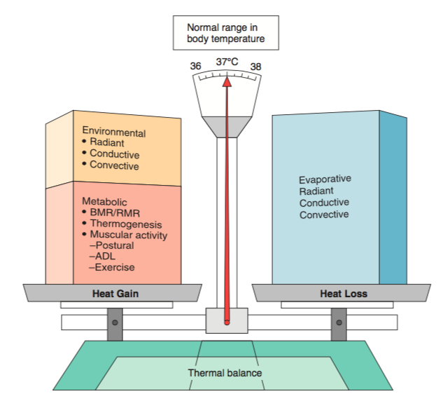
Basic Concepts
Thermal Balance
Body temperature results from a balance between heat gain and heat loss

Slide 8
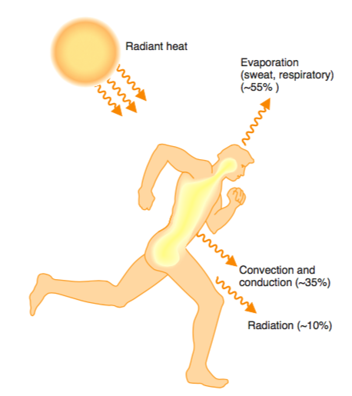
Heat Exchange
The exchange (transfer) of heat between the body and the environment occurs by the mechanisms
The effectiveness of heat exchange between an individual and the environment is affected by five factors:
The thermal gradient
The relative humidity
Air movement
The clothing worn

Slide 9
Thermoregulation
The body regulates its internal body temperature within a narrow range despite wide variations in environmental temperatures

Slide 10
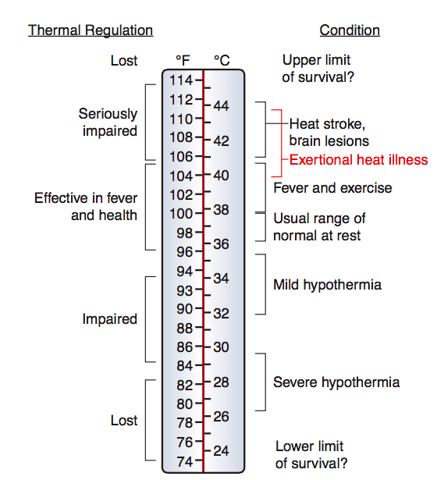
Normal Body Temperature
The human body typically regulates its temperature within approximately 1°C near 37°C

Slide 11
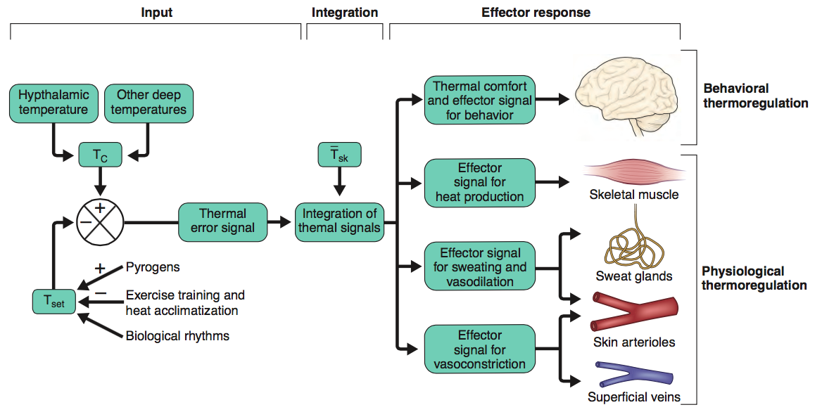
Schematic Diagramof Behavioral & Physiological Thermoregulation

Slide 12
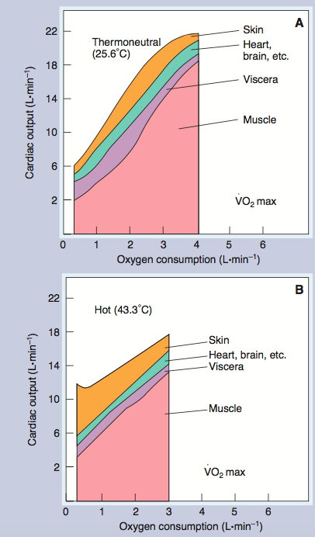
Distribution of Cardiac Output during Incremental Exercise in (A) Thermoneutral (25.6°C; 78°F)
(B) Hot (43.3°C; 110°F) Conditions.

Slide 13
Factors Affecting Cardiovascular Response to Exercise
Acclimatization
Fitness Level
Body Composition
Hydration Level

Slide 14
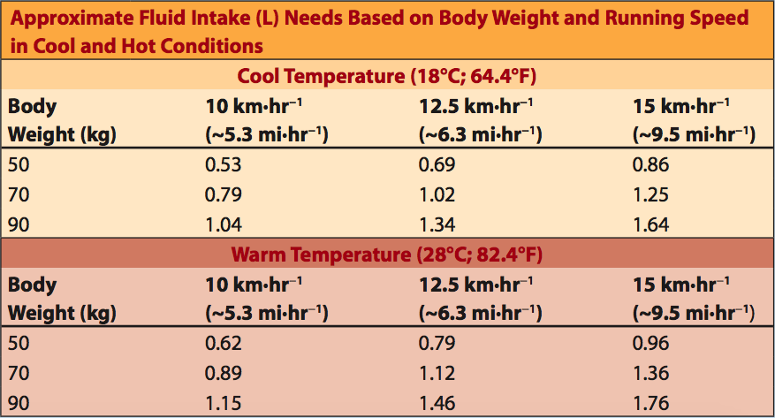
Exercise and Fluid Replacement

Slide 15
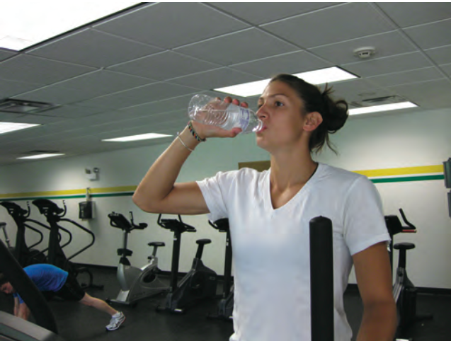
Water is an Appropriate Way to Replace Fluid Loss during Most Types of Physical Activity

Slide 16
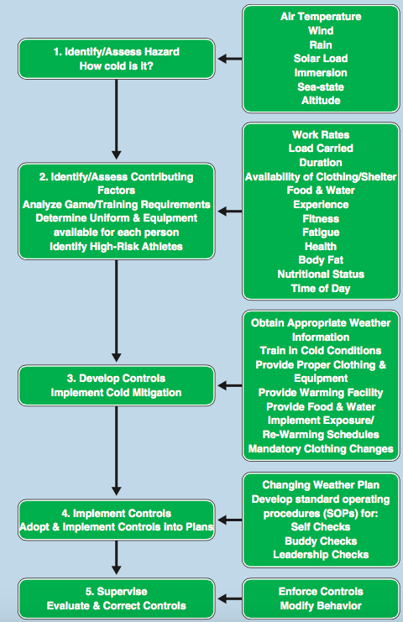
Preventing Cold Injuries during Exercise

Slide 18
Conclusion
Environmental conditions that affect human thermoregulation are ambient temperature (Tamb), relative humidity, and wind speed. The heat stress index assesses the risk of thermal injury from measures of ambient temperature and relative humidity.
An individual’s response to exercise is influenced by the degree of acclimatization, cardiovascular fitness, body composition, and hydration level.
Water balance is generally well maintained, but athletes need to pay particular attention to hydration before, during, and after exercise.
During exercise in the cold, heat loss may exceed heat production, potentially resulting in serious injuries: hypothermia

Slide 19
Coffee Break !
Discuss the effects of fitness level and body composition on an individual’s response to exercise in the heat.
Identify the factors that influence heat exchange, and discuss how each facilitates or impedes the transfer of heat to and from the body.
Explain the influence of hydration level on an individual’s response to exercise in the heat. What is necessary to maintain adequate hydration?

Slide 20
TERIMA KASIH

