Slide 1
GIZI KEBUGARAN
PERTEMUAN VI
Nazhif Gifari
Ilmu Gizi & FIKES

Slide 2
The Cardiovascular System and Exercise

Slide 3
BLOOD
Blood volume approximates 5 L, but varies in proportion to body size, endurance training status, and exposure to extreme environments (hypobaria, hyperbaria, heat, etc.)

Slide 4
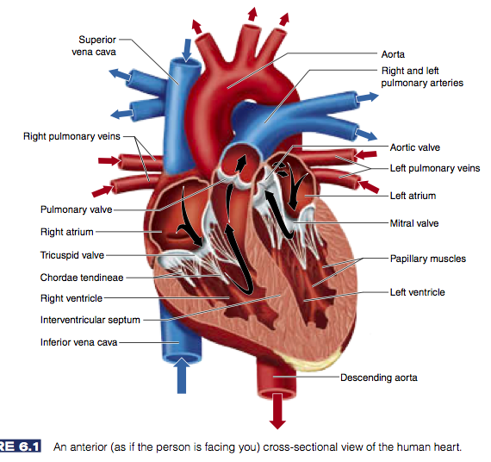

Slide 5
Cardiovascular Response to Acute Exercise
The components of the cardiovascular system must meet the increased demands for blood flow to the exercising muscle
Heart rate (HR)
Stroke volume (SV) : Jumlah darah yang dipompa oleh jantung pada setiap denyutannya
Cardiac output (Q) : Jumlah darah yang di pompa oleh jantung setiap menit.
Blood pressure (BP)
Blood

Slide 6
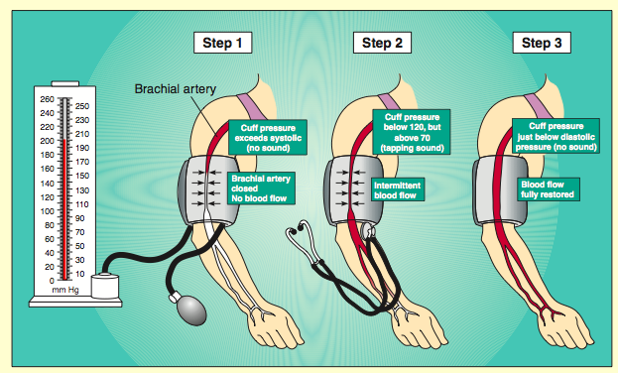

Slide 7
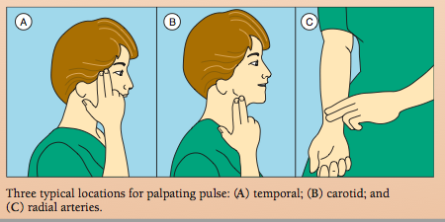

Slide 8
Cardiac output
Cardiac output (Q) = the volume of blood pumped by the heart each minute
Q (L/min) = SV (L) x HR (b/min)
for example, 5 L/min = 0.01 x 50 b/min
(rest conditions)

Slide 9
Oxygen Content in Blood
Oxygen content in arterial blood = 20 ml per 100 ml of blood
Mixed venous content (at rest) = 14 ml per 100 ml of blood
At rest: (a-v)O₂ difference = (20 ml – 14 ml) = 6 ml per 100 ml of blood
(a-v)O₂ difference increases with exercise intensity because of decreasing venous oxygen content

Slide 10
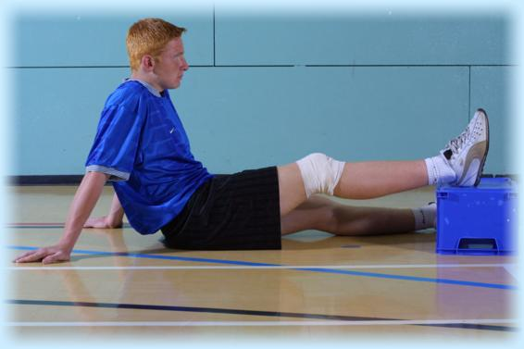
Resting Heart Rate
Averages 60 to 80 beats per minute (bpm)
Highly trained athletes: 28-40 bpm
RHR is affected by environmental factors (extreme temperatures and altitude)
Pre exercise heart rate is usually higher than RHR because of an anticipatory increase in sympathetic activity

Slide 11
Heart Rate During Exercise
HR increases in direct proportion to the increase in exercise intensity
HR will plateau at a maximum even as workload continues to increase (HR_{max})
HR_{max} remains constant day to day and declines ~1 beat per year
HR_{max} can be estimated:
HR_{max} = 220 – age in years

Slide 12
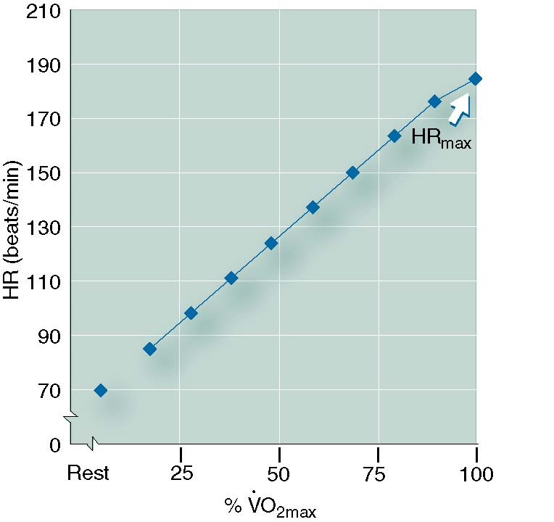
Heart Rate vs. Relative Workload

Slide 13
Steady-State Heart Rate
A heart rate that is maintained constant at submaximal levels of exercise when the rate of work is held constant. When workload is constant, HR increases rapidly until it reaches a plateau (i.e., steady state)
For each increase in workload, HR will increase to a new steady-state value in 2-3 minutes
Exercise training decreases steady-state heart rate for a given submaximal workload

Slide 14
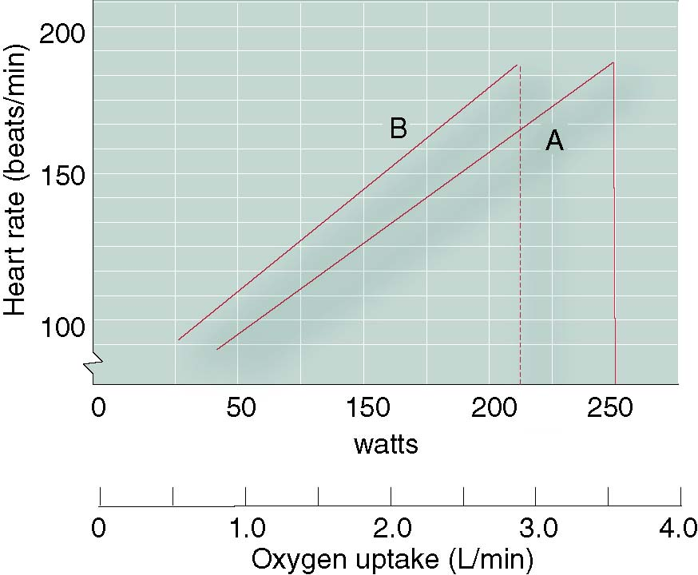
Heart Rate vs. Increasing Power Output and Oxygen Uptake in Two Subjects

Slide 15
Stroke Volume
SV is the major determinant of cardiorespiratory endurance capacity
Four factors that determine SV:
The volume of venous blood returned to the heart (preload)
Ventricular distensibility
Ventricular contractility
Aortic or pulmonary artery pressure (afterload)

Slide 16
Stroke Volume Increases With Exercise
SV increases with increases in work rate
SV usually plateaus at ~40-60% of VO_{2max}
SV is influenced by body position due to postural differences in venous return to the heart

Slide 17
Key Points
As exercise intensity increases, HR increases proportionately, up to maximal
SV increases proportionately with increasing exercise intensity but usually achieves its maximal value at ~40-60% of VO_{2max} in untrained individuals
Highly trained individuals can increase SV up to maximal exercise intensities
Increases in HR and SV combine to increase cardiac output

Slide 18
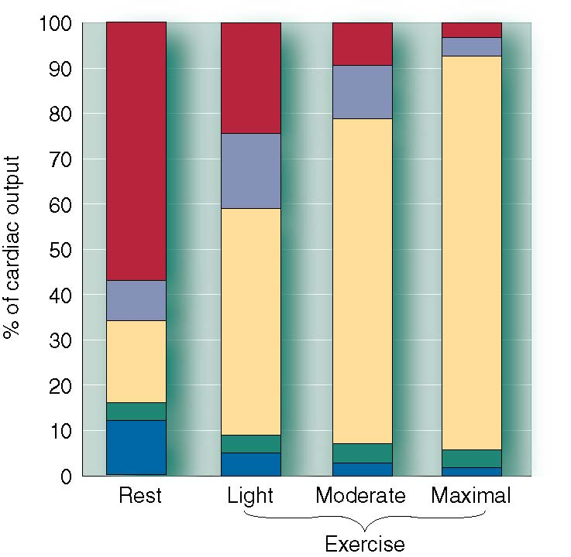
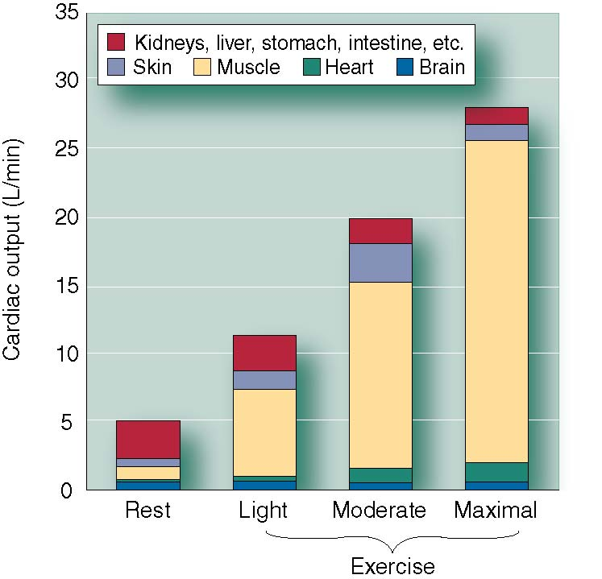
Distribution of Cardiac Output at Rest and During Exercise
Data from A.J. Vander, J.H. Sherman, and D.S. Luciano, 1985, Human physiology: The mechanisms of body function, 4th ed. (New York: McGraw-Hill).

Slide 19
TERIMA KASIH

