Slide 1
GIZI KEBUGARAN
PERTEMUAN VII
Nazhif Gifari
Ilmu Gizi & FIKES

Slide 2
Skeletal System & Muscle System

Slide 3
The Skeleton System
Bones protect our vital organs.
Inside the bone is jelly-like bone marrow.
As you grow older some of your bones grow together.

Slide 4
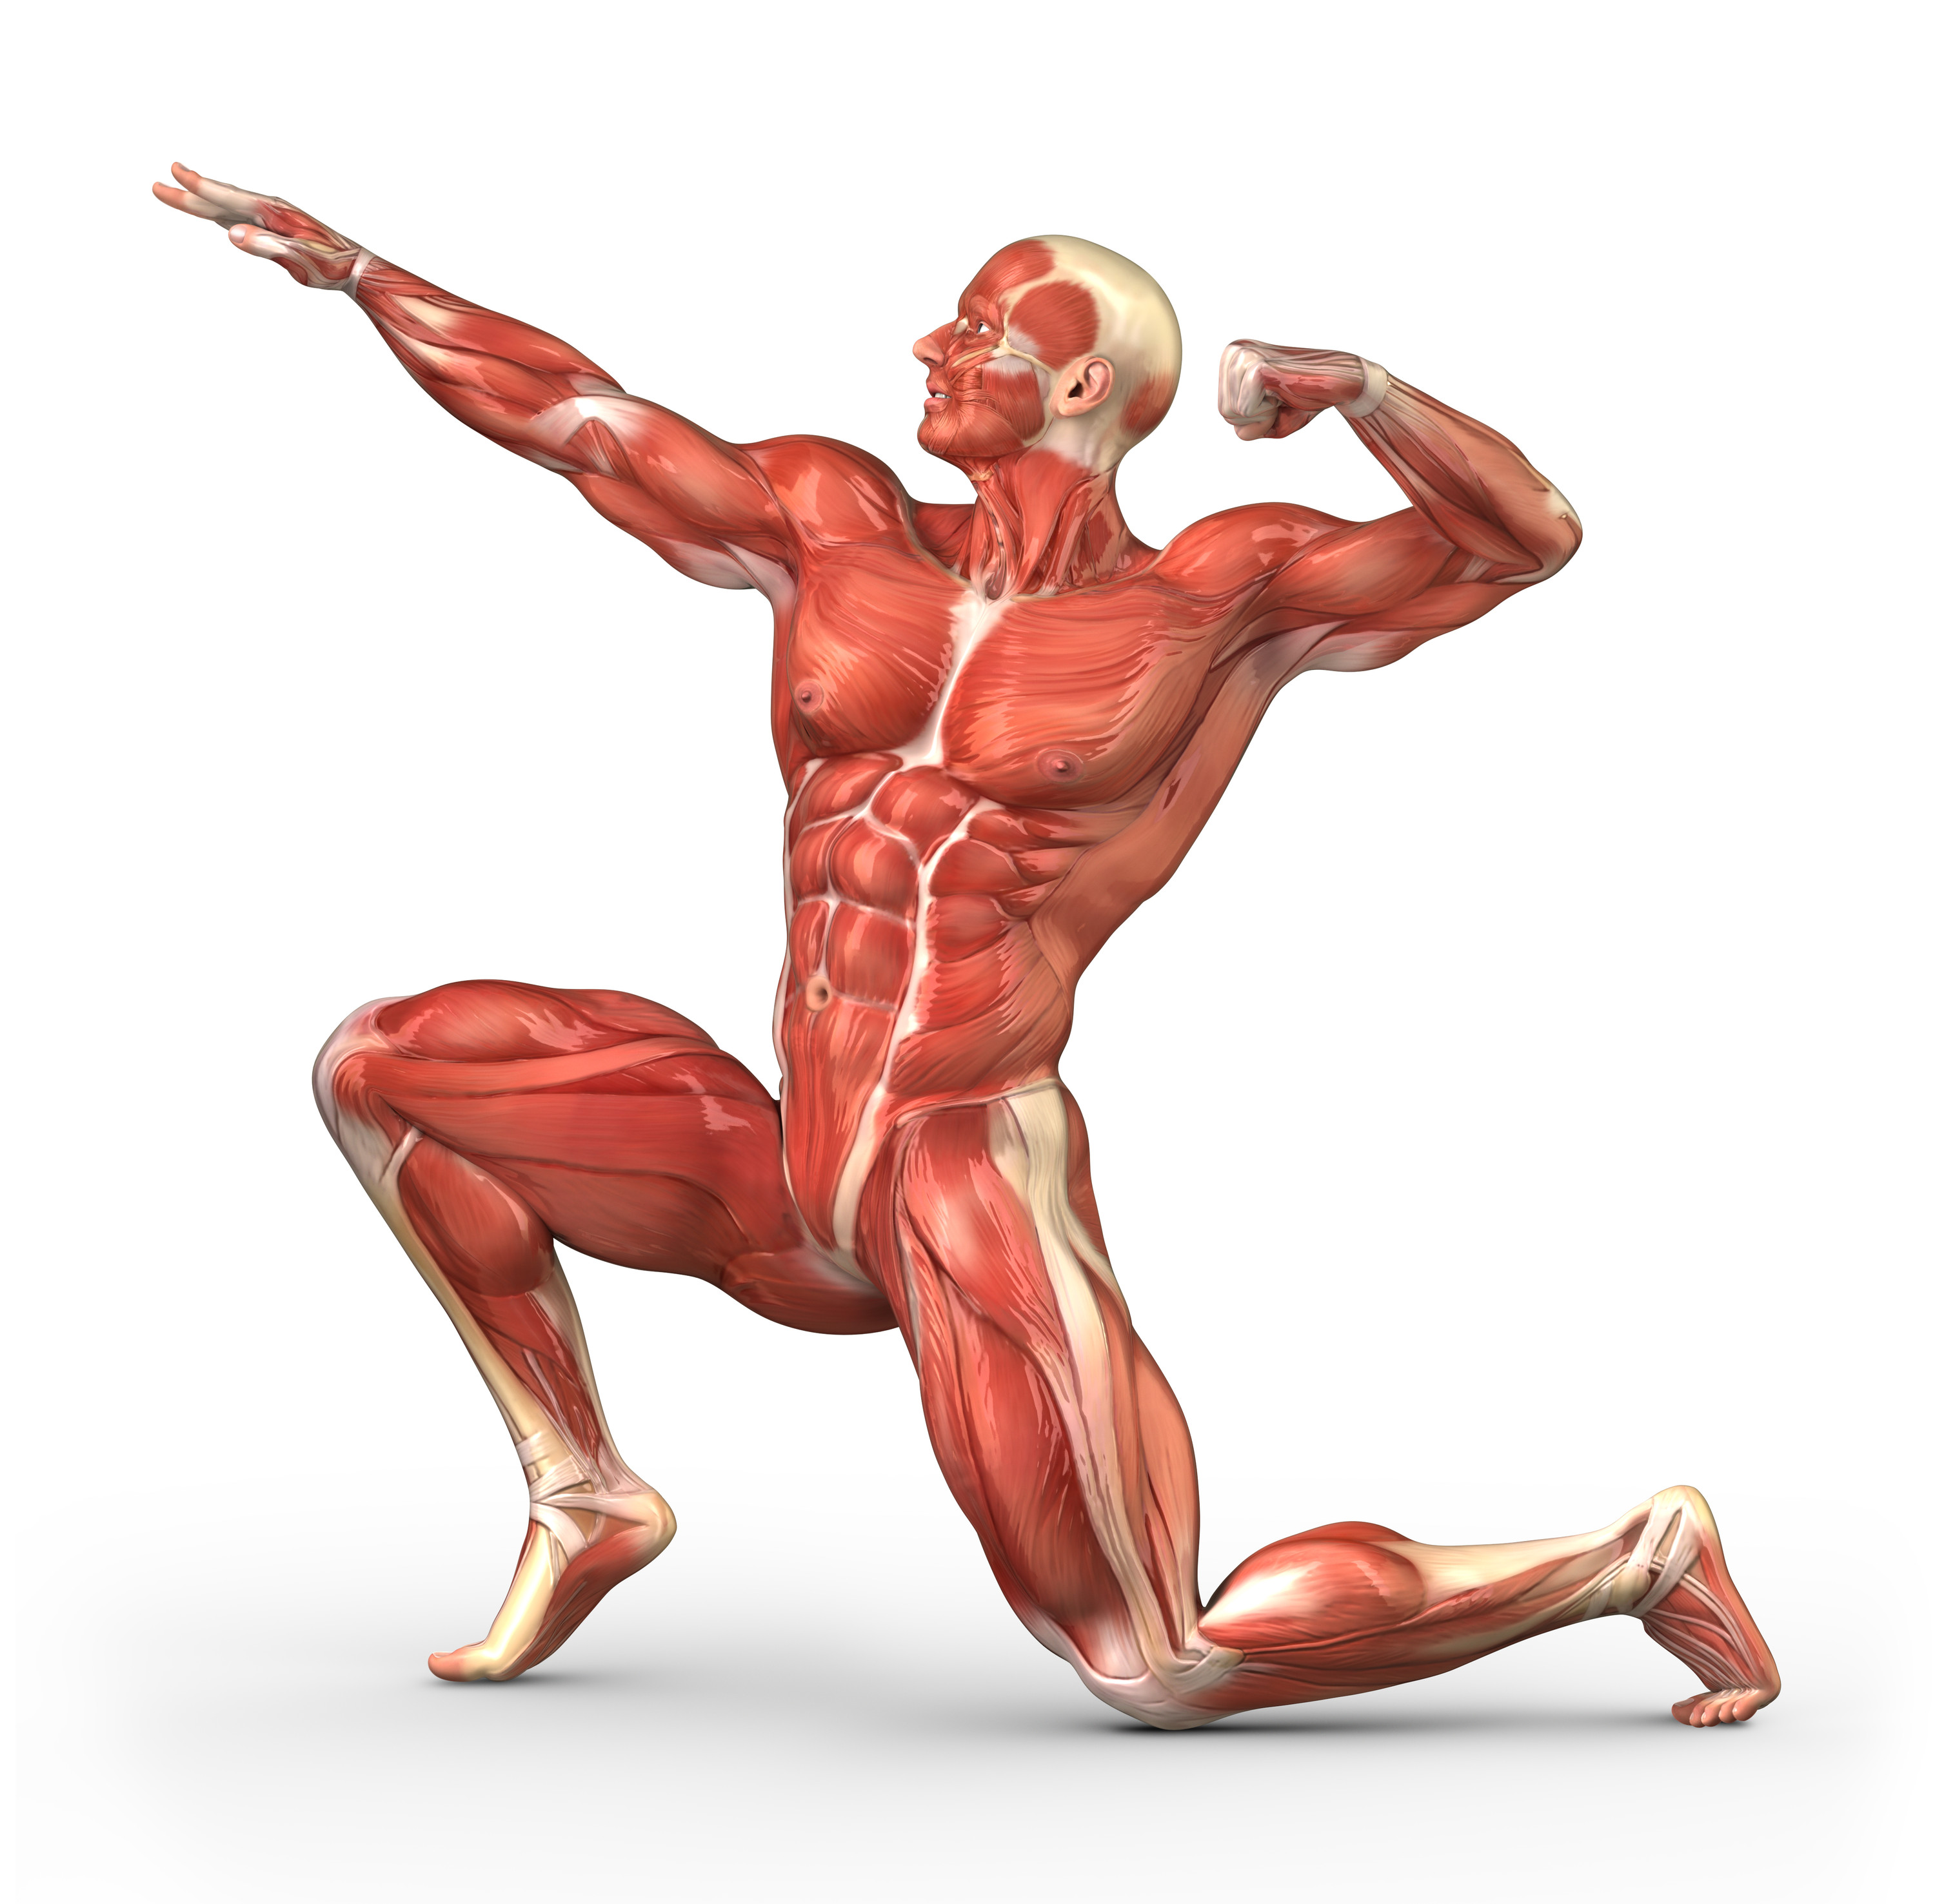
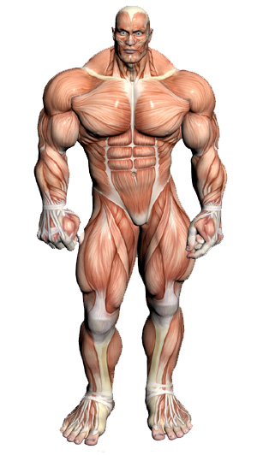

Slide 5
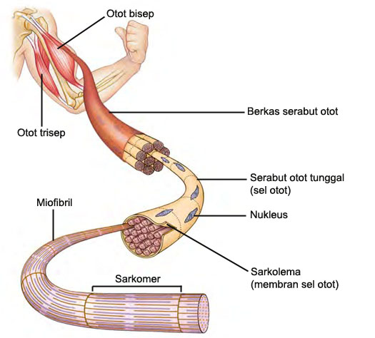
Contraction of a Skeletal Muscle
Individual muscle fiber contraction is “all or none”
Within a skeletal muscle, not all fibers may be stimulated
Different combinations of muscle fiber contraction give variations in response

Slide 6
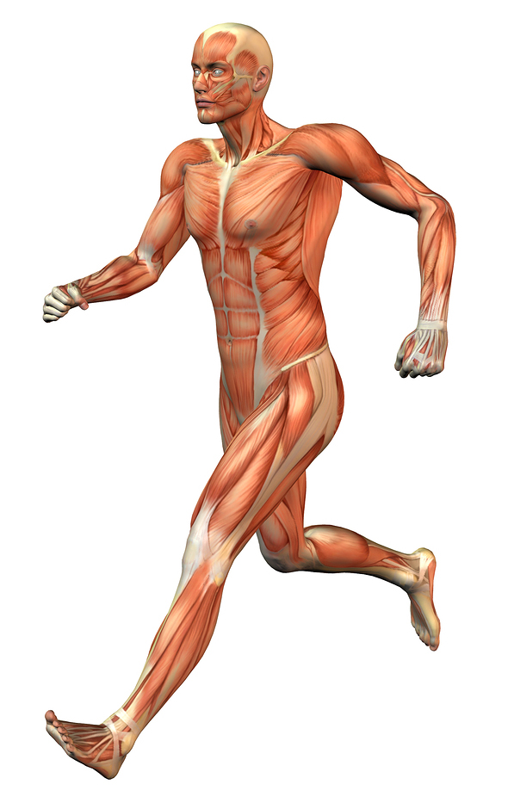
Immediate effects of exercise on the muscular system
Increase in muscle temperature
Increase in blood supply to the muscles as the capillaries dilate.
Muscle temperature increases- warm muscles are more pliable and the risk of damage and injury is reduced.
Fatigue and build up of lactic acid

Slide 7
Long term effects of exercise on the muscular system
Increased numbers of mitochondria (the cells powerhouse) means an increase in the rate of energy production.
The amount of myoglobin within skeletal muscle increases, which allows more Oxygen to be stored within the muscle, and transported to the mitochondria.
Muscles are capable of storing a larger amount of glycogen for energy.

Slide 8
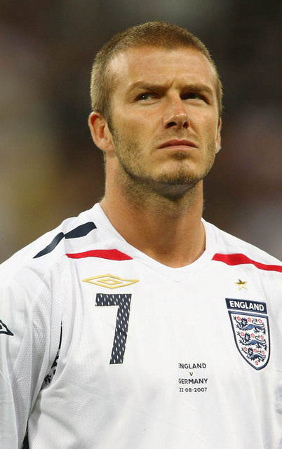
Rest Required for Adaptation
Rest allows muscles to repair the damage caused by exercise, rebuild before the next exercise session and strengthen. This is how muscles develop.

Slide 9
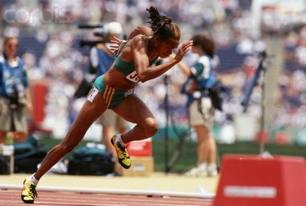
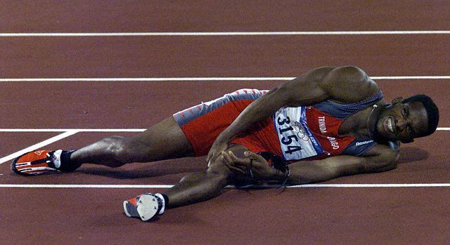
Potential for injury
SOFT TISSUE INJURIES
The most common muscular injuries are strains, pulls and tears.
The small muscle fibres may be torn away from their attachment to the tendon.
During in intense competition the muscle fibres contract very quickly and this can cause a tear in the connective tissue.
A thorough warm up can greatly reduce the risk of injury.

Slide 10
Effect of Exercise on Skeletal System

Slide 11
FUNCTION
Movement
Bones meet to form JOINTS. Tendons attach muscles (which cause the movement) to bones.
Support
We are able to stand and form other complex positions. The skeleton gives a framework and affects size/body composition.
Protection
Vital organs are protected e.g. cranium (brain), ribs (heart/lungs).

Slide 12
Exercise and the Skeletal System
Bones continue to grow until 18 ages. Regular exercise helps to develop bone structure.
Exercise helps by:
Increasing bone density
Tendons and ligaments become thicker, increasing flexibility and power

Slide 13
BONES
During high-impact exercise such as running or weightlifting, the bone breakdown rate at the cellular level is relatively high.
However, the mechanical strain on the bones recruits proteins to rebuild the bone specifically at the sites of stimulus.
→denser bones more capable of with standing impact if you consistently provide this stimulus.

Slide 15
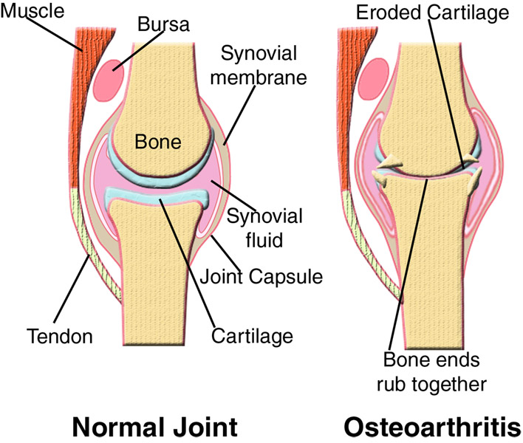

Slide 16
TERIMA KASIH

