Slide 1
UNDERSTANDING COMMUNICATION AND NETWORKS
PERTEMUAN 10
Ir. Nizirwan Anwar, MT
MIK | FAKULTAS ILMU-ILMU KESEHATAN

Slide 2
Outline Materi
Computer for Communications
Network
Communication Devices
Transmission Media

Slide 3
Komunikasi
Yang dibutuhkan dalam melancarkan suatu komunikasi, yaitu:
Sending device — initiates instruction to transmit data, instructions, or information
Communications device — connects the sending device to the communications channel
Communications channel — media on which data, instructions, or information travel
Communications device — connects the communications channel to the receiving device
Receiving device — accepts transmission of data, instructions, or information

Slide 4
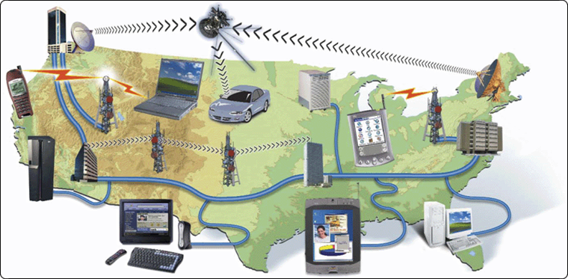
Komputer komunikasi
Dua atau lebih komputer, atau perangkat yang saling bertukar data, instruksi dan informasi
smart phones
notebook computers
Web-enabled PDAs
servers
GPS receivers
desktop computers
mainframe computers
set-top boxes
Tablet PCs

Slide 5
Yang Dibutuhkan Dalam Komputer Komunikasi Adalah:
Perangkat pengirim yang memulai instruksi untuk mengirim data.
Perangkat komunikasi yang menghubungkan pengirim ke komunikasi.
Saluran komunikasi atau media tranmisi.
Perangkat komunikasi yang menghubungkan komunikasi kepenerima.
Perangkat penerima yang menerima pengiriman data.

Slide 6
Wireless Messaging Services
Tiga teknik yang digunakan untuk send and receive wireless messages:
Text messaging
Picture/video messaging
Wireless instant messaging

Slide 7
Text Messaging
Beberapa Opsi Layanan Text Messaging untuk mengirim dan menerima pesan, yaitu:
Mobile to Mobile
Mobile to Email
Web to Mobile
Mobile to Provider
Mengirim pesan dengan memasukkan nomor empat atau lima digit yang ditetapkan ke konten tertentu atau penyedia layanan nirkabel, diikuti oleh pesan tersebut
Contoh:
Suara untuk sebuah program televisi (suara kontestan pencarian bakat)

Slide 8
Picture/Video Messaging
MMS
(Multimedia Message Service)
With picture messaging
users can send pictures and sound files
short text messages
With video messaging
users can send short video clips
Mobile to Mobile
Mobile to Email

Slide 9
Penggnaan Komunikasi Komputer
Global Positioning System (GPS) adalah:
Sistem navigasi yang terdiri dari satu atau lebih penerima earth-based yang menerima dan menganalisa sinyal yang dikirim oleh satelit untuk menentukan lokasi geografis penerima.

Slide 10
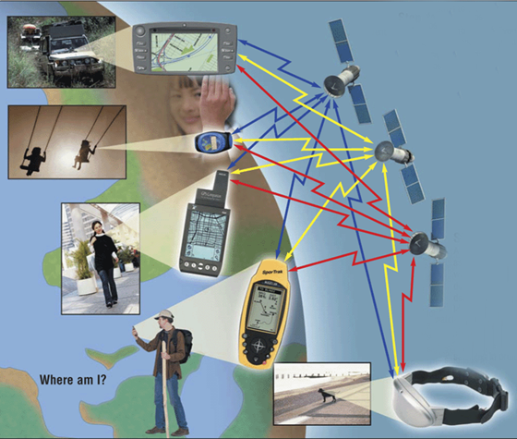
Penggnaan Komunikasi Komputer
Global Positioning System (GPS) adalah:
Step 1. GPS satellites orbit Earth. Every thousandth of a second, each satellite sends a signal that indicates its current position to the GPS server.
Step 2. A GPS receiver (such as in a car, a PDA, a watch, a handheld device, or a collar) determines its location on Earth by analyzing at least 3 separate satellite signals from the 24 satellites in orbit.

Slide 11
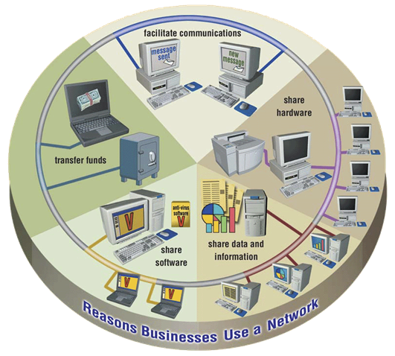
Networks
What is a Networks
A collection of computers and devices connected together via communications devices and transmission media.

Slide 12
Local Area Network
What is a Local Area Network ??
Network that connects computers and devices in a limited
geographical area such as a home, school computer laboratory, office building, or closely positioned
group of buildings.
Wireless LAN (WLAN)
LAN that uses no physical wires

Slide 13
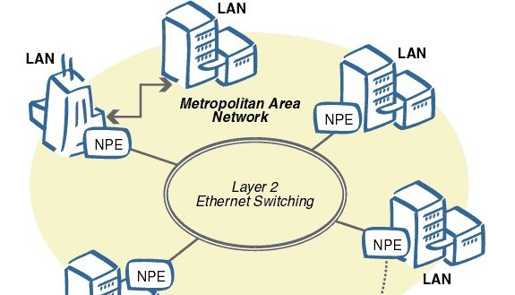
Metropolitan Area Network (MAN)
A high-speed network that connects local area networks in a metropolitan area.
Such as a city or town and handles the bulk of communications activity across that region.

Slide 14
Wide Area Network (WAN)
A network that covers a large geographic area (such as a city, country, or the world) using a communications channel that combines many types of media
Such as telephone lines, cables, and radio waves
WAN can be one large network or
can consist of two or more LANs connected together.

Slide 15
Network Architectures
Perancangan komputer
Perancangan perangkat komputer
Perancangan media dalam suatu jaringan
Dikategorikan sebagai;
Client / server
Peer to peer

Slide 16
Client/Server
Server controls access to the
Hardware
Software and
Other resources on the network and provides a centralized storage area for programs, data, and information.
clients are other computers
and mobile devices on the network that rely
on the server for its resources.

Slide 17
Peer-to-Peer
Jaringan yang menghubungkan kurang dari 10 komputer
Setiap komputer, yang disebut peer, memiliki tanggung jawab dan kemampuan yang sama, berbagi perangkat keras (seperti printer), data, atau informasi dengan komputer lain di jaringan peer-to-peer

Slide 18
Internet Peer-to-Peer
Menggambarkan jaringan internet dimana pengguna mengakses hard disk masing-masing dan bertukar file secara langsung.
Jaringan peer-to-peer jenis ini kadang disebut jaringan file sharing karena pengguna dengan perangkat lunak yang kompatibel dan salinan file koneksi internet dari hard disk orang lain ke hard disk mereka.

Slide 19
Network Topologies
Star Network
Refers to the layout of the computers and devices in a communications Network.
Three commonly used network topologies are:
Star
Bus, and
Ring
All of the computers and devices (nodes) on the network Connect to a central device

Slide 20
Bus Network
Bus network consists of a single central cable, to which all computers and other Devices connect

Slide 21
Ring Network
On a ring network, a cable forms a closed loop (ring) with all computers and devices arranged along the ring
Data transmitted
on a ring network travels from
device to device around the entire ring, in one direction

Slide 22
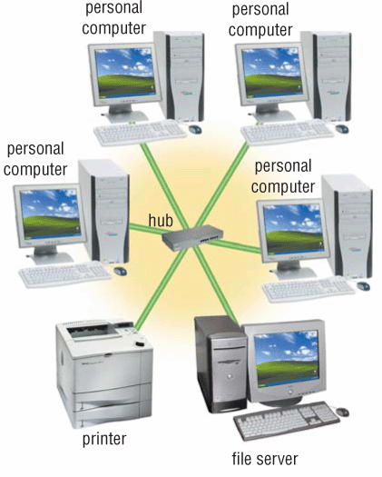
What is a star network ?
All devices connect to a central device, called hub
All data transferred from one computer to another passes through hub

Slide 23
Intranets (intra means within)
internal network that uses Internet technologies
Network Communications Standards
A network standard defines guidelines that specify the
way computers access the medium to which they are;
Attached
The type(s) of medium used
The speeds used on different types of networks
The type(s) of physical cable and/or the wireless technology used.

Slide 24
TCP/IP (Transmission Control Protocol/Internet Protocol)
Standar jaringan, khususnya protokol, yang mendefinisikan bagaimana pesan (data) diarahkan dari satu ujung jaringan ke ujung yang lain.
TCP / IP menjelaskan aturan untuk membagi pesan menjadi potongan kecil, yang disebut paket; menyediakan alamat untuk setiap paket; memeriksa dan mendeteksi kesalahan; paket sekuensing; dan mengatur arus pesan sepanjang jaringan

Slide 25
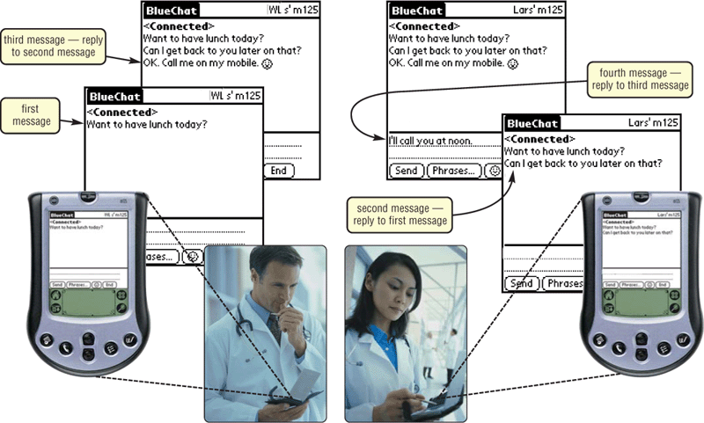
What is Bluetooth?
Short-range radio waves transmit data between Bluetooth devices

Slide 26
What are IrDA, RFID, and Wireless Applications Protocol (WAP)?
Radio Frequency Identification (RFID) uses radio signals to communicate with a tag placed in an object
IrDA specification allows data to be transferred wirelessly via infrared light waves
Wireless Applications Protocol (WAP) allow wireless mobile devices to access Internet

Slide 27
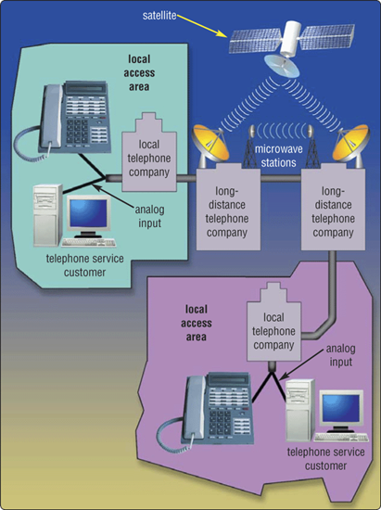
What is the public switched telephone network (PSTN)?
Worldwide telephone system that handles voice-oriented telephone calls

Slide 28
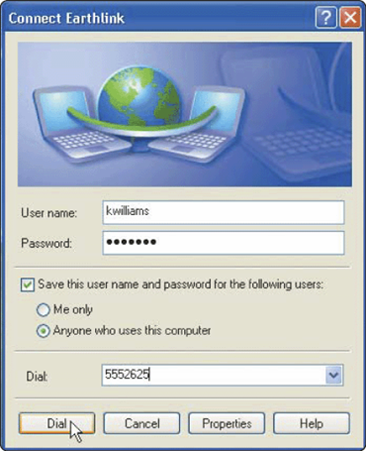
What is a dial-up line?
Temporary connection using telephone line for communications
Costs no more than making regular call
Computers at any two locations can establish a connection using modems and telephone network

Slide 29
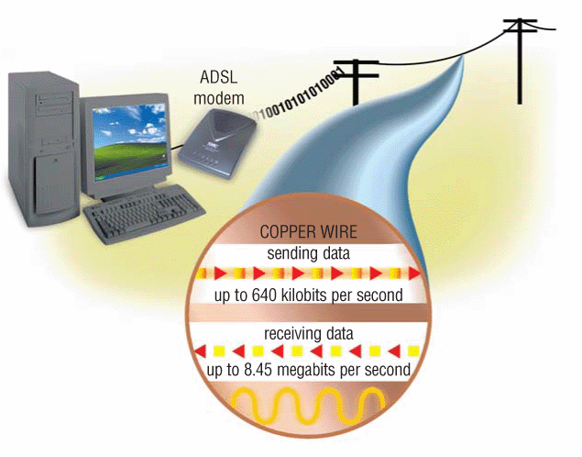
What is an ADSL (asymmetric digital subscriber line)?
Popular type of DSL (Digital Subscriber Line)
Faster when receiving data than when sending data
Ideal for Internet access

Slide 30
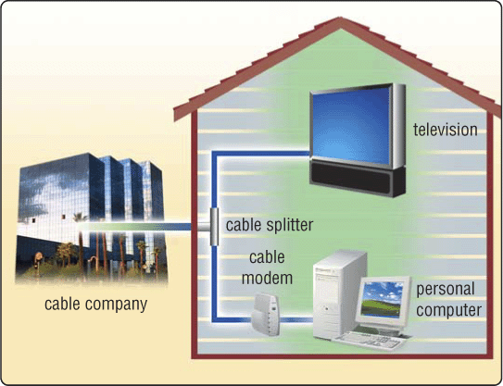
What is a cable modem?
Sends and receives data over cable television network
Much faster than dial-up modem or ISDN
Sometimes called a broadband modem

Slide 31
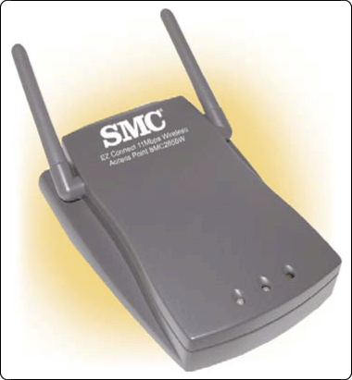
What is a wireless access point?
Central communications device that allows computers and devices to transfer data wirelessly among themselves or to wired network

Slide 32
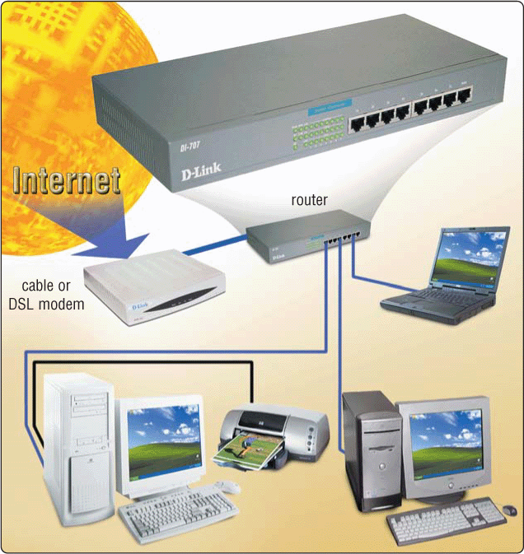
What is a router?
Connects computers and transmits data to correct destination on network
Routers forward data on Internet using fastest available path

Slide 33
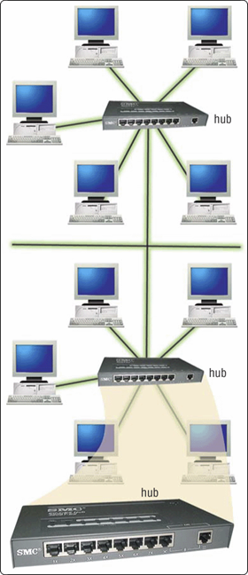
What is a hub?
Device that provides central point for cables in network

Slide 34
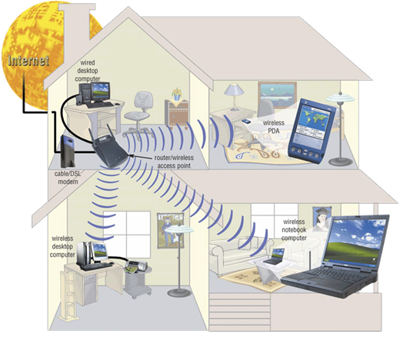
What is a home network?
Multiple computers connected in home
Several types of home networks
Ethernet — connect computers via cable
Powerline cable — use electrical lines in house
Phoneline — use telephone lines
HomeRF (radio frequency) — wireless

Slide 35
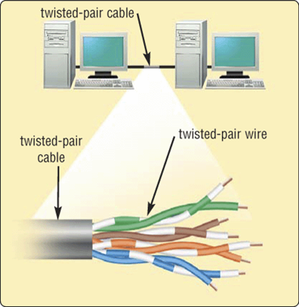
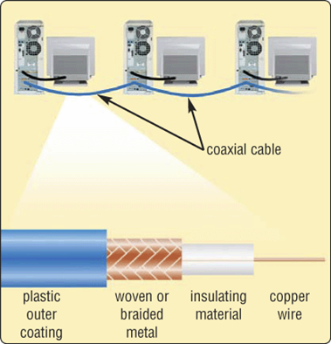
Physical Transmission Media
What are twisted-pair cable and coaxial cable?
Twisted-pair cable is used for telephone systems and network cabling
Coaxial cable is often used for cable television wiring

Slide 36
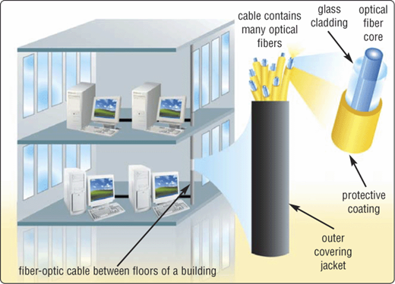
What is fiber-optic cable?
Capable of carrying significantly more data at faster speeds than wire cables
Less susceptible to interference (noise) and, therefore, more secure
Smaller size (thinner and lighter)

Slide 37
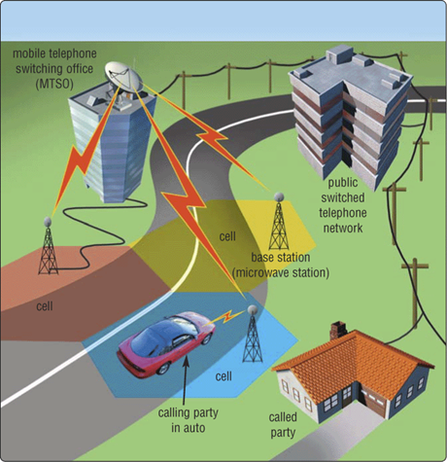
Wireless Transmission Media
What are broadcast radio and cellular radio?
Broadcast radio distributes radio signals over long and short distances
Cellular radio is form of broadcast radio used for mobile communications

Slide 38
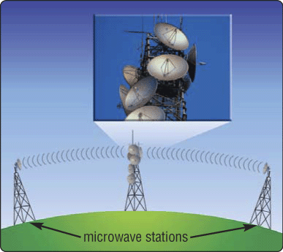
What is a microwave station?
Earth-based reflective dish used for microwave communications
Must transmit in straight line with no obstructions

Slide 39
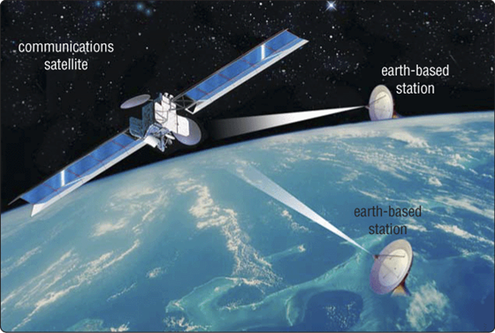
What is a communications satellite?
Space station that receives microwave signals from earth-based station, amplifies signals, and broadcasts signals back to any number of earth-based stations

Slide 40
Daftar Pustaka
Vermat, Sebok, Freund, Campbell, Frydenberg. 2016. Discovering Computers 2016 Tools, Apps, Devices, and the Impact of Technology. ISBN: 13:978-1-305-39185-7

Slide 41
Terima Kasih

