Slide 1
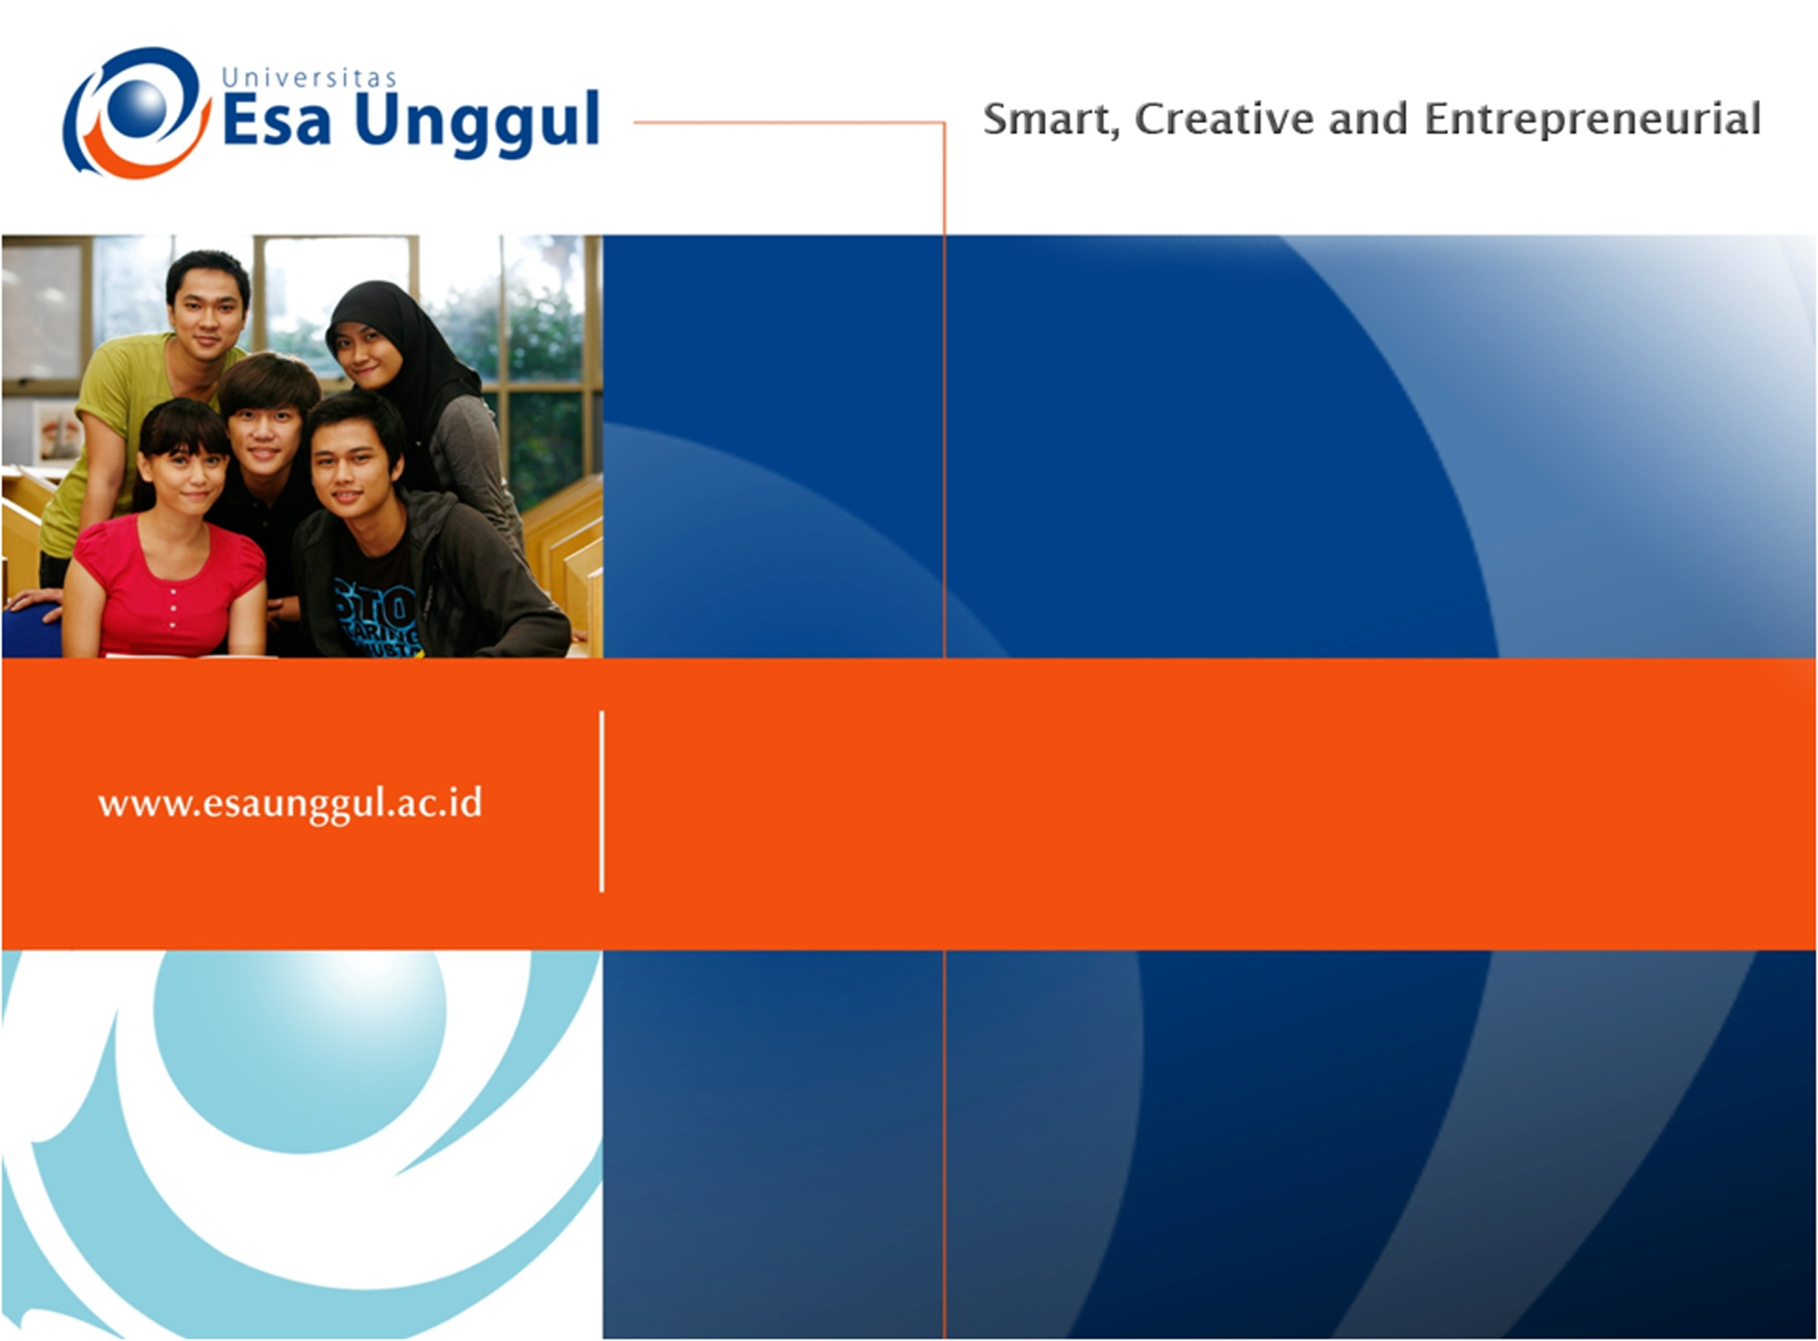
OPERATING SYSTEMS
PERTEMUAN 8
Ir. Nizirwan Anwar, MT
PRODI MIK | FAKULTAS ILMU-ILMU KESEHATAN

Slide 2

Learning Outcomes
Pada akhir pertemuan ini, diharapkan mahasiswa mampu menjelaskan jenis dan fungsi sistem operasi pada komputer

Slide 3
Outline Materi
Fungsi Sistem Operasi
Tipe Sistem Operasi
Sistem Operasi Stand-Alone
Utility Programs

Slide 4
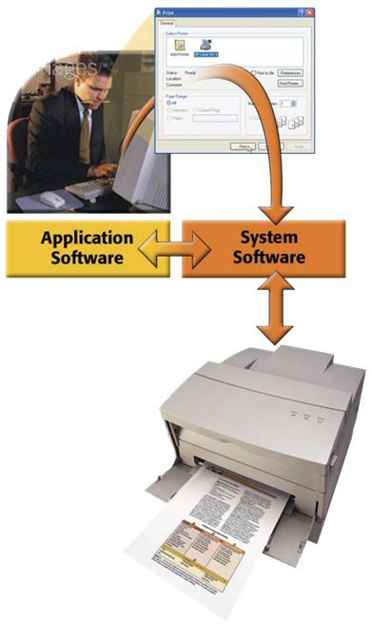
Software Sistem
Terdiri dari program yang mengendalikan dan memelihara peralatan operasi komputer
Perangkat lunak sistem berfungsi sebagai interface diantara user, aplikasi perangkat lunak dan perangkat keras komputer

Slide 5
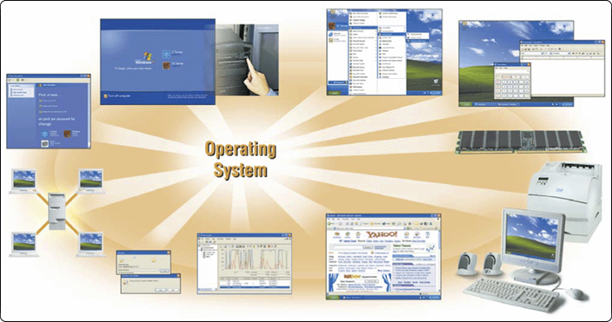
Sistem Operasi
Seperangkat program yang berisi instruksi, bekerjasama untuk mengkoordinasikan semua aktivitas diantara computer hardware resources
start the computer
provide a user interface
manage programs
administer security
manage memory
control a network
provide file management and other utilities
monitor performance
establish an Internet connection
schedule jobs and configure devices

Slide 6
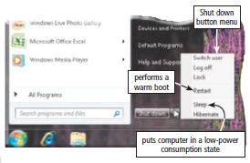
Fungsi Sistem Operasi
Starting and Shutting Down a Computer
Booting adalah process of starting or restarting a computer
Cold Boot dilakukan saat menyalakan komputer yang telah dimatikan sepenuhnya.
Warm Boot adalah proses menggunakan sistem operasi untuk me-restart komputer

Slide 7
Starting and Shutting Down a Computer
Sleep Mode
Menyimpan semua dokumen dan program yang terbuka ke RAM
Mematikan semua fungsi yang tidak dibutuhkan
Memposisikan komputer dalam tegangan/daya rendah
Hibernate
Menyimpan semua dokumen dan program yang terbuka ke Harddisk sebelum melepaskan daya dari komputer

Slide 8
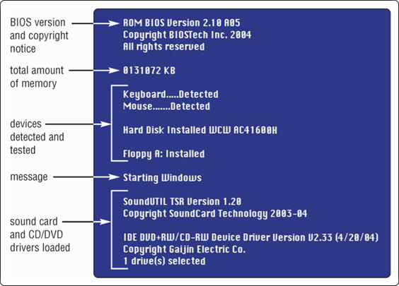
Fungsi Sistem Operasi
What messages display on the screen when you boot the computer?

Slide 9
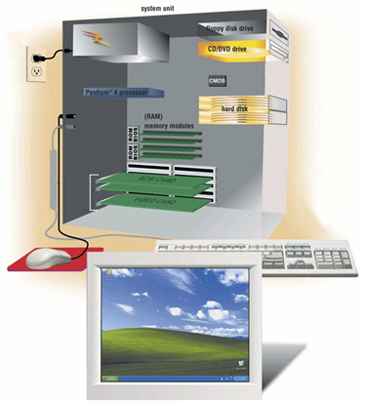
Fungsi Sistem Operasi
How does a personal computer boot up?
Step 1. Power supply sends signal to com-ponents in system unit
Step 4. Results of POST are compared with data in CMOS chip
Step 5. BIOS looks for system files in floppy disk drive or CD/DVD drive, and then hard disk
Step 2. Processor accesses BIOS to start computer
Step 6. Kernel (core) of operating system loads into RAM
Step 3. BIOS runs tests, called the POST, to check components such as mouse, keyboard, and adapter cards
Step 7. Operating system loads configuration information and displays desktop on screen

Slide 10
Menyediakan User Interface
User berintraksi dengan perangkat lunak melalui user interface, dimana user mengontrol cara memasukkan data, memberikan instruksi, dan cara menampilkan informasi pada layar
Back Button
Start
menu
Link
graphical user interface
Start Button
Notes:
graphical user interface)

Slide 11
Menyediakan User Interface
Command Entered by User
Command Prompt
Command line interface
Notes:
graphical user interface)

Slide 12
Menyediakan User Interface
Command line interface
Untuk mengkonfigurasi perangkat
Mengatur sumber daya sistem
Problem solving terhadap koneksi jaringan
Administrator jaringan
Notes:
Konfigurasi sistem komputer adalah melakukan settingan atau setelan pada sistem komputer agar komputer tersebut bisa masuk ke sistem jaringan dengan baik dan benar

Slide 13
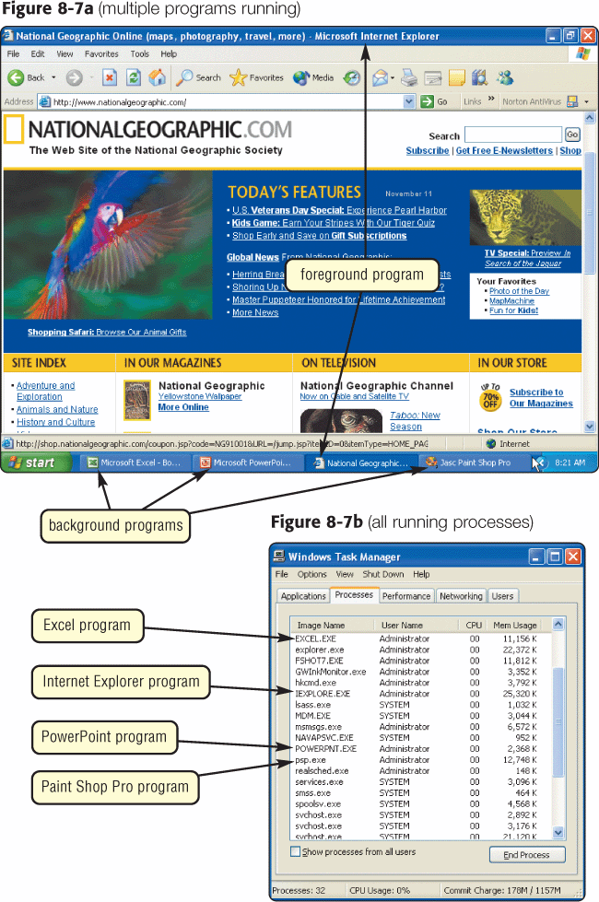
What is single user/ multitasking?
  Working on two or more programs that reside in memory at same time
    Foreground contains program you are using
    Background contains
    programs that are
    running but are not
    in use

Slide 14
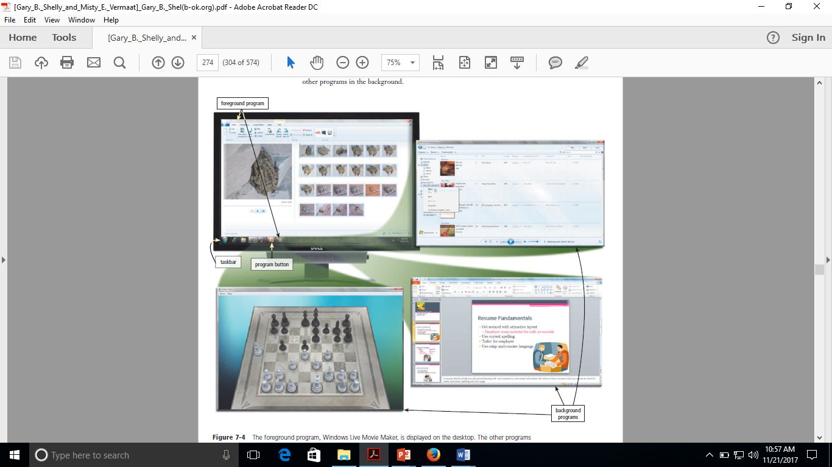

Slide 15
Sistem operasi multiuser memungkinkan dua pengguna atau lebih untuk menjalankan program secara bersamaan.
Contoh: Jaringan, server, mainframe, dan superkomputer memungkinkan ratusan hingga ribuan pengguna untuk terhubung pada saat bersamaan.
Sistem operasi multi-processing mendukung dua atau lebih prosesor yang menjalankan program pada saat bersamaan.

Slide 16
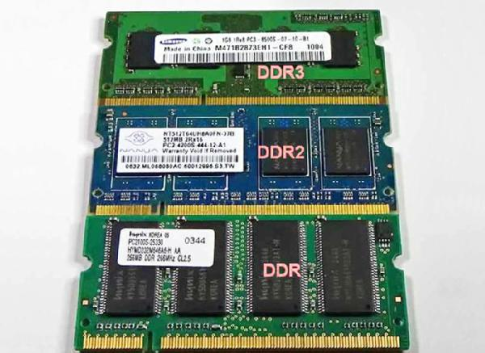
Managing Memory
Memory Management adalah mengoptimalkan penggunaan Random Access Memory (RAM)
Memori virtual adalah konsep dimana sistem operasi mengalokasikan sebagian media penyimpanan, biasanya hard disk, berfungsi sebagai RAM tambahan.

Slide 17
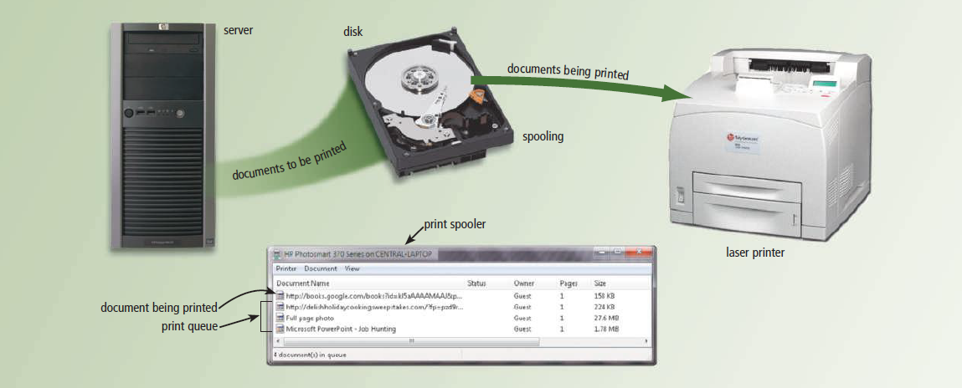
What is Spooling?
The operating system commonly uses buffers with printed documents.
Sends documents to be printed to a buffer instead of directly to printer
Print jobs line up in queue

Slide 18
Buffer adalah area memori yang menyimpan data ketika mereka sedang dipindahkan antara dua perangkat atau antara perangkat dan aplikasi.
Buffer dilakukan untuk tiga alasan
Untuk mengulangi kesalahan yang terjadi karena perbedaan kecepatan antara produsen dengan konsumen dari sebuah stream data.
Menyesuaikan device-device yang mempunyai perbedaan dalam ukuran transfer data.
Mendukung copy semantics untuk aplikasi I/O.

Slide 19
What is a device driver?
Program that
tells operating system
how to communicate
with device
With Plug and Play, operating system automatically configures new devices as you install them
Device Driver

Slide 20
Establishing an Internet Connection
Establish Internet connections.
Set up the Internet connection.

Slide 21
Monitoring Performance
Operating systems typically contain a performance monitor
Performance monitor is a program that assesses and reports information about various computer resources and devices
The information in performance reports helps users and administrators identify a problem with resources so that they can try to resolve any problems.

Slide 22
Administering Security
multiuser operating systems allow each user to log on, which is the process of entering a user name and a password into the computer.

Slide 23
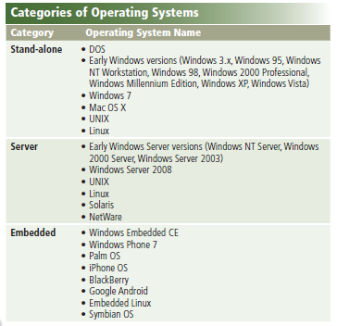


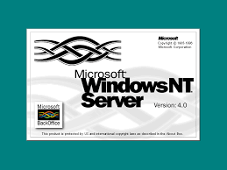
Types of Operating Systems
Notes:
Embedded = menempelkan

Slide 24
Stand-Alone Operating System
Sistem operasi lengkap yang bekerja pada komputer desktop, komputer notebook, atau perangkat komputasi mobile
Disebut sebagai sistem operasi klien, karena berhubungan dengan sistem operasi server
Sistem operasi klien dapat beroperasi dengan atau tanpa jaringan
Notes:
Embedded = menempelkan

Slide 25
Linux is one of the faster growing operating systems
Linux has a graphical user interface
UNIX have a graphical user interface.
Notes:
Embedded = menempelkan

Slide 26
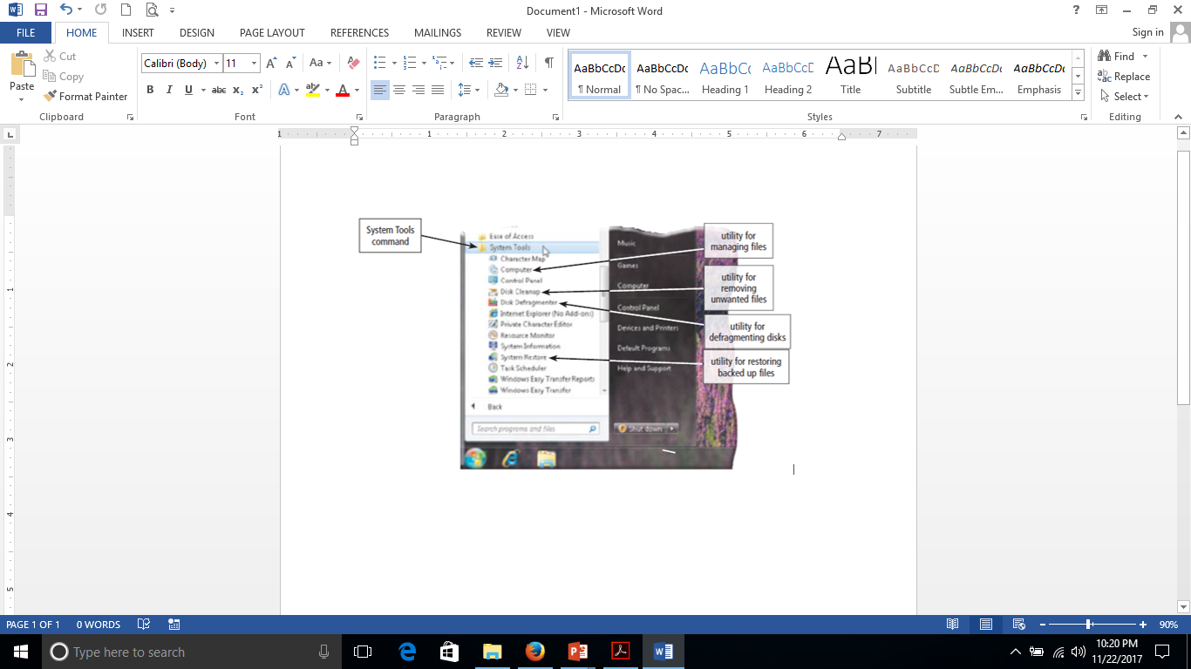
Utility Programs
  System software that performs maintenance-type tasks
  Also called utility
Notes:
Embedded = menempelkan
Utility = Kegunaan

Slide 27
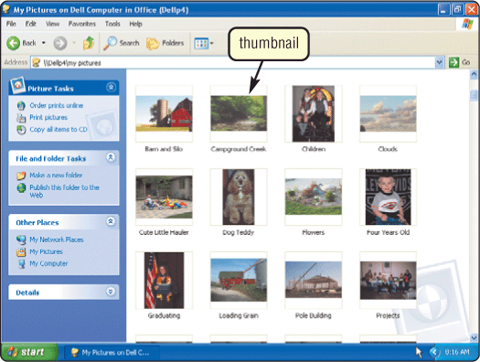
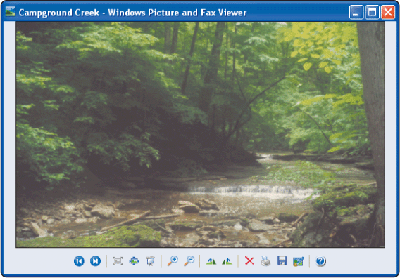
What is a file manager?
  Performs functions such as copying, renaming, deleting, and moving files
  Image viewer displays contents of graphics file when you double click on it
Notes:
Embedded = menempelkan

Slide 28
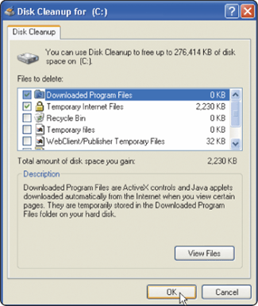
What is a disk scanner?
  Detects and corrects problems on hard disk or floppy disk
  Searches for and removes unnecessary files
Notes:
Embedded = menempelkan

Slide 29
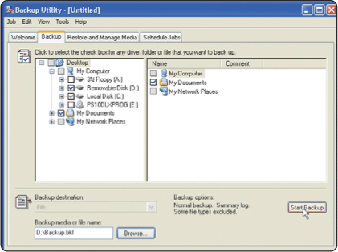
What is a backup utility?
  Copies selected files or entire hard disk onto another disk or tape
  Most compress files during backup to require less storage space
Notes:
Embedded = menempelkan

Slide 30
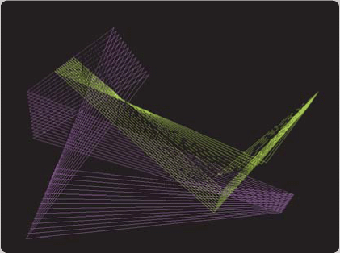
What is a screen saver?
  Causes monitor’s screen to display moving image or blank screen if there is no activity for a specified time
  To secure computer, user configures screen saver to require password to
  deactivate
Notes:
Embedded = menempelkan

Slide 31
What are three categories of operating systems?
Embedded
Network
Stand-alone
Notes:
Embedded = menempelkan

Slide 32
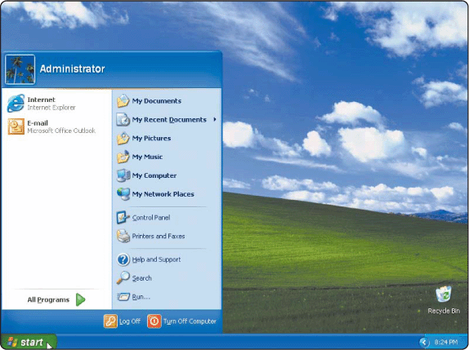
What is Windows XP?
  Microsoft’s fastest, most reliable Windows operating system
  Available in five editions:
  Home Edition, Professional Edition,
  Tablet PC Edition,
  Media Center Edition,
  and 64-bit Edition
Notes:
Embedded = menempelkan

Slide 33
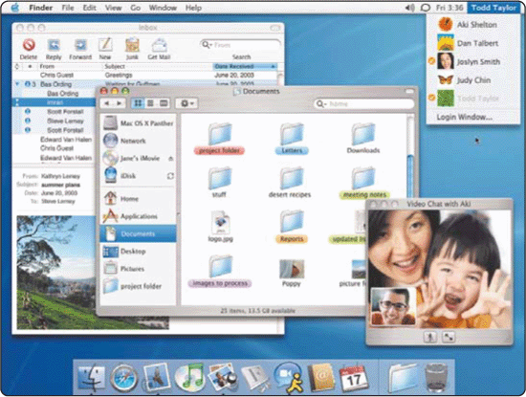
What is Mac OS X?
  Available only for computers manufactured by Apple
  Macintosh operating
  system has been
  model for most GUIs
Notes:
Embedded = menempelkan

Slide 34
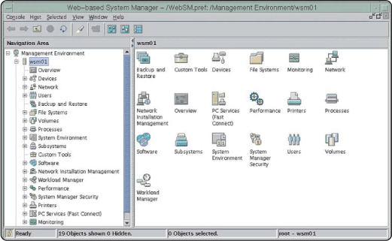
What is UNIX?
  Used by power users because of its flexibility and power
  Most versions
  offer GUI
  Both a stand-alone
  and a network
  operating system
Notes:
Embedded = menempelkan

Slide 35
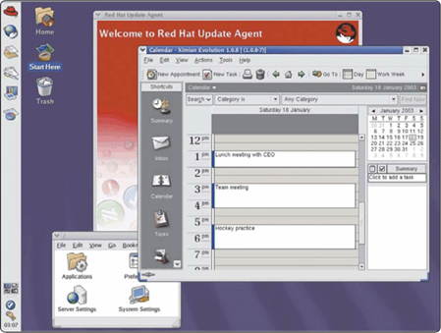
What is Linux?
  Popular, free, multitasking UNIX-type operating system
  Open-source softwaree
  code is available to
  public
  Both a stand-alone
  and a network
  operating system
Red Hat provides a version of Linux called Red Hat Linux. The GNOME graphical user interface is shown in this example.
Notes:
Embedded = menempelkan

Slide 36
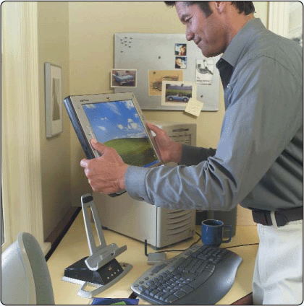
What is an embedded operating system?
  Found on most mobile computers, PDAs, and other small devices
  Windows CE .NET is
  scaled-down version of Windows
Notes:
Embedded = menempelkan

Slide 37
Daftar Pustaka
Vermat, Sebok, Freund, Campbell, Frydenberg. 2016. Discovering Computers 2016 Tools, Apps, Devices, and the Impact of Technology. ISBN: 13:978-1-305-39185-7
Notes:
Embedded = menempelkan

Slide 38
TERIMA KASIH
Notes:
Embedded = menempelkan

