Slide 1
BIOETHICS
PERTEMUAN 7
ARIYO P. HIDAYANTO
PRODI BIOTEKNOLOGI FAKULTAS ILMU
KESEHATAN

Slide 2
KEMAMPUAN AKHIR YANG DIHARAPKAN
Mahasiswa mampu untuk menerapkan konsep bioetik dalam disiplin ilmu bioteknologi

Slide 3
What Is Ethics?
Ethics identifies a code of values of our actions, especially toward other humans
In simple term, ethics could be considered as a guide to separate right and wrong, good and evil
It considers social, moral and religious aspects but cause occasionally “controversy”

Slide 4
Bioethics
Bioethics is the area of ethics that deal with the implications of Biological research and Biotechnological applications
It deals with some fundamental questions and in many aspects, it can affect the future of science, humanity, and the world where we live
“It can emerge dilemmas about what we believe to make decisions”

Slide 5
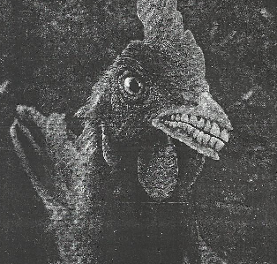
Bioethics
Illustration to described the importance of Ethics

Slide 6
History of Bioethics
Hippocrates (460 – 361 B.C.) “first Bioethicist” → emphasize patient rather than the disease
Immanuel Kant (1724 – 1804) → focuses on absolute principles
Jeremy Bentham (1748 – 1832) and John Stuart Mill (1806 – 1873) → “Something is good if it is useful”
Joseph Fletcher and Paul Ramsey (1970’s)
→ Modern Bioethicist

Slide 7
History of Bioethics
There are two main approach in ethical thought and methods :
Utilitarian approach :
Emphasizes consequences not intentions
Analyze various actions to determine which will have the greatest positive effect
Deontological approach :
Depends on absolute (the one that cannot be broken)
Sometimes, associated with religious tradition

Slide 8
Case :
“There is situation that a person hungry and has not money to buy food, what will he / she do in appropriate manner?”
Utilitarian = “no problem if he / she will steal for example a bread based on his / her primary needs, and there is only less disadvantage to the shop”
Deontological = “no matter what happened, stealing is completely wrong”

Slide 9
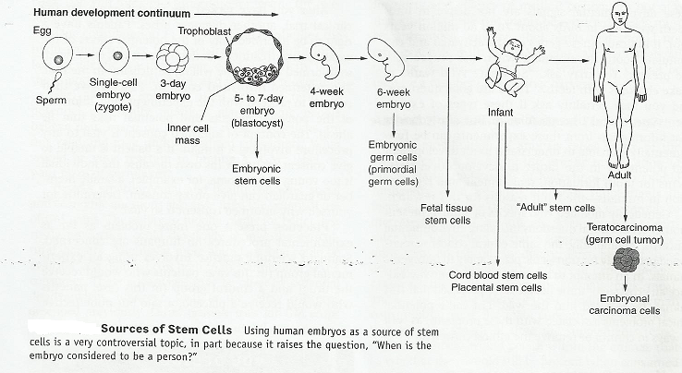
Controversy of Human Cloning

Slide 10
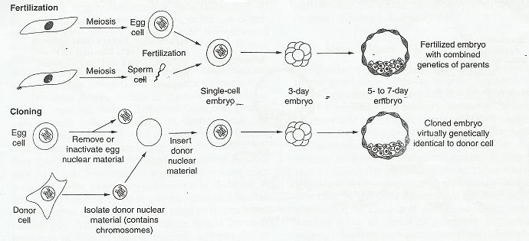
Controversy of Human Cloning

Slide 11
Controversy of Human Cloning
Based on pictures above, there are several dilemma questions including bioethics in human :
“What does it mean to be a human?”
“the status of the human embryo, is it just a simply clump of cells or is it a form of human life that deserve to be respected both moral and religious?”
“there are smooth alterations in genetic change in human cloning, that still can’t be avoided during the process, so does the human cloning still need necessary?”

Slide 12
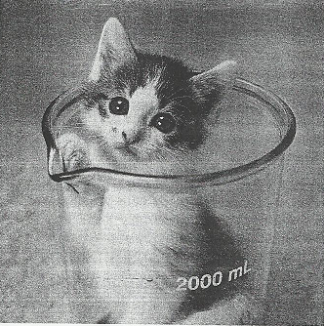
The First Cloned Result in Cat (the Carbon Copy Cat)

Slide 13
BIOETHICS of
HYMENOPLASTY

Slide 14
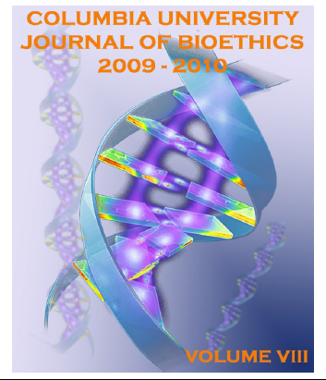

Slide 15
Background
Gender inequality is still a deeply rooted aspect of many cultures
Many societies still belief that having a son is a blessing
In Middle East culture, the people have misconception that bleeding from the “intact hymen” on a wedding night signifies the loss of a woman virginity

Slide 16
Background
Hymen is a thin delicate membrane partially covering the opening of the vaginal membrane
Most, but not all, women are born with it
Some scientists belief that hymen is used to protect the vagina from infection in infants and children, but there is no clear data indicating the biological function of hymen

Slide 17
Background
Hymen can be torn during a variety of non sexual intercourse including gymnastics, horse riding, bicycling
Most women will face problems with their own future in their marriage if the hymen is torn, assumed “to lose the virginity”
Technically, a virgin is defined as one who never had sexual intercourse

Slide 18
“So, is it true to justify a woman lost her virginity only from the hymen, while she is still considered never had sex before?”

Slide 19
Hymenoplasty, Is It Right?
Hymenoplasty is a cosmetic surgical procedure, performed in one to two hours under local anesthetic, to restore the broken hymen
The process also inserts a gelatin capsule, filled with a blood-like substance, which can be burst during intercourse that simulating bleeding (Immersive Medical, 2007)

Slide 20
Hymenoplasty, Is It Right?
The costs of the operation is varied :
In USA = $1800 - $5000
In Thailand = $1200 for 4 night stay
In the case of hymenoplasty, the operation may include side effects such as infection, swelling, pain and numbness, excess bleeding
Hymenoplasty can actually be one option for many desperate young women to save themselves from their defect and to keep their honor in front of their family and husband

Slide 21
“Whatever the purpose of Hymenoplasty, it always depends on cultures, religions, education, and gender background to defy virginity”

