Slide 1
FOOD BIOTECHNOLOGY
PERTEMUAN 5
ARIYO P. HIDAYANTO
PRODI BIOTEKNOLOGI FAKULTAS ILMU
KESEHATAN

Slide 2
KEMAMPUAN AKHIR YANG DIHARAPKAN
Mahasiswa mampu untuk menerapkan beberapa konsep mengenai bioteknologi pangan

Slide 3
OVERVIEW
Evolution
Biotechnology Agents
Products
Challenges

Slide 4
Year | Discovery
6000 BC | Yeast was used by Sumerians and Babylonians to make beer
4000 BC | Egyptians discovered how to make bread using yeast In China, other fermentation processes were discovered, such as the use of lactic acid bacteria to make yoghurt and molds to produce cheese, and the use of fermentation to make vinegar, soy sauce and wine
1724 | Antony van Leeuwenhoek used microscope to discover microbiology. He is the first scientist to describe protozoa and bacteria and to recognize that microorganism might play a role in fermentation
1852 | Cross-fertilisation in corn was discovered
1871 | Louis Pasteur invented the process of pasteurization, by heating wine sufficiently to inactivate microbes and prevent spoilage, but not ruining the flavour of the wine
1871 | Ernst Hoppe-Seyler discovered invertase, an enzyme that cuts the disaccharide sucrose into glucose and fructose. The enzyme is still widely used today in making sweeteners

Slide 5
Year | Discovery
1897 | Eduard Buchner demonstrated that fermentation could occur with an extract of yeast in the absence of intact yeast cells. It was a founding moment in biochemistry and enzymology
1953 | James Watson and Francis Crick proposed the double helix structure of DNA. They achieved this discovery with the help of Rosalind Franklin and Maurice Wilkins
1962 | Planting of high-yield wheat varieties (later known as ‘Green Revolution‘ grains) was begun in Mexico
1982 | Researcher Steven Lindow requested US Government permission to test genetically engineered bacteria to control frost damage in potatoes and strawberries
1986 | The US Environment Protection Authority approved the release of the first genetically engineered crop – a GM virus resistant tobacco plant
1987 | Calgene Inc. received a patent for the tomato polygalacturonase DNA sequence, used to produce an 'anti-sense' RNA to extend the shelf-life of fruit

Slide 6
BIOTECHNOLOGY AGENTS
Nutrients
Macro and Micro nutrients
Energy sources = light and chemicals
Specific nutrients
Environmentals
pH
Temperature
Osmotic pressure
Oxygen partial pressure

Slide 7
BIOTECHNOLOGY AGENTS CRITERIA
Genetically stabilized
Genetically modified
Toxin free content
Significant growth-rate
Sustainable
Effectively re-produced
Scale-up engineered
Easily controlled

Slide 8
MICROORGANISMS
Saccharomyces cerevisiae fungi
Candida utilis fungi
Chlorella sp. green microalgae
Spirulina sp. cyanobacteria

Slide 9
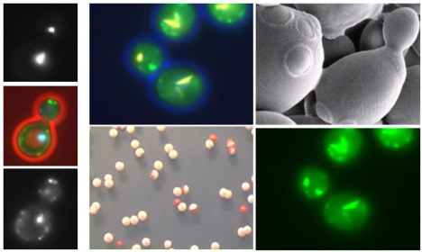
Saccharomyces cerevisiae

Slide 10
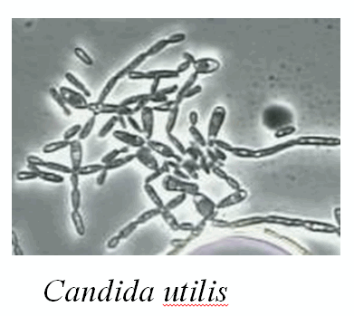
Candida utilis

Slide 11
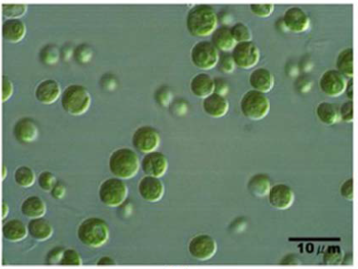
Chlorella sp.

Slide 12
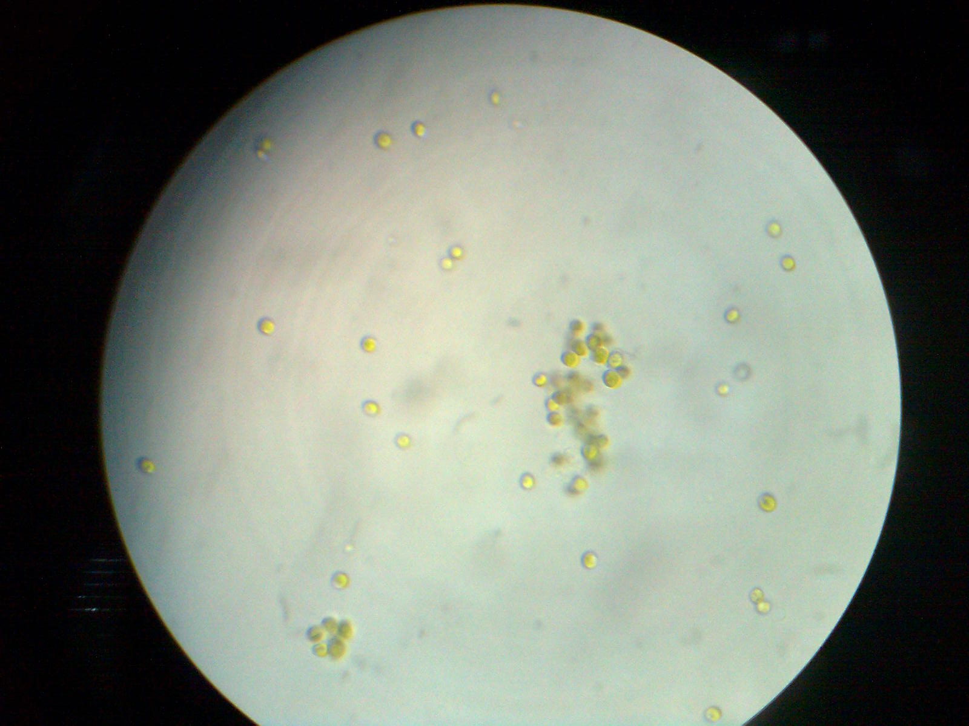
Chlorella sp.

Slide 13
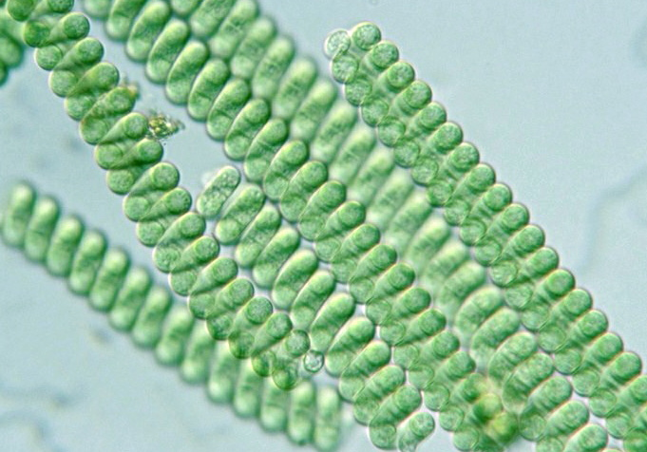
Spirulina sp.

Slide 14
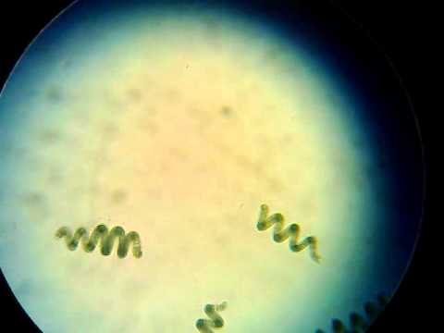
Spirulina sp.

Slide 15
SINGLE CELL PROTEIN (SCP)
Dried form of a biomass cell that is extracted from mixed cultures of algae, yeasts, fungi, or bacteria (edible unicellular microorganisms)
Vey potential as an ingredients for protein-rich foods as human consumptions or animal feedstocks

Slide 16
SCP BACKGROUND OVERVIEW
In England (1879), first SCP modern technology production was built (the introduction of bread paste)
In the First World War, Germany pioneered Torula yeast in commercial scale
In 1970, world population faced famine due to less of farm and livestock area

Slide 17
POINT OF INTERESTS
High nutrient content (protein, lipid, vitamin, mineral)
Faster growth rate than conventional food
Independent production rate (growth around the years and seasons)
Low-space production area
Environmental friendly

Slide 18
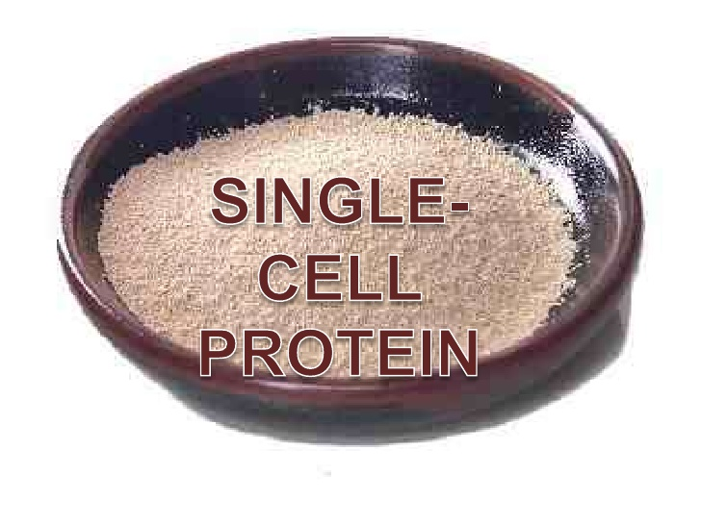
SCP PRODUCT

Slide 19
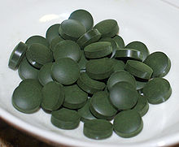
Spirulina sp. Tablet

Slide 20
Spirulina（dried）
Nutritional value per 100 g
ENERGY | 1,213 kJ (290 kcal)
CARBOHYDRATE | 23.9 g
FAT | 7.72 g
PROTEIN | 57.47 g
Thiamine (B1) | 2.38 mg
Riboflavin (B2) | 3.67 mg
Vitamin B6 | 0.364 mg
Folate (B9) | 94 μg
Vitamin C | 10.1 mg
Vitamin E | 5 mg
Vitamin K | 25.5 μg
Calcium | 120 mg
Iron | 28.5 mg
Magnesium | 195 mg
Water | 4.68 gr

Slide 21
DADIH
Buffalo milk
Fermentation
(natural)
Dadih
West Sumatera

Slide 22
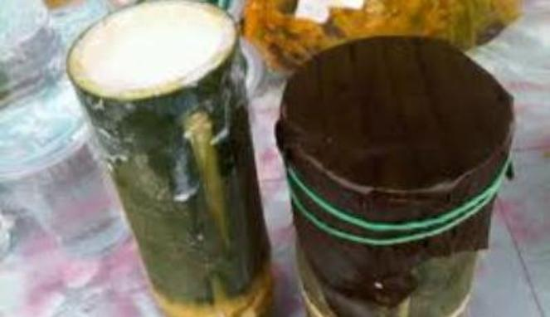
DADIH PRODUCTION
Buffalo Milk
Placed in bamboo (gombong’s bamboo and ampel’s bamboo)
Covered with banana leaves (which has whitered on the fire)
Incubated in room temperature for 48 – 72 hours
Dadih

Slide 23
NUTRIENT CONTENT
Nutrient | Amount
Moisture content | 84.35 %
Protein | 5.93 %
Fat | 5.42 %
Carbohydrate | 3.34
Acidity | ~ 3.4
Number of LAB | 36 strains

Slide 24
PROBIOTIC ROLEPLAY FROM DADIH
Live microorganisms which when administered in adequate amounts confer a health benefit on the host
(FAO and WHO)
To be identified as functional food, the probiotic microorganism should exhibit acid-base stability, resistance to digestive enzyme, adhesion to intestine surface, and offer health benefits and reduce the risk of chronic disease beyond the commonly accepted nutritional effects

Slide 25
FUTURE CHALLENGES
Enormous world population growth rate
Low space area for farmland
Lack of manpower qualification and technology availability
Lack of cooperation among academia and industries
Ethics and goverment policy
People mindset

Slide 26
TUGAS
BUAT PRESENTASI ± selama 30 menit tentang topik Bioteknologi Pangan serta aplikasikan pada contoh kasus

