Slide 1
DNA Mutation
Dr. Henny Saraswati, M.Biomed

Slide 2
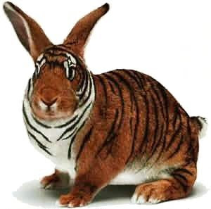
What is DNA mutation?
Sequence change in the genetic material (DNA)
It may also be passed from parent to offspring.

Slide 3
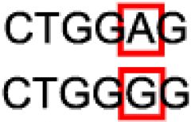
Sequence Change
Normal
Mutation

Slide 4
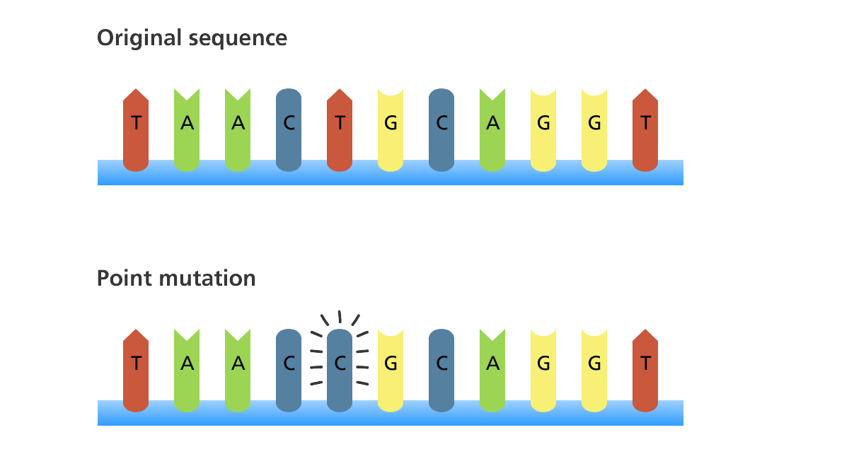
Types of Mutation
Point Mutation
a change in one base in the DNA sequence.
www.yourgenome.org

Slide 5
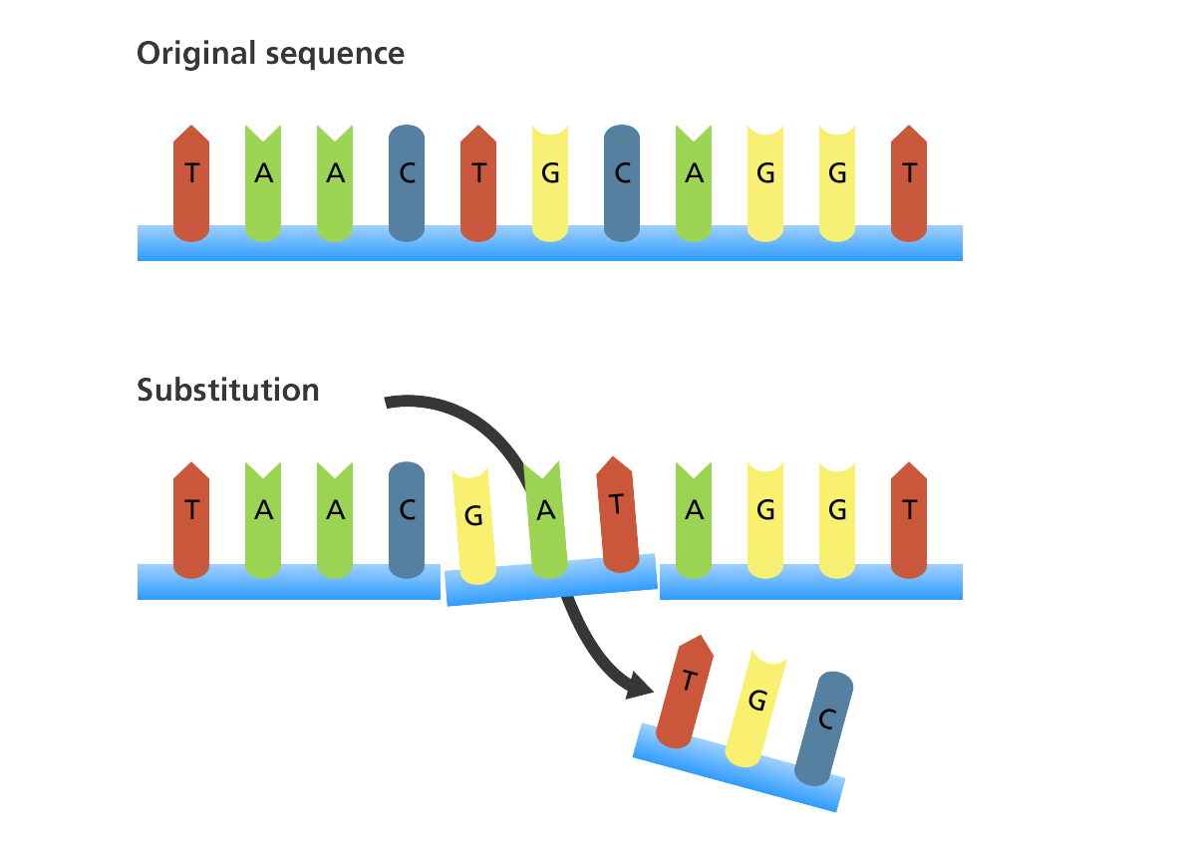
Types of Mutation
Substitution
when one or more bases in the sequence is replaced by the same number of bases (for example, a cytosine substituted for an adenine).
www.yourgenome.org

Slide 6
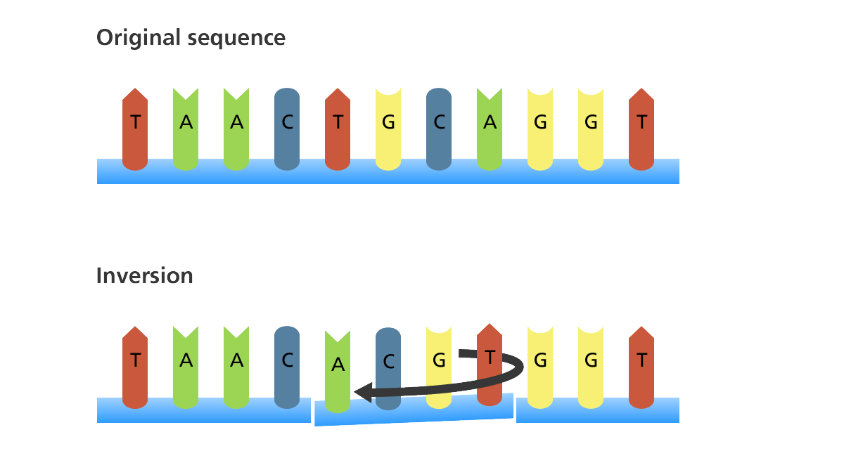
Types of Mutation
Inversion
when a segment of a chromosome is reversed end to end.
www.yourgenome.org

Slide 7
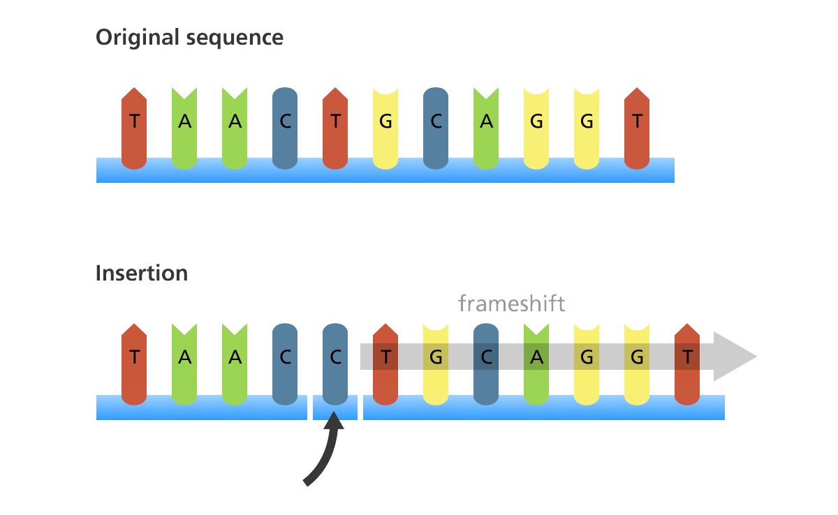
Types of Mutation
Insertion
when a base is added to the sequence
www.yourgenome.org

Slide 8
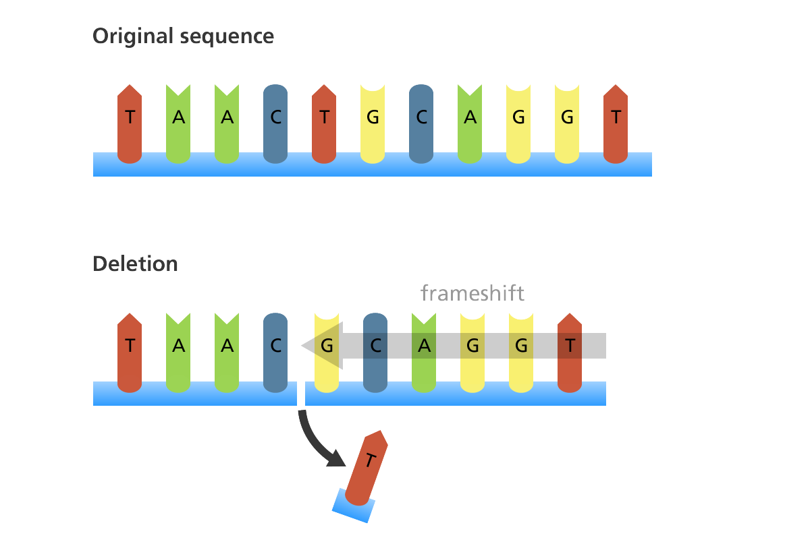
Types of Mutation
Deletion
when a base is deleted from the sequence
www.yourgenome.org

Slide 9
Effect of Mutation
Silent mutation
mutation that do not alter the amino acid sequence of the polypeptide even though the nucleotide sequence has changed
How?
Mutation occur in certain bases within a codon, such as the third base, so that the specific amino acid is not changed

Slide 10
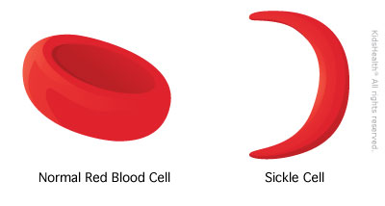
Effect of Mutation
Missense mutation
base substitutions in which an amino acid change does occur
Example
Sickle-cell anemia → the amino acid is changed from a glutamic acid to valine. This alters the structure and function of the hemoglobin protein. One consequence of this alteration is that the red blood cells sickle under conditions of low oxygen

Slide 11
Effect of Mutation
Nonsense mutation
a change from a normal codon to a stop codon
What will happen:
This terminates the translation of the polypeptide earlier than expected, producing a truncated polypeptide

Slide 12
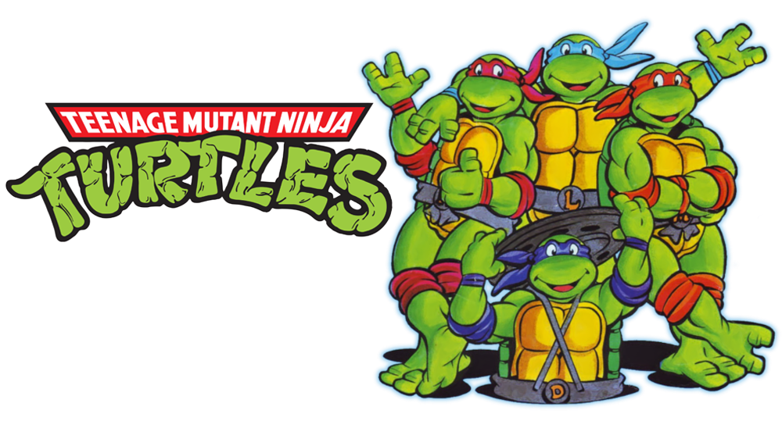
What is the name of organism that have mutation
Mutant

Slide 13
Organisme with mutation will……
Have no change → neutral mutation
Will decrease the chances of survival and reproduction → deleterious mutation
Experiencing death on the cell or organism → lethal mutation

Slide 14
Mutation can occur in germ cell or somatic cell
Germ cell → refers to cells that give rise to the gametes such as eggs and sperm
A germ-line mutation can occur directly in a sperm or egg cell, or it can occur in a precursor cell that produces the gametes
If a mutant gamete participates in fertilization, all cells of the resulting offspring will contain the mutation

Slide 15
Mutation can occur in germ cell or somatic cell
Somatic cell → comprise all cells of the body excluding the germ-line cells
Examples include muscle cells, nerve cells,and skin cells.
Mutations can also happen within somatic cells at early or late stages of development

Slide 16
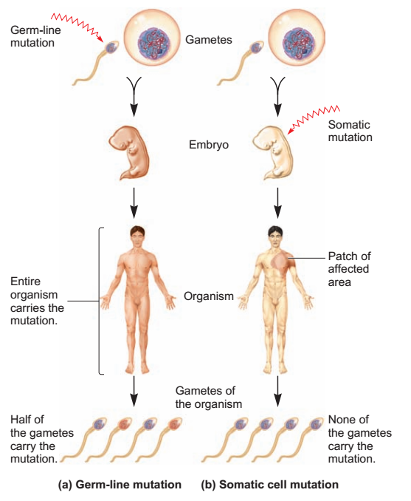

Slide 17
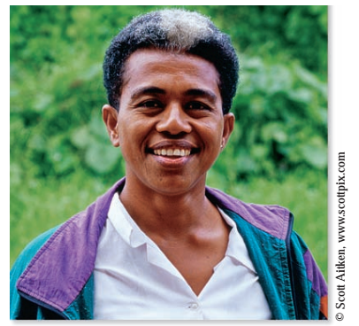
Example of somatic mutation

Slide 18
Cause of mutation
Geneticists categorize the cause of mutation in one of two ways :
Spontaneous mutations are changes in DNA structure that result from abnormalities in biological processes at early or late stages of development
induced mutations are caused by environmental agents (mutagen)

Slide 19
Examples of Spontaneous mutation
Abnormalities in crossing over can produce mutations such as deletions, duplications, translocations, and inversions
Aberrant segregation of chromosomes during meiosis can cause changes in chromosome number
DNA polymerase can make a mistake during DNA replication by putting the wrong base in a newly synthesized daughter strand
Normal metabolic processes may produce chemicals within the cell that can react directly with the DNA and alter its structure.

Slide 20
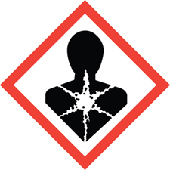
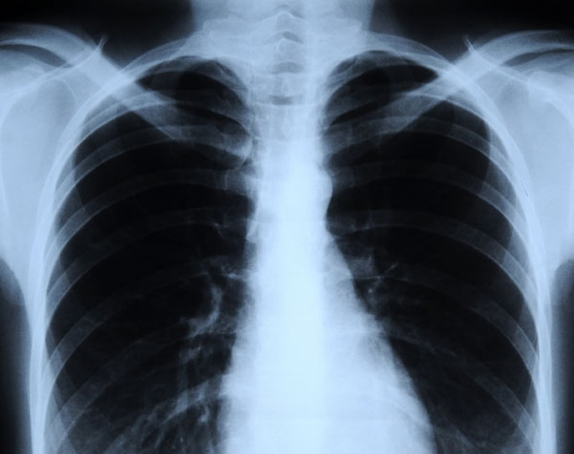
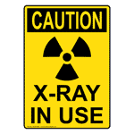
Examples of Induced mutation
Chemical agents →chemical substances may cause changes in the structure of DNA
Example : sodium azide, benzene
Physical agents → physical phenomena such as UV or X-rays can damage the DNA

Slide 21
DNA Repair
DNA repair systems are vital to the survival of all organisms
If DNA repair systems did not exist, spontaneous and environmentally induced mutations would be so prevalent that few species, if any, would survive
Living cells contain several DNA repair systems that can fix different types of DNA alterations

Slide 22
DNA Repair
In most cases, DNA repair is a multistep process :
one or more proteins in the DNA repair system detect an irregularity in DNA structure
the abnormality is removed by the action of DNA repair enzymes
normal DNA is synthesized via DNA replication enzymes.

Slide 23
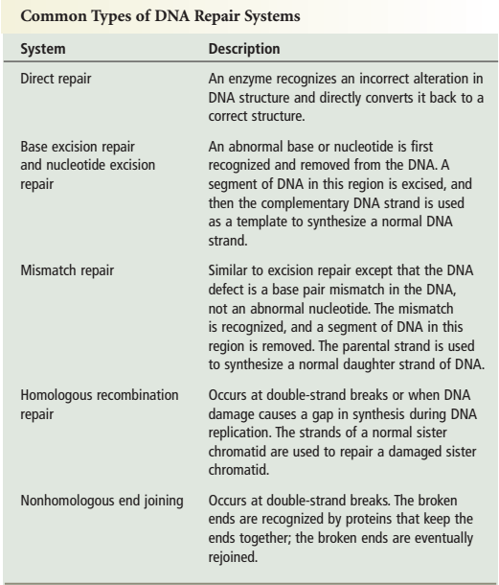

Slide 24
DNA Repair System
Damage Bases can be directly repaired
A second type of repair system, called base excision repair (BER), involves the function of a category of enzymes known as DNA N-glycosylases.
This type of enzyme can recognize an abnormal base and cleave the bond between it and the sugar in the DNA backbone, creating an apurinic or apyrimidinic site

Slide 25
DNA Repair System
Base Excision Repair Removes a Damaged Base In a few cases, the covalent modification of nucleotides by mutagens can be reversed by specific cellular enzymes
Example : Saccharomyces cerevisiae, and most plants produce an enzyme called photolyase that can repair thymine dimers by splitting the dimers, which returns the DNA to its original condition

Slide 26
DNA Repair System
Nucleotide Excision Repair Systems Remove Segments of Damaged DNA
An important general process for DNA repair is the nucleotide excision repair (NER) system.
In NER, several nucleotides in the damaged strand are removed from the DNA, and the intact strand is used as a template for resynthesis of a normal complementary strand
NERis found in all eukaryotes and prokaryotes, although its molecular mechanism is better understood in prokaryotic species.

