Slide 1

Human Factor and behavior

Slide 2
Human Factor
Mempelajari semua faktor untuk memudahkan dalam bekerja dengan cara yang benar
Diterapkan dimana saja saat manusia bekerja
Kadang-kadang disebut dengan Ergonomik
Human Factor sudah lama dipelajari dalam lingkungan kerja penerbangan (aviation) dan nuklir

Slide 3
Human Factors Experts
Mendesain pengembangan tempat kerja dan peralatannya agar sesuai dengan kemampuan dan keterbatasan manusia
Membuat suatu pekerjaan mudah dikerjakan oleh para pekerja dan dilakukan dengan cara yang benar
Meminimalkan terjadinya kesalahan

Slide 4
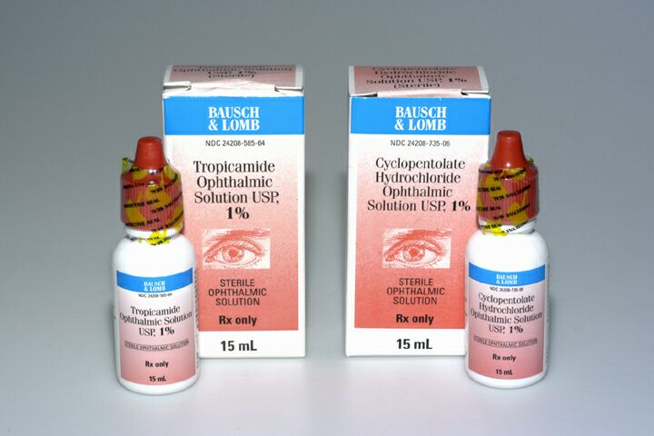
Avoidable confusion is everywhere…
US Department of Veteran affairs

Slide 5
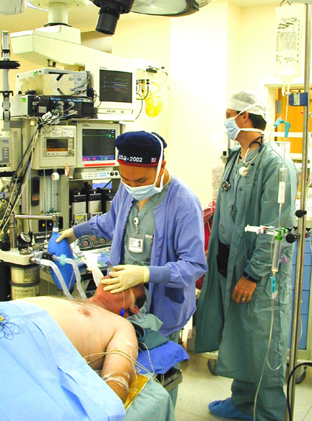
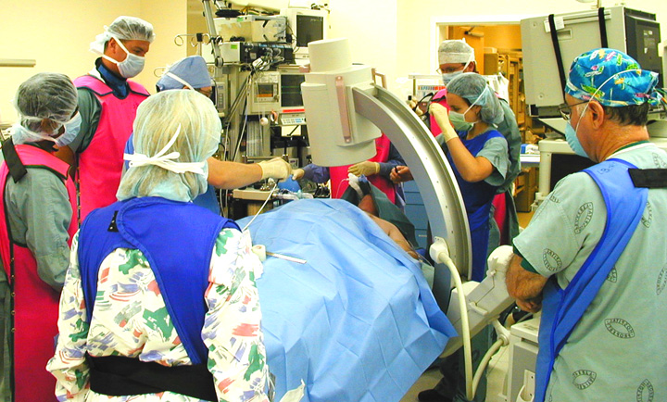
Health care is increasingly complex
Gaba
Notes:
The Institute of Medicine report reminds us that health care is probably the most complex of human endeavours!

Slide 6

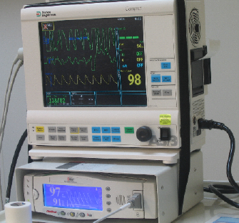
Human factors design principles
Psychomotor
Hands
Input Devices
Buttons
INTERFACE
Senses
- Vision - Hearing
Output
- Display - Sound
US Department of Veteran affairs
Notes:
This slide illustrates how we interact with equipment - and indeed human factors engineering is in part the study of the human machine interaction.
But actually this slide represents how we interact with everything - using our eyes, ears, fingers, hands …
Our senses take in inputs, then we rely on our memory and knowledge to process the information and then make decisions and formulate a response
HFE recognizes that we can make errors at each step of this process …

Slide 7
Human factors
Memahami bahwa :
  Manusia dapat melakukan kesalahan
  Kesalahan tidak dapat dihindarkan
berasumsi bahwa kesalahan terjadi
Mendesain tempat kerja dengan meminimalkan kemungkinan adanya kejadian yang menimbulkan berbagai konsekuensi

Slide 8
Because the human brain is ….
very powerful
very flexible
good at finding shortcuts (fast)
good at filtering information
good at making sense of things

Slide 9
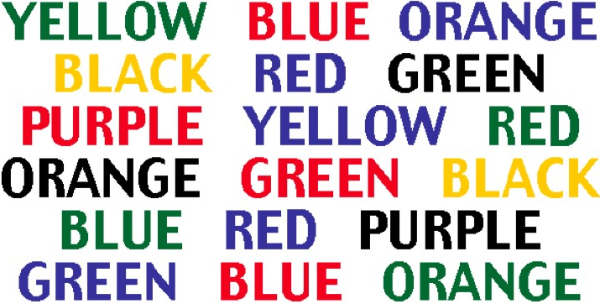
Look at the chart
Say the colour of the word, not the word itself
Why is it hard?
Optillusions.com
Notes:
Our brain wants to say the word - not the colour of the word.

Slide 10
The fact that we can misperceive
situations despite the best of
intentions is one of the main reasons
that our decisions and actions can
be flawed such that …

Slide 11
Human beings make
“silly” mistakes
Regardless of their experience, intelligence, motivation or vigilance, people make mistakes
Activity
Think about and then discuss with your colleagues any “silly” mistakes you have made recently when you were not in your place of work or study - and why you think they happened
Notes:
Detailed story + reason why.

Slide 12
The context of health care
When errors occur in the workplace the consequences can be a problem for the patient
  a situation that is relatively unique to health care
Notes:
Detailed story + reason why.

Slide 13
One definition of “human error” is “human nature”
Error is the inevitable downside
of having a brain!

Slide 14
Apakah itu kesalahan
Kegagalan dalam mencapai tujuan yang direncanakan.
Deviasi antara yang dikerjakan dan apa yang seharusnya dikerjakan.
Notes:
All common situations for inexperienced staff.

Slide 15
Situations associated with an increased risk of error
unfamiliarity with the task*
inexperience*
shortage of time
inadequate checking
poor procedures
poor human equipment interface Vincent
* Especially if combined with lack of supervision
Notes:
All common situations for inexperienced staff.

Slide 16
Individual factors that predispose to error
limited memory capacity
further reduced by:
  fatigue
  stress
  hunger
  illness
  language or cultural factors
  hazardous attitudes

Slide 17
Kelelahan
24 jam tidak tidur berakibat seperti efek 0.1% alkohol dalam darah
Dawson – Nature, 1997

Slide 18
Stress and performance
Performance level
Area of “optimum” stress
Low stress Boredom
High stress Anxiety, panic
Stress level
The relationship between stress and performance
Yerkes, R. M., & Dodson, J. D. (1908) The relation of strength of stimulus to rapidity of habit-formation.
Journal of Comparative Neurology and Psychology, 18, 459-482
Notes:
The optimum level of performance is reached when the level of arousal is neither too high or too low.
Boredom is a problem if we are doing a highly automated and repetitive task, e.g. transcribing medication charts:
may be easy to commit a transcribing error

Slide 19
Don’t forget ….
If you’re
  H ungry
  A ngry
  L ate
  or
  T ired …..
H
A
L
T

Slide 20
A performance-shaping factors “checklist”
I Illness
M Medication
  prescription, alcohol & others
S Stress
A Alcohol
F Fatigue
E Emotion
Jensen, 1987
Notes:
Here is a useful acronym to consider prior to entering the workplace each day.
It is borrowed (surprise, surprise) from the aviation industry!

Slide 21
Menerapkan Human Factor dalam lingkungan kerja
    Hindari pekerjaan yang hanya mengandalkan memori.
    Buat segala sesuatu mudah dilihat
    Cek dan sederhanakan segala proses.
    Buat standar umum proses dan prosedur.
    Gunakan cek list rutin dalam pekerjaan
    Turunkan aktifitas yang bergantung pada kehati-hatian pekerja.

Slide 22
Rangkuman
  Kesalahan tidak dapat dihindarkan dalam suatu pekerjaan
  Ada beberapa situasi yang dapat meningkatkan terjadinya kesalahan.
  Perhatian pada prinsip Human factors dapat mengurangi kesalahan yang terjadi dan konsekuensinya.

Slide 23
Rangkuman
Human factors engineering: mendesain tempat kerja dan peralatan yang dapat mengatasi keterbatasan manusia

