Slide 1

Kuliah 10
Deteksi Protein Bagian II

Slide 2
Deteksi Protein
BRADFORD
ELISA
Flow Cytometer

Slide 3
Flow Cytometry Is A Powerful Technique For Characterizing Immune Cells
Allows For Detection Of Surface Markers Of Cells
Allows For Detection Of Intracellular Factors
Allows Detection Of Secreted Factors By Cells
Allows For Detection Of DNA Content

Slide 4
Principles Of Flow Cytometry

Slide 5
Light can be measured at 90° :
Side scatter + Fluorescence
Laser
Photodiode
Fluorescence
Side scatter reflects the cell content

Slide 6
Fluorescence intensity
FITC
FITC
FITC
FITC
FITC
FITC
FITC
FITC
Number of Events
FITC
FITC
10¹
10²
10³
10⁴
Relative fluorescence intensity
Notes:
6

Slide 7
Basics of Flow Cytometry
Cells in suspension
flow in single-file through
an illuminated volume where they
scatter light and emit fluorescence
that is collected, filtered and
converted to digital values
that are stored on a computer
Fluidics
Optics
Electronics

Slide 8
The automated Microscope
Detector
& Counter
This primitive diagram shows the principle: Cells are passing the microscope objective, and an electronic circuit decides whether the cells is fluorescent or not. This is how a flow cytometer works!
Waste
Sample

Slide 9
Hydrodynamic focussing in the cuvette
Sample
Sample
Sheath
Sheath
Sample pressure low, small core stream. Good for DNA analysis
High sample pressure, broader core stream.
Bad for DNA analysis
LOW
HIGH
1
Notes:
1

Slide 10
Limitations With Light Scattering
Some Information Can Be Obtained
FSC Correlates With Cell Size
SSC Correlates With Internal Complexity
To Distinguish Between 2 Cell types
  A. Size Has To Be Different OR
  B. Internal Complexity i.e amount of granules
If These Two Parameters Are The Same, Then No Distinction Can Be Made
See The Following Figure

Slide 11
FSC vs SSC Dot Plot

Slide 12
Fluorescence And Antibodies
To The Rescue

Slide 13
Fluorescent Dyes And Antibodies
Fluorochromes Are Molecules That Emit Fluorescence Upon Excitation With Light
  Ex. FITC (Fluorescein Isothiocyanate)
  PE (Phycoerythrin)
  PerCP (Peridinin Chlorophyll Protein)
  APC (Allophycocyanin)
Some Fluorochromes Are Proteins, Some Are Small Organic Compounds
  Ex. PE (Phycoerythrin)-Protein
  Ex. FITC (Fluorescein Isothiocyanate)

Slide 14
Excitation Spectra Of Fluorochromes

Slide 15
Emission Spectra

Slide 16
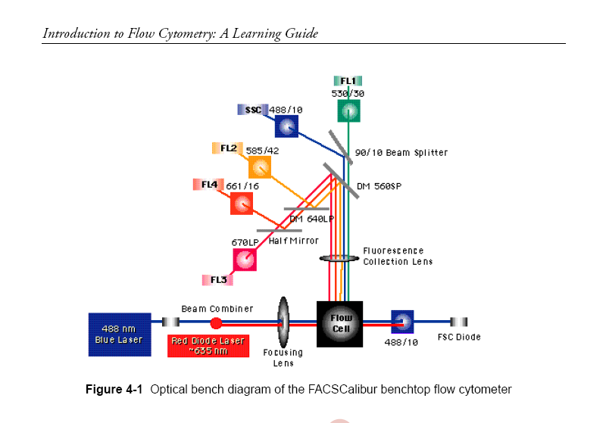
Architecture of A FacsCalibur Instrument

Slide 17
Analyzed Data

Slide 18
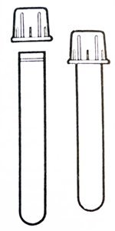
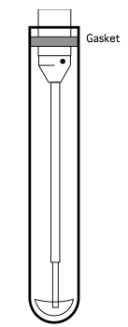
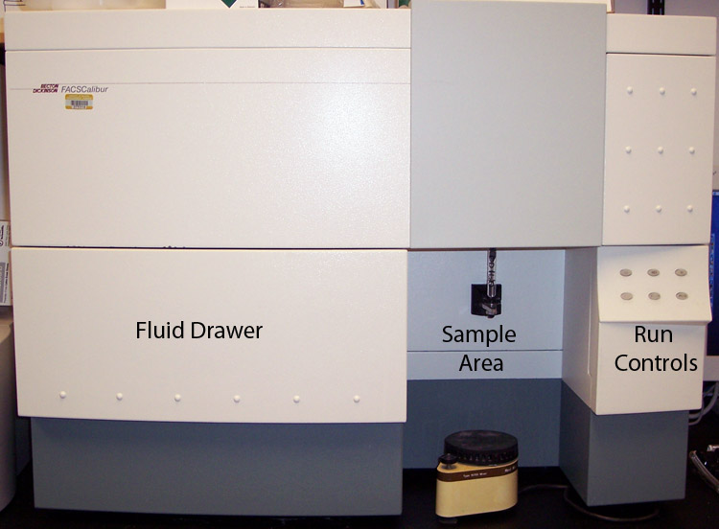
Flow Cytometry

Slide 19
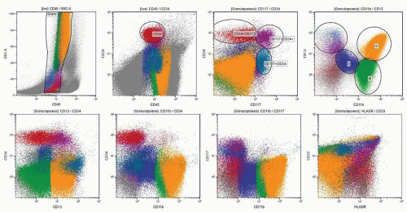
Cell Marker

Slide 20
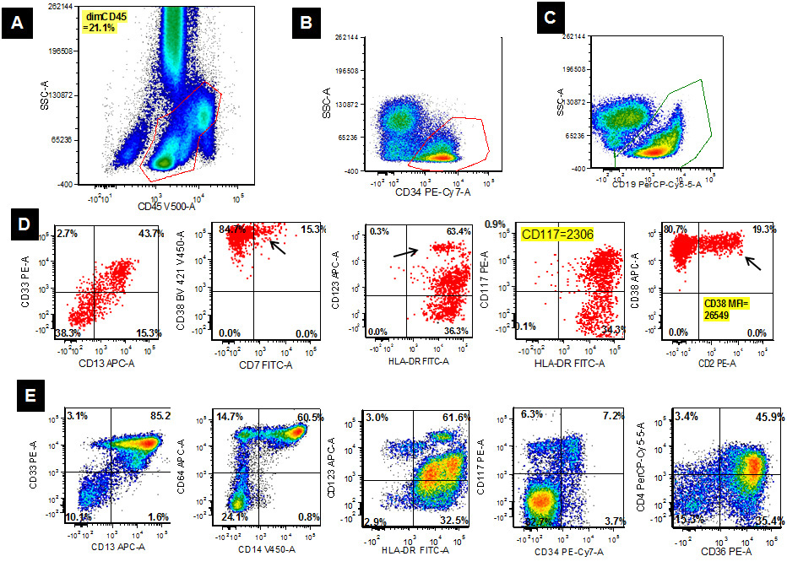
Cell Marker

Slide 21
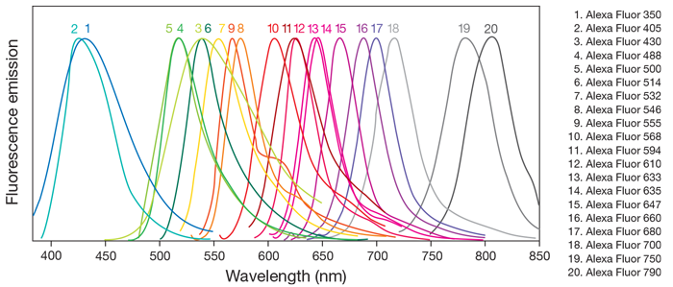
Fluophore

