Slide 1

Deteksi Protein
Kuliah 9
Deteksi Protein Bagian I

Slide 2
Deteksi Protein
SDS PAGE
Western Blot
Immunofluroescence

Slide 3
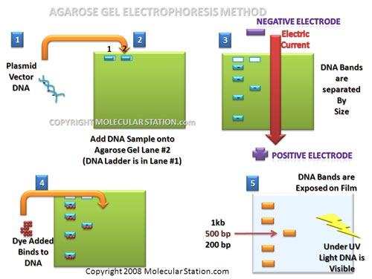
Agarose Gel Electrophoresis

Slide 4
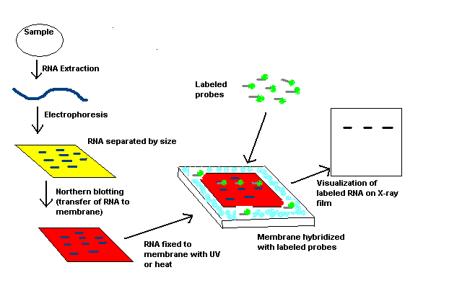
Blotting

Slide 5
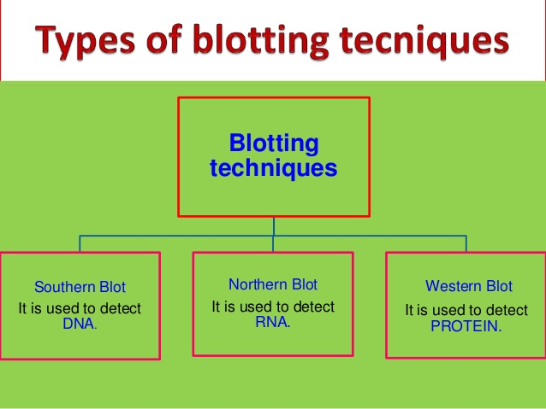

Slide 6
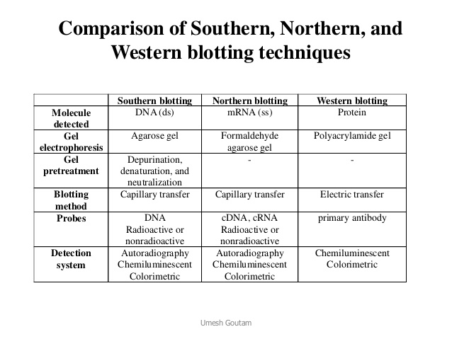

Slide 7
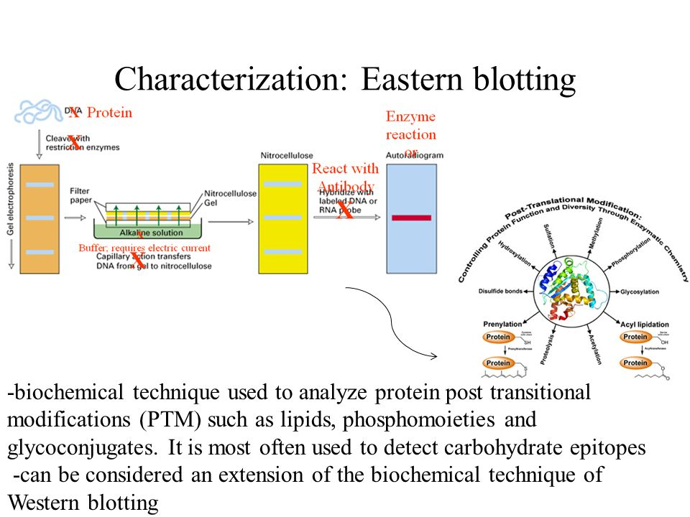
Eastern Blot

Slide 8
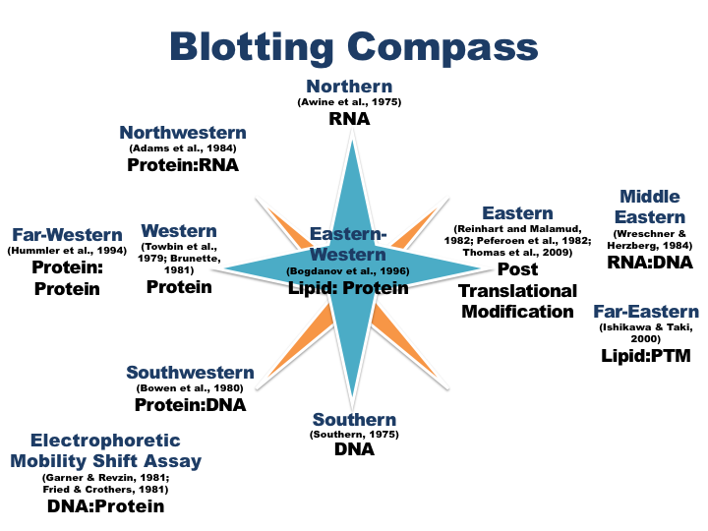

Slide 9
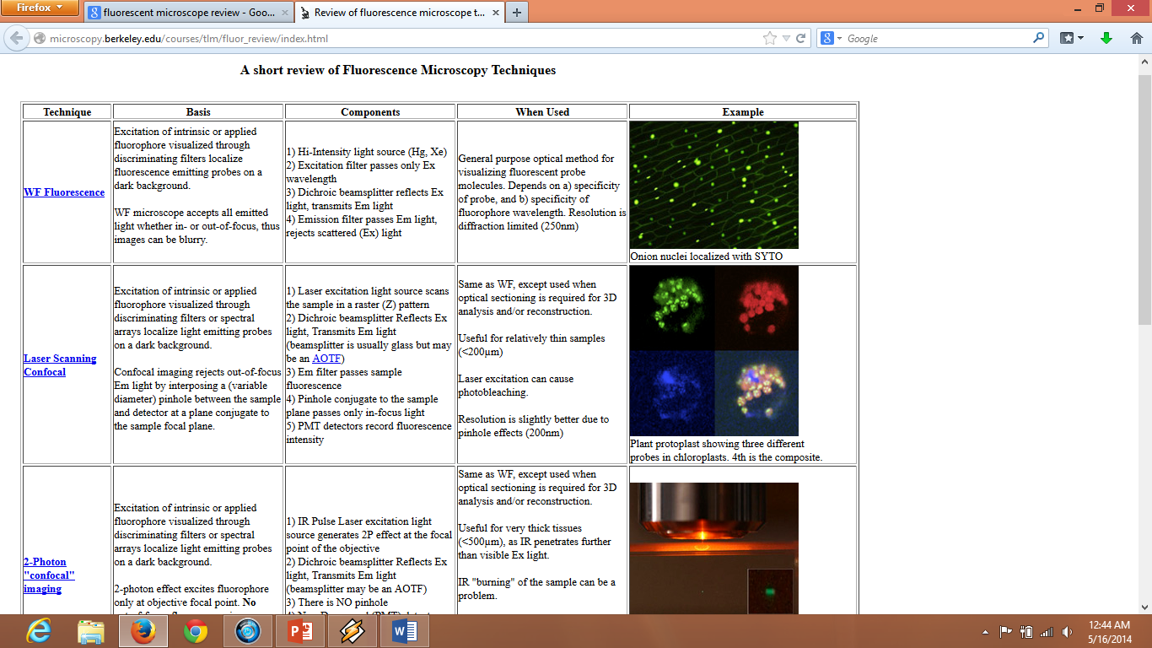
Fluorescence and Laser scanning microscope
http://microscopy.berkeley.edu

Slide 10
4 Steps in Bioimaging
Manipulate
Molecules , cells, tissues modification
Fixation (using formaldehyde, ethanol, aceton etc)
Stabilize cell morphology and tissue architecture
Disable proteolytic enzymes
Strengthen samples to withstand further processing and staining
Protect samples against microbial contamination and decomposition
Permeabilization (using tween, triton x, saponin etc)
Staining (fluorophore, antibody conjugated fluorophore)
Mounting (Mouviol, antifade..)

Slide 11
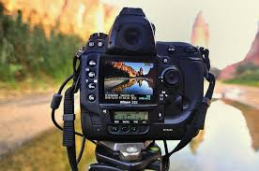
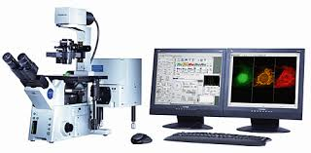
2. Measure
Acquisition of Images with various methods by managing technique
Minimizing Noise
Reducing unwanted room light
Reducing unwanted light
Other : vibration electromagnetic interference, contamination

Slide 12
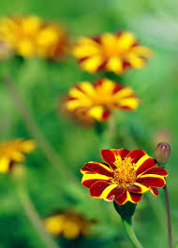

3. Mine
Analysis of acquired images by focusing on the point of interest

Slide 13
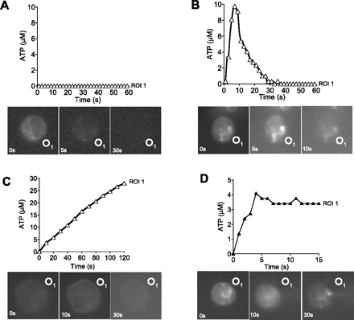
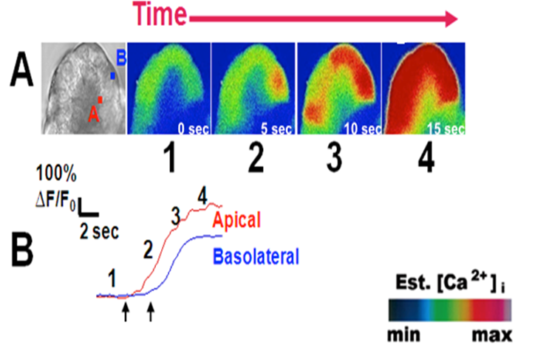
4. Model
Developing algorithms to model and
Assemble the knowledge gained from the imaging initiative
A novel method using fluorescence microscopy for real-time assessment of ATP release from individual cells
Ross Corriden , Paul A. Insel , Wolfgang G. Junger
American Journal of Physiology - Cell PhysiologyPublished 1 October 2007Vol. 293no. C1420-C1425DOI: 10.1152/ajpcell.00271.2007
Orabi, Abrahim I., Nathanson, Michael H. and Husain, Sohail Z. (2011). Measuring Ca2+ dynamics in pancreatic acini using confocal microscopy. The Pancreapedia: Exocrine Pancreas Knowledge Base, DOI: 10.3998/panc.2011.30

Slide 14
Fluorescence and Fluorophore
Fluorescence, the absorption and re-emission of photons with longer
wavelengths

Slide 15
Various Luminescent phenomena

Slide 16
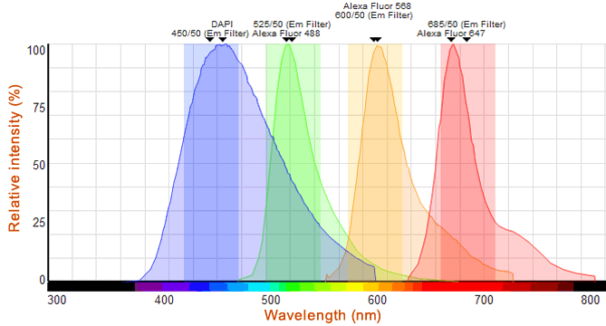
Fluorophore and wavelength

Slide 17
Concofal Microscope Application
Colocalization of proteins
Cell structure analysis
Host-pathogen interaction
Gen transfection
Fluorescence Resonance Energy Transfer (FRET)
etc

Slide 18
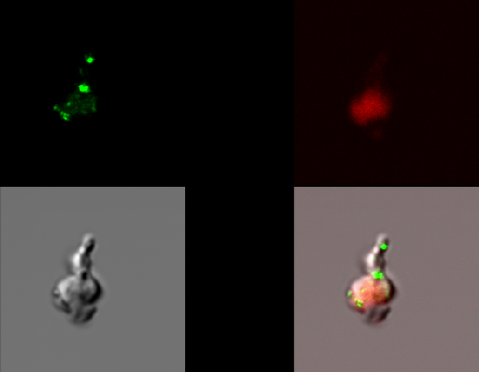
HIV and TB in PMBC

Slide 19
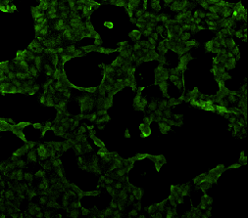
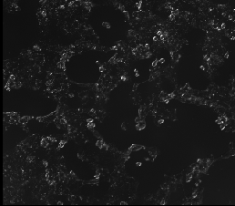
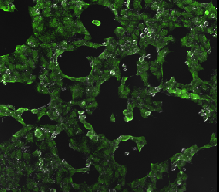
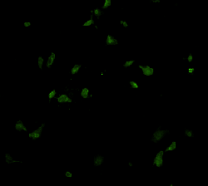
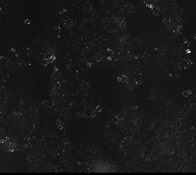
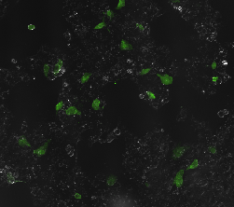
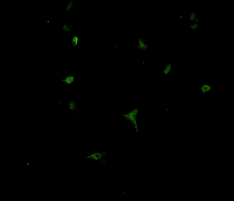
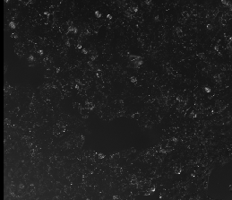
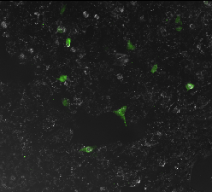
Virus detection : Immunofluorescence
H1N1 (green)
H1N1 (green)
Merged)
Aerosolized virus
Cells infected by
original virus
Cells infected by
aerosolized vrus
(PCI OFF)
Cells infected by
aerosolized virus
(PCI ON)

Slide 20
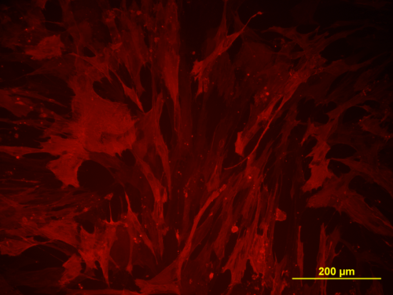
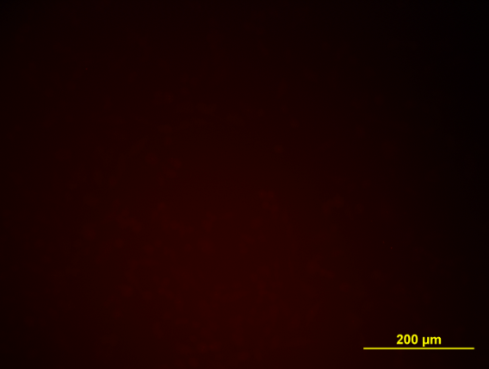
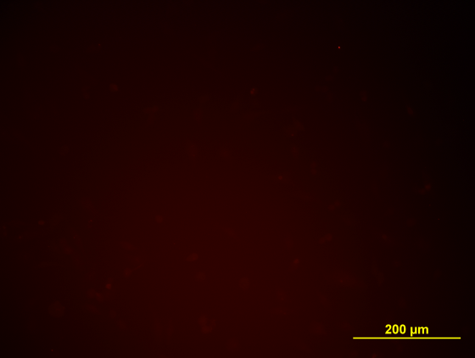
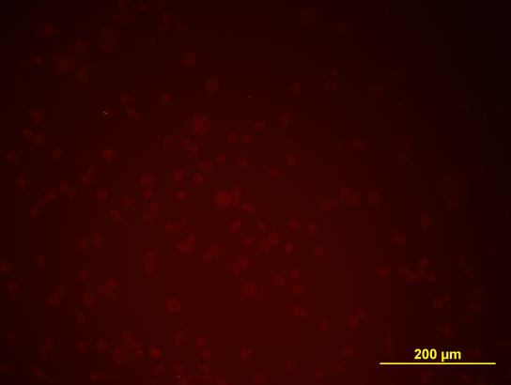
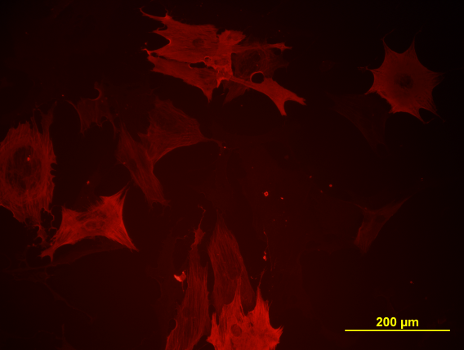
Αlpha Smooth Muscle Actin
IMR90
CS9K Fib
CS14K Fib
CSC 9K
CsBrN1

Slide 21
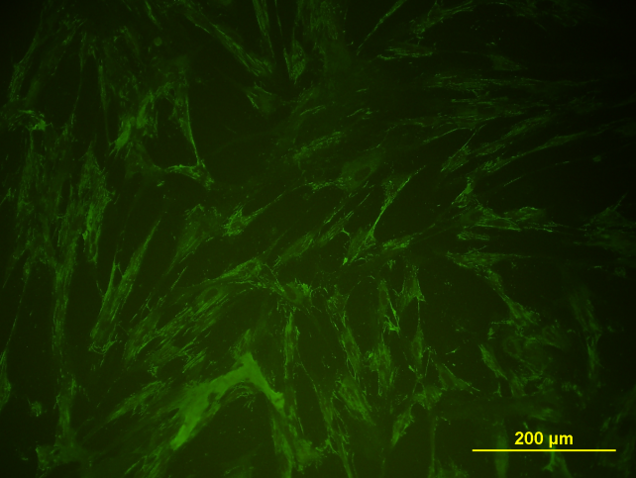
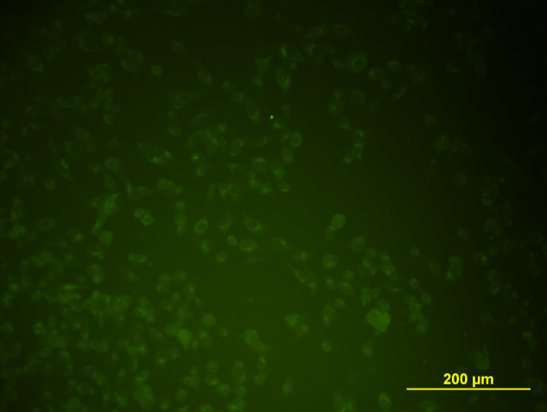
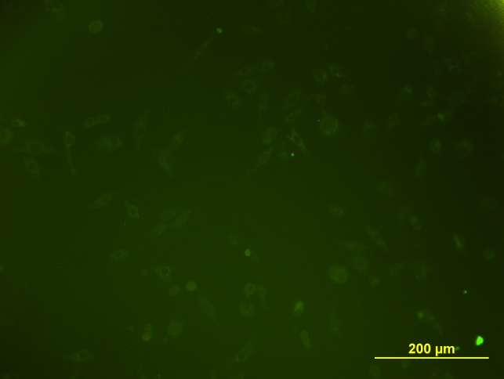
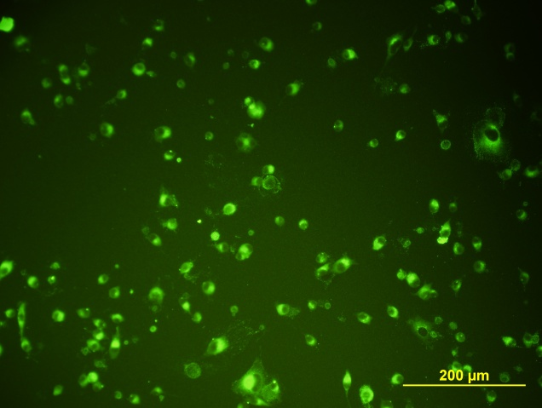
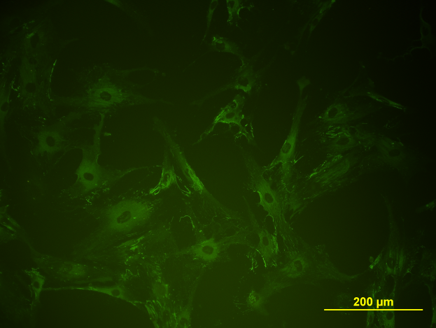
Fibronectin
IMR90
CS9K Fib
CS14K Fib
CSC 9K
CsBrN1

Slide 22
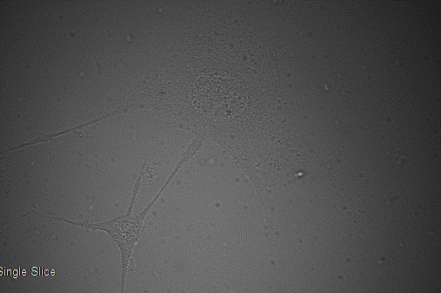
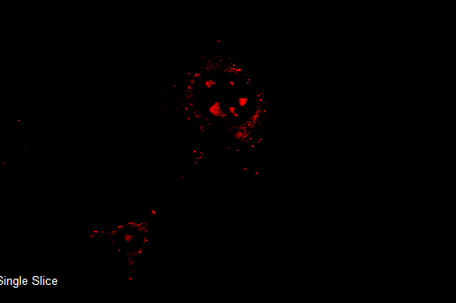
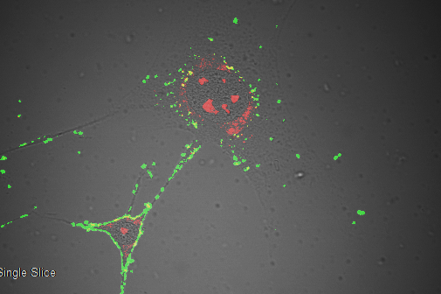
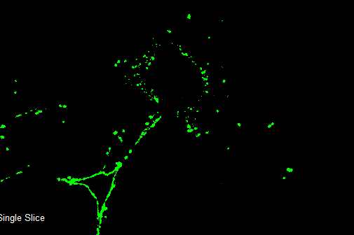
Apoptosis
BF
PI
Annexin V

Slide 23
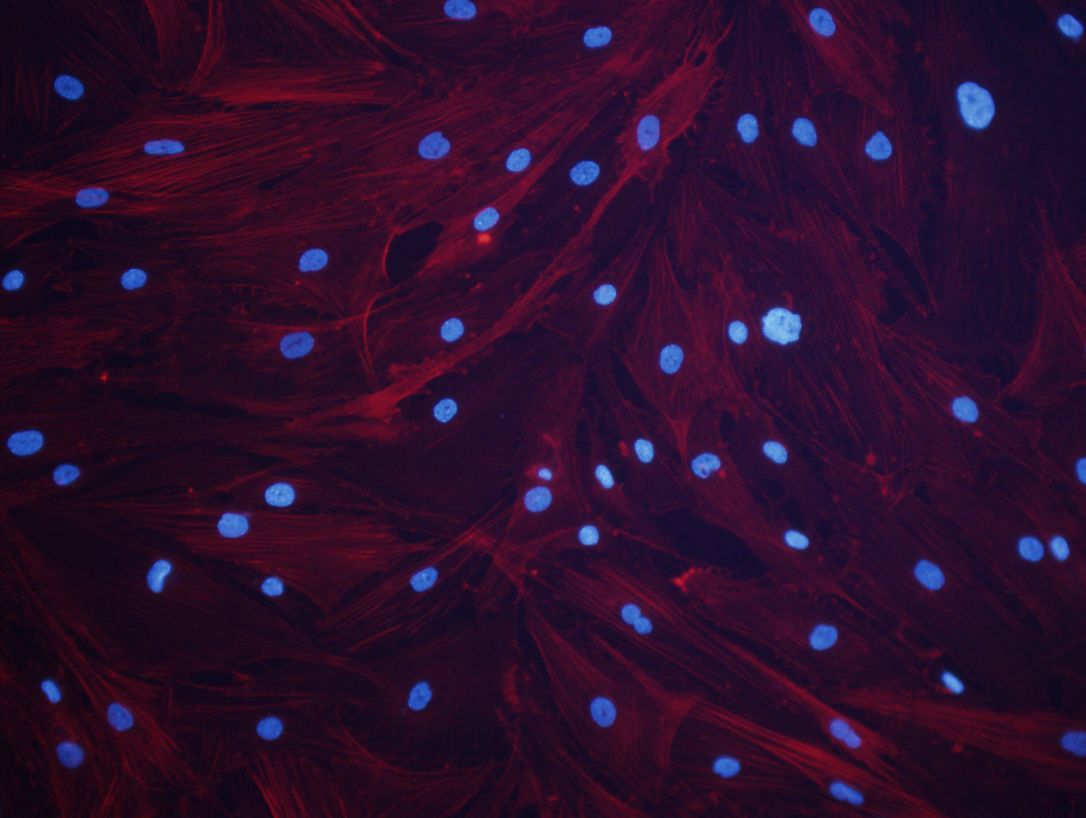
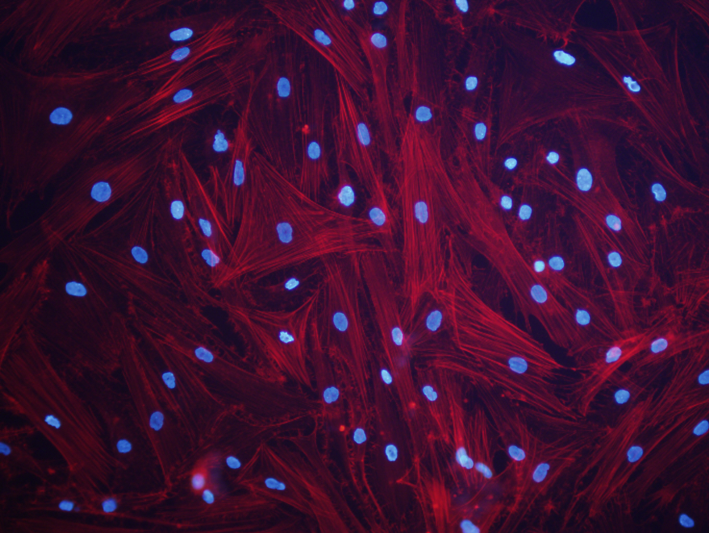
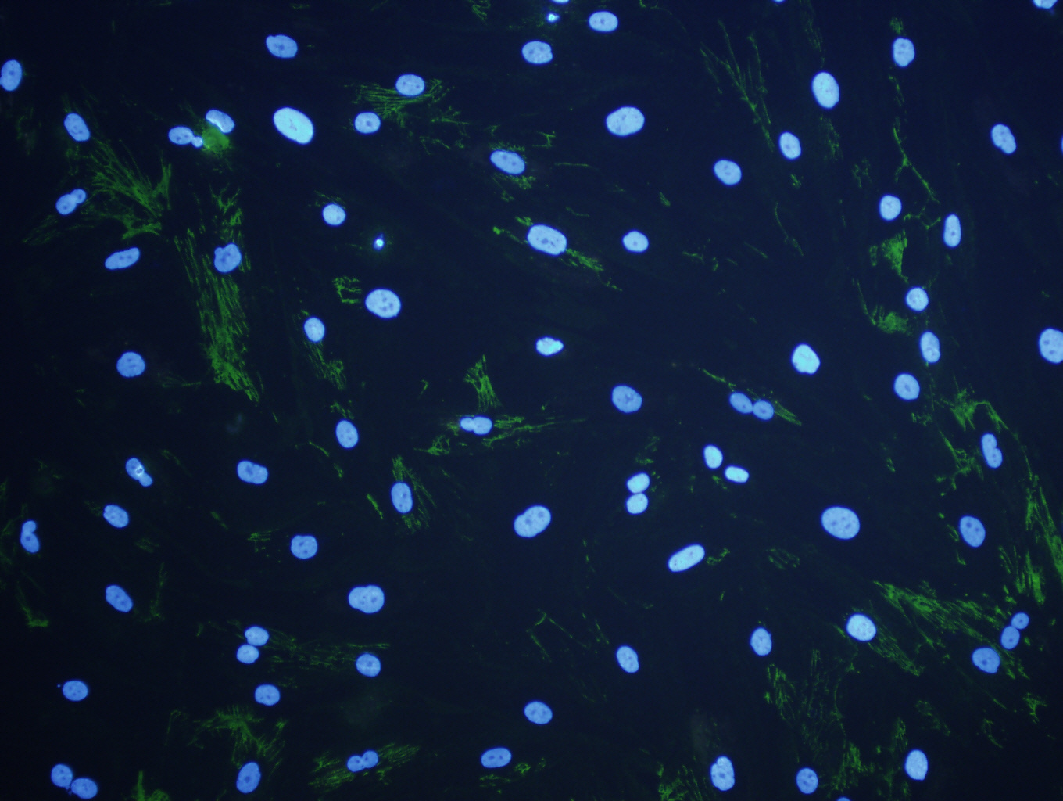
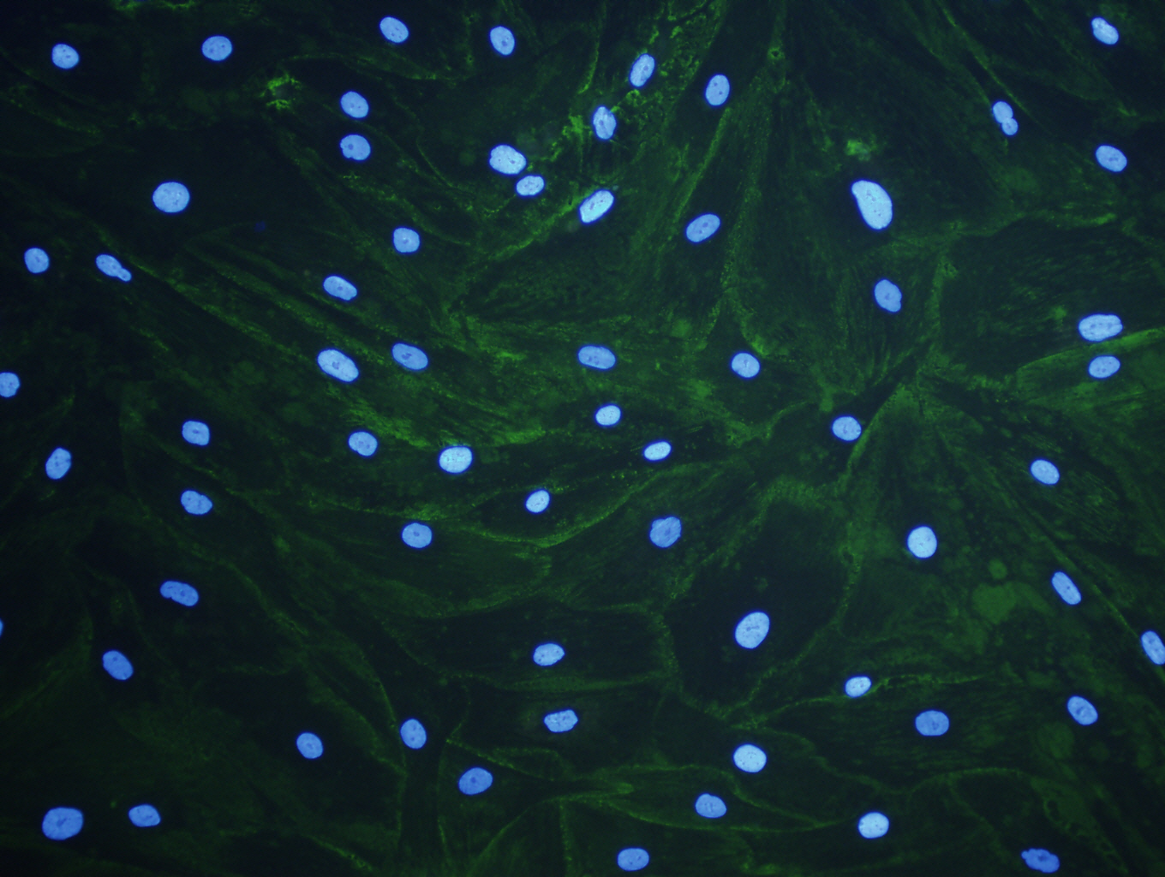
Effect of molecular crowding
Fibroblast cell layer without crowder. Red : actin with phalloidin staining, Green : Fibronectin with Primary antibody Rabbit anti human Fibronection and Secondary antibody anti rabbit conjugated with Alexa Fluor 488 staining, Blue : Nuclei with DAPI staining
Fibroblast cell layer with Dextran sulfate (DxS) crowder. Red : actin with phalloidin staining, Green : Fibronectin with Primary antibody Rabbit anti human Fibronection and Secondary antibody

Slide 24
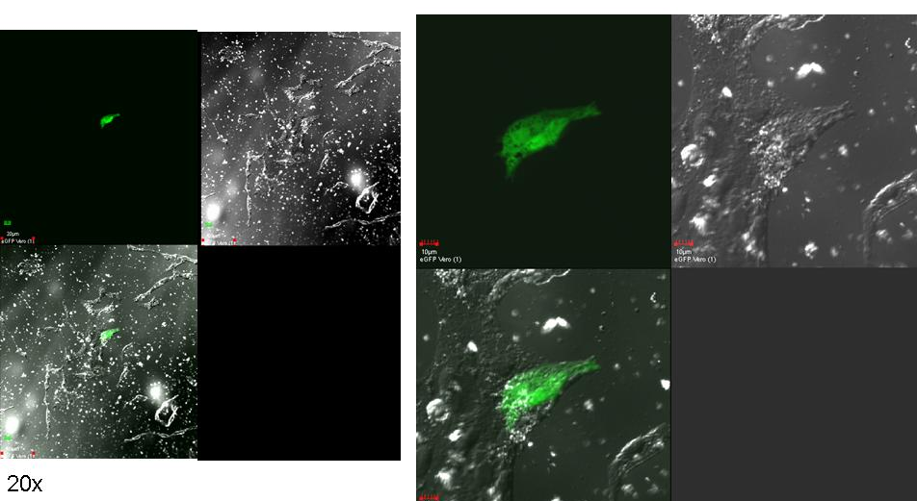
eGFP expression in Vero cell

Slide 25
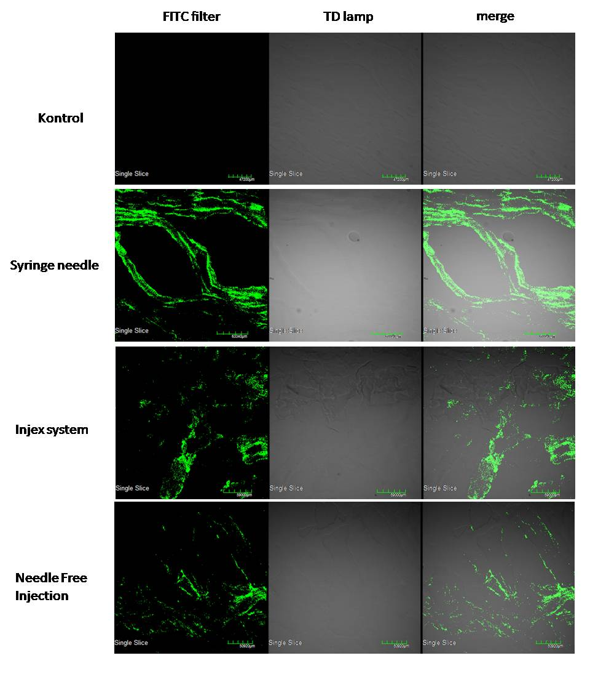
Visualisasi mikroskop konfokal dari potongan jaringan otot paha mencit yang divaksinasi dengan pcDNA3.1(+)eGFP. Pendaran warna hijau pada visualisasi dengan filter FITC menunjukkan bahwa protein eGFP berhasil diekspresikan oleh sel.

Slide 26
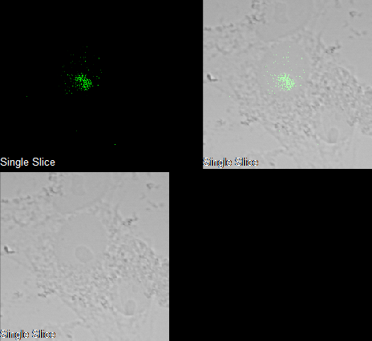
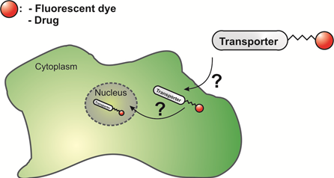
Cell Penetrating Peptide
VP22-eGFP

Slide 27
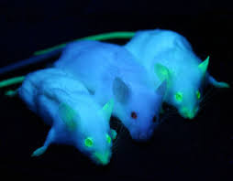
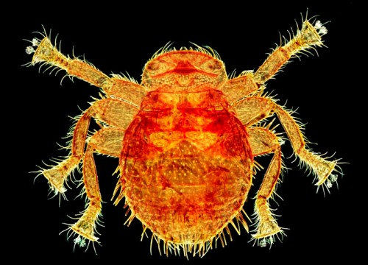
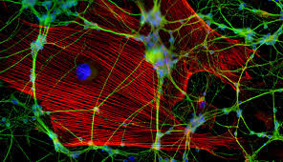
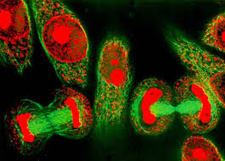
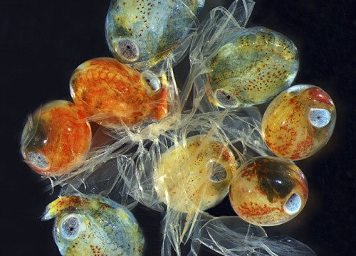

Welcome To The Microscope Universe
http://listsoplenty.com/pix/wickedly-cool-micro-imaging-pix

Slide 28


Hasil analisis Immunofluorescent. Gambar A1,B1,C1 menunjukkan gambar sel yang difoto menggunakan sinar merkuri dan laser. Gambar A2,B2, C2 menunjukkan gambar sel menggunakan sinar laser. Adanya fluoresensi warna hijau pada B2 dan fluoresensi warna merah pada C2 menunjukkan adanya protein NA (B2) dan HA (C2) dalam sel vero pasca transfeksi dengan vektor ekspresi pCDNA3.1 mengandung insert NA(B)s dan HA (C). Sel kontrol (A1,A2) tidak menunjukkan adanya fluorensi saat dipaparkan pada laser.

