Slide 1
IBL321 - Biodiversity
BIOGEOGRAFI
Biogeography Concept and its relation to Biodiversity
Radisti A. Praptiwi, B.Eng MSc. PhD

Slide 2
Branch of biology that deals with geographical distribution of plants and animals
(Oxford Dictionary)
BIOGEOGRAPHY ?

Slide 3
Apa yang menyebabkan perbedaan jenis flora & fauna di setiap bagian bumi?
Mengapa tidak ada orangutan di Kutub Utara; atau mengapa tidak ada koala di Indonesia?
DINAMIKA
GEOLOGI
BUMI
DINAMIKA
I K L I M
BUMI

Slide 4
BIOGEOGRAPHY
Mantle:
Temperature increases with depth (870º to 2200º C).
Composed mainly of iron and magnesium silicate.
Core:
Extremely hot!!! (above 5000º C).
Composed mainly of metallic nickel and iron.
The outer core is liquid, but the inner core is solid (due to the higher pressure).
Source:
http://butane.chem.uiuc.edu/pshapley/Environmental/L26/1.html

Slide 5
Theory: Plate Tectonics
Key principle:
“The lithosphere exists as separate and distinct tectonic plates, which float on the fluid-like (visco-elastic solid) asthenosphere. The relative fluidity of the asthenosphere allows the tectonic plates to undergo motion in different directions”.

Slide 6
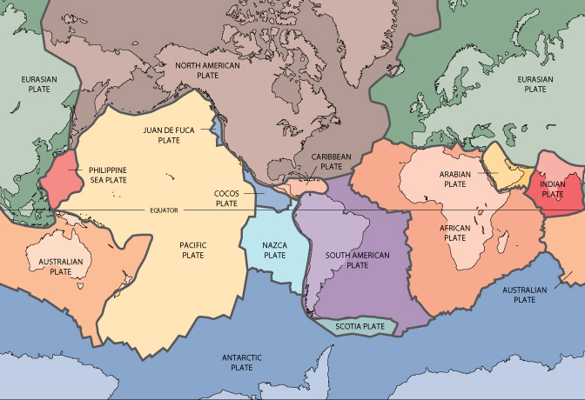
EARTH’S PLATE (current state)
Source:
https://pubs.usgs.gov/gip/dynamic/slabs.html

Slide 7
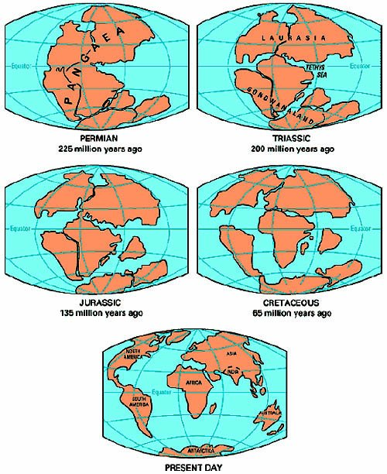
“PANGAEA” = “all lands”
Alfred Wegener (1880 – 1930), in his 1915 book The Origin of Continents and Oceans.
Citing with evidence of:
The fit of shapes between South America and Africa,
Fossil evidence (e.g. mesosaurus),
Similarity of rock structures.
Source:
https://www.uh.edu/engines/epi2188.htm
http://pangaea.org/Wegener.htm

Slide 8
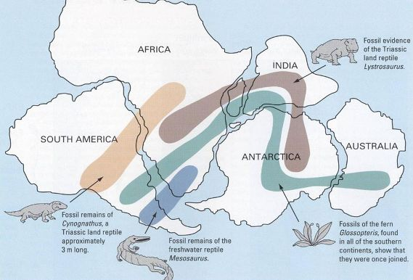
Source:
https://www.geolsoc.org.uk/Plate-Tectonics/Chap1-Pioneers-of-Plate-Tectonics/Alfred-Wegener/Fossil-Evidence-from-the-Southern-Hemisphere

Slide 9
Changes in Earth’s surface
Isolation or mixing of species and population
Earth’s Plate Dynamics
Earthquake
Annihilation or diminishing of habitat and population
Volcano eruption
Generation of new species

Slide 10
Biogeography of Indonesia Theory

Slide 11
Changes in the Indo-Australia Archipelago (IAA), or also known as Malesia or Malay Archipelago, over the past 50 million years.
IAA is the most geographically complex tropical region on Earth.
>20,000 islands in SE Asia (Indonesia, Brunei, East Timor, Malaysia, Philippines, Thailand, New Guineas, Singapore)
Lohman et. al. (2011). Biogeography of the Indo-Australian Archipelago. Annu. Rev. Ecol. Evol. Syst. 42: 405-426.

Slide 12
Two prominent biogeographical area: Sunda Shelf and Sahul Shelf,
Wallace’s line (further modified and improved by Huxley and Lydekker) made up a third biogeographycal region called Wallacea – the transition area.
Sources:
Suprijatna (2008). Melestarikan Alam Indonesia. Yayasan Obor Indonesia.
Lohman et. al. (2011). Biogeography of the Indo-Australian Archipelago. Annu. Rev. Ecol. Evol. Syst. 42: 405-426.

Slide 13
Is a faunal boundary line founded by Alfred Russel Wallace in 1859.
It separates the ecozones of Asia and Wallacea (a transitional zone between Asia and Australia.
West of the line: Organisms related to Asiatic Species.
East of the line: a mixture of species originated from Asia and Australia.
The line is seen as a deep water channel that marks the SE of Sunda Shelf – linking Borneo, Bali, Java and Sumatera to the mainland of southeastern Asia.
Wallace’s Line
Created in 1895 by Richard Lydekker
Separates Wallacea (on the west) from Australia-New Guinea (on the east)
Lydekker’s Line

Slide 14
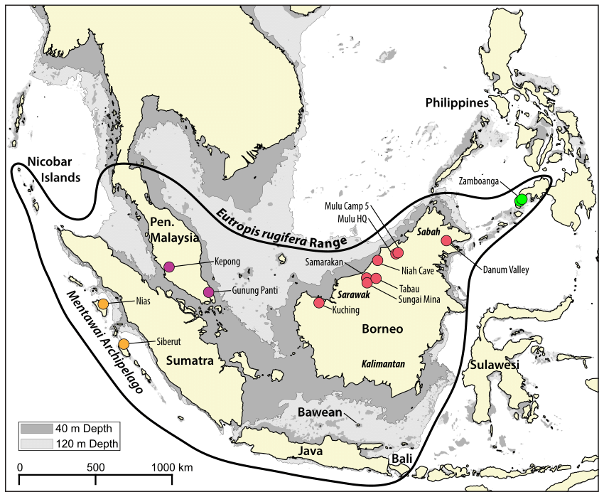
Sunda Shelf
Indonesian area:
Large islands (Sumatera, Java and Borneo/Kalimantan) and their surrounding small islands (e.g. Bali, Kep. Seribu, etc).
Tropical climate, high rainfall
Evergreen forests (lowland forest dominated by Dipterocarp trees; highland forest dominated by oak), mangroves.
Endemic fauna, includes: orangutan, tiger, rhinos, elephant, etc.
Figure is taken from:
Karin et. al. (2017). Ancient divergence time estimates in Eutropis rugifera support the existence of Pleistocenebarriers on the exposed Sunda Shelf. PeerJ 5:e3762; DOI 10.7717/peerj.3762

Slide 15
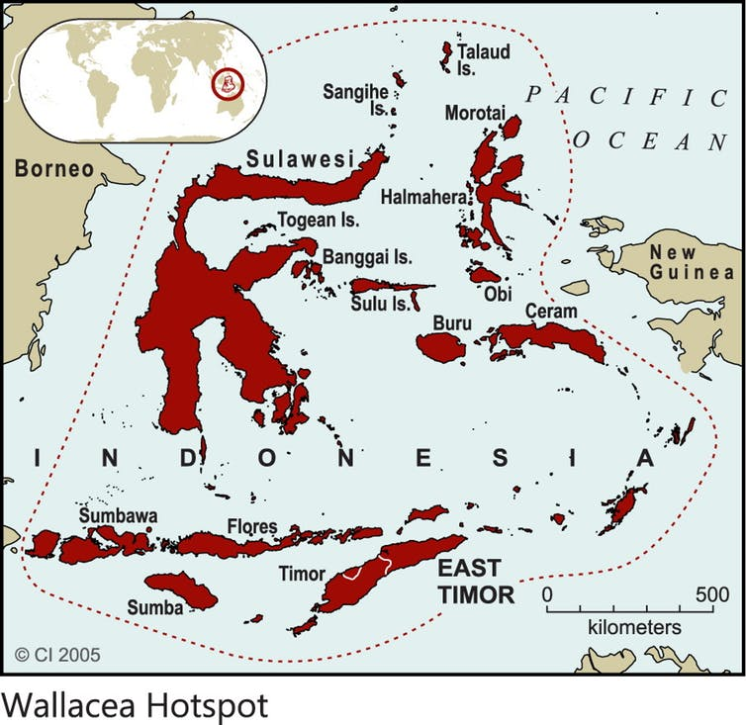
Wallacea
Sulawesi (largest island), Maluku, Lombok, NTT, NTB, Halmahera, Buru, Seram.
Tropical moist broadleaf forest; home to >>10,000 plant species (15% are endemic).
Endemic fauna, includes: anoa, babirusa, etc.
Important contributor to Indonesian megabiodiversity.
Figure is taken from:
http://theconversation.com/wallacea-a-living-laboratory-of-evolution-85602

Slide 16
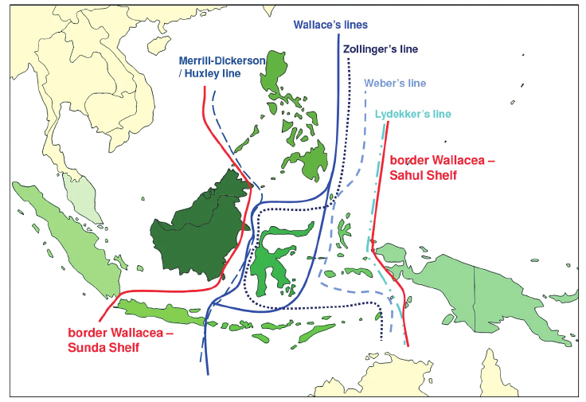
Sahul Shelf
Indonesian area:
Papua, Papua Barat, Kepulauan Aru.
Habitat for around 250 species of mammals; 20,000 plant species; and 750 species of birds.
Endemic fauna: cendrawasih, kakatua, kasuari, etc.
Figure is taken from:
Welzen and Raes (2011). The floristic position of Java. Gardens’ Bulletin Singapore 63 (1&2): 329-339.

Slide 17
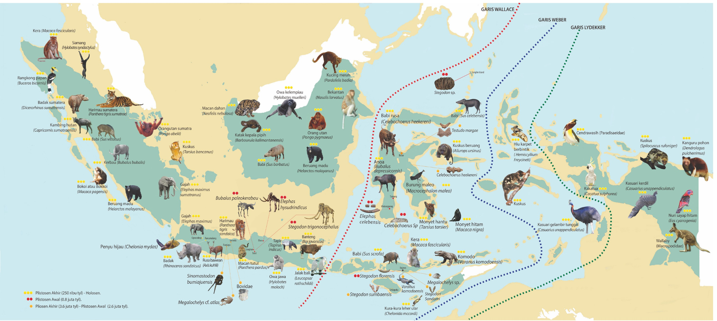
Faunal Distribution in Indonesia (Source: Museum Geologi)
Figure is taken from:
http://geomagz.geologi.esdm.go.id/wallace-dan-biogeografi-indonesia/

Slide 18
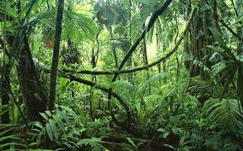
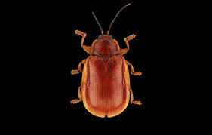
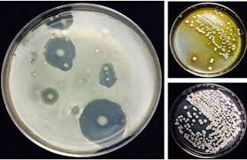
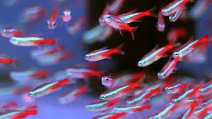
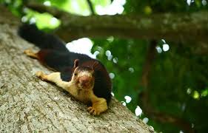
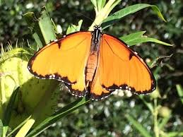
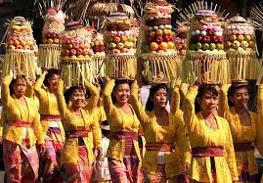
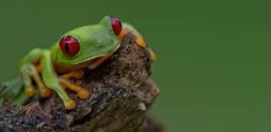
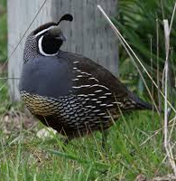
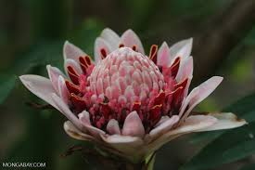
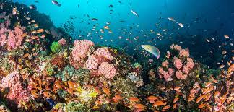
Geological Dynamics
Earth’s Surface
& Climate
Bio
diversity

