Slide 1
IBL 381
METODOLOGI PENELITIAN
10. Instrumen Pengukuran
Radisti A. Praptiwi, ST. M.Sc. PhD

Slide 2
Measuring Instruments
Introduction and definition
Measurement scales
Errors in measurement
Key criteria in measuring instruments

Slide 3
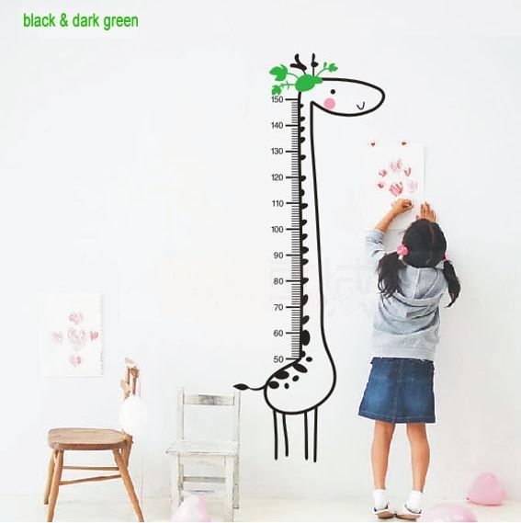
How familiar are we to measurement?
In our daily life, we are accustomed to measure physical objects.

Slide 4
And non-physical things….
We also measure when we judge how well we like songs, paintings, other people’s character, etc.
So, in our lives, we familiarize ourselves to measure both physical objects and abstract concepts.

Slide 5
Definition
Measurement is assigning numbers or other symbols to characteristics of objects being measured, according to predetermined rules.
Concept (or Construct) is a generalized idea about a class of objects, attributes, occurrences, or processes.
Relatively concrete constructs comprises of aspects such as: Age, gender, number of children, education, income.
Relatively abstract constructs take into accounts the aspects such as: personality, brand loyalty, level of satisfaction.

Slide 6
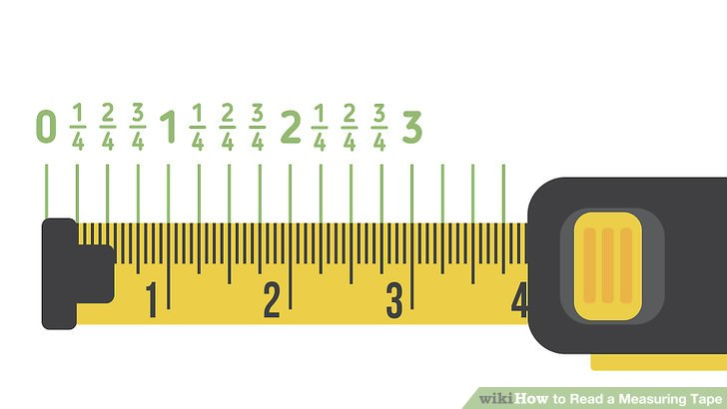
Measurement Scales
1. NOMINAL SCALE
2. ORDINAL SCALE
3. INTERVAL SCALE
4. RATIO SCALE

Slide 7
1. NOMINAL SCALE
Nominal scale is simply a system of assigning number symbols to events in order to label them.
The usual example of this is the assignment of numbers of basketball players in order to identify them.
The numbers are just convenient labels for the particular class of events and as such have no quantitative value
Nominal scale is the least powerful level of measurement.
It indicates no order or distance relationship and has no arithmetic origin.

Slide 8
2. ORDINAL SCALE
The ordinal scale is used for ranking and to arrange things in order.
The ordinal scale ranks the things from the highest to the lowest.
Ordinal scales are used to ascertain the consumer perceptions, preferences, etc. For example, the respondents may be given a list of brands which may be suitable and were asked to rank on the basis of ordinal scale.
From the information provided by ordinal scale, the researcher knows the order of preference but nothing about how much more one brand is preferred to another i.e., there is no information about the interval between any two brands
Other example of ordinal scale: Students may be categorized according to their grades of A, B, C, D, E, F etc. where A is better than B and so on. The classification is from the highest grade to the lowest grade.

Slide 9
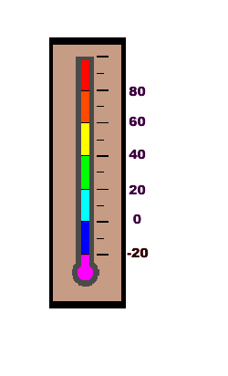
3. INTERVAL SCALE
Temperature is interval scaled, being measured either in Centigrade or Fahrenheit. We cannot speak of 50°F being twice as hot as 25°F since the corresponding temperatures on the centigrade scale, 100°C and -3.9°C, are not in the ratio 2:1.
it must be recognized that the zero point on an interval scale is arbitrary and is not a true zero. For instance, the zero degree Fahrenheit.
Interval scale uses the principle of "equality of interval" i.e., the intervals are used as the basis for making the units equal assuming that intervals are equal.
One can say that an increase in temperature from 30° to 40° involves the same increase in temperature as an increase from 60° to 70°, but one cannot say that the temperature of 60° is twice as warm as the temperature of 30°

Slide 10
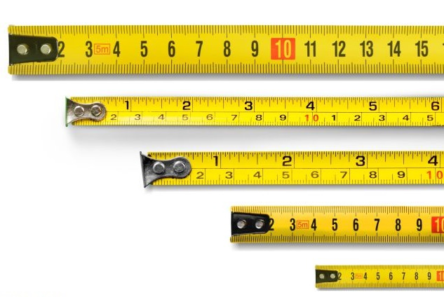
4. RATIO SCALE
Ratio scale is a special kind of internal scale that has a meaningful zero point.
With this scale, length, weight or distance can be measured. In this scale, it is possible to say, how many times greater or smaller one object is being compared to the other.
These scales are used to measure actual variables.
Ratio scales permit the researcher to compare both differences in scores and in the relative magnitude of scores.
For instance, the difference between 5 and 10 minutes is the same as that between 10 and 15 minutes, and 10 minutes is twice as long as 5 minutes.

Slide 12
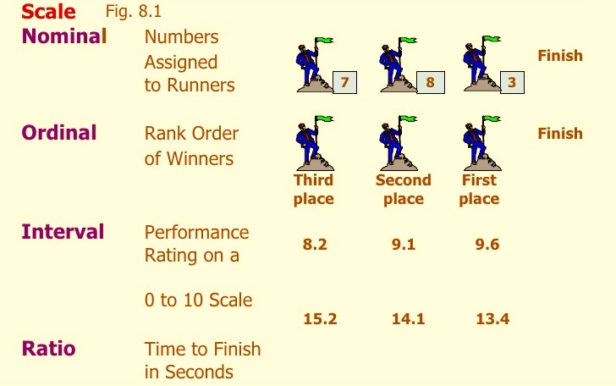

Slide 13
Sources of Error in Measurement
Measurement should be precise and unambiguous in an ideal research study.
This objective, however, is often not met with in entirety.
As such the researcher must be aware about the sources of error in measurement.

Slide 14
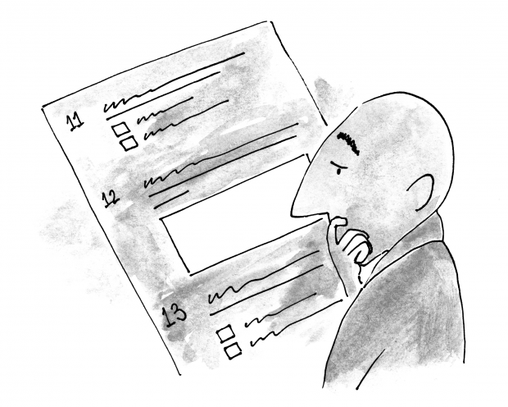
The following are the possible sources of error in measurement:
(a) Respondent
At times the respondent may be reluctant to express strong negative feelings or it is just possible that he may have very little knowledge but may not admit his ignorance.
All this reluctance is likely to result in an interview of ‘guesses.’ Transient factors like fatigue, boredom, anxiety, etc. may limit the ability of the respondent to respond accurately and fully.

Slide 15
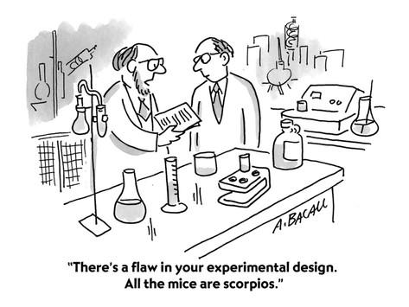
Sources of Error in Measurement
(b) Measurer
The interviewer can distort responses by rewording or reordering questions.
His/her behaviour, style and looks may encourage or discourage certain replies from respondents.
He/she may also not know how to utilise a measuring instrument correctly.

Slide 16
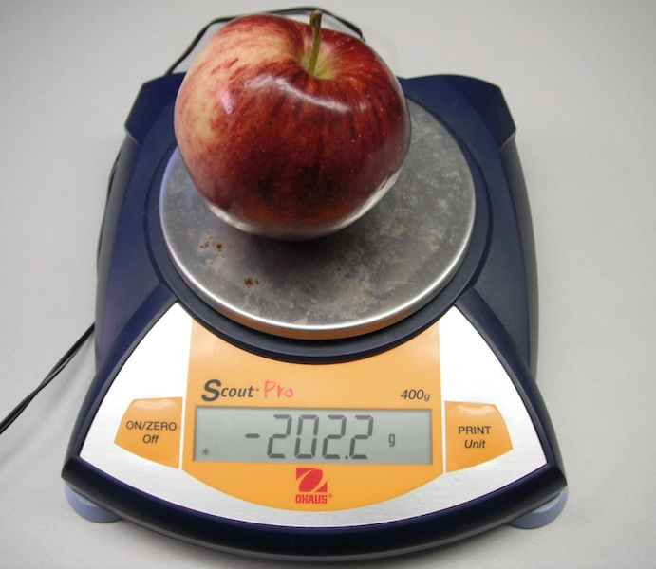
Sources of Error in Measurement
(c) Instrument
Error may arise because of the defective measuring instrument.
It is important to ensure that your measuring instruments are regularly calibrated.

Slide 17
Three Key Criteria for a Measuring Instrument
1. RELIABILITY
Reliability in this context (it has other meanings in statistics and in daily life) means consistency: do we get the same result if measured repeatedly?
Reliability means the extent to which the measurement process is free from errors.
Reliability deals with accuracy and consistency. The scale is said to be reliable, if it yields the same results when repeated measurements are made under constant conditions.
Various types of reliability:
Test-retest: measure a second time using the same sample and same instrument.
Split-half: compare results from different sets of items (applies to survey instruments, where we often assess using a combination of questions)
Inter-rater: compare the same sample across different instruments

Slide 18
Three Key Criteria for a Measuring Instrument
2. Validity
Validity is about whether our measurement really measures our concept (or variables)?
The paradigm of validity focused in the question "Are we measuring, what we think, we are measuring?“.
Some types of validity:
Face validity: does it even look like it is measuring the right thing (e.g. Assess weight by asking how much money in your pocket!)
Criterion (predictive) validity: does it predict outcomes that we believe relate to the concept (e.g. If heavy people have more diabetes, does our measure of weight predict diabetes?)?
Construct validity: does it relate to other variables in the way our theory predicts? (e.g. if we are measuring marital satisfaction and our theory says that it should be associated with marital fidelity, is that true?)

Slide 19
Three Key Criteria for a Measuring Instrument
2. Validity
Note that there may be some trade-off between reliability and validity.
Highly reliable measures are likely to be factual and give little insight and may not have high validity (they are often quantitative).
Measures that have high validity may be very personalised and have relatively low reliability (they are often qualitative).
A good strategy is often to use multiple measuring tools simultaneously to measure different dimensions.

Slide 20
Three Key Criteria for a Measuring Instrument
3. Practicality
The practicality characteristic of a measuring instrument can be judged in terms of economy, convenience and interpretability. From the operational point of view, the measuring instrument ought to be practical i.e., it should be economical, convenient and interpretable
Economy consideration suggests that some trade-off is needed between the ideal research project and that which the budget can afford.
Convenience test suggests that the measuring instrument should be easy to administer.
Interpretability means that the measuring instrument produces data that can be interpreted by anybody, even those not directly related to the research project.

Slide 21
Making Operational Choices
An example of operational choice (how to measure something):
Research Question: Is the lecture room at a comfortable temperature?
Concept: “comfort of the temperature in the lecture room”
Possible operationalizations:
Use the thermometer in the room.
Reliability is high but validity is questionable – this is measuring temperature, not comfort - one person may be wearing a T-shirt and another person is wearing a coat and may feel very differently about what is a comfortable temperature,
Ask everyone in the room how they feel about the temperature on the scale: very cold, cold, about right, warm, very warm.
The subjective scale would take into account how people feel, how they are dressed, whether they are sitting under the aircon vent, whether they are feeling unwell. Validity is high, but reliability is questionable – on another day, I may come in wearing more or less clothes.

