Slide 1
IBL 381
METODOLOGI PENELITIAN
11. Quantitative Research Method (Part 1: Introduction and Data Collection)
Radisti A. Praptiwi, ST. M.Sc. PhD

Slide 2
Quantitative Research
Definition
Quantitative vs Qualitative
Key characteristics
Types of quantitative research
Quantitative research data
Data collection and organization

Slide 3
Definition
Quantitative research methods are research methods dealing with numbers and anything that is measurable in a systematic way of investigation of phenomena and their relationships.
It is used to answer questions on relationships within measurable variables with an intention to explain, predict and control a phenomena.
An entire quantitative study usually ends with confirmation or disconfirmation of the hypothesis tested.
Researchers using the quantitative method identify one or a few variables that they intend to use in their research work and proceed with data collection related to those variables.
Quantitative method typically begins with data collection based on a hypothesis or theory and it is followed with application of descriptive or inferential statistics.

Slide 4
Quantitative vs Qualitative
Quantitative research is, as the term suggests, concerned with the collection and analysis of data in numeric form.
It tends to emphasize relatively large-scale and representative sets of data, and is often, falsely in our view, presented or perceived as being about the gathering of `facts'.
Qualitative research, on the other hand, is concerned with collecting and analysing information in as many forms, chiefly non-numeric, as possible.
It tends to focus on exploring, in as much detail as possible, smaller numbers of instances or examples which are seen as being interesting or illuminating, and aims to achieve `depth' rather than `breadth'. (Blaxter, Hughes and Tight, 1996: 61)

Slide 5
Quantitative vs Qualitative

Slide 6
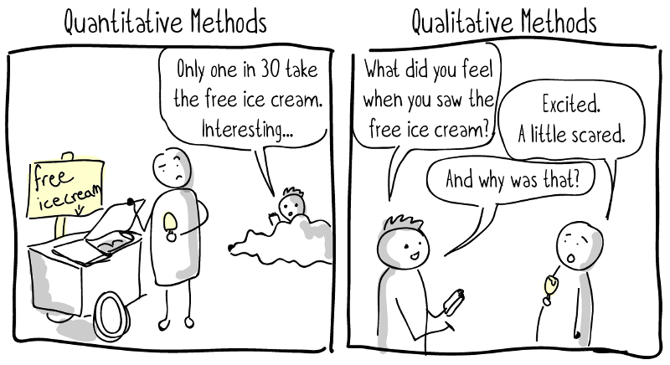
Whilst quantitative research may be mostly used for testing theory it can also be used for exploring an area and generating hypotheses and theory.
Similarly qualitative research can be used for testing hypotheses and theories even though it is mostly used for theory generation.
Qualitative data often includes quantification (e.g. statements such as more than, less than, most as well as specific numbers).
Quantitative (i.e. questionnaire) approaches can collect qualitative data through open ended questions.

Slide 7
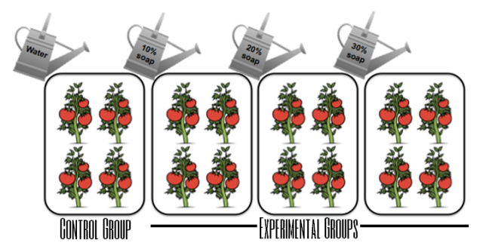
Quantitative Research: Key Characteristics
1. CONTROL
This is the most important element because it enables the scientist to identify the causes of his or her observations.
Experiments are conducted in an attempt to answer certain questions. They represent attempts to identify why something happens, what causes some event, or under what conditions an event does occur.

Slide 8
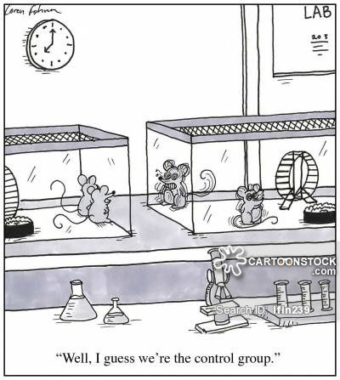
Quantitative Research: Key Characteristics
1. CONTROL
Control is necessary in order to provide unambiguous answers to such questions.
Controlled inquiry is absolutely essential to this because without it the cause of an effect could not be isolated.

Slide 9
Quantitative Research: Key Characteristics
2. OPERATIONAL DEFINITION
This means that terms must be defined by the steps or operations used to measure them.
Such a procedure is necessary to eliminate any confusion in meaning and communication.
Stating an operational definition forces one to identify the empirical referents, or terms.
In this manner, ambiguity is minimised. For instance, introversion may be defined as a score on a particular personality scale, hunger as so many hours since last fed, and social class as defined by occupation

Slide 10
Quantitative Research: Key Characteristics
3. REPLICATION
To be replicable, the data obtained in an experiment must be reliable; that is, the same result must be found if the study is repeated.
If observations are not repeatable, our descriptions and explanations are thought to be unreliable.

Slide 11
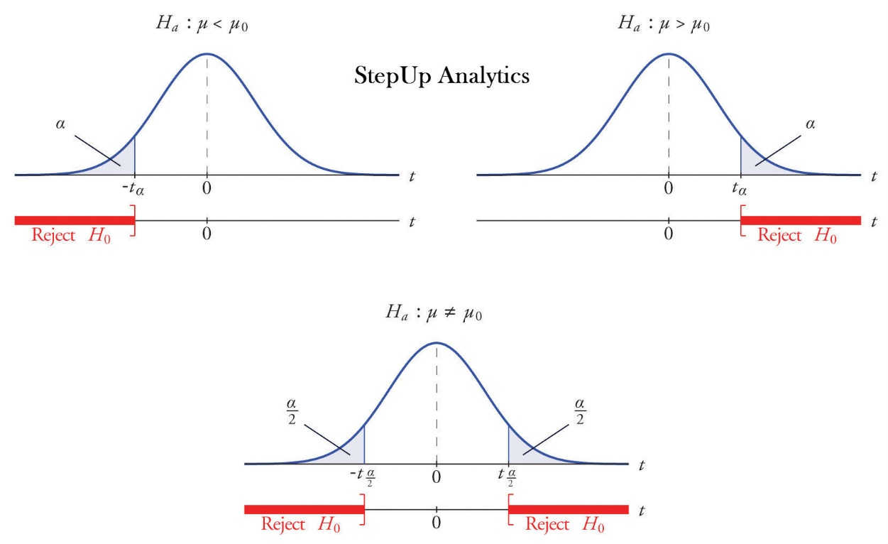
Quantitative Research: Key Characteristics
4. HYPOTHESIS TESTING
The systematic creation of a hypothesis and subjecting it to an empirical test.

Slide 12
Types of Quantitative Research
Correlational Research
Correlational research or studies examine differences of characteristics or variables of two or more entities.
A correlation exists when one variable increases or decreases correspondingly with the other variable.
A researcher will gather data about two or more variables in a particular group. These data are numbers that reflect measurement of the characteristics of research questions.

Slide 13
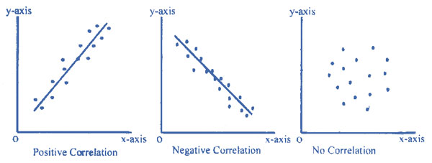
Types of Quantitative Research
Correlational Research
Correlational results can be represented using various means of visualisation. One such example would be using the scatterplot which allows a visual inspection of the relationship between two variables.
By examining the scatterplot, we can identify or describe the homogeneity or heterogeneity of the two variables. Secondly, we can describe the degree of which the two variables are intercorrelated or using statistical approach known as correlation coefficient. Finally, we can interpret these data and give them meaning.

Slide 14
Types of Quantitative Research
Survey Research
Kerlinger (1973) defined survey research as a study on large and small populations by selecting samples chosen from the desired population and to discover relative incidence, distribution and interrelations
The ultimate goal of survey research is to learn about a large population by surveying a sample of the population. In this method, a researcher poses a series of questions to the respondents, summarises their responses in percentages, frequency distribution and some other statistical approaches
Basically, information is acquired by asking respondents questions by using interviews or questionnaires

Slide 15
Quantitative Research Data
The data are needed in a research work to serve the following purposes:
It is something like the raw material that is used in the production of analysis. Quality of data determines the quality of research.
It provides a definite direction and definite answer to a research inquiry. Whatever inquiry has to give a definite answer to an investigation. Data are very essential for a scientific research.
The data are needed to substantiate the various arguments in research findings.
The main purpose of data collection is to verify the hypotheses.
Statistical data are used in two basic problems of any investigation:
Estimation of population parameters, which helps in drawing generalization.
The hypotheses of any investigation are tested by data collection procedure.

Slide 16
Quantitative Research Data
The quantitative data are collected by administering the research tools. These should possess the following characteristics:
The quantitative data should be collected through standardized tests. If self-made test is used it should be reliable and valid.
They are highly reliable and valid. Therefore, generalization and conclusions can be made easily with certain level of accuracy.
The obtained results through quantitative data can be easily interpreted with scientific accuracy.
The use of quantitative data is always based upon the purpose of the study.
The inferential statistical can be used with the help of quantitative data.

Slide 17
Quantitative Research Data
The quantitative data are collected by administering the research tools. These should possess the following characteristics:
The quantitative data should be collected through standardized tests. If self-made test is used it should be reliable and valid.
They are highly reliable and valid. Therefore, generalization and conclusions can be made easily with certain level of accuracy.
The obtained results through quantitative data can be easily interpreted with scientific accuracy.
The use of quantitative data is always based upon the purpose of the study..
The inferential statistical can be used with the help of quantitative data.

Slide 18
Data Collection & Organization
The task of data collection begins after a research problem has been defined and research design/plan chalked out.
The mass of data collected through the use of various tools, however reliable, valid and adequate it may be is yet but raw. It needs to be systematized and organized, i.e. edited, classified and tabulated before it can serve any worthwhile purpose.
Editing implies the checking of gathered data for accuracy, utility and completeness.
Classifying refers to the dividing of the information into different categories, classes or heads, for their use.
Tabulating denotes the recording of the classified material in accurate mathematical terms e.g. marking and counting frequency tallies for different items on which Information is gathered. Before tabulating, all raw data should be tested on the basis of the purpose for which they are gathered and only the useful and usable data should be tabulated.

