Slide 1
IBL 381
METODOLOGI PENELITIAN
13. Research Ethics
Radisti A. Praptiwi, ST. M.Sc. PhD

Slide 2
Etika Dalam Penelitian
Pendahuluan: konsep kode etik
Kejujuran: (i) kepemilikan intelektual & plagiarism, (2) sitasi dan pengakuan, (3) tanggungjawab dan integritas penelitim, (4) data dan interpretasi
Etika penggunaan hewan dalam penelitian

Slide 3
Materi dalam kuliah ini disadur dari:
Nicholas Walliman (2011). Research Methods: the basics. Routledge: London & NY.
Ranjit Kumar (2011). Research Methodology: a step by step guide for beginners. SAGE: London.
Christina Rodriguez. The ethics of using animals in research (website: www.goshen.edu/bio/Biol410/bsspapers06/ChristinaR/ChistinaR.html)

Slide 4
The concept of ethics
All professions are guided by a code of ethics that has evolved over the years to accommodate the changing ethos, values, needs and expectations of those who hold a stake in the professions.
Most professions have an overall code of conduct that also governs the way they carry out research. In addition, many research bodies have evolved a code of ethics separately for research.

Slide 5
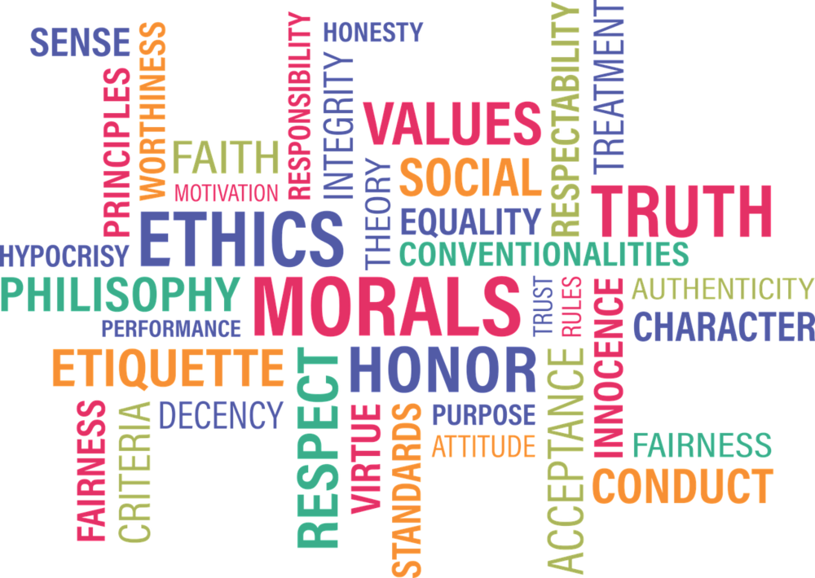
The concept of ethics
According to the Collins Dictionary (1979: 502), ethical means ‘in accordance with principles of conduct that are considered correct, especially those of a given profession or group’.

Slide 6
The concept of ethics
The keywords here, ‘principles of conduct’ and ‘considered correct’, raise certain questions:
1. What are these principles of conduct?
2. Who determines them?
3. In whose judgement must they be considered correct?
4. Are there universal principles of conduct that can be applied to all professions?
5. Do these change with time? Should they?
6. What happens when a professional does not abide by them?

Slide 7
The concept of ethics
The subject of ethics needs to be considered in light of these questions.
The way each profession serves society is continuously changing in accordance with society’s needs and expectations and with the technology available for the delivery of a service.
The ethical codes governing the manner in which a service is delivered also need to change.

Slide 8
The concept of ethics
What has been considered ethical in the past may not be so judged at present, and what is ethical now may not remain so in the future. Any judgement about whether a particular practice is ethical is made on the basis of the code of conduct prevalent at that point in time.
As the service and its manner of delivery differ from profession to profession, no code of conduct can be uniformly applied across all professions. Each profession has its own code of ethics, though there are commonalities. If you want guidelines on ethical conduct for a particular profession, you need to consult the code of ethics adopted by that profession or discipline.

Slide 9
The concept of ethics
‘What are these principles of conduct?’ is the most important question as it addresses the issue of the contents of ethical practice in a profession.
As the code of conduct varies from profession to profession, it is not possible to provide a universal answer to this question.
However, in research, any dilemma stemming from a moral quandary is a basis of ethical conduct.
There are certain behaviours in research – such as causing harm to individuals, breaching confidentiality, using information improperly and introducing bias – that are considered unethical in any profession

Slide 10
The concept of ethics
There are two aspects of ethical issues in research:
The individual values of the researcher relating to honesty and frankness and personal integrity.
The researcher’s treatment of other people involved in the research, relating to informed consent, confidentiality, anonymity and courtesy.

Slide 11
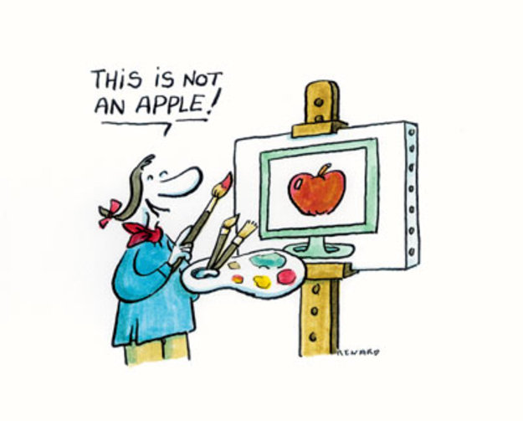
Honesty in your work
Honesty is essential, not only to enable straightforward, above-board communication, but to engender a level of trust and credibility in the outcomes of the research. This applies to all researchers, no matter what subject they are investigating.
Although honesty must be maintained in all aspects of the research work, it is worth focusing here on several of the most important issues (continue to next slide):

Slide 12
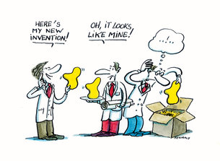
Honesty in your work
INTELLECTUAL OWNERSHIP AND PLAGIARISM
Unless otherwise stated, what you write will be regarded as your own work; the ideas will be considered your own unless you say to the contrary.
The worst offence against honesty in this respect is called plagiarism: directly copying someone else’s work into your report, thesis etc. and letting it be assumed that it is your own.
Using the thoughts, ideas and works of others without acknowledging their source, even if you paraphrased into your own words, is unethical. Equally serious is claiming sole authorship of work which is in fact the result of collaboration.

Slide 13
Honesty in your work
ACKNOWLEDGEMENT AND CITATION
Obviously, in no field of research can you rely entirely on your own ideas, concepts and theories. You can avoid accusations of plagiarism by acknowledging the sources of these features and their originators within your own text. This is called citation.
You should also indicate the assistance of others and any collaboration with others, usually in the form of a written acknowledgement at the beginning or end of the report.

Slide 14
Honesty in your work
RESPONSIBILITY AND ACCOUNTABILITY OF THE RESEARCHER
Apart from correct attribution, honesty is essential in the substance of what you write. You do have responsibilities to fellow researchers, respondents, the public and the academic community. Accurate descriptions are required of what you have done, how you have done it, the information you obtained, the techniques you used, the analysis you carried out, and the results of experiments – a myriad of details concerning every part of your work.

Slide 15
Honesty in your work
DATA AND INTERPRETATIONS
Although it is difficult, and some maintain that it is impossible, to be free from bias, distorting your data or results knowingly is a serious lapse of honesty.
Scientific objectivity should be maintained as much as possible. If you can see any reason for a possibility of bias in any aspect of the research, it should be acknowledged and explained.
If the study involves personal judgements and assessments, the basis for these should be given.
Silently rejecting or ignoring evidence which happens to be contrary to one’s beliefs, or being too selective in the data used and in presenting the results of the analysis constitutes a breach of integrity.
The sources of financial support for the research activities should also be mentioned, and pressure and sponsorship from sources which might influence the impartiality of the research outcomes should be avoided.

Slide 16
The ethics of using animals in research
Animal research has been used as a method of study, when the study of humans is deemed impractical or unethical.
In the last century major important medical advances have benefited directly or indirectly from animal research.
However, serious ethical issues arise regarding the use of animals.
Animals are subjected to painful procedures or toxic exposures that leave them injured, living impaired or even dead.
In addition these techniques result in high levels of stress in animals and altered physiological functions often leading to inconclusive results.

Slide 17
“No responsible scientist wants to use animals or cause them unnecessary suffering if it can be avoided, and therefore scientists accept controls on the use of animals in research. More generally, the bioscience community accepts that animals should be used for research only within an ethical framework” (Festing & Wilkinson 2007).

Slide 18
The ethics of using animals in research
The replacement of animal methods as much as possible with non-animal techniques would yield both ethical and technical advantages.
The exploration and implementation of non-animal methods should be a priority for investigators and research institutions, and should take advantage of a wide variety of viewpoints to ensure progress toward scientific, human health, and animal protection goals.

Slide 19
Ethical Justification for the use of animals
Some organizations, part of the general public and scientists that advocate for animal testing also argue that it would be unethical to administrate substances and drugs that might have dangerous side effects to humans.
In addition some experiments need to observe the variables for large periods of time; humans can not be confined in a laboratory for extended periods of time.

Slide 20
Ethical Justification for the use of animals
Part of the ethical justification for the use of animals is that scientific procedures depend on it and also because there is a moral obligation to increase the knowledge in every way possible so that, for instance, new therapies and drugs can be developed to ease the suffering caused by lines and other conditions.
Many scientists and governments agree that if animals are to be used in experiments, procedures should be carried out so that the animal subjects experience minimal discomfort or distress, and that animals should be used only if there is no other method available to deliver consistent and substantial results.
Three guiding principles are used in many countries to observe the use of animals. They are commonly called the Three R’s:
Reduction,
Replacement and
Refinement

Slide 21
Ethical Justification for the use of animals
Reduction refers to methods that enable researchers to obtain comparable results from fewer animals, or to obtain more information from the same number of animals.
Replacement refers to the preference for non-animal methods over animal methods whenever the results won’t be affected.
And refinement refers to methods to alleviate or minimize potential pain suffering and distress that animals go through the procedures.

Slide 22
Contending Views and Alternatives
Animal rights groups strongly believe that human beings have no moral right to use individual animals in ways that would not benefit those individuals, as they are also sentient beings capable of agency.
Today, there are two major accepted alternatives:
Computer simulation, and
In vitro cell culture techniques.
Many of these techniques are still under development and many of them would still need to use data from prior animal experiments or other animal derived animals’ cultures.
However, these would significantly decrease the number of animals used in experiments

Slide 23
Contending Views and Alternatives
Examples of computer simulation models include diabetes asthma and drug absorption model.
Cell culture has proven to be the most effective and it has been used for more than 30 years for cosmetic and other tests by some laboratories.
Micro-dosing using voluntary human subjects is also becoming popular. In these assessments, the drugs that are administrated give doses below the doses that would produce a whole body effect.
Some institutions that carry on alternatives to animal’s testing include: The John Hopkins Center for Alternatives to animal testing, The university of California Center for animal testing

