Slide 1
IBL 381
METODOLOGI PENELITIAN
14. Writing Research Proposal and Report
Radisti A. Praptiwi

Slide 2
Writing Research Proposal & Report
Introduction
Research Proposal Structure
Research Report: When to start writing, structure, results and analysis, conclusions.

Slide 3
Materi dalam kuliah ini disadur dari:
Nicholas Walliman (2011). Research Methods: the basics. Routledge: London & NY.
Ranjit Kumar (2011). Research Methodology: a step by step guide for beginners. SAGE: London.

Slide 4
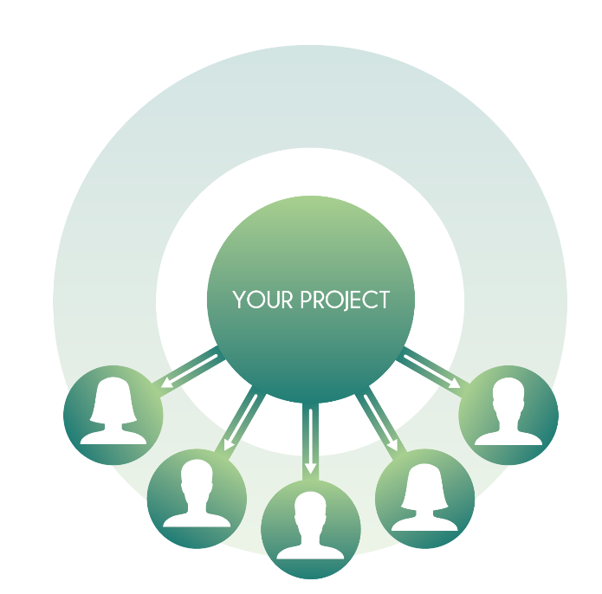
Introduction
One of the skills essential to successful research is that of writing.
Good research needs to be communicated:
At the beginning of research → to explain what you will do
At the end of research → to explain what you have done

Slide 5
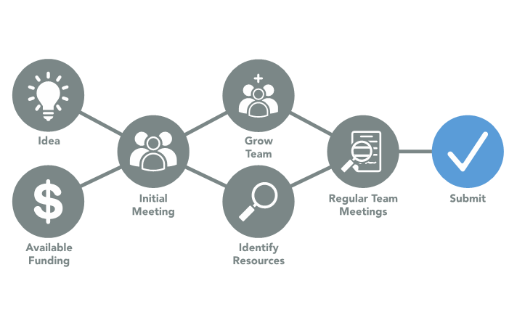
Research Proposal
Before starting a research programme it is necessary to work out exactly what you want to do, why and how.
A research proposal is a succinct summary of just that. Obviously it will be very helpful to you, the researcher, to make it clear to yourself what the aims of the research are and what you need to do to achieve the desired outcome.
It will also be useful as a way to inform others of your intentions.
Common processes for project proposal development

Slide 6
Research Proposal
Fortunately, research proposals tend to follow a defined pattern.
They all need to explain the nature of the research and its context, and why it is needed.
This then prepares the way for a statement of the aims and objectives of the research and how it will be carried out and what the outcomes are likely to be.
Then there is a description of what resources will be required (time, money, equipment, staffing etc.) in order to carry out the work.

Slide 7
Research Proposal Structure
Academic research proposals are usually composed of the following elements:
the title;
aims of the research;
the background to the research – context and previous research;
a definition of the research problem;
outline of methods of data collection and analysis;
possible outcomes;
timetable of the project and description of any resources required;
list of references.

Slide 8
Research Proposal Structure
1. THE TITLE
The function of the title is to encapsulate in a few words the essence of the research.
Ideally it should contain all the essential key words that someone might use in an attempt to locate the kind of study you are proposing.
These words are likely to include the main concept and variables, and limits to the scope.

Slide 9
Research Proposal Structure
2. AIMS OF THE RESEARCH
One main aim, and perhaps two or three subsidiary aims resulting from it are sufficient.
Precision is essential – too many or vague aims indicate woolly thinking and will be difficult or impossible to achieve within the available resources and time.

Slide 10
Research Proposal Structure
3. THE CONTEXT – BACKGROUND AND PREVIOUS RESEARCH
This explains to the reader the background from which the research problem emerges. It should explain the major factors which surround your problem, and of any significant literature which relates to it.
Virtually every subject has been researched previously, so a critical account of what has been achieved so far to address the problem is required in order to identify the gaps in knowledge or contentious issues. The research should fill one of these gaps or try to resolve the contention.
Do not assume that the reader knows anything about your subject.

Slide 11
Research Proposal Structure
4. THE RESEARCH PROBLEM
The research problem provides the focus of the research project. It is the culmination of the background work and the initiator of the specific research tasks.
It must be very clearly defined to explain the nature of the problem and why it is significant. The problem may be expressed in abstract terms initially, but through the statement of sub-problems, you should indicate how it can be investigated practically.

Slide 12
Research Proposal Structure
5. OUTLINE OF METHODS
This part of the proposal explains briefly what you are going to do in order to carry out your research, based on your chosen research approach. The explanation will outline which methods you will use for what, and why.
Every proposal is different in its description of methods, as these have to be specifically tailored to efficiently collect and analyse data relevant to the specific research problem and to produce the outcomes aimed at.
It is generally relevant to distinguish between the methods of data collection and data analysis.

Slide 13
Research Proposal Structure
6. POSSIBLE OUTCOMES OF THE RESEARCH
Although you cannot predict exactly what the outcomes will be (if you could, there would be little point in carrying out the research) you should try to be quite precise as to the nature and scope of the outcomes and as to who might benefit from the information.
The outcomes should relate directly to the aims of the research.

Slide 14
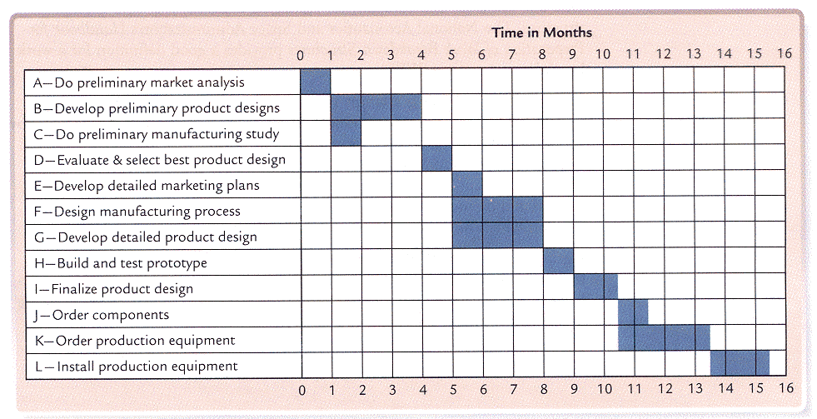
Research Proposal Structure
7. TIMETABLE OF THE PROJECT AND DESCRIPTION OF ANY RESOURCES REQUIRED
There is always a time limit to research projects. The formulation of a timetable is therefore essential in order to allocate time limits to the sequence of tasks that you need to accomplish in order to hand the finished report or dissertation in on time. This is not only a test of the practicality of the proposed project, but also an organizational guide when you carry out the work.
Resources that are essential to the project, such as equipment, transport, skills, software etc. should be listed and availability assured in order to convince the reader (and yourself) of the practicality of achieving the aims of the project.
Example of Gantt Chart

Slide 15
Research Proposal Structure
8. LIST OF REFERENCES
Where did you find the cited works?
It must be clearly recorded in list of references.
References must be relevant to your work.

Slide 16
Research Report
Research report is considered a major component of the research study for the research task remains incomplete till the report has been presented and/or written.
As a matter of fact even the most brilliant hypothesis, highly well designed and conducted research study, and the most striking generalizations and findings are of little value unless they are effectively communicated to others. The purpose of research is not well served unless the findings are made known to others.

Slide 17
Research Report – When to start writing?
First you will need to prepare a structure for the writing as soon as you are clear what you will be doing, probably after you have completed your proposal.
The trick then is to gradually amass a collection of notes, observations and data on the issues relevant to your study, which you can then use as a basis for your first draft.
The structure will provide a framework into which you can insert your text.

Slide 18
Research Report – Structure
The framework for your dissertation is most easily created by making a list of possible chapter or section headings. Consult your proposal and plan of work for indications of what these may be. At the very simplest level the divisions may be like this:
Introduction
Background and previous research
The main issues and research problem
Research methods – how you will investigate the problem
A description of the research actions and their results
Conclusions in relation to the research problem
Reference
This is a conventional format and can be applied to a study in almost any subject.

Slide 19
Research Report – Results And Analysis
The result section of the report should contain statistical summaries and reductions of the data rather than the raw data.
All the results should be presented in logical sequence and splitted into readily identifiable sections.
All relevant results must find a place in the report.

Slide 20
Research Report – Results And Analysis
Toward the end of the main text, the researcher should state and analyse the implications that flow from the results of the study, for the general reader is interested in the implications. Such implications may have three aspects as stated below:
A statement of the inferences drawn from the present study which may be expected to apply in similar circumstances.
The conditions of the present study which may limit the extent of legitimate generalizations of the inferences drawn from the study.
The relevant questions that still remain unanswered or new questions raised by the study along with suggestions for the kind of research that would provide answers for them.

Slide 21
Research Report – Conclusions
The whole point of collecting data and analysing them is so that you can come to some conclusions that are relevant to your research problem and achieve the aims of your project.
You cannot rely on the reader to make inferences from your results.
It really is up to you to vividly explain how the results of your analysis provide evidence for new insight into your chosen subject, and respond to the particular research problem that you exposed at the beginning of the research.

Slide 22
Research Report – Conclusions
Coming to conclusions is a cumulative process.
It is unlikely that the problem you have chosen is simple, with questions raised that can be answered with a simple yes or no.
Normally, you will find that the questions have several sub-questions requiring individual Investigation and answers.
Throughout the analysis part of your work you should come to conclusions about these fragments of the main issues.
The skill is to gather these up at the end in the concluding chapter to fit them together into a ‘mosaic’ that will present the complete picture of the conclusion to the entire research project.

