Slide 1
Kuliah 12.
Birth Control
(Contraception)

Slide 2
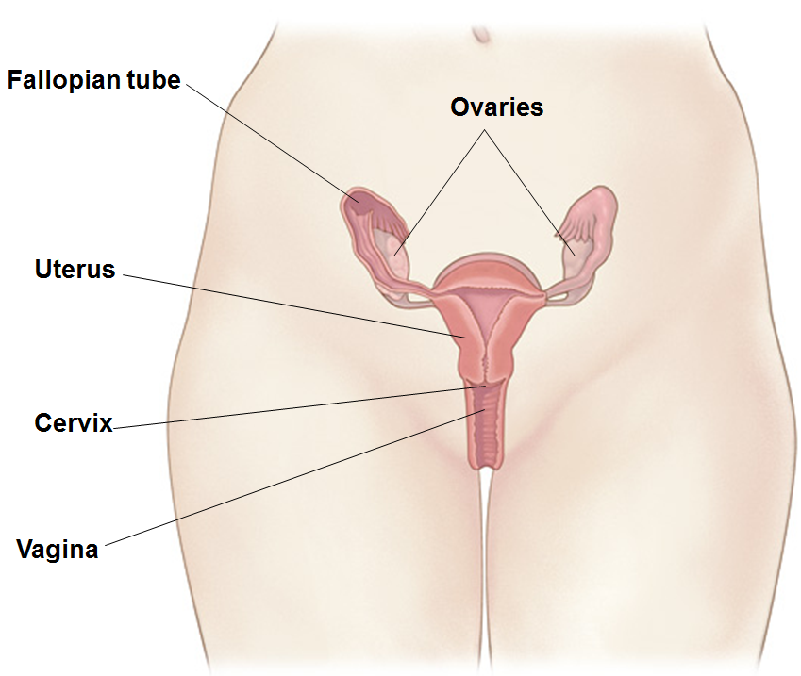
Organ reproduksi wanita
Notes:
Fallopian tube: connects ovaries to the uterus, creating passageway for the egg to be transported from the ovaries to the uterus
Ovary: main reproductive organ. They produce hormones and eggs
Uterus: connects all the organs. This is where a baby develops.
Cervix: neck of the vagina
Vagina: muscular tube leading from external genitals to the cervix. Menstrual blood leaves the body through this passageway. A penis is inserted in to the vagina during vaginal sex. A baby is delivered from the uterus through the cervix and vaginal opening.
Source www.sexandu.ca

Slide 3
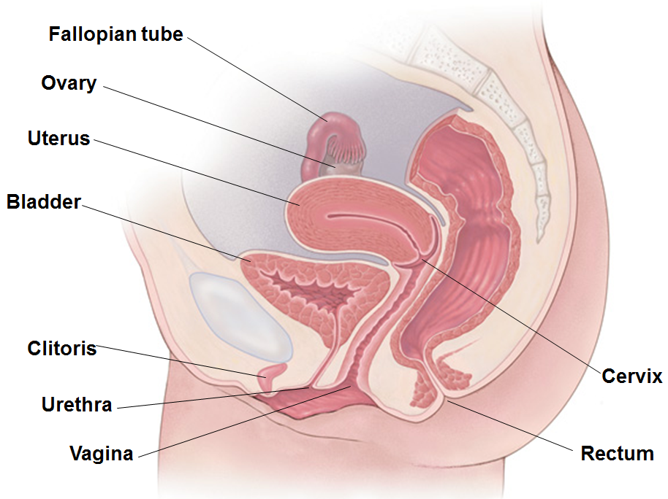
Organ reproduksi wanita
Notes:
Fallopian tube: connects ovaries to the uterus, creating passageway for the egg to be transported from the ovaries to the uterus
Ovary: main reproductive organ. They produce hormones and eggs
Uterus: connects all the organs. This is where a baby develops.
Cervix: neck of the vagina
Vagina: muscular tube leading from external genitals to the cervix. Menstrual blood leaves the body through this passageway. A penis is inserted in to the vagina during vaginal sex. A baby is delivered from the uterus through the cervix and vaginal opening.
Source www.sexandu.ca

Slide 4
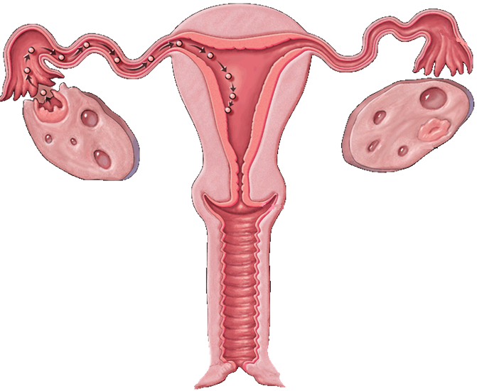
Siklus menstruasi
Notes:
Review menstrual cycle.
Girls are born with hundreds of thousands of tiny eggs, called ova – one is called an ovum.
These egg cells are only half formed.
At puberty, hormones tell the ovaries it is time to start releasing ova.
Usually one egg at a time matures (develops) and is released from an ovary.
At the same time, the uterus starts to grow a thick lining on the inside wall.
The lining has lots of tiny blood vessels.
The lining is there to protect and feed an egg that has combined with a sperm to form a fertilized egg.
If an egg does not meet a sperm, the lining is not needed.
It breaks up.
Mixed with some blood it comes out the uterus into the vagina and then out the vaginal opening.
This is called menstruation but lots of females just call it their period.
If a woman is not pregnant then her ovary will release another egg, the lining build up and, if the egg is not fertilized, she has another period.
This is called the menstrual cycle.

Slide 5
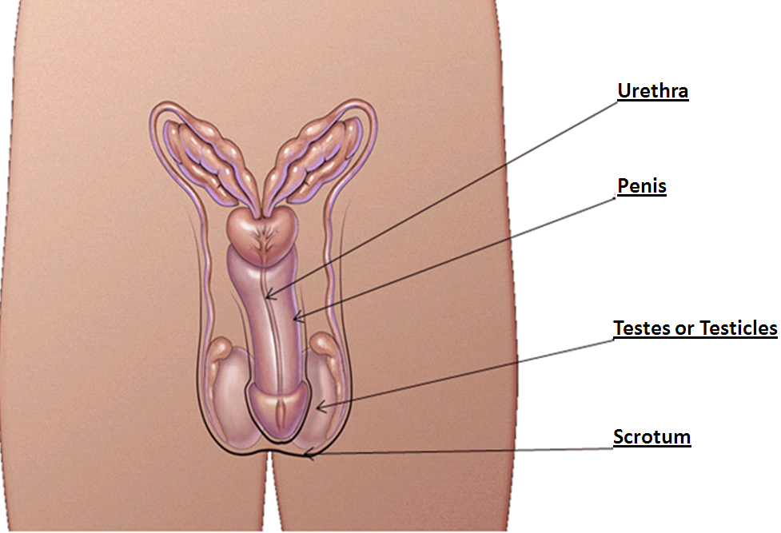
Organ reproduksi pria
Notes:
Urethra
Penis: delivers sperm through the urethra
Testes/Testicles: produce and store millions of tiny sperm cells. They also produce the hormone testosterone
Scrotum: contains the testicles

Slide 6
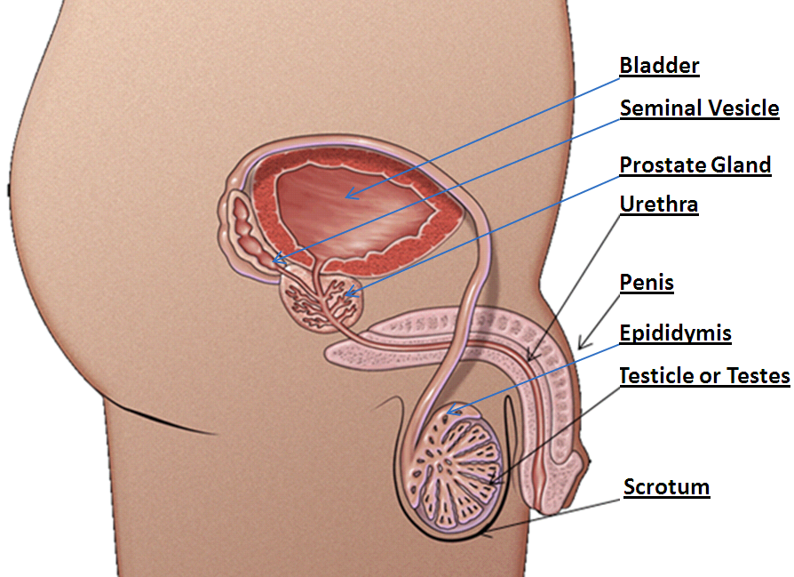
Organ Reproduksi Pria
Notes:
Urethra
Seminal vesicle: secrets a thick fluid that nourishes the sperm.
Prostate gland: enlarges to block urine from leaving the bladder when sperm is ejaculated.
Penis: delivers sperm through the urethra.
Epididymis: where sperm matures.
Testes/Testicles: produce and store millions of tiny sperm cells. They also produce the hormone testosterone.
Scrotum: contains the testicles.

Slide 7
Pencegahan Sexually Transmitted Infection dan Kehamilan
Absen
Metode hormonal
Metode non hormonal
Notes:
Ways to prevent STIs and Pregnancy
Note: hormonal methods will not prevent STIs

Slide 8
Apakah yang paling efektif?
Absen tentu saja!

Slide 9
Apakah artinya ABSEN
Tidak ada hubungan badan penis-vagia
Tidak ada oral dan anal
Tidak ada kontak organ kelamin
Absen tidak berarti tidak ada sama sekali
Notes:
Abstinence is a personal choice. It is the only 100% effective method against STIs and pregnancy if you do not have vaginal, anal, oral sex or skin to skin contact.

Slide 10
Absen
Absen merupakan metode yang 100% efektif untuk mencegah STIs dan kehamilan.
Notes:
Alternative ways – hugging, holding hands, kissing

Slide 11
Metode Hormonal untuk mencegah kehamilan

Slide 12
Pil
Metode hormonal yang digunakan
estrogen dan progesterone atau
progesterone saja
Mencegah dilepaskannya oosit matang.
Menebalkan mukosa serviks.
Merubah saluran uterus.
91% efektif
Notes:
https://www.healthunit.com/the-pill
Need prescription from doctor
What are the advantages?
1. One of the most effective reversible birth control methods when taken consistently and reliably
2. Simple and easy to use
3. Regulates menstrual cycle and reduces cramps
4. Does not interfere with intercourse
5. Decreases acne
6. Reduces the risks of endometrial and ovarian cancer
7. May reduce perimenopausal symptoms
What are the disadvantages?
1. Must be taken every day. The progestin-only pill must be taken at the same time every day
2. May cause irregular bleeding or spotting
3. Effectiveness may be reduced by other medications
4. Should not be used by women over the age of 35 who smoke
5. May increase the risk of blood clots, particularly in women who have certain blood disorders or a family history of blood clots
6. Does not protect against STIs
7. May increase the number of headaches
8. May not be suitable for breastfeeding women

Slide 13
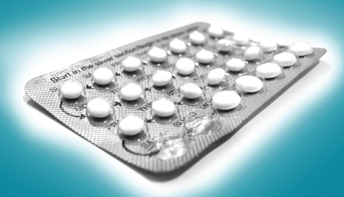
Notes:
Oral Contraceptive (The Pill)

Slide 14
Transdermal patch
Ditempelkan pada kulit dan mengeluarkan hormone.
Tipis, halus
Mencegah dikeluarkannya sel telur yang matang.
Mempertebal saluran mukosa
Mengubah saluran uterus
91% efektif
Notes:
https://www.healthunit.com/evra
Need prescription from a doctor
What are the advantages?
1. A reversible and highly effective birth control method
2. Once-a-week regimen; no daily contraceptive routine required
3. Simple and easy to use
4. Regulates menstrual cycle and reduces cramps
5. Does not interfere with intercourse
6. Expected to provide other benefits similar to oral contraceptives; research is needed
What are the disadvantages?
1. May cause irregular bleeding or spotting
2. May cause breast sensitivity or headache
3. Does not protect against STIs
4. Patch may detach from skin (less than 2%)
5. Possible skin irritation at the application site

Slide 15
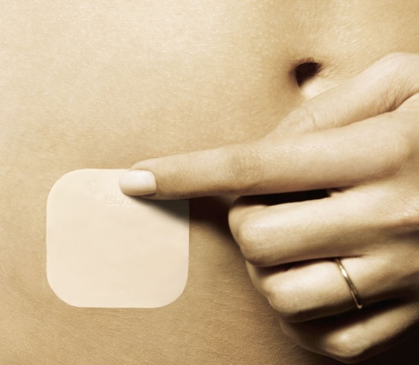
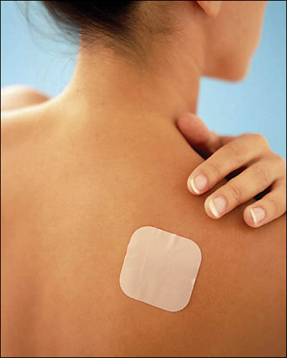
Notes:
Transdermal Patch or EVRA
Can be placed on the buttocks, upper outer arms, lower abdomen, or upper torso excluding the breast

Slide 16
Nuva Ring (vaginal ring)
Lembut dan feksible dimasukkan ke vagina.
Ring pelan-pelan akan menghasilkan hormon selama 3 minggu
Mencegah dikeluarkannya sel telur yang matang.
Mempertebal mukosa serviks.
Mengubah saluran uterus.
91% efektif
Notes:
http://www.sexualityandu.ca/video/single/vaginal-ring-nuvaring
What are the advantages?
1. A reversible and highly effective birth control method
2. Once-a-month regimen; no daily contraceptive routine required
3. Regulates menstrual cycles
4. Does not interfere with intercourse
5. Does not require daily attention
6. Expected to provide other benefits similar to oral contraceptives; research is needed
What are the disadvantages?
1. Does not protect against STIs
2. May cause irregular bleeding or spotting
3. May cause side effects such as headache, nausea, or breast tenderness
4. May cause vaginal discomfort
5. The ring may be expelled from the vagina but this is uncommon

Slide 17
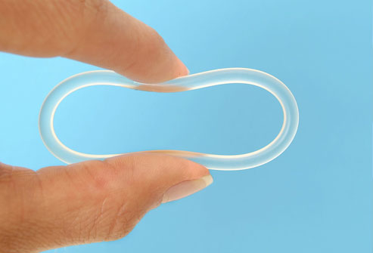
Notes:
Vaginal Ring or Nuvaring

Slide 18
Injeksi
Injeksi progestin dilakukan setiap 12 sampai 13 minggu.
Mencegah dikeluarkannya sel telur yang matang.
Mempertebal mukosa serviks
Mengubah saluran uterus
94% efektif
Notes:
What are the advantages?
1. One of the most effective reversible birth control methods available
2. Does not contain estrogen
3. No daily contraceptive routine required; 1 injection lasts for 3 months
4. Effectiveness is not reduced by other common medications
5. May be suitable for breastfeeding women or women who smoke
6. With continued use, menstrual cycles cease in over half of users after the first year, and two-thirds of users after two years of use
7. Improves symptoms of endometriosis
8. Reduces the risk of endometrial cancer
9. Effective immediately when given during the first 5 days of a normal menstrual period
What are the disadvantages?
1. Initially, irregular bleeding is the most common side effect
2. Decrease in bone mineral density which may be reversible when a woman stops taking the injection. Calcium supplementation is advised.
3. May be associated with weight gain in some women
4. Takes an average of nine months after the last injection for the ovaries to start releasing eggs again
5. Does not protect against STIs
6. The lack of a monthly period may be bothersome for some women

Slide 19
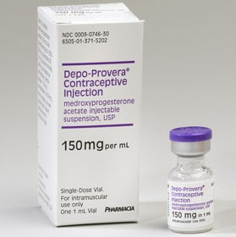
Notes:
Injectable contraceptive or “Depo-Provera” or “the needle”

Slide 20
Spiral (IUD)
Bentuk T dimasukkan ke uterus oleh dokter atau bidan yang berpengalaman.
Ada 2 macam :
Copper intrauterine device (tidak ada hormon)
IUD yang mengeluarkan hormon(mengandung progestin)
99.8% efektif
Notes:
Advantages
-One of the most effective forms of birth control
-Reversible
-Can be in for 3-10 years depending on type inserted
-Low cost when averaged over duration of insertion
-Option for women who are breastfeeding or cannot take estrogen
-Reduces risk of endometrial cancer
Disadvantages
-May cause irregular bleeding/spotting when first inserted
-Large up-front cost
-Pain/discomfort during insertion
-Rare risks with the insertion could include infection, perforation of the uterus, or expulsion of the IUC
-Provides no protection against STIs
LNG-IUS
Advantages
-Very low dose of hormone
-May make periods lighter with less cramping
-Many women won’t get a period ~6 months after insertion
-Improves symptoms of endometriosis
Disadvantages
-Risk of hormonal side effects: acne, headaches, breast tenderness, changes in mood
-Irregular bleeding, light or no periods (some think of this as an advantage, others as a disadvantage)
Source: www.sexandu.ca

Slide 21
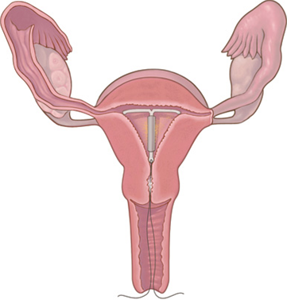
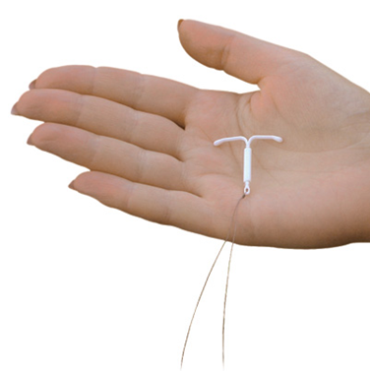
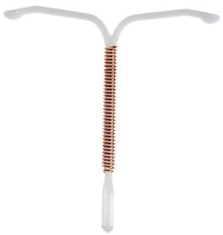
Notes:
Intrauterine System (IUS)

Slide 22
Alat Kontrasepsi yang mengandung hormon
Efek samping terjasi pada beberapa bulan pertama seperti
- Pendarahan, fleks.
- Mual
- Mood yang tidak stabil
- Payudara melunak
- Kembung
- Sakit kepala
Notes:
Reason:
Your body is getting used to birth control
Fluctuating hormone levels when you start
When will it stop?
Most symptoms are normal and will decrease or stop in the first 2-3 months.
If they bother you or don’t get better:
Talk to your healthcare provider
There might be a method that’s better suited for you.

Slide 23
Alat kontrasepsi darurat
Diminum setelah 5 hari berhubungan badan
Semakin awal semakin bagus bekerjannya.
Memperlambat atau mencegah keluarnya sel telur matang.
Mencegah menempelnya sel telur yang sudah dibuahi.
95 % efektif, setelah 24 jam setelah berhubungan badan
85% efektif setelah 25-48 jam setelah berhubungan badan.
58% efektif setelah 49-72 jam setelah berhubungan
Notes:
https://www.healthunit.com/emergency-contraception
Two options:
Plan B : Plan B is a safe form of emergency contraception that only contains progestin. It is used to prevent pregnancy up to 72 hours (3 days) after a single act of unprotected intercourse, however, there is some evidence that it may be used up to 120 hours (5 days) after unprotected intercourse, but that it may not be as effective. It may not be effective for women who weigh more than 165 pounds. According to Health Canada Plan B is not effective if you are over 176 pounds. Plan B is not intended as a method of birth control; it is for emergency use only.
2. Ella: Ella is a type of emergency contraceptive pill (ECP) that is available only by prescription. The active ingredient of Ella is ulipristal acetate. It works by blocking the effects of the hormone progesterone. Ella is used to prevent pregnancy up to 120 hours (5 days) after unprotected intercourse. It may be less effective for women who have a Body Mass Index (BMI) over 30kg/m2 or are 194 pounds or more. Ella is not intended as a method of birth control; it is for emergency use only.
Emergency contraception is intended for occasional use only. You should not rely on EC as your primary method of birth control, as it’s less effective than regular contraceptive methods. It does not, by any means, protect against Sexually transmitted infections.
Someone who takes ECP should expect their period to come at the regular time. If their period is late they should see a medical professional for a pregnancy test.
Emergency Contraception (EC) can prevent an unplanned pregnancy in the following situations:
No contraception was used
Missed birth control pills, patch, or ring
The condom slipped, broke, or leaked
The diaphragm or cervical cap is dislodged during sexual intercourse or was removed too early
Error in the calculation of the fertility period
Non-consensual sexual intercourse (sexual assault)
If implantation does occur, EC does not harm fetus
Insertion of a copper IUD up to five days after unprotected sex can also be used an emergency contraception

Slide 24
Metode barrier tanpa hormon

Slide 25
Kondom
Lateks yang tipis atau polyurethane
Menangkap sperma agar tidak masuk vagina atau serviks.
82% efektif
Mencegah STIs dan HIV
Notes:
Condom Demonstration: (may choose to demonstrate with a real condom while showing the slides)
https://teachingsexualhealth.ca/teachers/resource/male-condom-demonstration/
What are the advantages?
1. Available widely without a prescription
2. Inexpensive
3. Latex condoms protect against STIs
4. Allows the male partner to assume some responsibility for birth control
5. Both partners can participate in their use
6. May help the wearer avoid premature ejaculation
What are the disadvantages?
1. Must be available at time of intercourse
2. May slip or break during intercourse
3. Must be stored and handled properly
4. People with latex allergies cannot use latex condoms, but may be able to use non-latex condoms
5. May reduce sensitivity for either partner
6. May interfere with the maintenance of an erection
7. May reduce spontaneity
8. Lambskin condoms do not protect against STIs

Slide 26
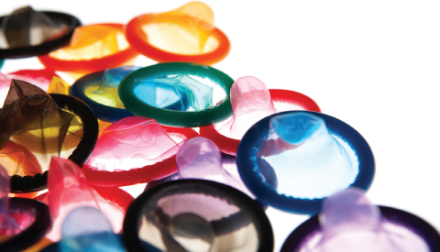

Slide 27
Kondom Wanita
Polyurethane yang dimasukkan ke vagina.
Mencegah sperma masuk saluran serviks
79% efektif
Notes:
What are the advantages?
1. Available without a prescription
2. No daily contraceptive routine or continued use required
3. Woman remains in charge of placement and use
4. Protects against some STIs
What are the disadvantages?
1. Must be available at time of intercourse
2. Requires proper insertion technique
3. Flexible inner ring may cause discomfort for some
4. More expensive than the male condom and not available in all stores
5. Makes a noise during intercourse
6. May slip or break during intercourse
7. May be considered messy by some

Slide 28
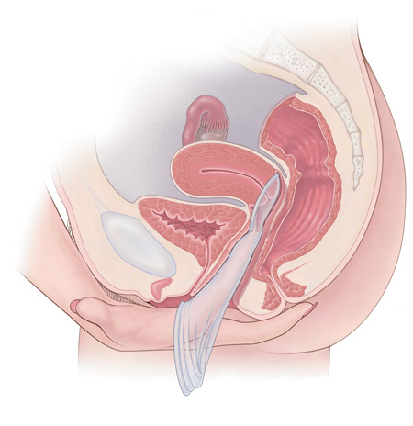
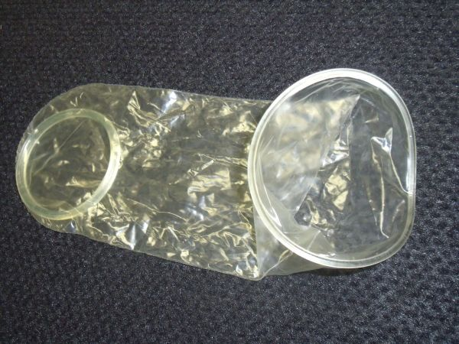
Notes:
Female Condom

Slide 29
Spon dan Spermisida
Spon lembut, sekali pakai dan mengandung spermisida
76%-88% efektif
Menangkap dan menyerap sperma untuk mempercepat efek spermisida
Spermisida menyebabkan sperma tidak berfungsi
Efektif sampai 12 jam
88% efektife
Notes:
** At the discretion of teacher whether to include this method of contraception ** - not widely used
spermicides can cause vaginal irritation which can increase the risk of STI transmission

Slide 30
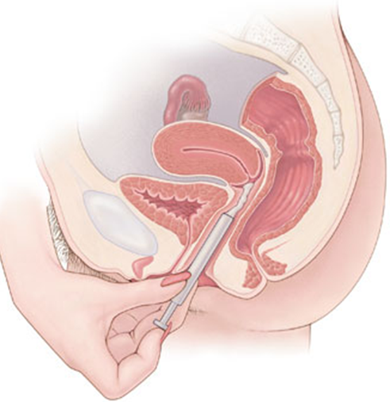
Notes:
** At the discretion of teacher whether to include this method of contraception ** - not widely used
What are the advantages?
1. Does not contain hormones
2. Can be used by women who are breastfeeding
3. Can be used by women who smoke
4. Spermicide may provide added lubrication
What are the disadvantages?
1. Must be available at time of intercourse
2. Does not protect against certain STIs
3. Cannot be used by people who are allergic to spermicides
4. Requires proper insertion technique
5. Sponge users may experience vaginal irritation or infection
6. Spermicide must be inserted into the vagina in advance (time depends on product)
7. If left in the vagina in excess of the recommended time, symptoms of toxic shock syndrome may appear

Slide 31
Metode operasi

Slide 32
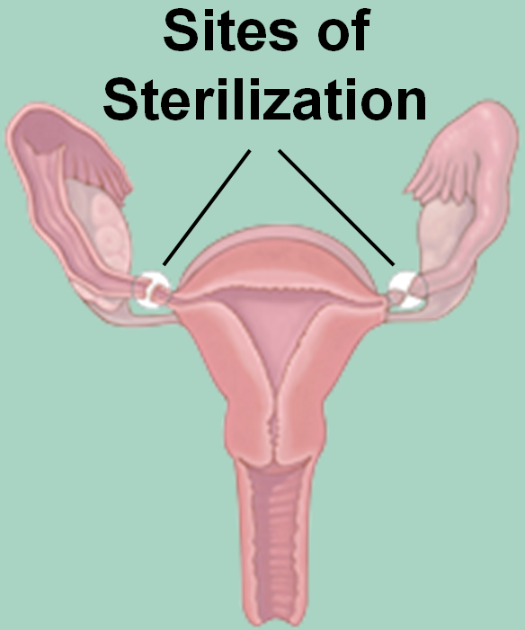
Sterilisasi
Tubal ligation – prosedur untuk menutup atau menghalangi tuba falopii sehingga sperma dan sel telur tidak bertemu.
Notes:
Female sterilization = tubal ligation
Permanent; only for couples who are absolutely sure their family is complete
Abdominal surgery

Slide 33
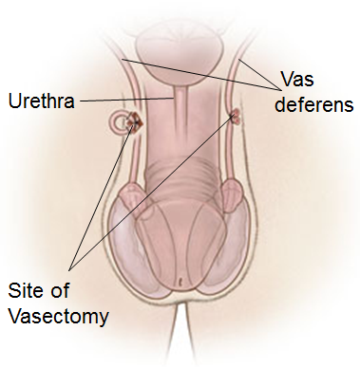
Sterilisasi
Vasectomy – Prosedur untuk menutup atau menyumbat vas deferens
Notes:
How does it work?
• The vas deferens are closed so that no sperm is released to fertilize the egg
• Common techniques include:
• Conventional vasectomy – one or two incision are made in the scrotum to reach the vas deferens
• No-scalpel vasectomy – a puncture opening is made in the scrotum
• Vas deferens are closed by:
• Electric current (cauterization)
• A mechanical method, such as a clip
• Removal of a small segment of each tube
• Another form of contraception is required until a semen analysis shows no sperm
What are the advantages?
1. No contraceptive routine required; nothing to remember
2. Private
3. Does not interfere with intercourse
4. No significant long-term side effects
5. Simple procedure
6. Less invasive and more cost-effective than tubal ligation for women
7. Allows the male partner to assume some responsibility for birth control
What are the disadvantages?
1. Difficult to have reversed
2. Possible post-sterilization regret
3. Possible short-term surgery-related complications: pain and swelling; vasovagal reaction; infection at the incision site
4. Does not protect against STIs
5. Not effective immediately. Must do a follow-up sperm analysis that shows no sperm are present in the semen
Typical effectiveness is 98%

Slide 34
Perbandingan Efektivitas
Abstinence 100%
IUC 99.8%
Depo Provera 94%
The Pill 91%
The Patch 91%
The Ring 91%
Male Condom 82%
Female Condom 79%
Sponge and Spermicides 76-88%

Slide 35
Terima Kasih

