Slide 1

KKKkkkk
STEM CELL
KULIAH 3
Sumber Stem Cell

Slide 2
Macam-macam stem cell
Tipe Stem cell | Deskripsi | Contoh
Totipotent | Satu sel dapat berkembang menjadi suatu individu baru | Sel dari awal embrio (1-3 hari)
Pluripotent | Sel dapat berubah menjadi berbagai macam jenis sel (sekitar 200 jenis) tipe sel | Sel dari blastocyst (5 -14 hari)
Multipotent | Sel terdiferensiasi tetapi hanya dalam jumlah terbatas dari suatu jaringan. | Jaringan fetal, darah tali pusat, adult stem cells.
Notes:
2
Stem cells can be classified into three broad categories, based on their ability to differentiate. Totipotent stem cells are found only in early embryos. Each cell can form a complete organism (e.g., identical twins). Pluripotent stem cells exist in the undifferentiated inner cell mass of the blastocyst and can form any of the over 200 different cell types found in the body. Multipotent stem cells are derived from fetal tissue, cord blood and adult stem cells. Although their ability to differentiate is more limited than pluripotent stem cells, they already have a track record of success in cell-based therapies. Here is a current list of the sources of stem cells:
Embryonic stem cells - are harvested from the inner cell mass of the blastocyst seven to ten days after fertilization.
Fetal stem cells - are taken from the germline tissues that will make up the gonads of aborted fetuses.
Umbilical cord stem cells - Umbilical cord blood contains stem cells similar to those found in bone marrow.
Placenta derived stem cells - up to ten times as many stem cells can be harvested from a placenta as from cord blood.
Adult stem cells - Many adult tissues contain stem cells that can be isolated.

Slide 3
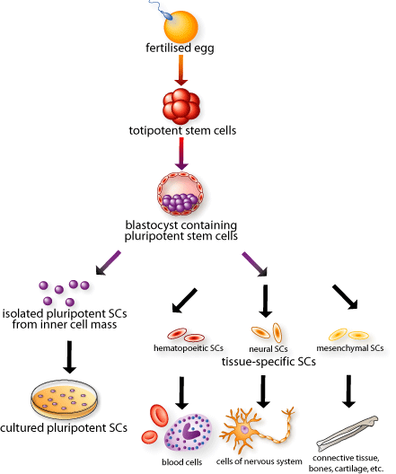
Totipotent
This cell
Can form the
Embryo and placenta
Pluripotent
This cell
Can just form the
embryo
Multi-
potent
Fully mature
Notes:
3
CLICK! This diagram will eventually show the entire range of development, from fertilized egg to mature cell types in the body.
Each cell in the 8-cell embryo, here in red, can generate every cell in the embryo as well as the placenta and extra-embryonic tissues. These cells are called CLICK! TOTIPOTENT stem cells. Why are they called totipotent? (wait for answers) Because one red cell can potentially make all necessary tissues for development. CLICK!
During In Vitro Fertilization, can parents choose whether their baby is going to be a boy or a girl? (wait) Yes, there is a widely-practiced procedure called pre-implantation genetic diagnosis, where one cell is removed from the 8-cell embryo and its DNA is examined. What might you look for when trying to identify the embryo’s sex? (wait) If there’s an X and Y chromosome it’s a boy and if there are two X’s it’s a girl. The parents can decide whether to implant it. Also parents with a genetic disease might want to see if their baby has any identifiable genetic disorders and decide whether to implant based on this information. Pre-implantation genetic diagnosis doesn’t destroy the embryo. Scientists are attempting to adapt this pre-implantation genetic diagnosis procedure and use it to create a stem cell line from one single TOTIPOTENT cell, without destroying the embryo.
The embryonic stem cells inside the blastocyst, here in purple, can generate every cell in the body except placenta and extra-embryonic tissues. These are called CLICK! PLURIPOTENT stem cells…why? (wait for answers) Because they can differentiate into all the 200+ cell types in the body, but they do not form the placenta. CLICK! Pluripotent stem cells can be isolated and grown in culture, or left to develop into more specialized cells in the body.
CLICK! Adult stem cells or tissue-specific stem cells have restricted lineages. Adult stem cells show up when the three distinct layers form in the 14-day-old embryo, and are present in the fetus, baby, child, and so forth. Adult just means they’ve gone further down their lineage pathway than the initial stem cells in the embryo. They are called CLICK! MULTIPOTENT stem cells because they will only become mature cells from the tissue in which they reside. Adult stem cells are present throughout your life and replace fully mature CLICK!, yet damaged and dying cells.
So to review (if time): TOTIPOTENT stem cells come from embryos that are less than 3 days old. These cells can make the TOTAL human being because they can form the placenta and all other tissues. PLURIPOTENT stem cells come from embryos that are 5-14 days old. Embryos and fetuses that are older than 14 days DO NOT contain pluripotent cells. These cells can form every cell type in the body but not the placenta. MULTIPOTENT stem cells are also called adult stem cells and these appear in the 14 day old embryo and beyond. At this point these stem cells will continue down certain lineages and CANNOT naturally turn back into pluripotent cells or switch lineages.

Slide 4
Macam-macam Stem Cell
Embryonic stem cells
Embrio 5- 6 hari
Embryonic germ cells
Berasal dari bagian embrio atau fetus yang memproduksi sel telur atau sperma.
Adult stem cells
Sel yang tidak terdiferensiasi yang ditemukan diantara sel – sel yang terdiferensiasi di jaringan atau organ setelah kelahiran.
Kemampuannya untuk memproduksi berbagai macam sel dan berkembang biak sendiri terbatas.

Slide 5
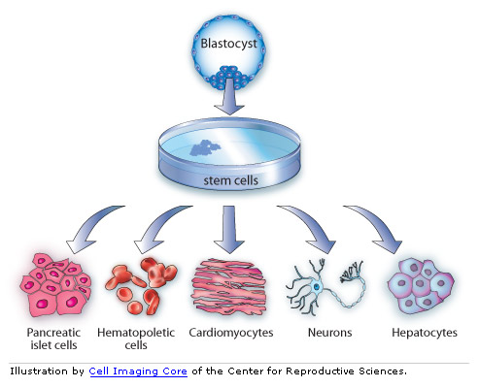
Stem Cells Pluripoten
Lebih berpotensial untuk menjadi berbagai macam jenis sel

Slide 6
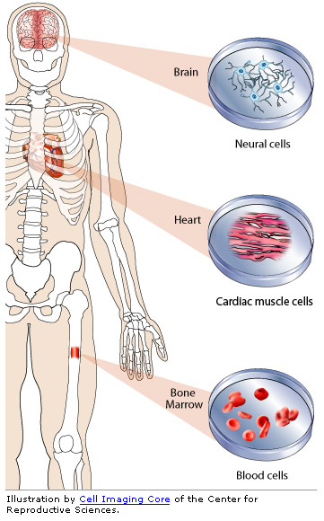
Stem cells multipoten
Stem cells multipotent hanya dapat menjadi berbagai jenis sel dengan jumlah tipe yang terbatas.

Slide 7
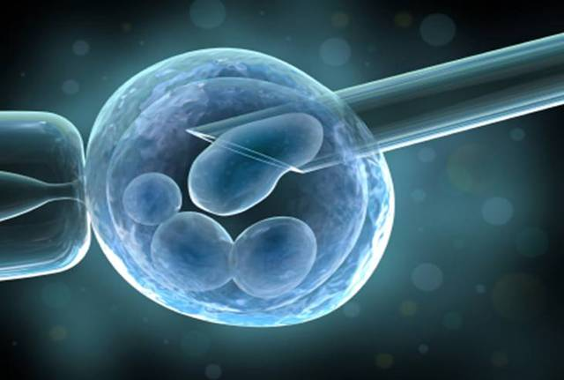
Stem Cell embryonic
Kebanyakan berasal dari In vitro Fertilization (IVF)

Slide 8
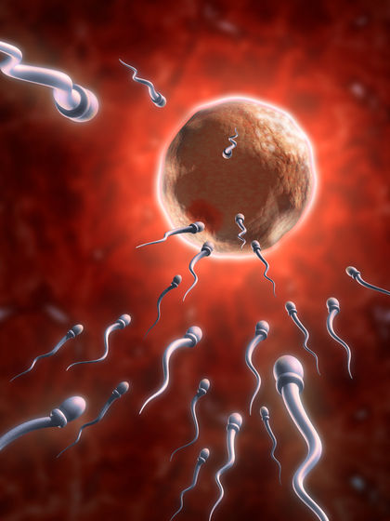
Reproduksi seksual
Notes:
8
Every cell contains a complete copy of “the blueprint of life”
DNA consists of two strands of nucleotides - 4 bases (A,G,T,C)
23 pairs of chromosomes
If unwound and tied together, human DNA in one cell would stretch ~ 5 feet, but would be only 50 trillionths of an inch wide!
Genes are specific sequences of DNA, each of which “codes” for a protein with a specific function
Genes are copied each time a cell divides, passing on the blueprint

Slide 9
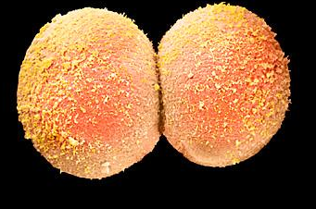
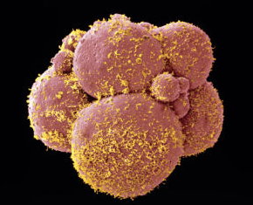
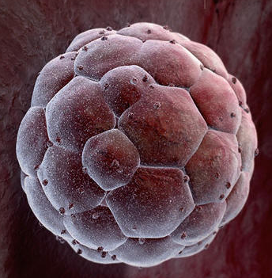
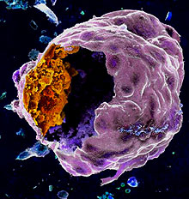
Tahapan Embryogenesis
cleavage
8-cell stage
blastocyst
Blastocyst inner mass cells
Notes:
9
The early stages of embryogenesis are the point at which embryonic stem cell lines are derived. The fertilized egg (day 1) undergoes cell division to form a 2-cell embryo, followed by 4-cell, etc. until a ball of cells is formed by the fourth day. The ball becomes hollow, forming the blastocyst. This is the stage at which pluripotent embryonic stem cell lines are generated. Following the blastocyst stage, the tissues of the embryo start to form and the cells become multipotent.

Slide 10
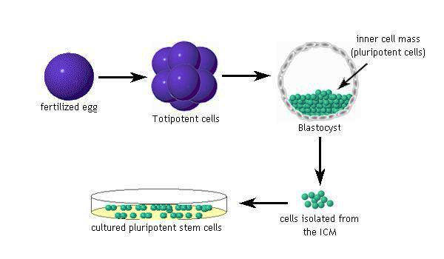
Diagram Blastocyst

Slide 11
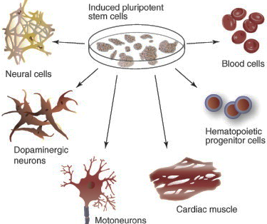
Induced Pluripotent Stem Cells
Notes:
11
Every cell contains a complete copy of “the blueprint of life”
DNA consists of two strands of nucleotides - 4 bases (A,G,T,C)
23 pairs of chromosomes
If unwound and tied together, human DNA in one cell would stretch ~ 5 feet, but would be only 50 trillionths of an inch wide!
Genes are specific sequences of DNA, each of which “codes” for a protein with a specific function
Genes are copied each time a cell divides, passing on the blueprint

Slide 12
Terima Kasih

