Slide 1
STEM CELL
KULIAH 4
Sumber Stem Cell : Adult Stem Cell

Slide 2
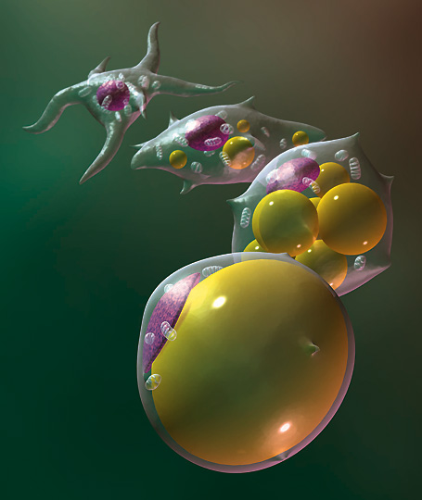
Adult Stem Cells
Sel yang tidak terdiferensiasi ditemukan diantara sel yang terdiferensiasi di jaringan atau organ setelah kelahiran.
Sumber :
Kulit
Sel lemak
Sumsum tulang belakang
Otak
Beberapa jaringan dan organ lainnya
Notes:
1990s that scientists agreed that the adult brain does contain stem cells that are able to generate the brain's three major cell types—astrocytes and oligodendrocytes, which are non-neuronal cells, and neurons, or nerve cells.
A. Where are adult stem cells found, and what do they normally do?
Adult stem cells have been identified in many organs and tissues, including brain, bone marrow, peripheral blood, blood vessels, skeletal muscle, skin, teeth, heart, gut, liver, ovarian epithelium, and testis. They are thought to reside in a specific area of each tissue (called a "stem cell niche"). In many tissues, current evidence suggests that some types of stem cells are pericytes, cells that compose the outermost layer of small blood vessels. Stem cells may remain quiescent (non-dividing) for long periods of time until they are activated by a normal need for more cells to maintain tissues, or by disease or tissue injury.
Typically, there is a very small number of stem cells in each tissue, and once removed from the body, their capacity to divide is limited, making generation of large quantities of stem cells difficult. Scientists in many laboratories are trying to find better ways to grow large quantities of adult stem cells in cell culture and to manipulate them to generate specific cell types so they can be used to treat injury or disease. Some examples of potential treatments include regenerating bone using cells derived from bone marrow stroma, developing insulin-producing cells for type 1 diabetes, and repairing damaged heart muscle following a heart attack with cardiac muscle cells.
B. What tests are used for identifying adult stem cells?
Scientists often use one or more of the following methods to identify adult stem cells: (1) label the cells in a living tissue with molecular markers and then determine the specialized cell types they generate; (2) remove the cells from a living animal, label them in cell culture, and transplant them back into another animal to determine whether the cells replace (or "repopulate") their tissue of origin.
Importantly, it must be demonstrated that a single adult stem cell can generate a line of genetically identical cells that then gives rise to all the appropriate differentiated cell types of the tissue. To confirm experimentally that a putative adult stem cell is indeed a stem cell, scientists tend to show either that the cell can give rise to these genetically identical cells in culture, and/or that a purified population of these candidate stem cells can repopulate or reform the tissue after transplant into an animal.

Slide 3
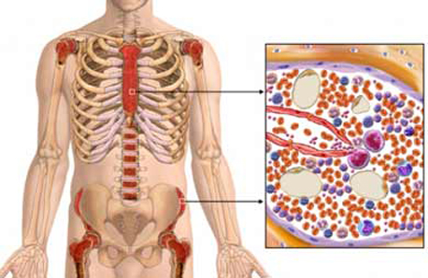
Sumsum Tulang Belakang
Ditemukan di bagian sponge tulang dimana sel darah dibentuk.
Fungsi awalnya adalah untuk menggantikan sumsum tulang yang rusak atau hancur dan diganti dengan stem cell sumsum tulanga yang sehat.
Untuk mengobati pasien yang didiagnosa leukemia, anemia aplastic dan limfoma.
Kompatibilitasnnya terbatas
Notes:
3/31/2019

Slide 4
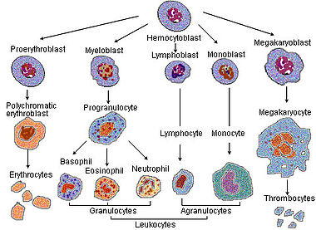
Pembentukan sel darah

Slide 5
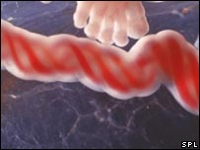
Stem cell tali pusat
Juga disebut dengan Wharton’s Jelly
Adult stem cells dari bayi
Tidak invasive seperti sumsum tulang dalam pengambilannya
Kompatibilitasnya lebih besar
Lebih murah
Notes:
3/31/2019

Slide 6
Stem cell tali pusat
3 Fungsi utama
Plasticity: Mempunyai potensi untuk berubah menjadi tipe sel yang lain seperti sel saraf.
Homing: Berjalan menuju jaringan yang rusak.
Engraftment: Bersatu dengan jaringan yang lain.

Slide 7
Aplikasi Stem Cell
Perbaikan jaringan
- Saraf, hati, otot, organ, kulit.
Pengobatan Kanker
Pengobatan Autoimmune diseases
- diabetes, rheumatoid arthritis

Slide 8
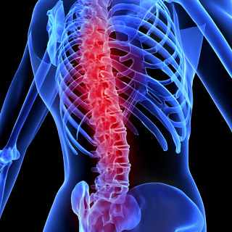
Perbaikan Jaringan
Regenerasi spinal cord, hati, jaringan, dan jaringan-jaringan utama lain yang ada di tubuh.

Slide 9
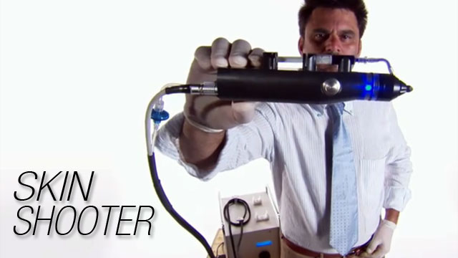
Menggantikan Kulit

Slide 10
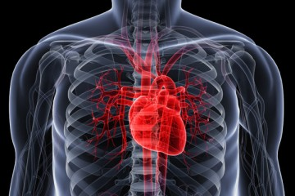
Penyakit hati
Adult bone marrow stem cells diinjeksi ke jantung dipercaya dapat memperbaiki fungsi jantung pada kasus gagal jantung atau serangan jantung.

Slide 11
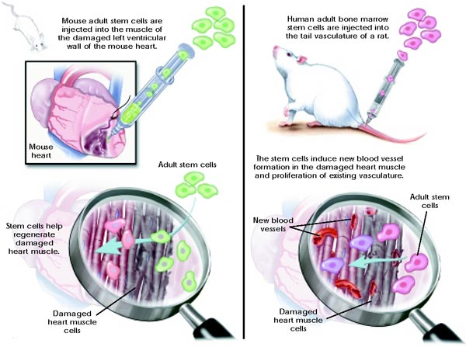

Slide 12
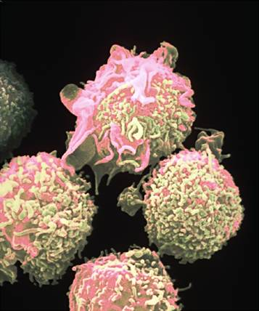
Leukemia and Kancer
Pasien leukemia diobati dengan stem cell terlihat sembuh dari penyakit tersebut.
Injeksi stem cell juga mengurangi kanker pancreas pada beberapa pasien..
Proliferasi sel darah putih

Slide 13
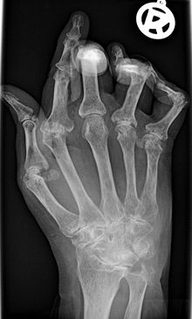
Rheumatoid Arthritis
Adult Stem Cells dapat memperbaiki cartilage

Slide 14
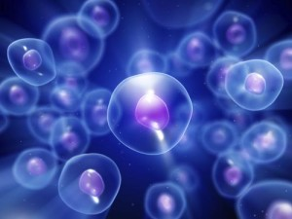
Diabetes Tipe 1
Sel pancreas tidak dapat memproduksi insulin.
Embryonic Stems Cells dapat membuat sel islet pankreas untuk menghasilkan insulin.

Slide 15
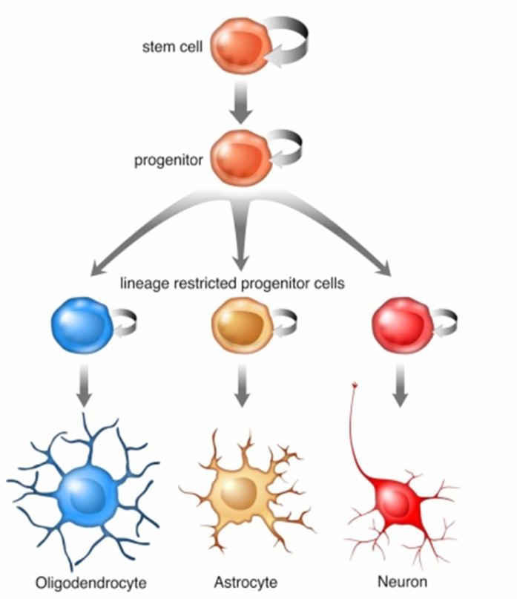
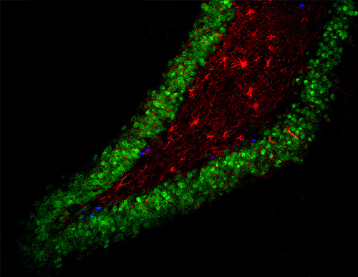
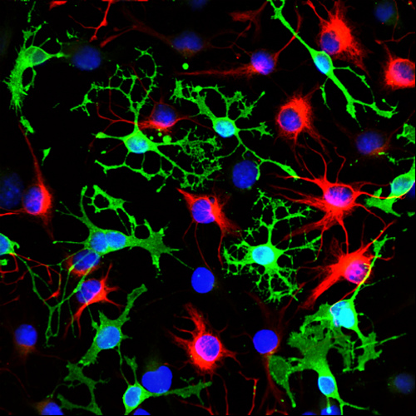
Stem cells pada otak dewasa:
Notes:
Adult stem cells are found all over your body. Here are a few examples of places in the body with stem cells.
Who here has been told that brain cells never regenerate? (hands) Whoever told you that was misinformed! Relatively recently scientists discovered that in two specific parts of your brain, neural stem cells divide and differentiate to become neurons and glial cells, which support the growth of neurons. Without neural stem cells in the hippocampus, you would probably not be able to learn or remember.
The top right picture is a cross-section of the rat hippocampus, and neural stem cells are the blue dots, which divide and differentiate to form mature neurons (green) and astrocytes (red).
The bottom right picture is of cultured neural stem cells (just plain blue dots), and derived from those stem cells, neurons (blue dots surrounded by red) and oligodendrocytes (blue dots surrounded by green).
15

Slide 16
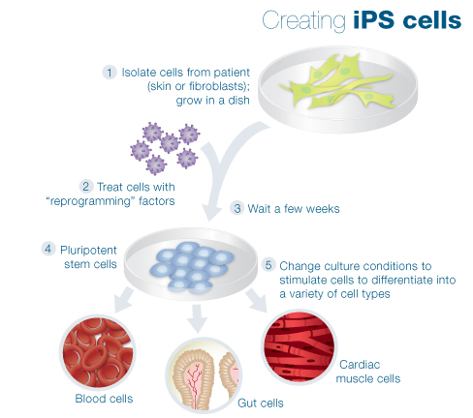
Penelitian baru– reprogramming cells

Slide 17
Tantangan teknis
Sumber – Galur sel mungkin akan mengalami mutasi
Mengirim ke area target.
Mencegah penolakan tubuh.
Mengurangi tumor.

Slide 18
Masalah dalam Adult Stem Cells

Slide 19
Mengapa penelitian stem cell penting?
Stem cells dapat menggantikan sel yang rusak atau terkena penyakit.
Stem cells dapat digunakan untuk studi perkembangan dan genetik.
Stem cells dapat digunakan untuk mengetes berbagai bahan obat dan kimia

Slide 20
Mengapa terdapat kontroversi stem cell?
Embryonic Stem cells diambil dari bagian extra blastocyst yang dibuang dalam proses In Vitro Fertilization.
Ekstraksi stem cells dapat menghancurkan perkembangan blastocyst (embryo).
Beberapa hal yang harus dipertimbangkan dan dipikirkan
Apakah embrio itu manusia?
Apakah secara moral dapat diterima untuk menggunakan embrio dalam penelitian.
Saat kapan embrio disebut sebagai manusia?

Slide 21
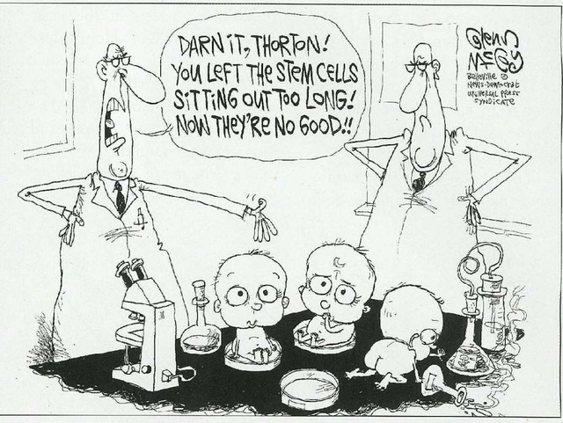

Slide 22
Terima Kasih

