Slide 1
Bioteknologi Kedokteran
Titta Novianti

Slide 2
VISI DAN MISI UNIVERSITAS ESA UNGGUL

Slide 3
Materi Sebelum UTS
01.
02.
03.
04.
05.
06.
07.

Slide 4
Materi Setelah UTS
08.
09.
10.
11.
12.
13.
14.

Slide 5
Introduction
Biotechnology has offered modern medical devices for diagnostic and preventive purposes, which include diagnostic test kits, vaccines and radio-labeled biological therapeutics used for imaging and analysis
Human health is a major growing concern worldwide because of infectious diseases

Slide 6
Biotechnology has played a dynamic role in improving the challenges regarding to human health as it has flexibility to reduce global health differences by the provision of promising technologies
Health, life quality and expectancy of life have been increased worldwide through the services provided by biotechnology

Slide 7
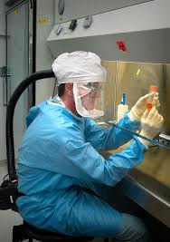
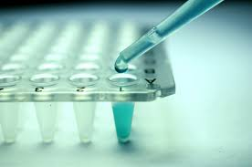

Slide 8
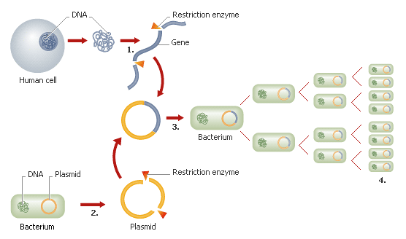
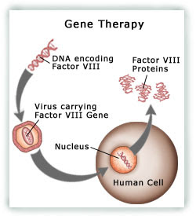
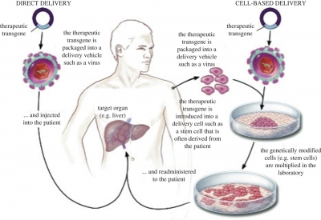

Slide 9
Biotechnology contributes much towards the growing public and global health needs
It has revolutionized mankind since its existence, effective diagnostics, prevention and treatment measures including production of novel drugs and recombinant vaccines, effective drug delivery approaches, new methods for therapeutics, nutritionally enriched genetically modified crops and efficient methods for environmental cleanup.

Slide 10
Health, life quality and expectancy of life have been increased worldwide through the services provided by biotechnology
Parasitic and infectious diseases like Acquired Immunodeficiency Syndrome (AIDS) and tuberculosis (TB) have been diagnosed rapidly at relatively low cost

Slide 11
Nearly 40% deaths are due to infectious and parasitic diseases (malaria, tuberculosis, and AIDS) each year
Spread of these diseases can be overcome by the development of quick and accurate diagnostic tools
These developments result in increase in survival rate as well as help to prevent the waste of resources on non-suitable treatment
Many conventional diagnostic tools are inaccurate, time consuming, laborious and expensive. In contrast, modern biotechnology comprised of molecular diagnostic tools sketches recent advances in biology for the detection of diseases

Slide 12
Molecular diagnostics was being ranked by the scientific panel in the University of Toronto as the most ideal set of technologies for improving the health status
Biotechnology is based on following diagnostic techniques; PCR, Monoclonal antibodies and microarrays
These are simple, quick, cost effective and have high sensitivity and specificity
PCR requires small volume of sample to amplify and identify the DNA sequence of pathogen (that cause the disease)
It is identified in a very quick and accurate manner as compared to conventional diagnostics. The infectious or dangerous organisms (HIV, Mycobacterium and plasmodium) that are difficult to grow in culture are identified by the PCR
Multiplex PCR are used to detect the pathogens which cause the broad range of diseases at once and hence it saves both time and resources

Slide 13
Molecular diagnostic tools including polymerase chain reaction (PCR), recombinant antigens and monoclonal antibodies have been used for this purposes
Biotechnology has offered modern diagnostic test kits, rickettsial, bacterial and viral vaccines along with radiolabelled biological therapeutics for imaging and analysis

Slide 14
Vaccines have eliminated small pox, polio and other deadly diseases for the last hundred years
Biotechnology has made advancements in vaccination by making recombinant vaccines that have the potential to eradicate non-communicable diseases like cancer
Naked DNA vaccines, viral vector vaccines and plant-derived vaccines are found to be most effective against a number of bacterial and viral disorders

Slide 15
Naked DNA vaccines, viral vector vaccines and plant-derived vaccines are found to be most effective against a number of bacterial and viral disorders
Biotechnology has play a major role in eliminating these problems by producing nutrients enriched food such as Golden Rice, Maize, potato and soybean etc
Biotechnology has also played an important role in controlling the environmental pollution through biodegradation of potential pollutants

Slide 16
This review sketches improvement of human health by the use of biotechnological advances in molecular diagnostics, medicine, vaccines, nutritionally enriched genetically modified crops and waste management.

