Slide 1
Kuliah 9 Instrumentasi Bioteknologi
Gel Documentation System

Slide 2
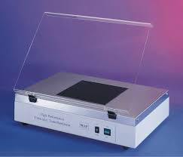
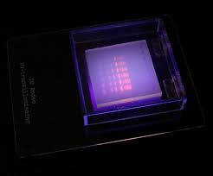
Gel Documentation System UV Transilluminator

Slide 3
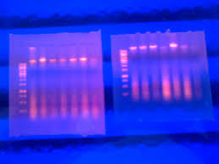
Gel Documentation System UV Transilluminator

Slide 4
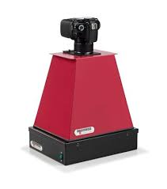
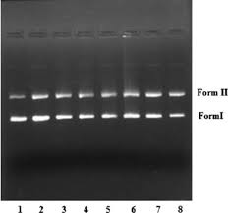
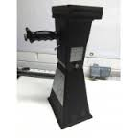
Gel documentation system UV Transilluminator dan Photo polaroid

Slide 5
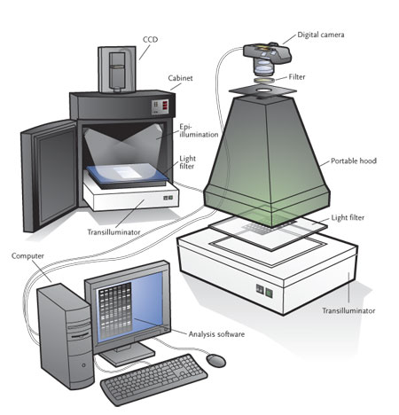
Gel Documentation system

Slide 6
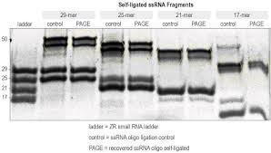
Gel Documentation System

Slide 7
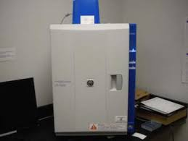
Gel Documentation System Protein

Slide 8
Gel Documentation System

Slide 9
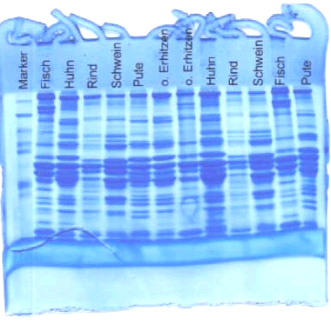
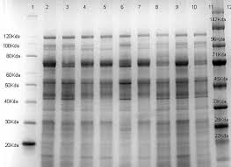
Gel Documentation System Protein

Slide 10
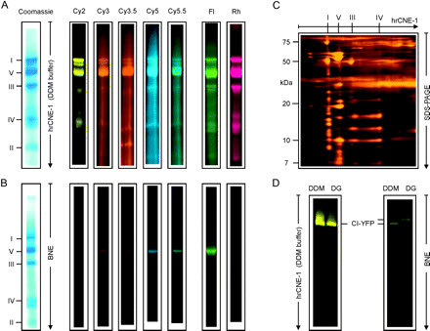
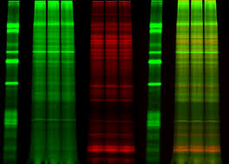
Gel Documentation System Protein

Slide 11
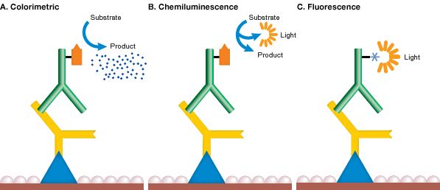
Gel Documentation System

Slide 12
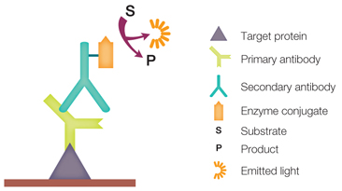
Gel Documentation System

Slide 13
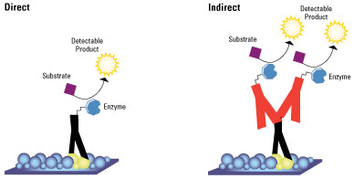
Gel Documentation System

Slide 14
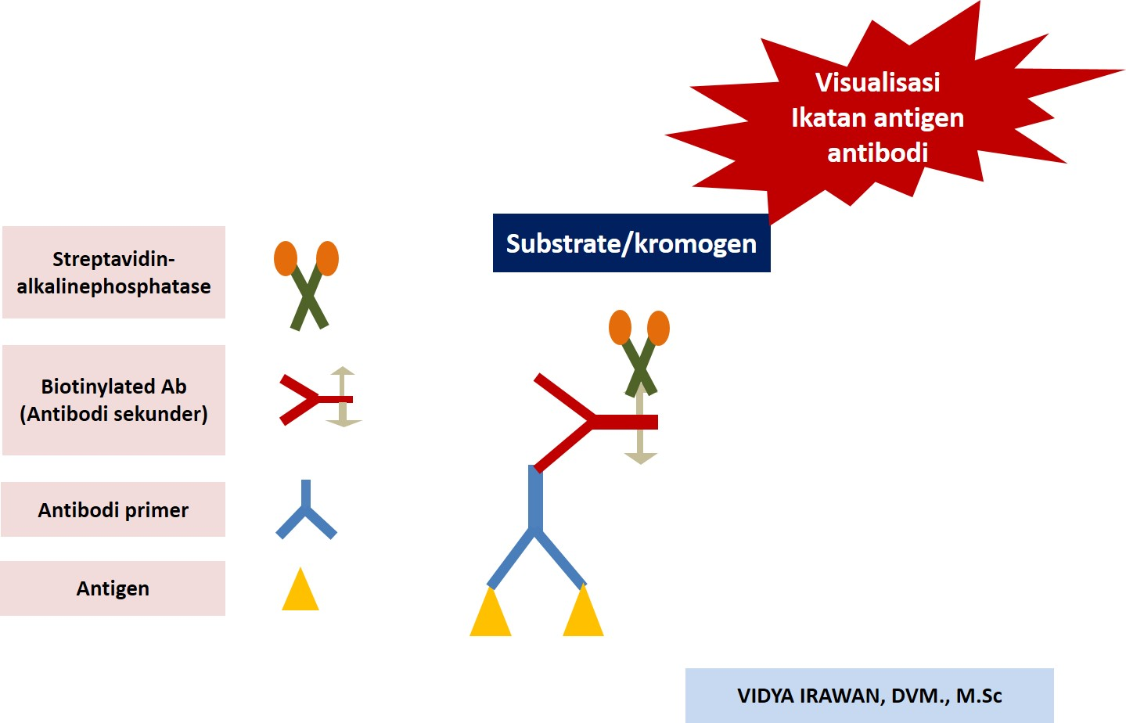
Enzim - Substrat

Slide 15
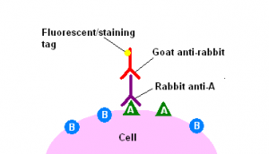
Fluorescence

Slide 16
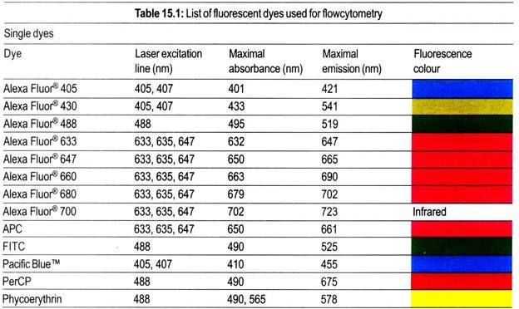
Fluorescence

Slide 17
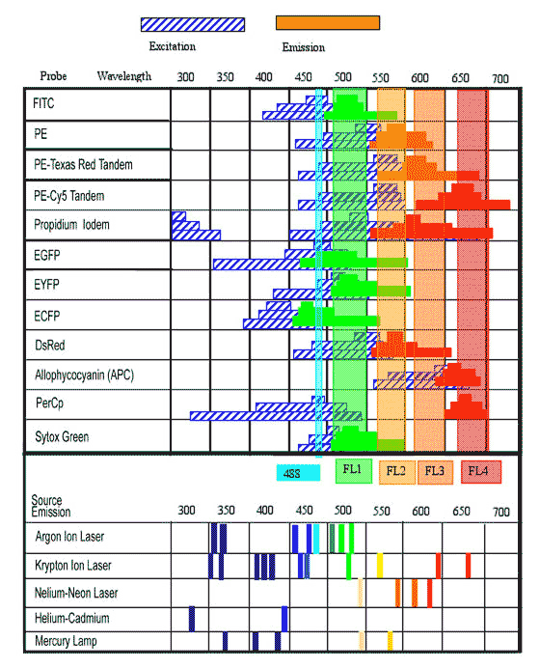
Fluorescence

Slide 18
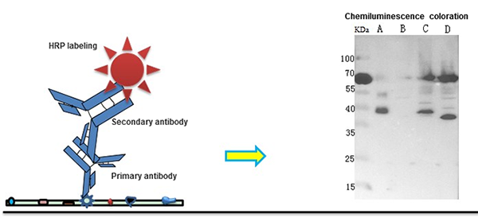
Chemiluminescence

Slide 19
Chemiluminescence

Slide 20
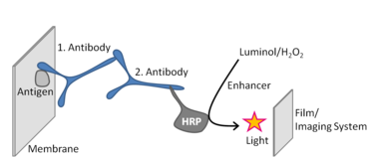
Chemiluminescence

Slide 21
Chemiluminescence

