Slide 1
PRESERVATION OF HEALTH RECORD

Slide 2
Preservation of Health Record
Medical Record Preservation
Legal Limit for Preservation of Medical Records
Correction of Original Data
ESSENTIALS OF RECORDS MANAGEMENT
Types of Damages
Maintenance of Old Records
CONCLUSION

Slide 3
Medical Record Preservation
P

Slide 4
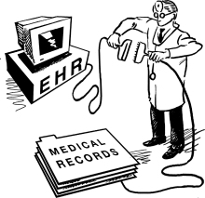
Medical Record Preservation
The diagnostic reports, clinical as well as Para clinical care, medico-legal reports, birth and death certificates are various medical records which are prepared in a hospital in the interest of patient, hospital and law the medical records required to be preserved up to certain length of time and this article discussing the safe methods of preservation of medial record.
The management and preservation of hospital records in the Indian context presents a very gloomy picture. Of course, the private hospitals have been found establishing an edge over the government hospitals even in respect of records management.

Slide 5
Medical Record Preservation
Despite intensive endeavors at national and international levels the fundamental health care needs of the population in developing countries are still unmet and the underprivileged in these countries scarcely have excess to health services. The lack of basic health data renders difficulties in formulating and applying a rational for the allocation of limited resources that are available for patient care and disease prevention.
Prior to last four decades, the status of medical record administration and technology in developing countries was deplorable. The medical staff only vaguely appreciated the value of the health care record, record completion task and its maintenance remains a low priority.

Slide 6
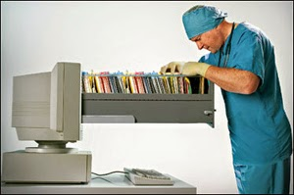
Legal Limit for Preservation of Medical Records

Slide 7
Legal Limit for Preservation of Medical Records
Where there is chance of litigation arising for medical purpose of negligence, record should be preserved for at least 25 years, specially because there are rules where the minors have the rights to sue the doctor within three years from the date of majority, for the injuries sustained due to negligence of the doctor during the period of his minority.
Other medico legally important records should be preserved upto 10 years after which they can be destroyed after making index and recording summary of the case.
6
7

Slide 8
Legal Limit for Preservation of Medical Records
Routine cases records may be preserved upto 6years after completion of treatment and upto 3 years after death of the patient.
There are certain records in hospital, which are of public interest and are transferred to public records library after 50 years for release to public and those involve confidentiality of the individuals are released only after 100 years
1
2

Slide 9
Correction of Original Data

Slide 10
Correction of Original Data
When correcting an error, strike out the incorrect statement with a single line and place your initial and date next to it. Then make the correct entry in the record. Attempting to obliterate the erroneous entry by applying a whitener or scratching through the entry in such a way that a person cannot determine what was originally written raises the suspicion of someone looking for negligent or inappropriate care.
Entries in a medical record should be made on every line. Skipping lines leaves room for tampering the record, a practice not in the best interest of the patient or provider.
1
2

Slide 11
Correction of Original Data
In medico-legal cases, the record should be in the custody of the doctor who examines the patient and finalizes the report. No one else should have access to it.
Correcting of personal identification of data of the patient like: name, father/ husband name, age, sex, address should only be done the basis of affidavit by notary or 1st class magistrate.
3
4

Slide 12
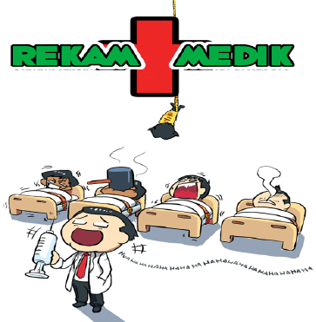
Essentials of Records Management

Slide 13
Essentials of Records Management
Comprehensive : The records should be such as can be easily understood when retrieved back for planning, policy making and decision making. The language used should be simple and understandable.
Properly planned : The records are to be screened at regular intervals of time to weed out the information not required for future. In this way we can reduce the paper work to 25%. This would indirectly help us in locating the desired information quickly.
Economical : We should manage the records economically so that we may achieve more with minimum efforts.
1
2
3

Slide 14
Essentials of Records Management
Accurate : The records should be accurate otherwise its utility would be doubtful.
Timely : The time taken in retrieving the information should be as short as possible. Reducing retrieval time is essential for effective material management.
Classification : Records must be classified to be of practical use. The classification is done either on the basis of subjects or chronology.
4
5
6

Slide 15
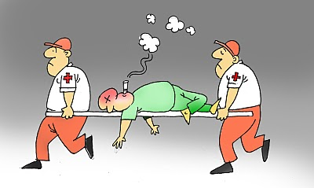
Types Of Damages

Slide 16
Types of Damages
With age it may become weak. Sometimes paper gets so weak that it gets broken into pieces.
There may be a colour alteration in it and it may get yellowed.
Dust and dirt may be present on the surface.
Insects of various types may have damaged the document.
Fungi may be actively present, or may have damaged the paper in the past.
The document may have got stained by various means e.g.: water stains, fungus stains oil stains, ink stains or simply dirt stains.
1
2
3
4
5
6

Slide 17
Types of Damages
Water may have affected the paper at some time, and besides staining, it may have made it limp.
In prolonged contact with water it may become soggy.
The sizing materials may have deteriorated, making the paper loose or soft.
The document may not be complete and some part may be missing.
If the paper is kept folded, it may become weak or may break at the creases.
These are only examples, and apart from them, there may be some other types of defects also present in the paper.
7
8
9
10
11

Slide 18
Maintenance of Old Records

Slide 19
Maintenance of Old Records
Collection of old register, records and index cards of the medical record department and other departments of the hospital.
Classifying them according to the different sections.
Allocating an old record in a place designated for the purpose for a prescribed period.
Filing all old records in a place designated for the purpose for a prescribed period.
1
2
3
4

Slide 20
Maintenance of Old Records
Destroying the records as per the regulations established for retention of records.
Enter in a destruction register, the records destroyed
Keeping a note of the records destroyed, of the records for which microfilm copies (or microfiches) are available.
5
6
7

Slide 21
Conclusion

Slide 22
Conclusion
The medical record is the property of the hospital. The chief value of medical records as evidence is that they contain unbrased statements in as much as the doctors, nurses and other concerned in making the medical record at the time of the patient’s hospitalization had no interest in any subsequent litigation. The hospital medical record is not merely a collection of papers recounting the tale of patients sojourn under the care of his physician in a hospital. It is an inpatient document and is frequently used in the court.
1

Slide 23
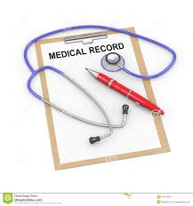
Conclusion
In order to balance the health care provider (doctor & hospitals) and the receiver / consumer (patients) there is a need to legalize the importance of maintaining and scientific preservation of patient records in all the healthcare facilities including private practitioner clinics, nursing homes, PHCs and small and big hospitals.
2

Slide 24
Conclusion
If any request is made for medical records either by the patients/ authorized attendants or a legal authorities involved, the same may be duly acknowledged and documents shall be issued within the period of 72 hours. Even while issuing a medical certificate the registered medical practitioner shall maintain a register of medical certificates giving full details of certificates issued. It has also suggested that efforts shall be made to computerize medical records for quick retrieval.
3

