Slide 1
Ad review
Bugi Satrio Adiwibowo, S.E., M.I.Kom.

Slide 2
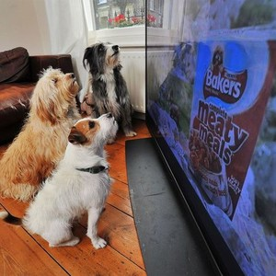
Advertising is information that contents the audience to be interested in the goods or services offered.

Slide 3
Ad features
Communicative
Informative
Understandable
Eye Catching

Slide 4
Terms of ad
Sentences are ordered and not multiple interpretations
Interesting and memorable language
Not humiliate / insult competitors
Does not contain slander or lying elements
Pay attention to grammar, ethics, courtesy, etc.

Slide 5
Benefits of ad
Profit
Good Reputation
Information
Promotion

Slide 6
What should we concern to manage advertisement?

Slide 7
Advertising management
Advertising agency
Service Agencies
Agency Personnel
Full Service Agency and Limited Service Agency
Recognition and Commission System

Slide 8
advertising agency
Professional organizations that serve clients in ad creation.

Slide 9
The role of the agency
Act as the person in charge
Producing movies and videos, creative teams and art, photography, printing, setting letters, marketing research and offering the media an economical way of buying and selling advertising space and time.
Production quality is preferred and supervised by law and ethical code

Slide 10
Agency services
FULL SERVICE
Full Service Bureau
Medium Class Ad Agency
Interagency Agencies
LIMITED SERVICE

Slide 11
Full service bureau
Take part in:
Marketing research
PR
Ad Creation
Sales promotion
Examples: Saatchi & Saatchi, Abbott Mead and Lopex

Slide 12
Mid-size advertising agency
In order to reduce costs, middle class agencies reinforce their daily staff with freelancers, such as copywriters and visualisers when needed.

Slide 13
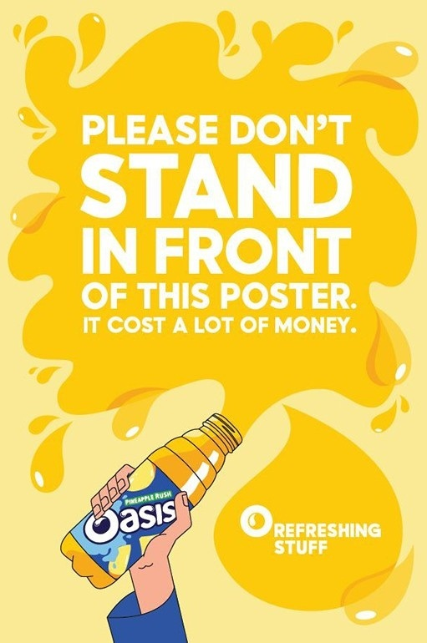
Copywriter
Visualiser
(also can be video)

Slide 14
Inter-business agency
This agency specializes in industrial and technical goods.
Usually where producers and consumers alike form a company
Example: promotion of technology through film advertising

Slide 15
Personil biro iklan
Account Directors
Marketing
Media
Creative
TV
Production
Admin
Research
Planning
Copywriter;
Writer;
Studio;
Art Buying
Storyboard;
Hiring talent
Print Buying;
Flyer;
Traffic
Accounts;
Library;
Secretary

Slide 16
RECOGNITION AND COMMISSION SYSTEM
Commission on the purchase of advertising space in print and electronic media.
Standards are set differently: 15% Newspapers nasonal, 10% regional newspapers.

Slide 17
thanks

